Slide 1
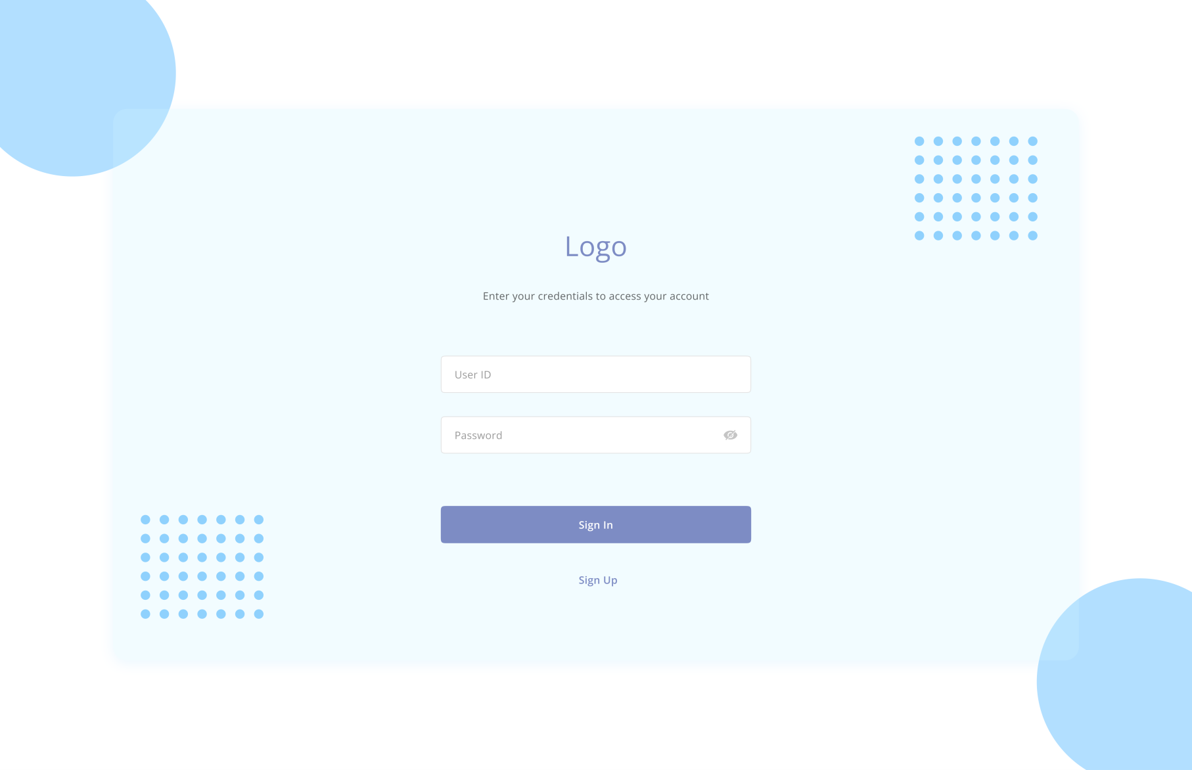
Sign-in

Slide 2
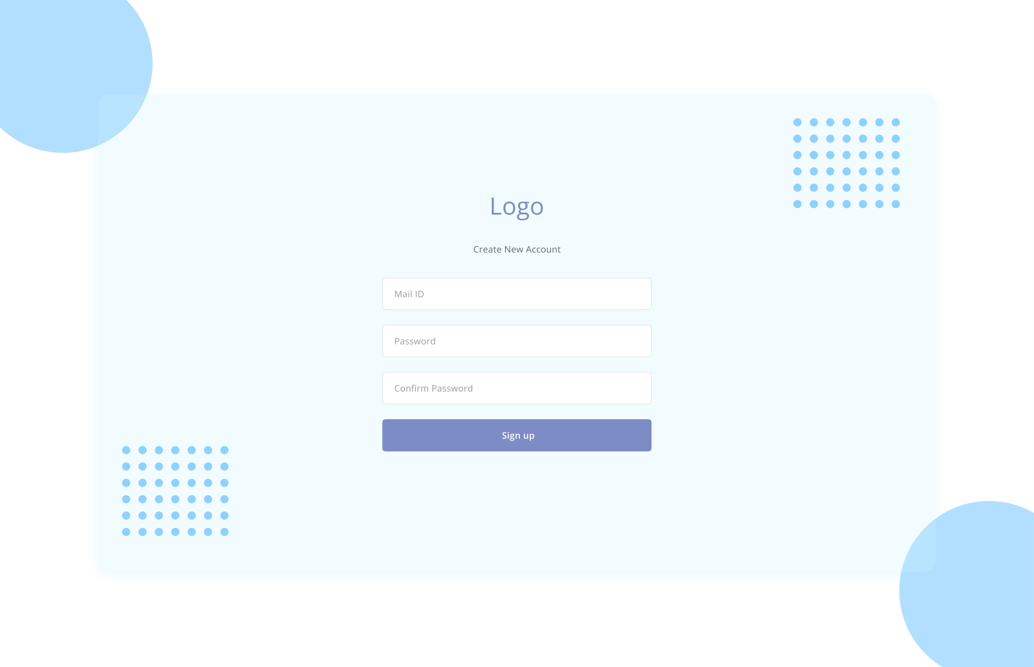
If not sign-in---move to signup

Slide 3
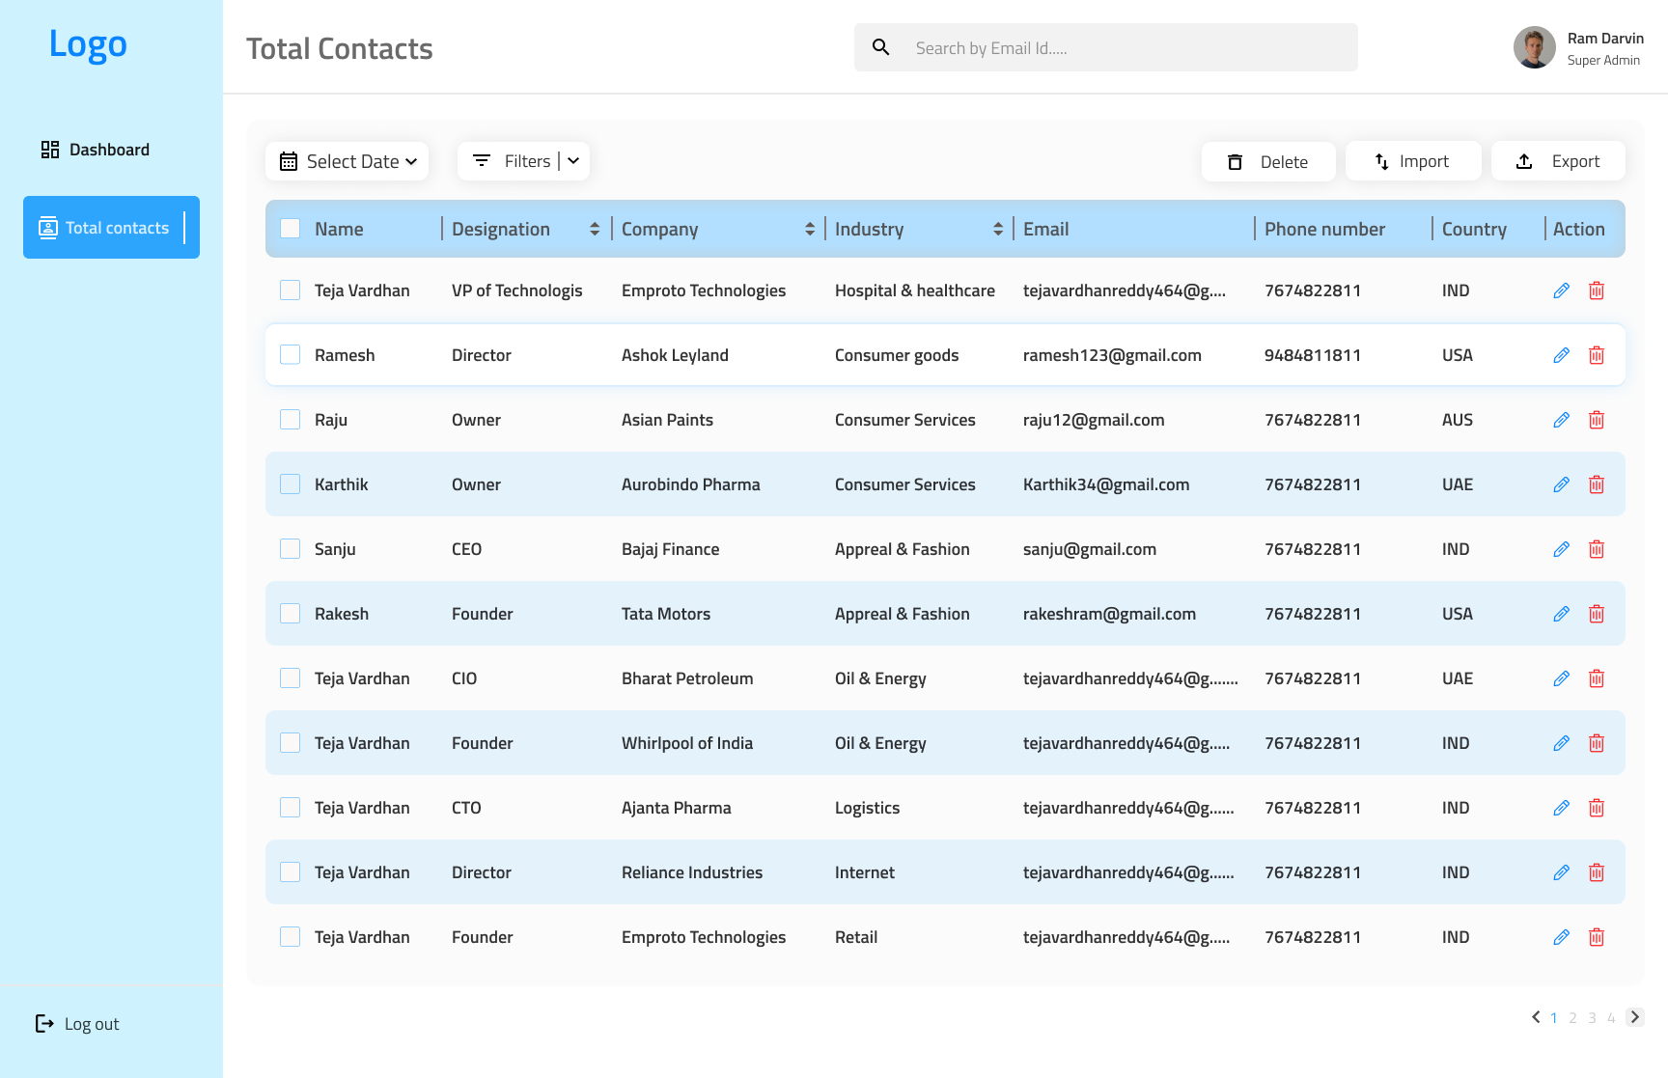
After successful login

Slide 4
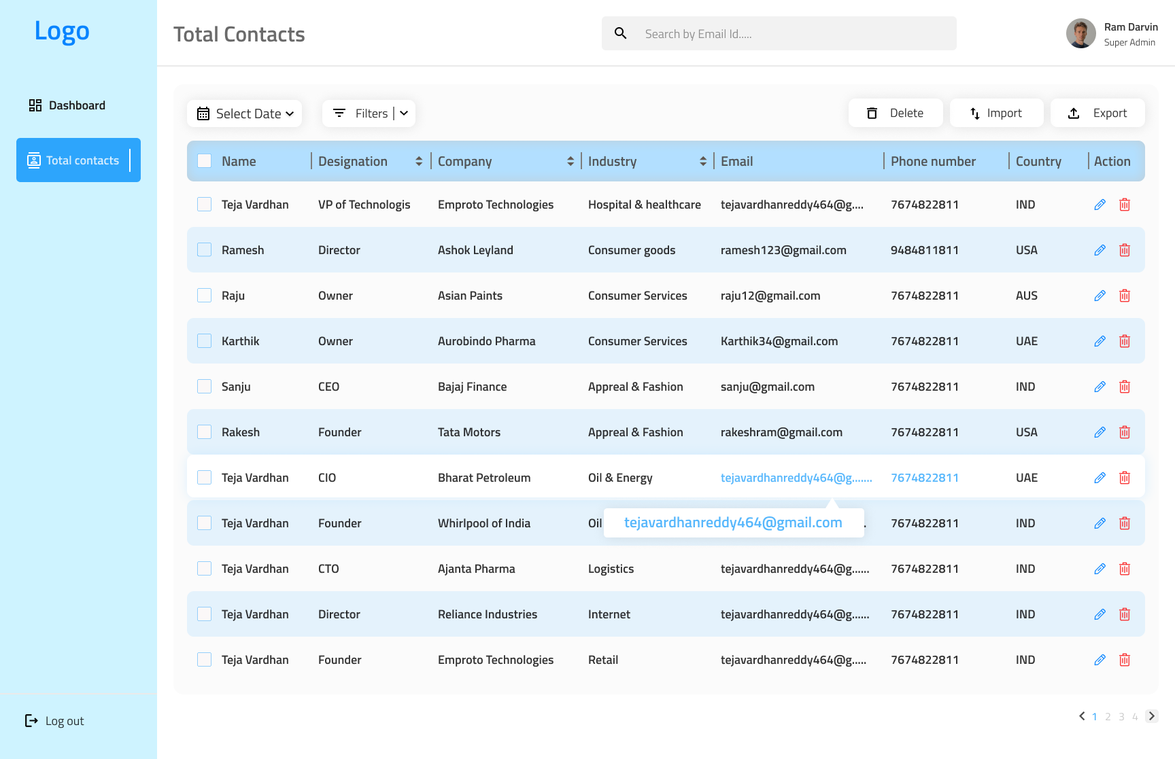
tool-tip : Hover over -→highlight email and phone and show tool-tip-box

Slide 5
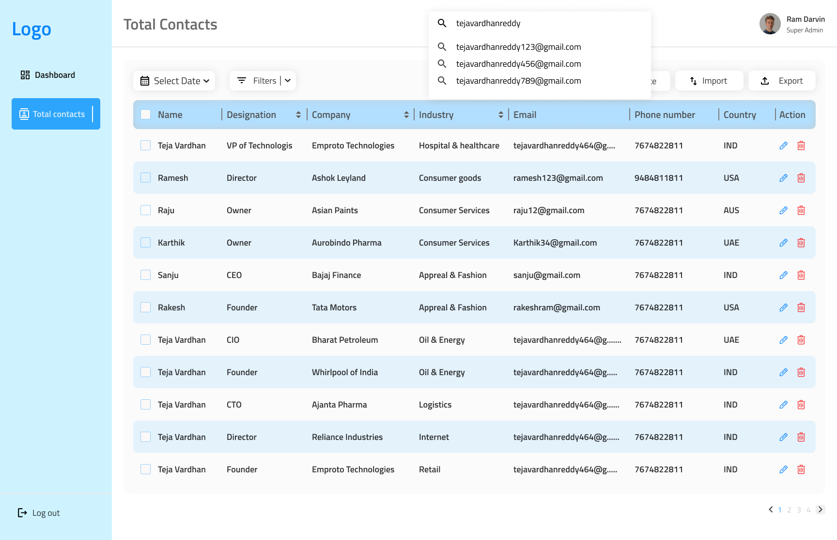
Search in text—sorting database by email primary or any field data

Slide 6
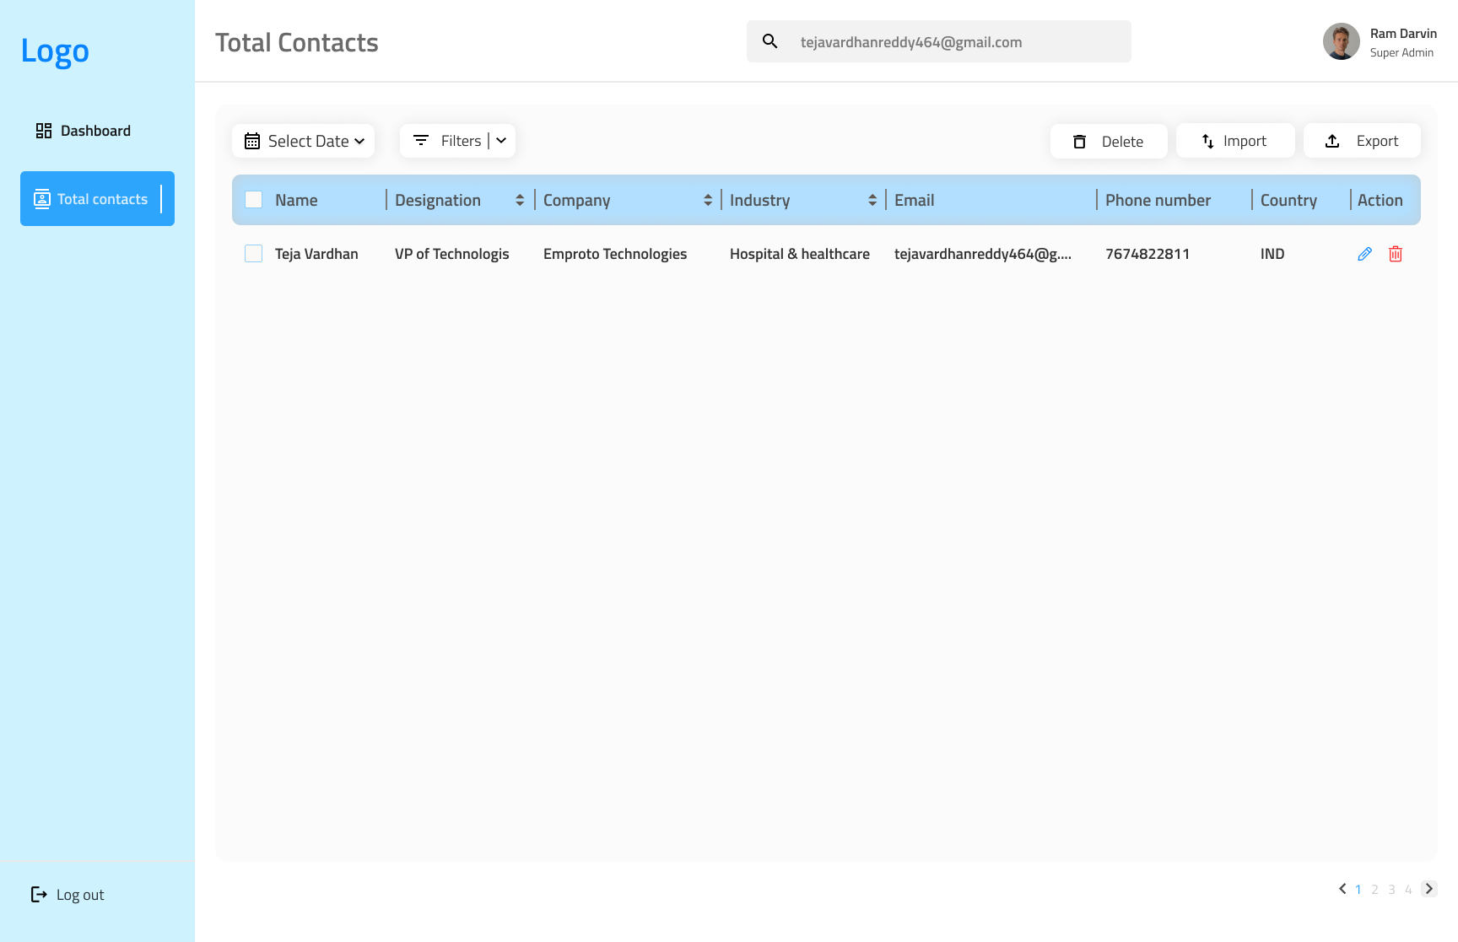
Successful search

Slide 7
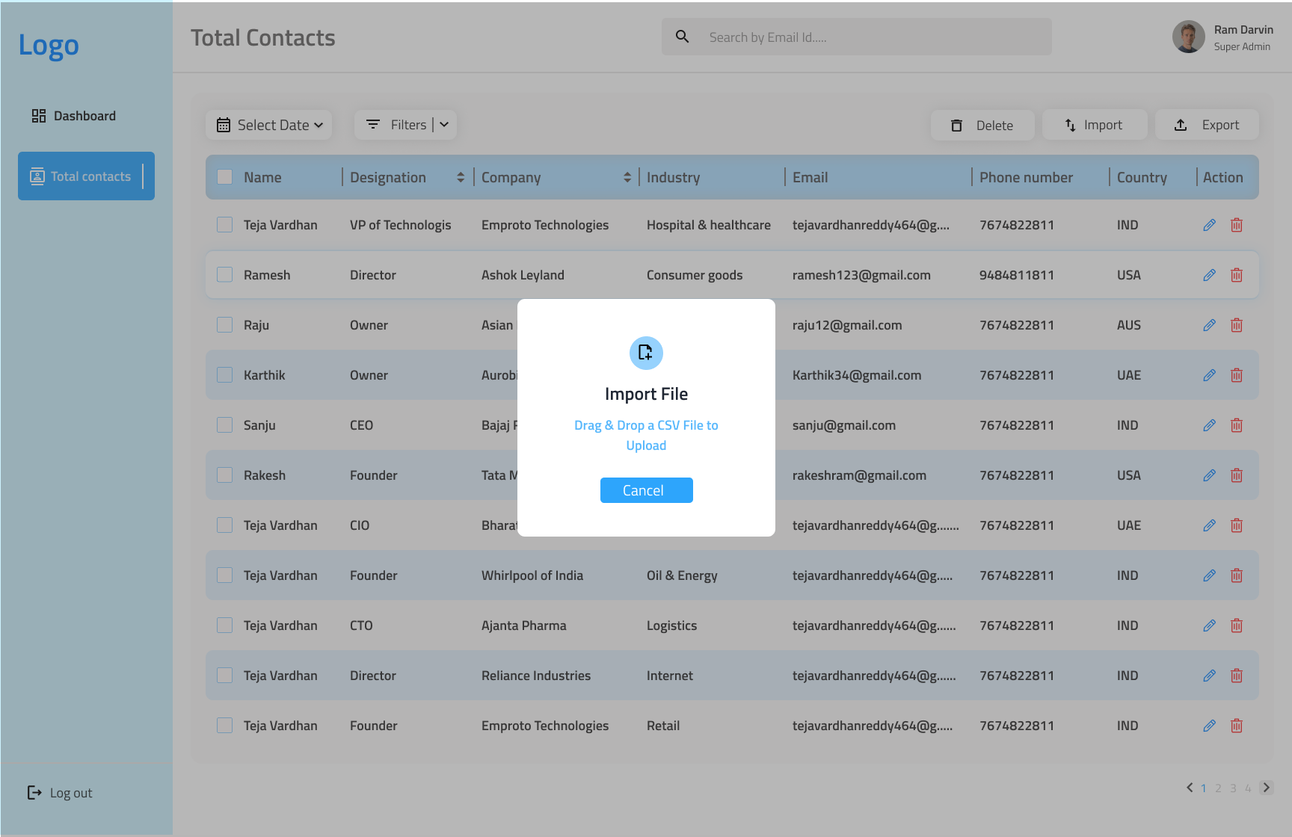
Import csv file and its front end

Slide 8
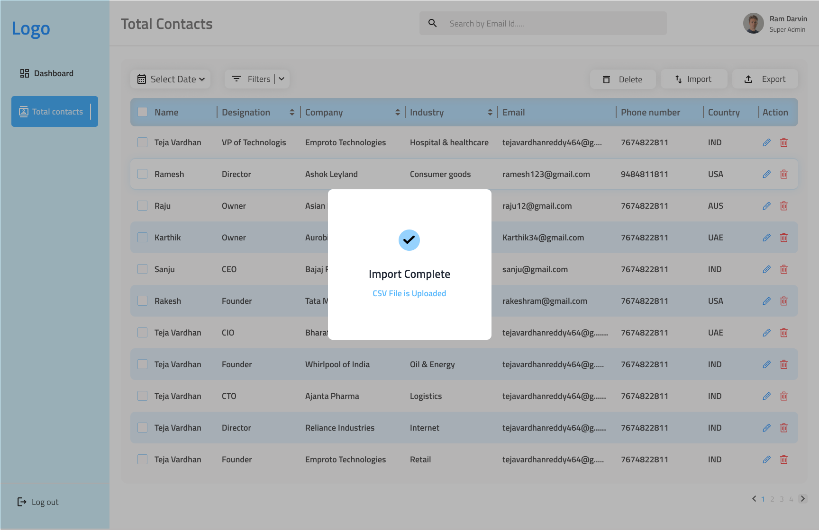
Successful import page

Slide 9
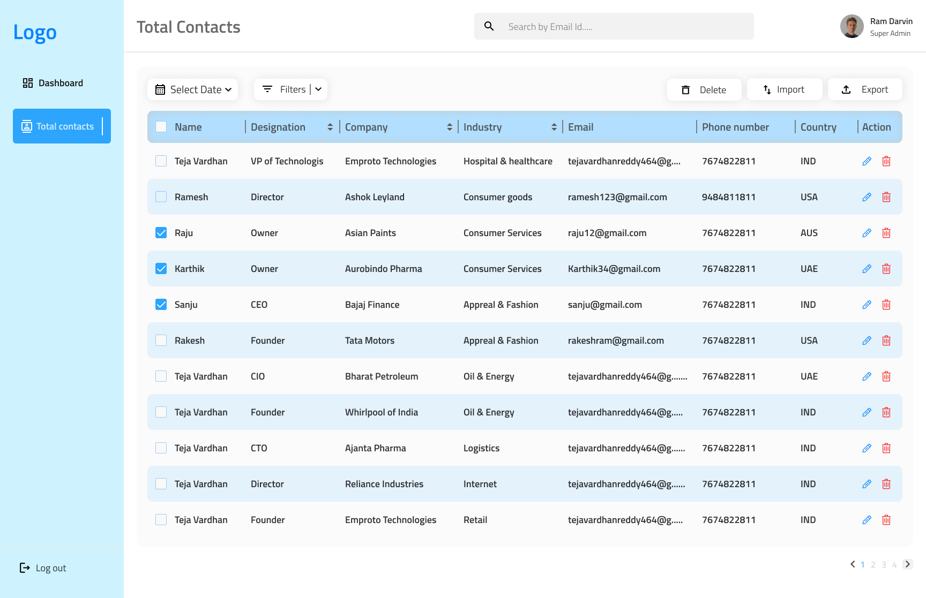
Delete screen by checkbox

Slide 10
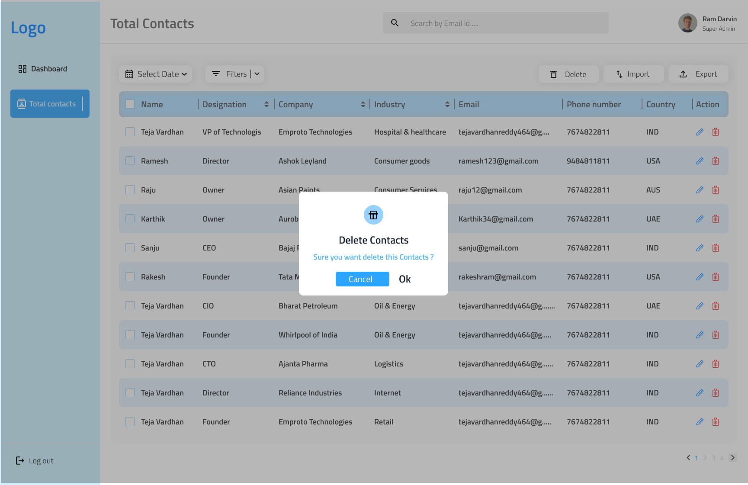
Delete confirmation-screen

Slide 11
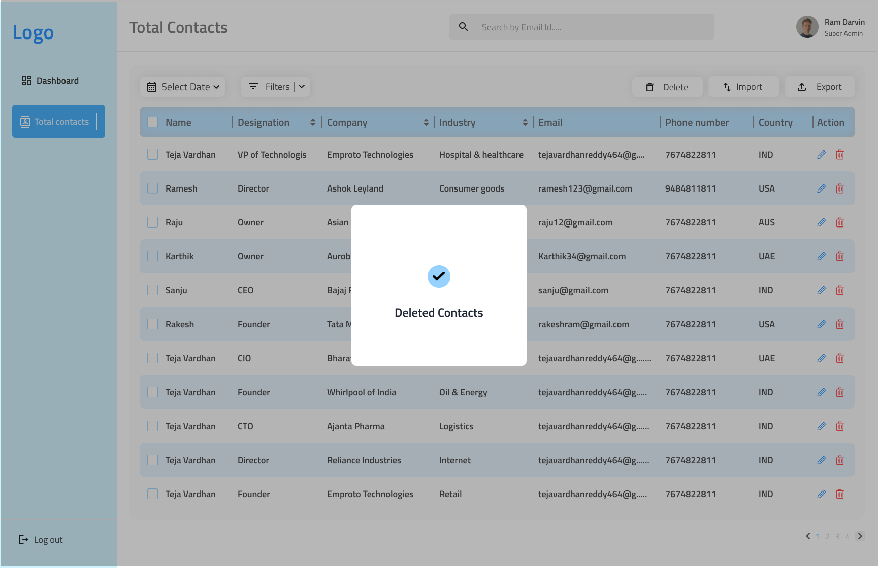
Successful deletion

