Slide 1
Topic Modelling on Telugu-English Code-Mixed Data Using LDA

Slide 2
Abstract
Topic modelling is the new revolution in text mining. It is a statistical technique for revealing the underlying semantic structure in large collection of documents. Most topic modelling/detection techniques applied well for English language but very little work is available when it comes to Indian languages and code mixed data. we used Latent Dirichlet Allocation(LDA) for detecting the hidden topics for the Telugu-English code mixed data and measured the accuracy of the topic modelling model using coherence score and evaluated using visualization and some testing dataset.

Slide 3
Introduction
Motivation for the Work:
Processing hundreds, or even thousands of customer interactions every day, analysis of social media posts, emails, chats, open-ended survey responses, and many more, is not an easy task for humans to do alone.
That’s why text analysis uses a wide variety of methods or algorithms to process language naturally, one of which is topic analysis – used to automatically detect topics from texts.

Slide 4
Real world applications:
Detecting Patterns
Identify Emerging Trends
Enhance Customer Service
Topic Tracking
Spam Filter
Recommender System

Slide 5
Existing Work
English News Data Classification - (Only English)
Topic Categorization Of Hindi News Articles - (Only Hindi)
Hindi Text Classification - (Only Hindi)
Telugu Movie Review Sentiment Analysis - (Only Telugu)
Named Entity Recognition in Telugu language - (Only Telugu)
A Twitter Corpus for Code Mixed POS Tagging - (Hindi-English)

Slide 6
Limitations:
Most of the Topic Modelling techniques applied on
English
Hindi
Telugu
Hindi-English code-mixed data
But there is no proper work on “Telugu-English” code-mixed data.

Slide 7
Proposed Work
Topic Modelling For Telugu-English Code-Mixed Data
Data Collection
Data Cleaning
Pre-Processing
Evaluation
Modelling

Slide 8
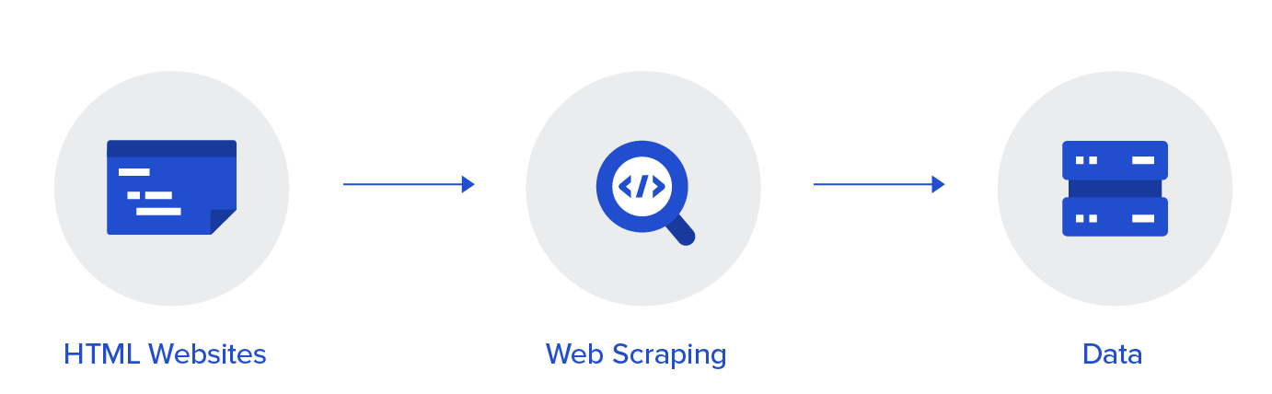
Data Collection
Data Scrapping from YouTube Comments
Requirements:
Python code
Google API key
YouTube video ID / Playlist ID
Topics collected:
Movies, Serials, Short Films, Political News, Sports, Shows etc..

Slide 9
Data Cleaning
A process of removing unnecessaries and adding necessaries before the data is going to be sent to the dataset for easy reading by the computer program
Removing emojis
Removing IDs(Instagram Id, Facebook Id)
Removing URLs
Removing other languages
Removing less than n words sentences
Removing special characters

Slide 10
Data Pre-processing
A process of removing unnecessaries and adding necessaries before the data is going to be sent to the model
Removing Punctuation
Lower Casing
Tokenization
Removing English and Telugu Stop Words
ID to Word Dictionary
Replacing Word with ID
Libraries used:
Nltk
String
Re
Corpus

Slide 11
Model Training
LATENT DIRICHLET ALLOCATION(LDA)
A tool and technique for Topic Modelling, Latent Dirichlet Allocation (LDA) classifies or categorizes the text into a document and the words per topic, these are modelled based on the Dirichlet distributions and processes.
The LDA makes two key assumptions:
Documents are a mixture of topics, and
Topics are a mixture of tokens (or words)

Slide 12
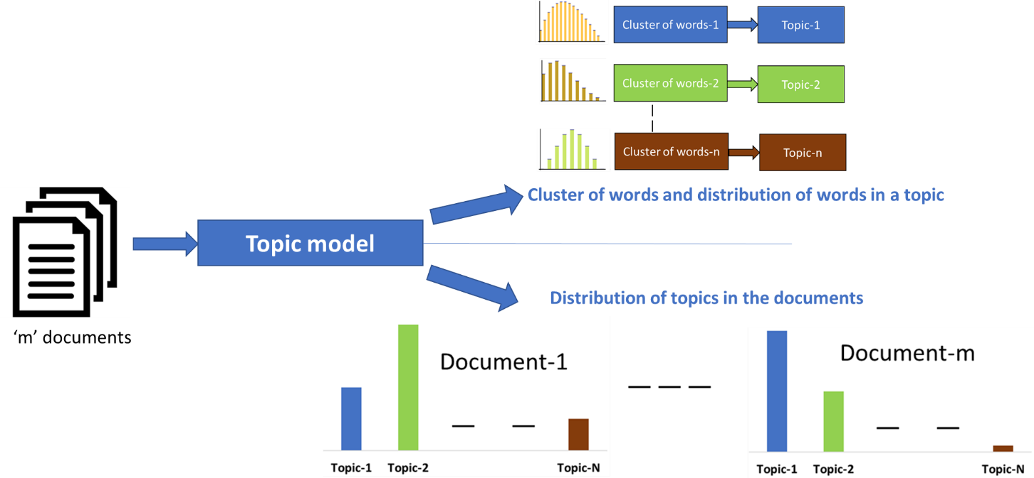
Latent Dirichlet Allocation (LDA)

Slide 13
Building The Model
Parameters of LDA
alpha : Document-topic density
beta : Topic-word density
chunksize : Number of documents to be used in each training chunk
update_every: How often the model parameters should be updated
passes : Total number of training passes
Libraries used:
gensim.models.ldamodel.LdaModel

Slide 14
Evaluating topic models
Testing with tools/models
Visualization
Testing with unseen data
Testing with prepared testing dataset (5%)

Slide 15
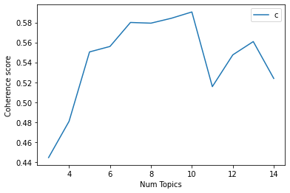
Testing with tools/models
Perplexity
Coherence
Libraries Used:
coherence_model_lda
Num Topics = 3 has Coherence Value of 0.528
Num Topics = 4 has Coherence Value of 0.5584
Num Topics = 5 has Coherence Value of 0.5793
Num Topics = 6 has Coherence Value of 0.557
Num Topics = 7 has Coherence Value of 0.6155
Num Topics = 8 has Coherence Value of 0.5874
Num Topics = 9 has Coherence Value of 0.5845
Num Topics = 10 has Coherence Value of 0.5731
Num Topics = 11 has Coherence Value of 0.5592
Num Topics = 12 has Coherence Value of 0.5446
Num Topics = 13 has Coherence Value of 0.5505
Num Topics = 14 has Coherence Value of 0.5539

Slide 16
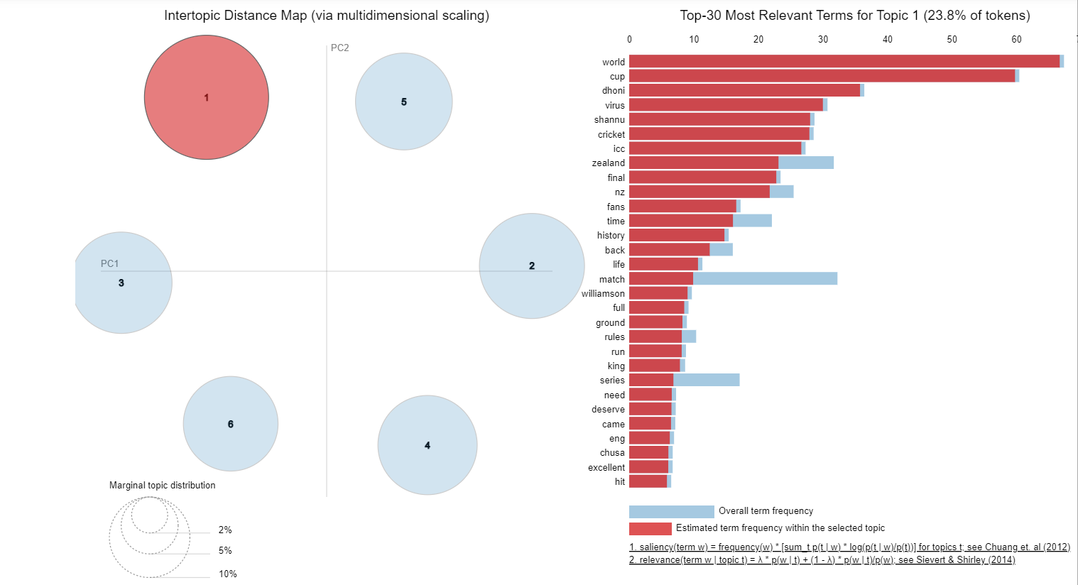
Visualization
Create the visualizations of the topic clusters.
Libraries used:
pyLDAvis

Slide 17
Testing With Unseen Data
Input1:
new_sentence ="esari world cup india gelustundi"
Output:
Associated %: 52.22 %
The topic name: Sports
Input2:
new_sentence ="ntr acting movies lo baguntundi"
Output:
Associated %: 40.97 %
The topic name: Entertainment (movies,serials,webseries)

Slide 18
Testing With Dataset
Comment | Topic Predicted | Actual Results
esari world cup india gelustundi | Sports | Sports
ntr acting movies lo baguntundi | Entertainment | Entertainment
india team lo virat form loki vacchadu | Sports | Sports
kcr trs ki goppa nayakudu | Politics | Politics
Karthika deepam timings maristhey matches chuskovacchu | Entertainment | Sports
Dhoni next world cup ki vuntada | Sports | Sports
Accuracy : (Correctly Predicted / Total Predicted) *100= (376 / 500)*100 = 75.2%

Slide 19
Advantages
Used in graph based models to obtain semantic relationship between words
Used in text summarization to quickly find out what the document or book is explaining about
provides improved customer service by identifying the keyword the customer is asking about and acting accordingly
can identify the keywords of search and recommend products to the customers accordingly

Slide 20
Conclusion
We started from scratch by collecting, importing, cleaning and processing the collected dataset to build the LDA model. Then we saw multiple ways to visualize and test the accuracy of the outputs of topic models including the coherence score and word clusters which intuitively tells you what topic is dominant in each topic. The pyLDAVis provides more details into the clustering of the topics and the coherence score gives the accuracy.

Slide 21
Future scope
This model(what we have developed) can be easily implemented under various situations.
We can add new features as and when we required.
Reusability is possible as and when required in this model
There is flexibility in all the modules
Any researcher can use our collected Telugu-English(24k comments) code mixed data for topic classification
Any researcher can use our labelled Telugu-English(10k+ comments)code mixed data for sentimental analysis
Slow LDA training would like to explore with di-grams , tri-grams and different lemmatization methods.

Slide 22
References
https://www.researchgate.net/publication/361045137_Sentiment_Analysis_of_Code-Mixed_Social_Media_Text_SA-CMSMT_in_Indian-Languages
https://www.researchgate.net/publication/358873355_Sentiment_Extraction_from_English-Telugu_Code_Mixed_Tweets_Using_Lexicon_Based_and_Machine_Learning_Approaches
https://www.researchgate.net/publication/334447179_Text_Processing_of_Telugu-English_Code_Mixed_Languages

Slide 23
THANK YOU
PRESENTED BY -
P SANTOSH (N70425)
A SHANIL KUMAR(N170778)
B NAGAJYOTHI (N170264)
K YOGINI (N171004)
P KHYATHI(N170245)

