Slide 1
ACCIDENT SEVERITY PREDICTION USING MACHINE LEARNING
TOPIC PRESENT BY
<Your Sweet Name>
<Your Register Number>
<Class and Section>
<College>
<Date>
UNDER THE GUIDANCE OF
<Guide Name>
<Guide Designation>
<Department Name>

Slide 2
INDEX
Objective
Literature Survey
Flow Diagram
Modules Description
Result Analysis
References

Slide 3
OBJECTIVE
The project’s major purpose is to:
Identify the group of factors lead to the road accident
Develop a system to identify the road accident severity
Deploying a model with higher accuracy and lower error rate
Developing countermeasures for accident injuries
Developing E-mail based road accident tracing system
3

Slide 4
LITERATURE SURVEY
NAME OF THE AUTHOR | DESCRIPTION | TECHNIQUES USED | MERITS / DE-MERITS
1. Mubariz et al | severity of the accidents based on decision level fusion of machines and deep learning models | RFCNN | RFCNN gives the best occuracy than the traditional CNN and RF
2. Sachin et al. | accident data analysis to identify the main factors associated with a road and traffic accident | K-modes clustering algorithm | Segmenting the accident data makes the unstuctured data to the stuctured data for supervised learning based model

Slide 5
NAME OF THE AUTHOR | DESCRIPTION | TECHNIQUES USED | MERITS / DE-MERITS
3. Shakil et al. | machine learning model for identifying the severity of the accident | KNN | KNN m odel used for accident severity prediction
4. Mohamed et al | data analytics on accident injury data | XGBoost | XGBoost algorithm provide best accuracy when compared with traditional ANN

Slide 6
NAME OF THE AUTHOR | DESCRIPTION | TECHNIQUES USED | MERITS / DE-MERITS
5. Sharma et al. | upport vector machines with different Gaussian kernel functions for crash to extract important features related to accident occurrence | SVM | The SVMs method has the same disadvantages of ANN in traffic accident severity prediction
6. Mehdizadeh et al | a comprehensive review on data analytic methods in road safety | Comprehencive Study | Provide the historical researches on road accident severity prediction
8

Slide 7
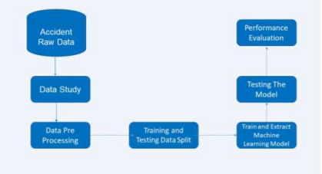
BLOCK DIAGRAM

Slide 8
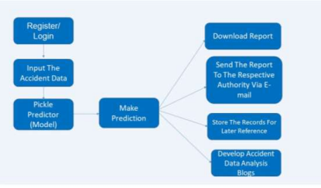
SYSTEM WORK FLOW DIAGRAM

Slide 9
Module 1: Data Collection
Module 2: Data Preporocessing
Module 3: Classification
Module 4: Performance Evaluation
Implement UI
MODULES

Slide 10
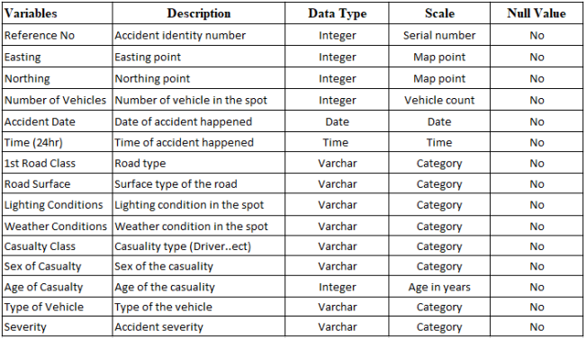
Module 1: Data Collection
This project was implemented using the Accident Severity dataset from the kaggle. The dataset contains 3057 accident samples.

Slide 11
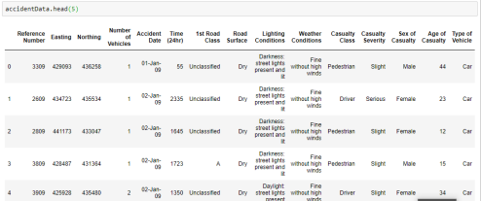
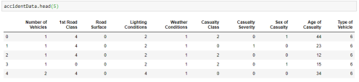
Module 2: Data Preprocessing
1. Data reduction
2. Encoding the categorical data
3. Dropping the unwanted columns
s
Dataset Before PreProcess Dataset After PreProcess

Slide 12
Module 3: Classification
Decision Tree Learning
Randim Forest Learning
KNN Learning
Gradient Boosting Learning

Slide 13
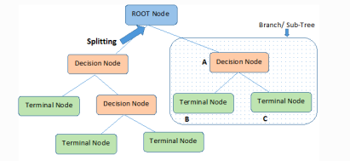
Decision Tree Learning
Decision Tree Stucture

Slide 14
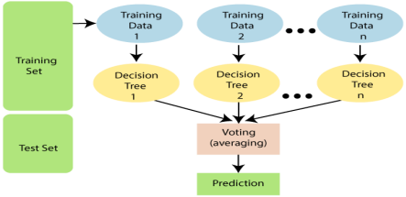
Random Forest Learning
Random Forest Tree Stucture

Slide 15
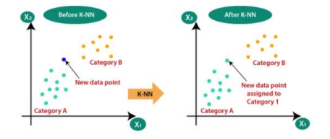
KNN Learning
K-Nearest Neighbor

Slide 16
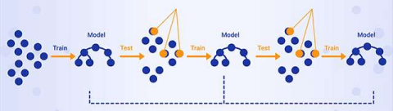
Gradient Boosting Learning
GB Learning Methodology

Slide 17
Module 4: Performance Evaluation
Accuracy
Accuracy is defined as the ratio of correctly predicted examples by the total examples.
Accuracy = TP+ TN
TP + TN + FP + FN
Where, TP-True Positive
TN-True Negative
FP-False Positive
FN- Negative
Error Rate : 1 - Accuracy
Precision
Also called Positive predictive value. The ratio of correct positive predictions to the total predicted positives.
Precision = True Positive
Truepositive + False positive

Slide 18
Contd..
Recall
Also called Sensitivity, Probability of Detection, True Positive Rate. The ratio of correct positive predictions to the total positives examples.
Recall = True Positive
True positive + False negative
4. ROC Curve
A ROC curve (receiver operating characteristic curve) graph shows the performance of a classification model at all classification thresholds. It plots two Perameters namely true Positive rate and False positive rate
True Positive Rate = True Positive
False Positive + True Negative
False positive Rate = False Positive
False positive+True Negative

Slide 19
Contd..
AUC Curve
AUC stands for Area under the ROC Curve. A perfect classifier would have an AUC of 1. Usually, if your model behaves well, you obtain a good classifier by selecting the value of the threshold that gives TPR close to 1 while keeping FPR near 0.

Slide 20
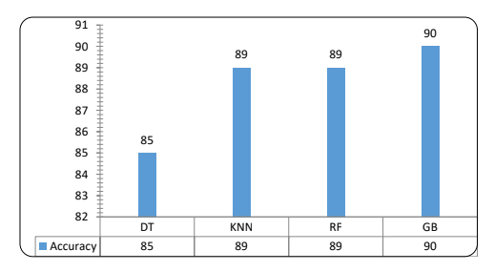
PERFORMANCE METRICS
The result shows that Gradient Boosting Algorithm Provide the Best Accurate Classification for the Accident Data

Slide 21
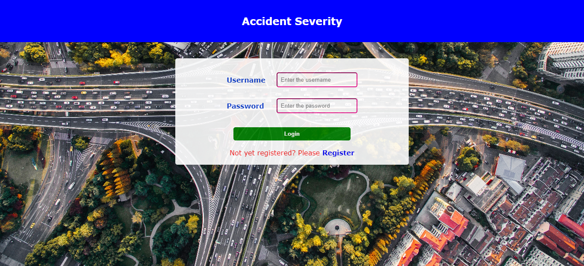
Module V : Implementatiom OF UI
User Authendication

Slide 22
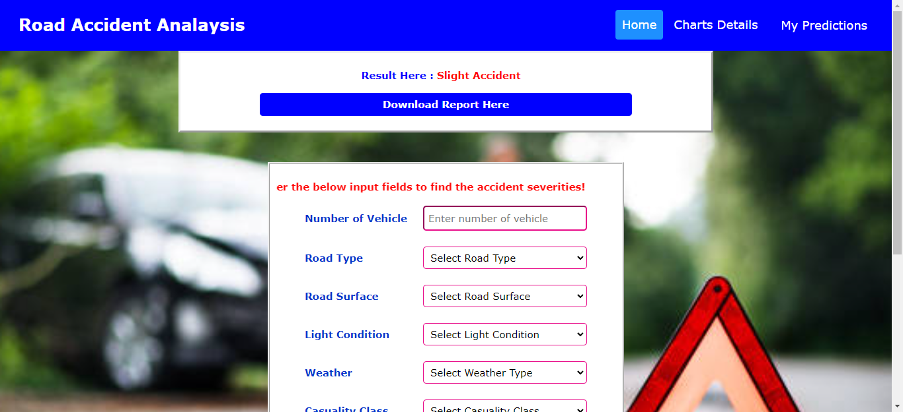
GB Based Road Accident Classification

Slide 23
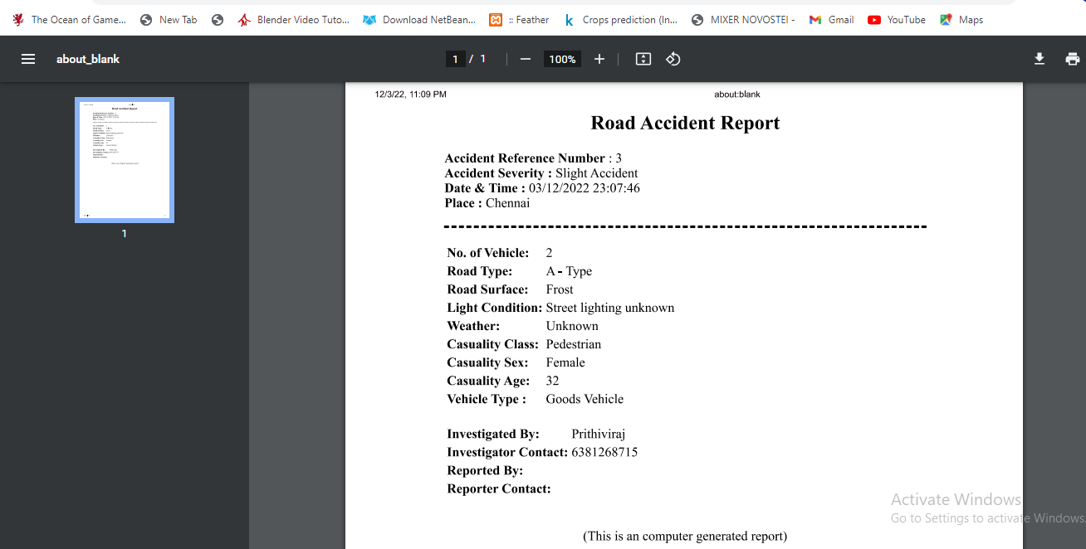
Report

Slide 24

E-mail Report

Slide 25
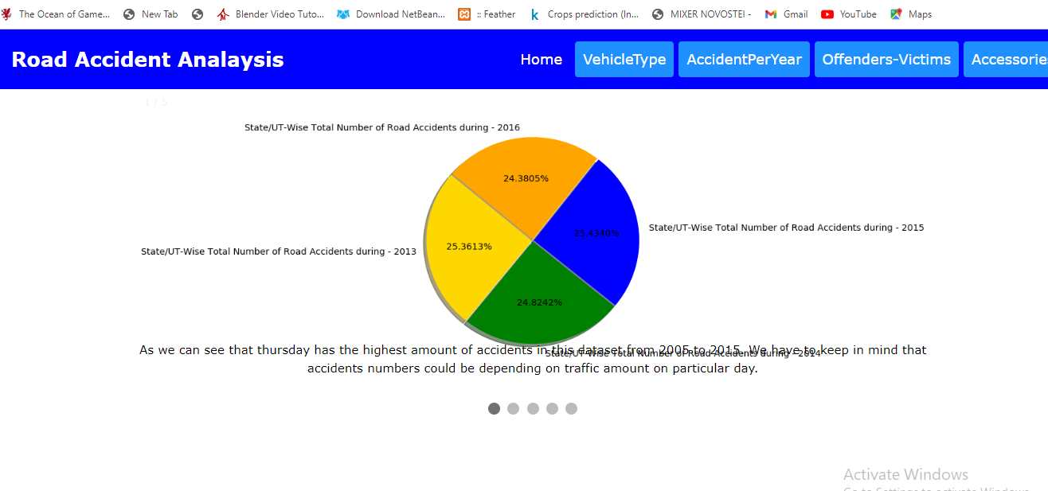
Data Descriptive Charts

Slide 26
Conclusion
Road accidents are one of the most regrettable hazards in this hectic world. Road accidents lead to numerous casualties, injuries, and fatalities each year, as well as significant economic losses. Predicting the accident severity is one of the major tasks. The proposed model could achieve an accuracy of 90 percent. Number of Vehicles, Road Class, Road Surface, Lighting Conditions, Spot Weather Conditions, Casualty Class, Sex of Casualty, Age of Casualty, Type of Vehicle are used to predict the accident severity. This is extraordinarily beneficial for the highway authorities, police departments and for journalists.
5.1 Advantages
The key advantages of this model is:
∙ Early accident severity prediction
∙ No expert knowledge required
∙ Can be access the model anytime and anywhere
∙ Can be access the previous predictions
∙ Can send mail immediately to the respective authority.

Slide 27
References
[1] Mubariz mansoor, Muhammad umar , Saima sadiq , Abid isaq, Saleem ullah, Hamza, and Carmen, "RFCNN: Traffic Accident Severity Prediction Based on Decision Level Fusion of Machine and Deep Learning Model", Digital Object Identifier 10.1109/ACCESS.2021.3112546.
[2] Sachin Kumar and Durga Toshniwal, "A data mining framework to analyze road accident data", DOI 10.1186/s40537-015-0035-y
[3] Shakil Ahmed, Md Akbar Hossain, Md Mafijul Islam Bhuiyan, Sayan Kumar Ray, "A Comparative Study of Machine Learning Algorithms to Predict Road Accident Severity", 978-1-6654-6667-7/21/$31.00 ©2021 IEEE DOI 10.1109/IUCC-CIT- DSCI-SmartCNS55181.2021.00069
[4] Accident Data Analysis to Develop Target Groups For Countermeasures, Max Cameron
[5] Mohamed K Nour, Atif Naseer, Basem Alkazemi, Muhammad, "Road Traffic Accidents Injury Data Analytics", (IJACSA) International Journal of Advanced Computer Science and Applications, Vol. 11, No. 12, 2020
[6] A. Mehdizadeh, M. Cai, Q. Hu, M. A. A. Yazdi, N. Mohabbati-Kalejahi, A. Vinel, S. E. Rigdon, K. C. Davis, and F. M. Megahed, “A review of data analytic based applications in road traffic safety. Part 1: Descriptive and predictive modeling,” Sensors (Switzerland), vol. 20, no. 4, pp. 1–24, 2020.

Slide 28
References contd..
[7] Q. Hu, M. Cai, N. Mohabbati-Kalejahi, A. Mehdizadeh, M. A. A. Yazdi, A. Vinel, S. E. Rigdon, K. C. Davis, and F. M. Megahed, “A review of data analytic applications in road traffic safety. Part 2: Prescriptive modeling,” Sensors (Switzerland), vol. 20, no. 4, pp. 1–19, 2020.
[8] J. Ma, Y. Ding, J. C. Cheng, Y. Tan, V. J. Gan, and J. Zhang, “Analyzing the Leading Causes of Traffic Fatalities Using XGBoost and Grid-Based Analysis: A City Management Perspective,” IEEE Access, vol. 7, pp. 148 059–148 072, 2019.
[9] N. Zagorodnikh, A. Novikov, and A. Yastrebkov, “Algorithm and software for identifying accident-prone road sections,” Transp. Res. Procedia, vol. 36, pp. 817– 825, 2018. [Online]. Available: https://doi.org/10.1016/j.trpro.2018.12.074.
[10] L. G. Cuenca, E. Puertas, N. Aliane, and J. F. Andres, “Traffic Accidents Classification and Injury Severity Prediction,” in 2018 3rd IEEE Int. Conf. Intell. Transp. Eng. ICITE 2018, 2018, pp. 52–57
‹#›

Slide 29
Thank you☺

