Slide 1

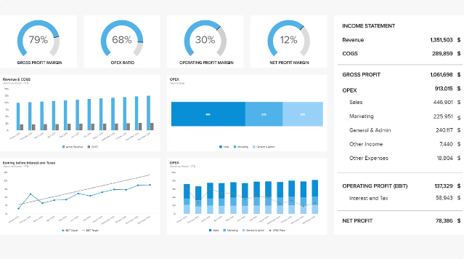
Insurance Claims Analysis
This detailed presentation outlines a comprehensive analysis of insurance claims data to help detect potential fraud and identify opportunities to improve claim handling processes. Through a combination of exploratory data analysis and rigorous hypothesis testing, the analysis aims to derive actionable insights that can enhance the efficiency and effectiveness of the insurance company's operations.
by Santosh G
SG

Slide 2
Data Overview
Datasets Used
Data Preparation
Data Quality
The analysis is based on two key datasets:
The data was imported and merged to create a comprehensive view. Key steps in the data preparation process included:
A thorough data audit was conducted to ensure the integrity of the data. This included:
claims_data.csv: Contains information about individual insurance claims, including Claim ID, Incident Cause, Claim Date, Claim Area, Police Report, Claim Type, Claim Amount, Total Policy Claims, and Fraudulent indicator.
Verifying data types for all columns
Removing duplicate records
Handling missing values
Identifying and correcting any data type mismatches
Converting claim_amount to a numeric format
Checking for completeness and consistency across the datasets
cust_data.csv: Provides customer demographic information to enable deeper analysis.

Slide 3

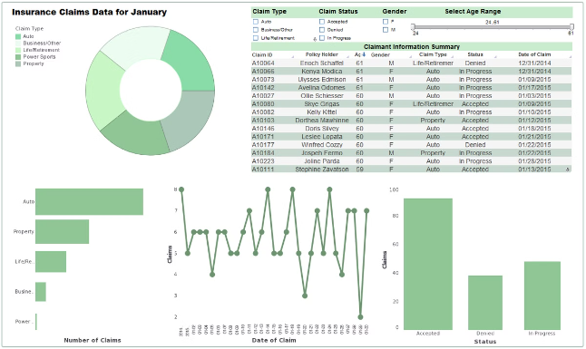
Exploratory Data Analysis
1
Claim Amount Distribution
Analyzed the distribution of claim amounts to identify any outliers or patterns that may be indicative of fraudulent activity.
2
Incident Cause Insights
Explored the most common causes of insurance incidents to understand potential risk factors and areas for enhanced monitoring.
3
Fraudulent Claim Indicators
Investigated the relationship between claim amount and the likelihood of a claim being fraudulent, using visualizations to uncover any significant trends.

Slide 4


Hypothesis Testing
1
High Claim Amounts
Tested the hypothesis that higher claim amounts are more likely to be fraudulent, using t-tests to evaluate the statistical significance of the differences.
2
Incident Causes
Examined whether certain incident causes are more prone to fraudulent claims, employing chi-square tests to identify any significant associations.
3
Unreported Injuries
Created an alert flag for injury claims that were not reported to the police, as this may be a potential indicator of fraudulent activity.

Slide 5

Findings and Recommendations
Key Fraud Patterns
The analysis identified several patterns and indicators of fraudulent insurance claims, including higher claim amounts, specific incident causes, and a lack of police reporting for injury claims.
Improving Verification
To mitigate the risk of fraud, it is recommended that the insurance company implement stricter verification processes for high-amount claims and increase monitoring of claims with certain incident causes.
Future Opportunities
Further analysis on additional datasets and the development of predictive models for real-time fraud detection could enhance the insurance company's fraud prevention efforts and strengthen their overall claims management processes.

