Slide 1

SQL Advanced Case Study
This document presents a detailed SQL case study with 10 advanced questions related to analyzing customer and sales data for a cellphone business. The questions cover a range of topics including identifying customer locations, top-selling manufacturers and models, pricing analysis, and customer spending trends.
by Santhosh Gowdru

Slide 2

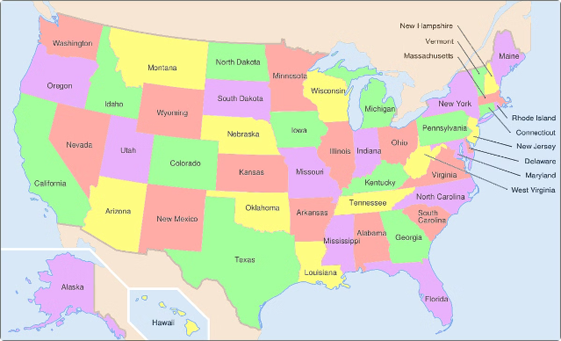
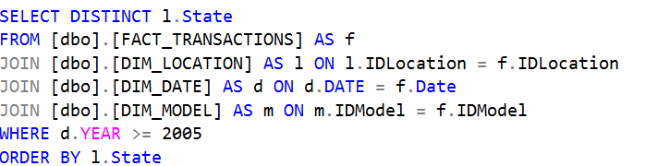
States with Cellphone Customers
The first question asks to list all the states where the company has customers who have bought cellphones from 2005 to the present day. This can be achieved by joining the FACT_TRANSACTIONS, DIM_LOCATION, DIM_DATE, and DIM_MODEL tables, and selecting the distinct states where transactions occurred during the specified time period.

Slide 3
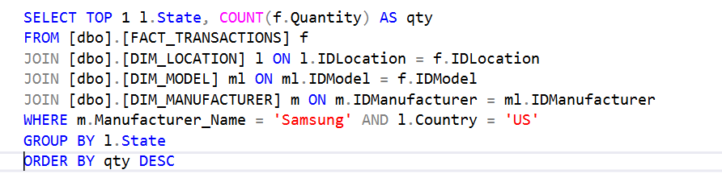
Top State for Samsung Cellphones
The second question focuses on identifying the US state that is buying the most Samsung cellphones. This can be done by joining the relevant tables, filtering for Samsung as the manufacturer, limiting to the US, grouping by state, and selecting the top result by total quantity.

Slide 4
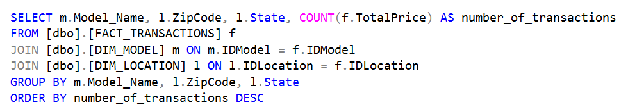
Cellphone Sales by Model, Zip, and State
The third question asks to show the number of transactions for each cellphone model, broken down by zip code and state. This requires joining the FACT_TRANSACTIONS, DIM_MODEL, and DIM_LOCATION tables, grouping by the relevant dimensions, and counting the number of transactions.

Slide 5


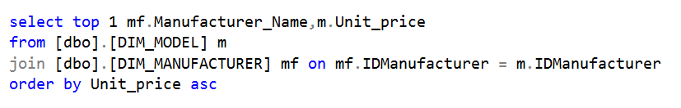
Cheapest Cellphone
The fourth question is to find the cheapest cellphone, including the price. This can be achieved by joining the DIM_MODEL and DIM_MANUFACTURER tables, ordering by the unit price, and selecting the top result.

Slide 6
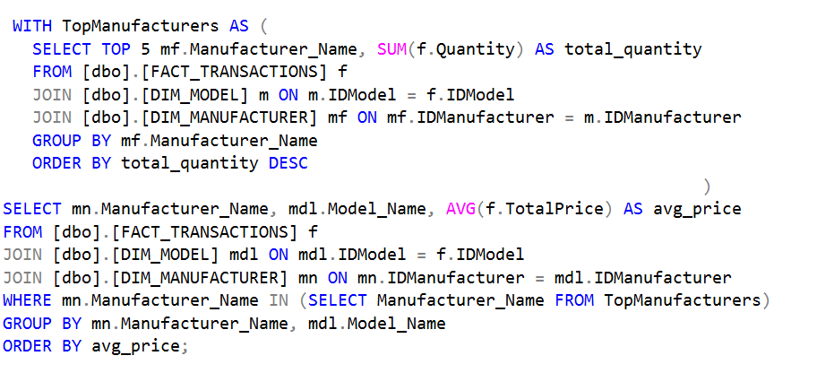
Top 5 Manufacturers by Avg Price
Top 5 Manufacturers
Average Price by Model
Ordered by Avg Price
The fifth question requires finding the top 5 manufacturers by total sales quantity, and then calculating the average price for each of their models.
This can be done using a CTE to get the top 5 manufacturers, and then joining that with the FACT_TRANSACTIONS, DIM_MODEL, and DIM_MANUFACTURER tables to calculate the average price for each model from those top 5 manufacturers.
The results are then ordered by the average price to show the most expensive to least expensive models from the top 5 manufacturers.

Slide 7

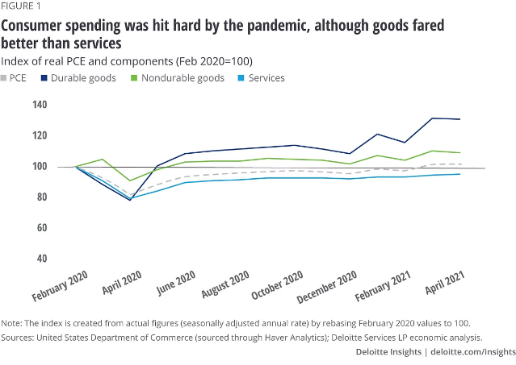
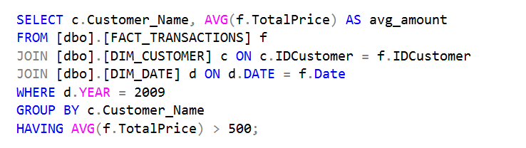
Top Spending Customers in 2009
The sixth question asks to list the names of customers who spent more than $500 on average in 2009, along with their average spend amount. This involves joining the FACT_TRANSACTIONS, DIM_CUSTOMER, and DIM_DATE tables, filtering for 2009, grouping by customer, calculating the average spend, and filtering for averages over $500.

Slide 8
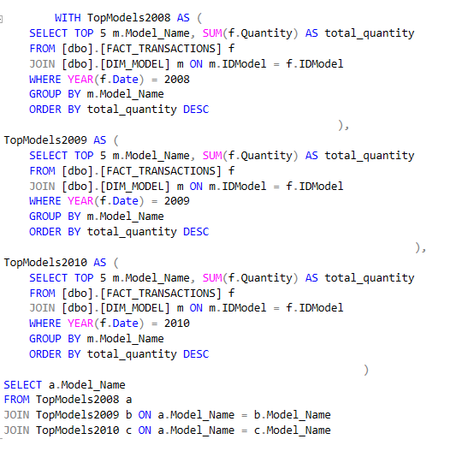
Models in Top 5 for 3 Years
1
2008 Top 5 Models
2
2009 Top 5 Models
3
2010 Top 5 Models
The seventh question looks for any cellphone models that were in the top 5 by sales quantity in 2008, 2009, and 2010. This requires using CTEs to find the top 5 models for each year, and then joining those to find the intersection.
The CTEs calculate the top 5 models by total quantity sold for each year, allowing the final query to check for any models that appeared in all three years' top 5 lists.
Identifying models that maintained top 5 status across multiple years provides insight into the consistent best-sellers in the product line.

Slide 9
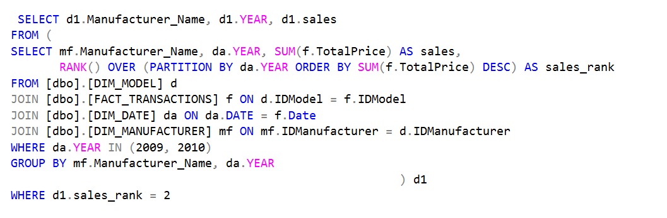
2nd Top Selling Manufacturers
2nd Top in 2009
2nd Top in 2010
The eighth question asks to show the manufacturer with the 2nd highest sales in 2009, and the manufacturer with the 2nd highest sales in 2010. This can be achieved by joining the relevant tables, grouping by manufacturer and year, calculating the total sales, and using a RANK() window function to get the 2nd ranked result for each year.
Identifying the 2nd place manufacturers provides insight into the competitive landscape and how sales performance may have shifted between the top players from one year to the next.

Slide 10


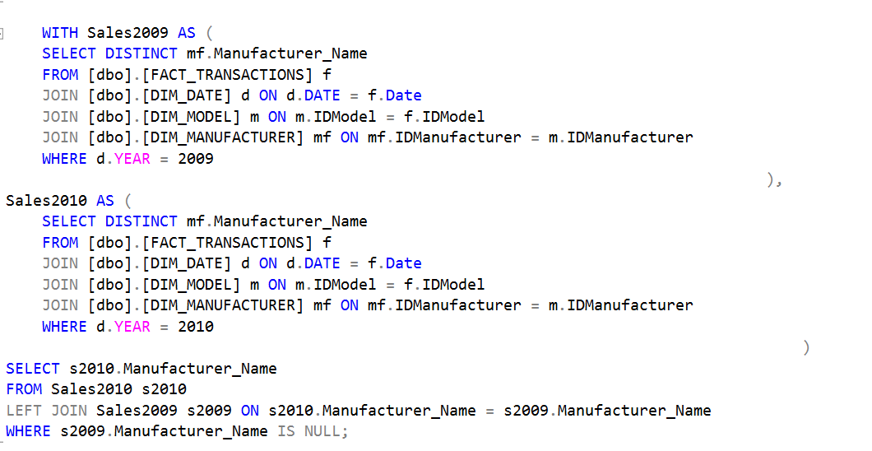
New Manufacturers in 2010
The ninth question asks to show the manufacturers that sold cellphones in 2010 but did not in 2009. This can be done using a pair of CTEs to get the distinct manufacturers for each year, and then doing a LEFT JOIN to find the manufacturers present in 2010 but not 2009.

Slide 11



Top 100 Customers Spending Trends
Top 100 Customers
The tenth question focuses on the top 100 customers by total spend, and analyzes their average spend, average quantity, and year-over-year percentage change in spend for each year.
Yearly Averages
This involves using CTEs to first get the top 100 customers, then calculate the yearly stats for each, and finally compute the year-over-year percentage change in total spend.
Spending Change %
Tracking the spending patterns of the most valuable customers provides insights into how their behavior and loyalty may be evolving over time.

Slide 12
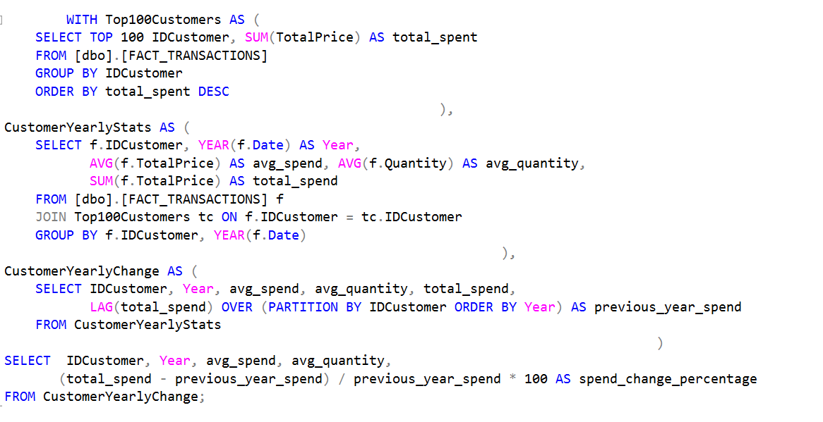
Top 100 Customers Spending Trends
Top 100 Customers
The tenth question focuses on the top 100 customers by total spend, and analyzes their average spend, average quantity, and year-over-year percentage change in spend for each year.
Yearly Averages
This involves using CTEs to first get the top 100 customers, then calculate the yearly stats for each, and finally compute the year-over-year percentage change in total spend.
Spending Change %
Tracking the spending patterns of the most valuable customers provides insights into how their behavior and loyalty may be evolving over time.

