Slide 1


A Project Report On
“E-WASTE COLLECTION SYSTEM”
Submitted to
Savitribai Phule Pune University
Developed By
Abhishek Bhawalkar & Santosh Yadav
In the partial fulfillment of the degree of
Bachelor of Science (Computer Science) (2020-2021)
Under the Guidance of
Mrs. Sangeeta Raut
Pune District Educations Association’s
Department of Computer Science
Modern College of Arts, Commerce & Science
Pune-411005..

Slide 2
INDEX
Sr. No Title Page
1 Introduction 3
2 Puspose 3
3 Existing System & It’s Drawbacks 4
4 Proposed System 4
5 Scope 5
6 Objective 5
7 Feasibility Study 6
8 Requirements 7
9 ER Diagram 8
10 UML Diagrams 9
11 Data Dictionary 14
12 Testing 17
13 Limitations 20
14 Future Scope 20
15 Conclusion 21
16 References 21

Slide 3
INTRODUCTION
Our E-Waste Collection System is used for collection of electronic and electrical waste generated from individuals, scrap dealers, firms and so on. Users can contact us online through our website to sell their generated e-waste. Users can also provide the details of the type of e-waste they are generating. They just have to schedule a scrap (e-waste) pickup online, our team visits there place as per the scheduled time and collect the e-waste upon inspection and pays them according to type and amount of e-waste collected. We also provide E-Certificate for the donation of the e-waste.
We collect all types of e-waste such as computer components, laptops, i-pads, tablets, batteries, TV's, refrigerators, washing machines etc. After collection from it' s generator, the materials are loaded into our specialized carriers and brought to our storage facility.

Slide 4
PURPOSE
The main purpose of online e-waste collection system is to provide another way for the customer to giving the e-waste material. The E-waste collection system is an Internet based application that can be accessed throughout the Net and can be accessed by anyone who has a net connection. It is an automatic system, where we will automate the selling the waste material and enquiries about which waste equipment are collection After inserting the data to database, staff need not to worry about the orders received through the system and hence reduces the manual labor. One of the best features of the system is to deploy or recycling the electrical and electronic equipment from the customer house and the city.
The goals of the system are:
To provide anytime anyplace service for the customer. To reuse electronic waste material by recycling or deploy
To decrease the electronic waste material from household.
To obtain statistic information about the problems effect by the e-waste material.
To provide awareness about electrical and electronic material using for household.

Slide 5
EXISTING SYSTEM AND IT' S DRAWBACKS
The waste collection system is offline which is done by the government like the waste material with all the mixture with solid and liquid waste. The waste is send to the garbage factories for the deployment of the waste.
In our E-waste Collection System everything is done manually, so it is very difficult to maintain the records in registers.
It’s also very difficult to find the all activities of our system manually.
It takes so long time to evaluate any process.
It use to be very hard to contact and to search the details of employee in the registers.
The major drawback of the existing system is that, it is an offline e-waste system, has experienced lot of difficulties in collection of e-waste and other required things.
As public had less idea of such system, we use to have very less vendors and customers in our hand.
Also, being offline is not convenient and also it is hard to spread awareness /information.

Slide 6
PROPOSED SYSTEM
The waste collection system is now on online waste collection website. The public get the information about the e-waste material and aware about the waste. We will collect the household electronic and electric equipment from the public and which will recycle or deploy waste. The recycling waste will be used in the other equipment's, and industries can use the recycling equipment's for new material, etc.
The goals of the system are:
To provide anytime anyplace service for the customer.
To reuse electronic waste material by recycling or deploy to decrease the electronic waste material from household.
To obtain statistic information about the problems effect by the e-waste material.

Slide 7
SCOPE
The scope of the project is to provide approaches and strategies which have proved to be the suitable when assessing the e-waste system of the defined region. This collection will reduce the e-waste from the household, company, industries, city, etc. The Environment pollution will reduce and the electronic waste will recycle or deployed. The fundamental aims of the Basel Convention are the control and reduction of trans boundary movements of hazardous and other wastes including the prevention and minimization of their generation, the environmentally sound management of such wastes and the active promotion of the transfer and use of technologies.
This technique could eliminate waste disposal costs, reduce raw material costs and provide income from a salable waste. Waste can be recovered on-site, or at an off-site recovery facility, or through inter industry exchange. A number of physical and chemical techniques are available to reclaim a waste material such as reverse osmosis, electrolysis, condensation, electrolytic recovery, filtration, centrifugation etc. For example, a printed circuit board manufacturer can use electrolytic recovery to reclaim metals from copper and tin-lead plating bath.

Slide 8
OBJECTIVES
The major purpose of project is to build capacity of practitioners and decision makers to guide and handhold them to plan, design and implement Online WEEE/E-waste Collection System including policy, collection, transportation and treatment in a city/ geographical area and country.
Encourage and promote the development and progress of Online E-waste Collection System towards achieving in the field of computer sciences and technology for Theater applications both for recycling and deployment of electronic waste.
Online E-waste Collection System amongst clients for awareness and recycling of the waste material by using latest system. Simulate and offer aid for system for the benefit of manufacturers and users. Help in the improvement of standards. Terminology equipment's, methods and implementation practices in the field of Online E-waste Collection System.
FEASIBILITY STUDY
A feasibility analysis evaluates the project’s potential for success; therefore, perceived objectivity is an essential factor in the credibility of the study for potential investors and lending institutions. The importance of a feasibility study is based on organizational desire to “get it right” before committing resources, time, or budget. A feasibility study might uncover new ideas that could completely change a project’s scope. It’s best to make these determinations in advance, rather than to jump in and to learn that the project won’t work. Conducting a feasibility study is always beneficial to the project as it gives you and other stakeholders a clear picture of the proposed project. There are five types of feasibility study separate areas that a feasibility study examines, described below.

Slide 9
1. Technical Feasibility
This system will work efficiently with technical resources available to us. The technical resources meet capacity and whether the technical team is capable of converting the ideas into working systems. System ensures accuracy, reliability and easy to data retrieval.
2. Economic Feasibility
System is cost effective helping organizations determine the viability, cost, and benefits associated with a project before financial resources are allocated. It also serves as an independent system and enhances project credibility—helping decision-makers determine the positive economic benefits to the organization that the proposed project will provide. The system works with very basic software and hardware consumption with low maintenance cost.
3. Legal Feasibility
System doesn’t conflicts with legal requirements like zoning laws, data protection acts or social media laws.
4. Operational Feasibility
The system meets need of both seller as well as buyer they can access the system without having any code knowledge. The system plan satisfies the requirements identified in the requirements analysis phase of system development. The overall system is user friendly and provides precise updation, deletion, etc operations.

Slide 10
5. Scheduling Feasibility
System is scheduled to be completed in estimated time. System execution time was estimated previously and promisingly completed within the time.
HARDWARE REQUIREMENTS
•Processor: Pentium IV or higher, (Minimum 2.5 GHz)
•Hard Drive: Minimum 1Gb free space
•Memory (RAM): Minimum 256MB
•Ethernet connection (LAN) OR a wireless adapter (Wi-Fi)
SOFTWARE REQUIREMENTS
•Front-end Tools: PHP, HTML, JavaScript
•Back-end Tools: My SQL
•Web Browser: Microsoft Internet Explorer/ Mozilla Firefox/ Google Chrome/ Opera.
•Operating System: Windows XP or newer/MAC OS X v10.7 or higher/ Linux Ubuntu

Slide 11
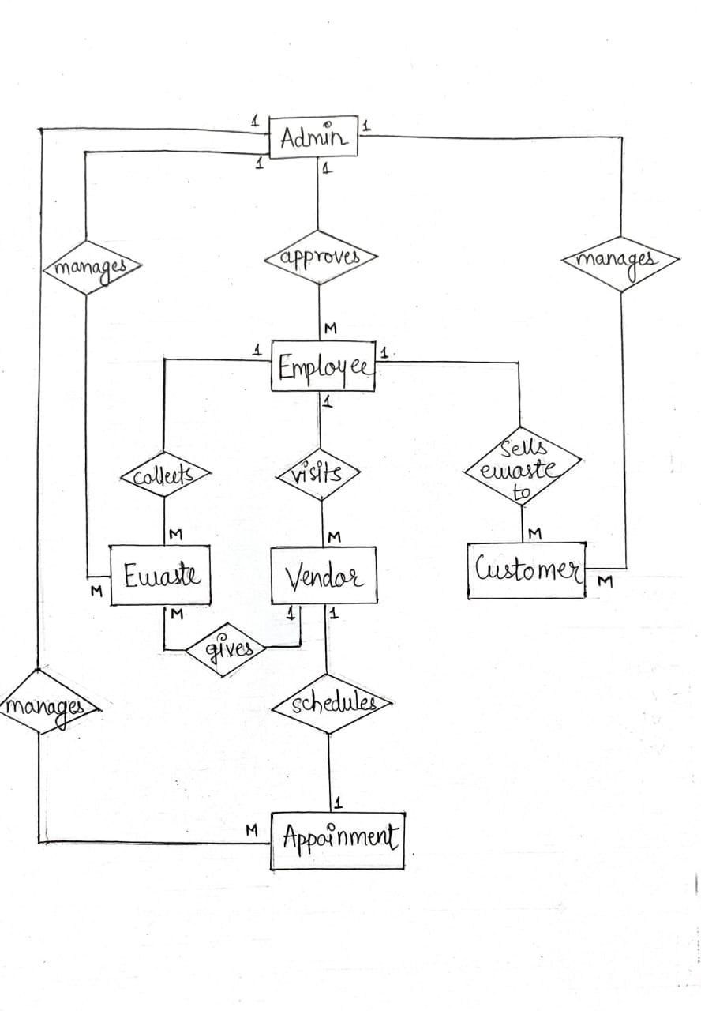
ER-Diagram

Slide 12
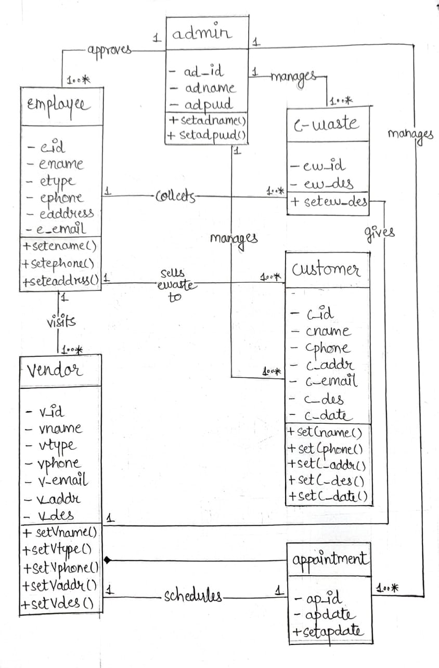
UML Diagrams
CLASS DIAGRAM

Slide 13
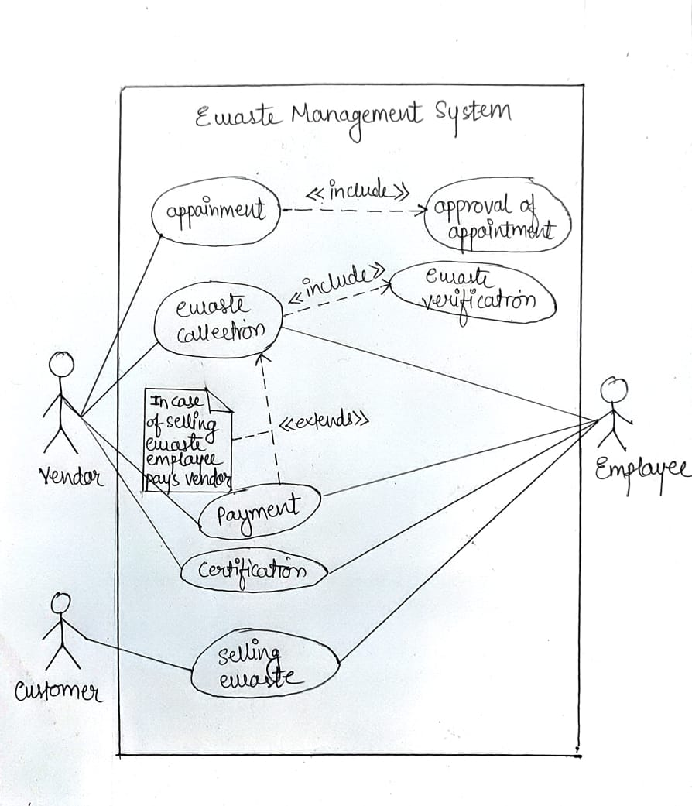
USE CASE DIAGRAM

Slide 14
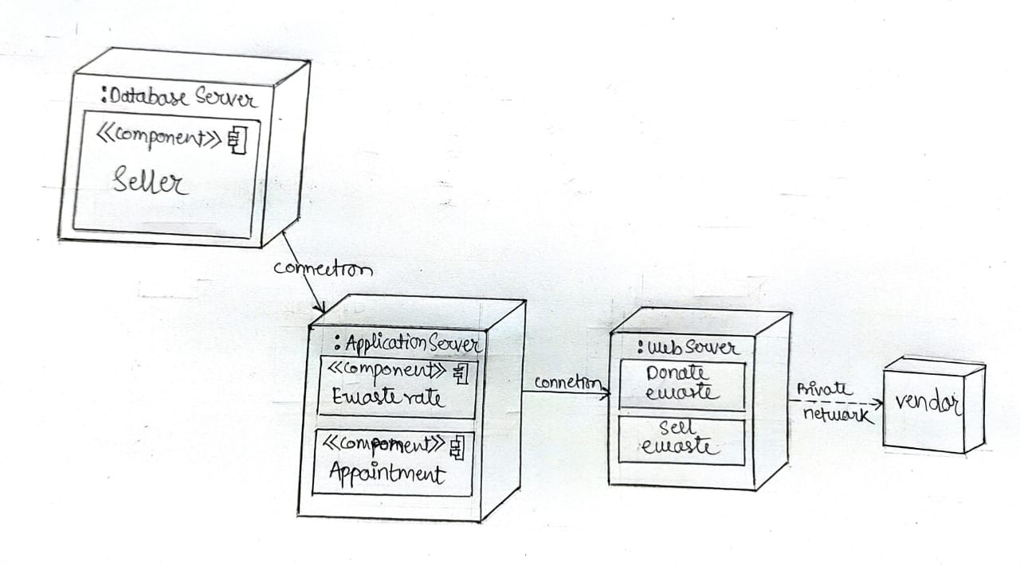
DEPLOYMENT DIAGRAM

Slide 15
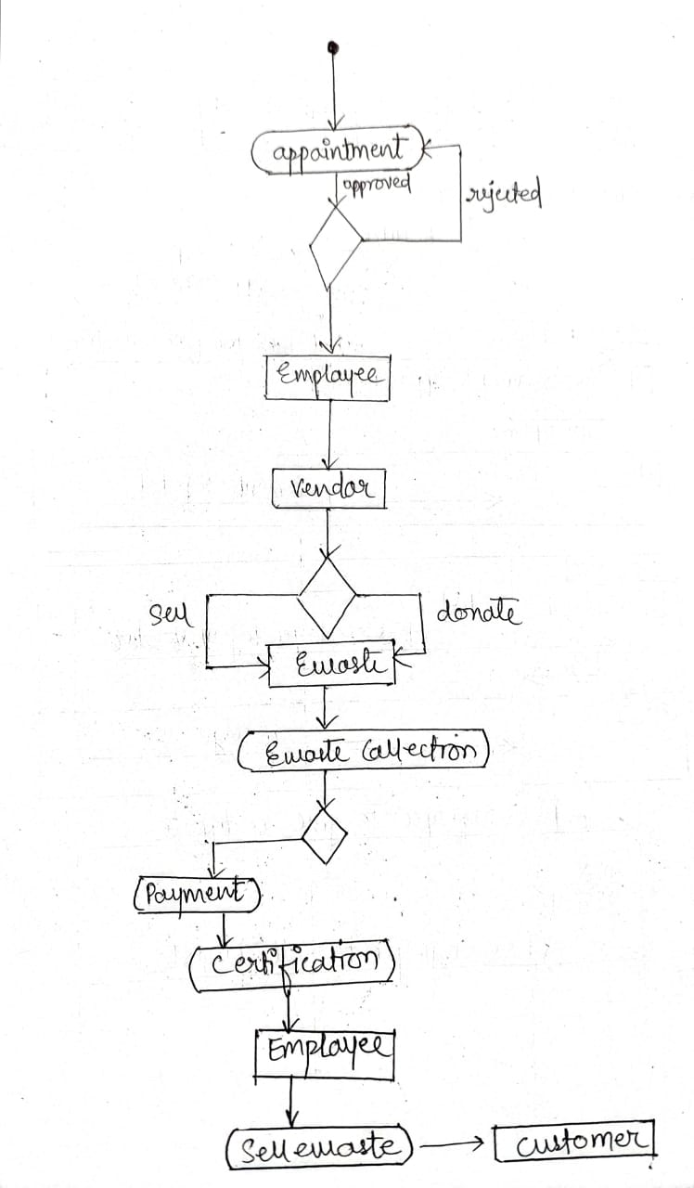
ACTIVITY DIAGRAM

Slide 16
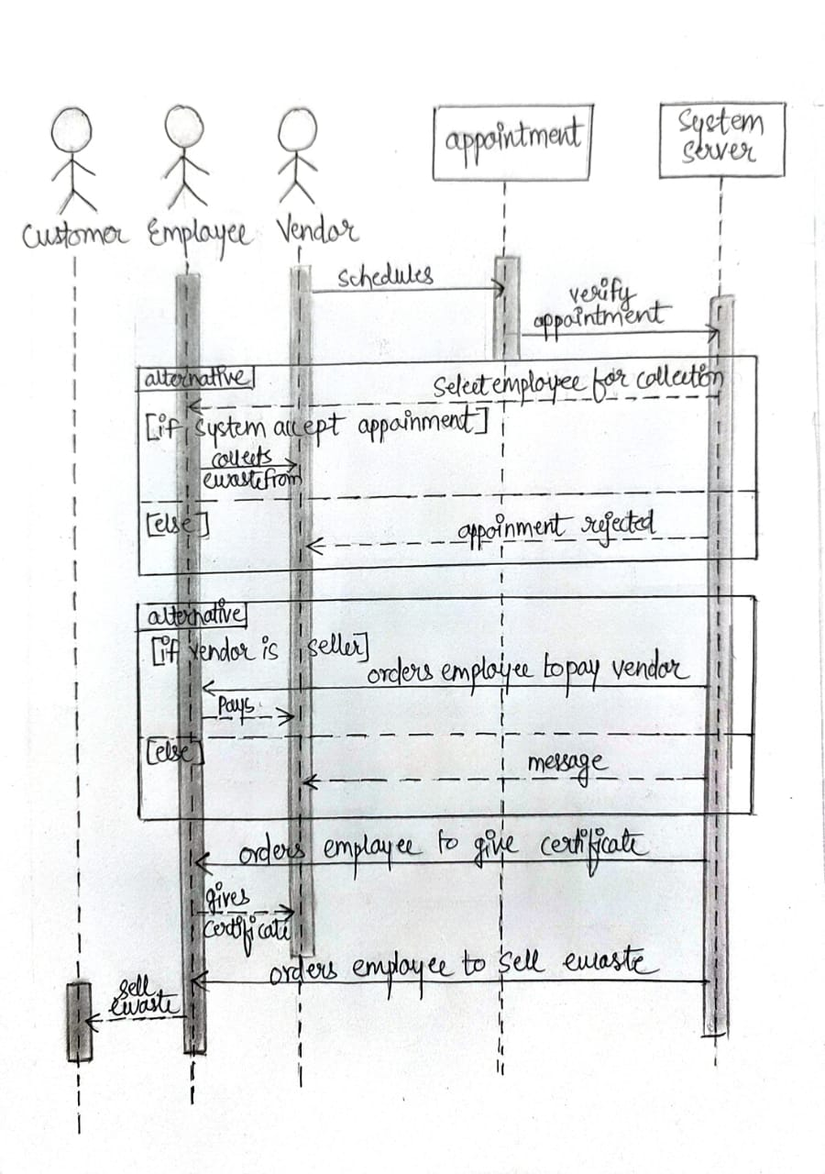
SEQUENCE DIAGRAM

Slide 17
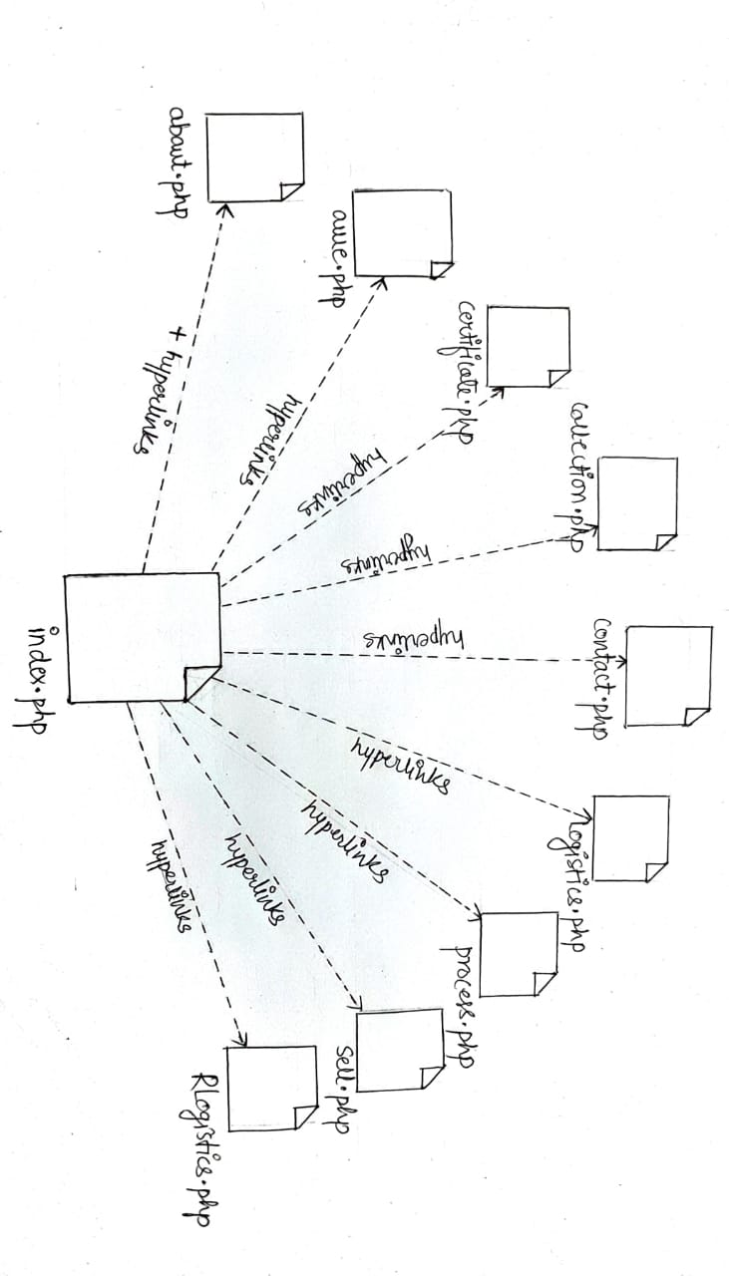
COMPONENT DIAGRAM

Slide 18
TESTING
The purpose of testing is to identify and correct errors in the candidate system. Testing is an important element of software quality assurance ad represents the ultimate review of specification, design and coding. The increasing visibility of the software as a system element and the cost associated with a software failure are motivated forces for well planned through testing.
System testing was conducted in order to detect errors and for comparing then the final system with the requirement specification reports, i.e. whether the system meets requirements. During testing the software was executed with the set of test cases and the output of programs for the test cases was evaluated to determine if the program is performing as it was expected to.
Testing presents an interesting challenge for the software engineers attempt to build software from an abstract concept to an acceptable implementation. In testing engineer create a series of test cases that occurs when errors are uncovered. Testing is the process of executing a program for finding errors. A good test is one that has the high probability of finding an uncovered error. A successful error is one that uncovers undiscovered errors.
The term error is used to refer the difference between actual output of the software and the current output. Fault is a condition that causes the software to fail to perform its required function Software reliability is defined as a required function. Software reliability is defined as the probability that the software will not undergoes failures for a specified times under specified condition. Failure is the inability of a system of a component to perform a required function according to its specification. Different levels of testing were employed for software to make it error free, fault free and reliable.

Slide 19
Unit Testing
Unit testing was conducted first. Different modules of the software were tested against the specifications produced during design of the modules Verification of the code produced during the coding phase was done. Each module was tested separately.
Unit testing focuses verification effort on the smallest unit of software design module This uncovers errors within the boundary of a module. Unit testing is actually White box testing both the external things as well as the internal codes are tested. In testing, the interfaces are tested in order to ensure the proper flow of data in and out of the module. The boundary testing is done to ensure that the module keeps the limit of it. All independent paths are tested to ensure that all statements are tested at least once. At last the error path is also tested.
Unit testing comprises the set of tests performed by an individual programmer prior to integration of the unit into a larger system. There are four categories of test that can be performed on a program unit.
System Testing
Then system testing was conducted. Here the entire software system was tested.
The reference document used for this process was requirement document and the goal was to see if the software meets its requirements.
System testing includes the thorough testing of the product. System testing is actually a series of different tests whose primary purpose is to fully exercise the computer based system. The tests are recovery testing this checks the recovery of the system when failure occurs. This is to ensure that there are recovery procedures for error occurrences.
System testing involves unit testing, integration testing, acceptance testing. Careful planning and scheduling are required to ensure that modules will be available for integration into the evolving software product when needed.

Slide 20
A test plan has the following steps:
Prepare test plan.
Specify conditions for user acceptance testing.
Prepare test data for program testing.
Prepare test data for transaction path testing.
Plan user testing.
Compile/Assemble program.
Prepare job performance aids.
Prepare operational documents.
Objectives of Testing
First of all objectives should be clear.
Testing as a process of executing a program with the intent of finding errors.
To perform testing, test cases are designed. A test case is a particular made up of artificial situation upon which a program is exposed so as to find errors. So a good test case is one that finds undiscovered errors.
If testing is done properly, it uncovers errors and after fixing those errors we have software that is being developed according to specifications.

Slide 21
LIMITATIONS
Setting up new recycling unit involves high cost. Recycling is not always cost-effective. Sometimes, there may be a need to establish separate factories to process reusable products. This may create more pollution as they would go under the process of cleaning storage and transportation.
Recycled products are always not of durable quality. Such items are mostly made of trashed waste, picked up from heaps other waste products which are of fragile or overly used. For this reason, recycled products are cheap and last for a shorter period. Recycling sites are often unsafe and unhygienic.
This not only causes widespread pollution but is harmful for dedicated people who recycle such products. Long-term effects on environment is still unknown. So increasing the education about the e-waste is needed
FUTURE SCOPE
Could the sustainable cities of the future prominently feature e-waste collection? E-waste Collection System is future to reduce the electronic waste and reusability of the electronic material in future.
The E-waste Collection System that develop the information and awareness about the recycling and problem affect by them collection. Decrease the Electronic & Electric Waste from the World and Less Development of Electronic and more recycling of the material.

Slide 22
CONCLUSION
Electronic and electrical equipment's cannot be avoided in today's world. So also is the case of waste electronic and electrical equipment. As long as this is a necessary evil, it has to be best managed to minimize its adverse impacts on environment. Electronic waste piles are growing, as is their pollution potential. Most of these problems have their source in the development and design of the products concerned. Using this type of system we can conclude that using the methodology of Reduce, Reuse and Recycle (3R) decrease the piles of electronic and electrical equipment, and make environment to be cleaned and healthy.
REFERENCE
http://wiki.org/e-waste-system/
http://zerowaste.com/
http://e-wasterecycling.com/
http://govproject.gov.in/
http://solidwasterecycle.org/

