Slide 1

NATIONAL INSTITUTE OF TECHNOLOGY DURGAPUR
DEPARTMENT OF ELECTRONICS & COMMUNICATION ENGINEERING
B.TECH. (Electronics & Communication Engineering)
Image Processing & Edge Detection of the image
Developed By
Santosh Prasad
B.Tech. (Electronics & Communication Engineering), 3rd year student (2022-2026 batch),
NIT Durgapur
Instructor : Hemanta Kumar Mondal
Assistant Professor, Department of ECE, NIT Durgapur

Slide 2
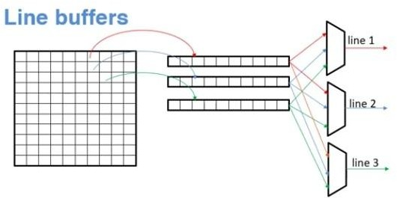
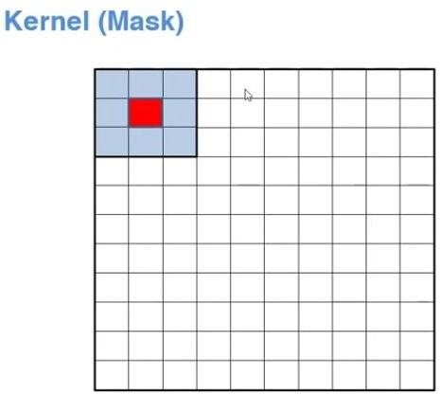
IMAGE PROCESSING & EDGE DETECTION USING VIVADO TOOL:
Step1: Line Buffer Design :
One line buffer will be going to store one line of the image.
It is some kind of RAM where data will be initially filled from the original image and data will be read out & processed later.
Each pixel is only one byte.
Writing the Verilog code for line buffer and then we have to perform simulation: Code_Link →LineBuffer.v code
Note: Xilinx provide different kind of Ips ,but as per our requirement we have to write our own IP because we can customise them as per our need.

Slide 3
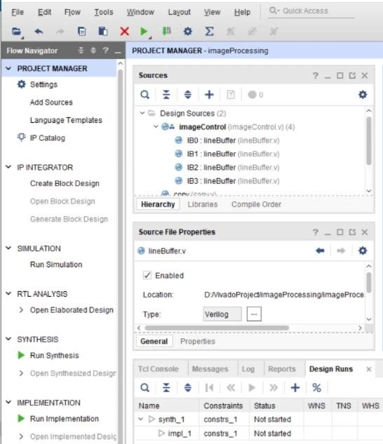
Step2: Design of module which will do multiplication and summation operation.
[MAc module→ Multiplication & Accumulation]
This module will get the pixels & it will also get the kernels & it will basically multiply pixels with corresponding kernel value & add them together.
Writing the verilog code for the module. Code_Link →conv.v code
Step3: Design of Control Logic.
Design a module which instantiate all the line buffers and these multiplexers ,
Which control storing the data into line buffers as well as which control sending data from these module to the MAc module
Here we will write our imageController verilog code. Code_Link →imageControl.v code
Step4: IP Packaging:
We will combine all the modules we have developed till now and we will complete hardware design for our IP. So that we can package our own IP.
Code_Link →ImageProcessTop.v code

Slide 4
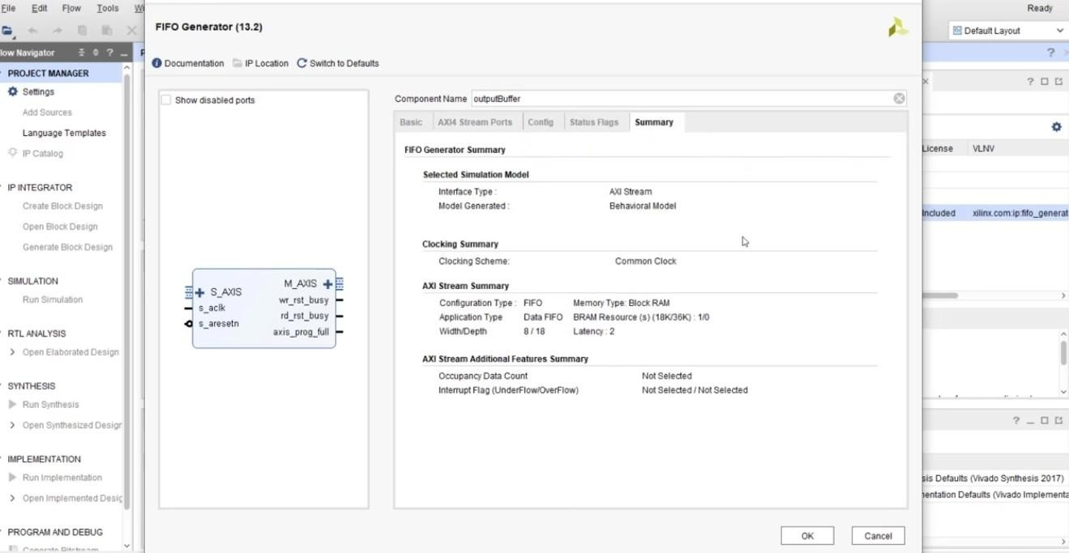
Then click IPCatalog → select FIFO Generator → we are going to use AXI stream FIFO →click OK →click Generate.

Slide 5
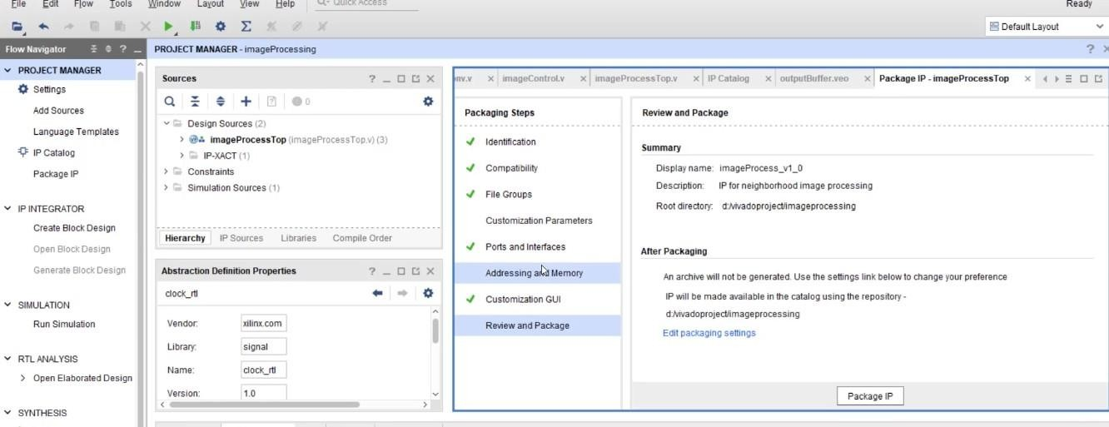
Instantiate this into my ImageProcessTop.v file → Code_Link →ImageProcessTop.v code
Now we will convert it into IP AXI format . So that we can use this IP in our block design.
Click on Tools →Create Package IP →Package your current project →Next→Finish

Slide 6
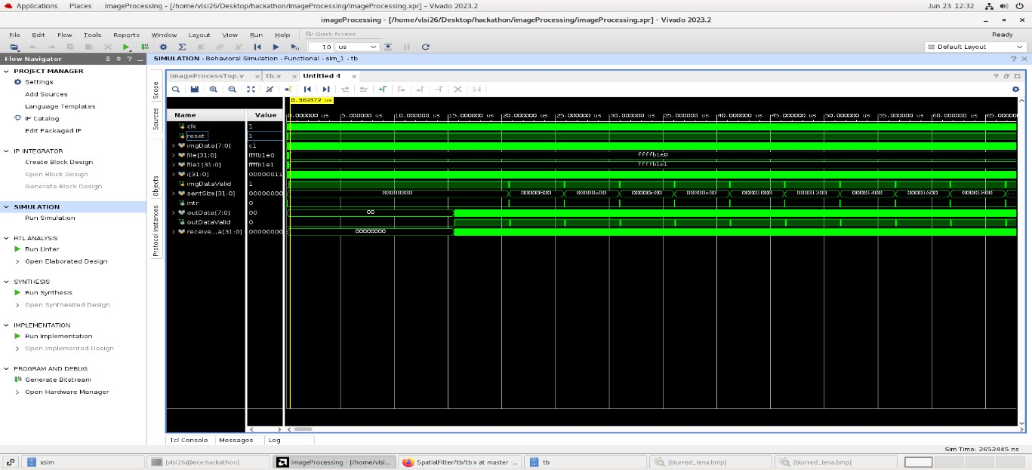
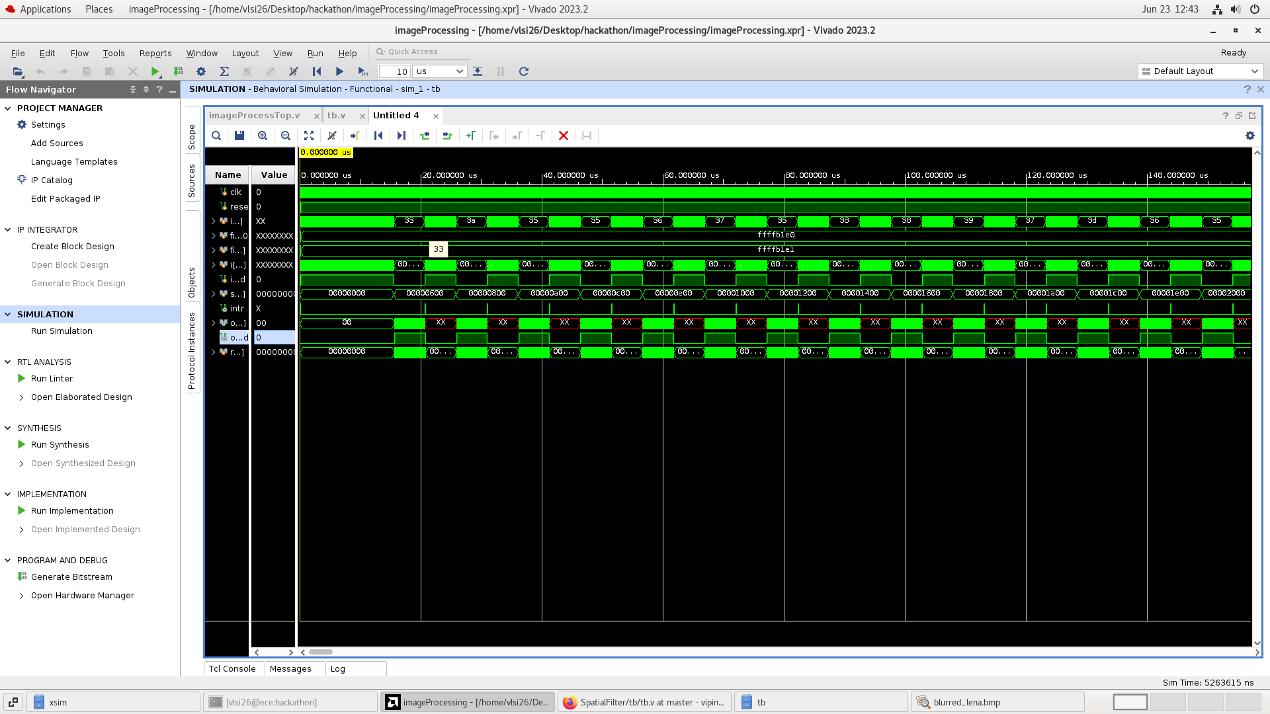
Step 5: Simulation.
Till now we have packaged our IP but not yet verified.So we have to do simulation and we cannot verify it by waveform here.
We have to realy send an image(.bmp format) & check whether the output is coming properly or not.
So we have to write our own test bench [which will read the image & send it to our IP and it will receive the data coming from the IP and I will be able to see the actual output.]
Code_Link → tb.v file
After that go to settings →simulation →OK→run simulation

Slide 7


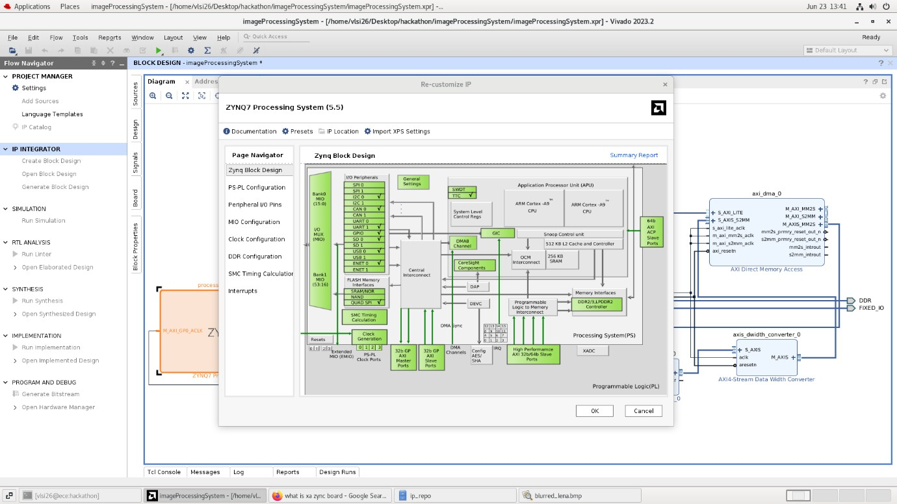
Input image .bmp file
output blurred image .bmp file
Step 6: System Integration
We are going to build a system which is going to use this IP core.
Create new project →create block design .Select the following IP:
Zynq Processing System | our IP(ImageProcessTop_v1) |AXI DMA
Then run connect automation | after that select some more IPs like AXI4 - Data width Converter| AXI Interconnect | Concat IP → then again run connect automation

Slide 8
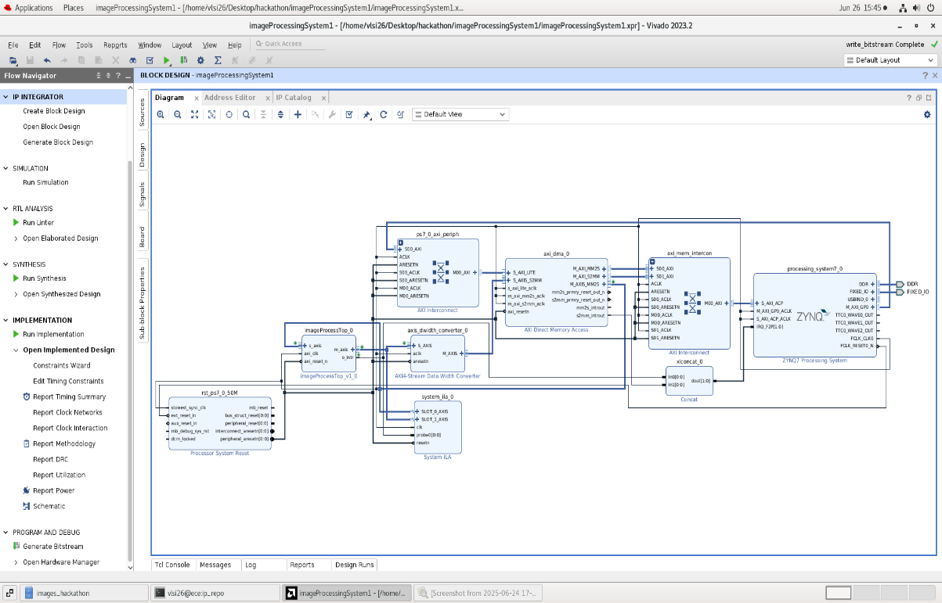

Slide 9
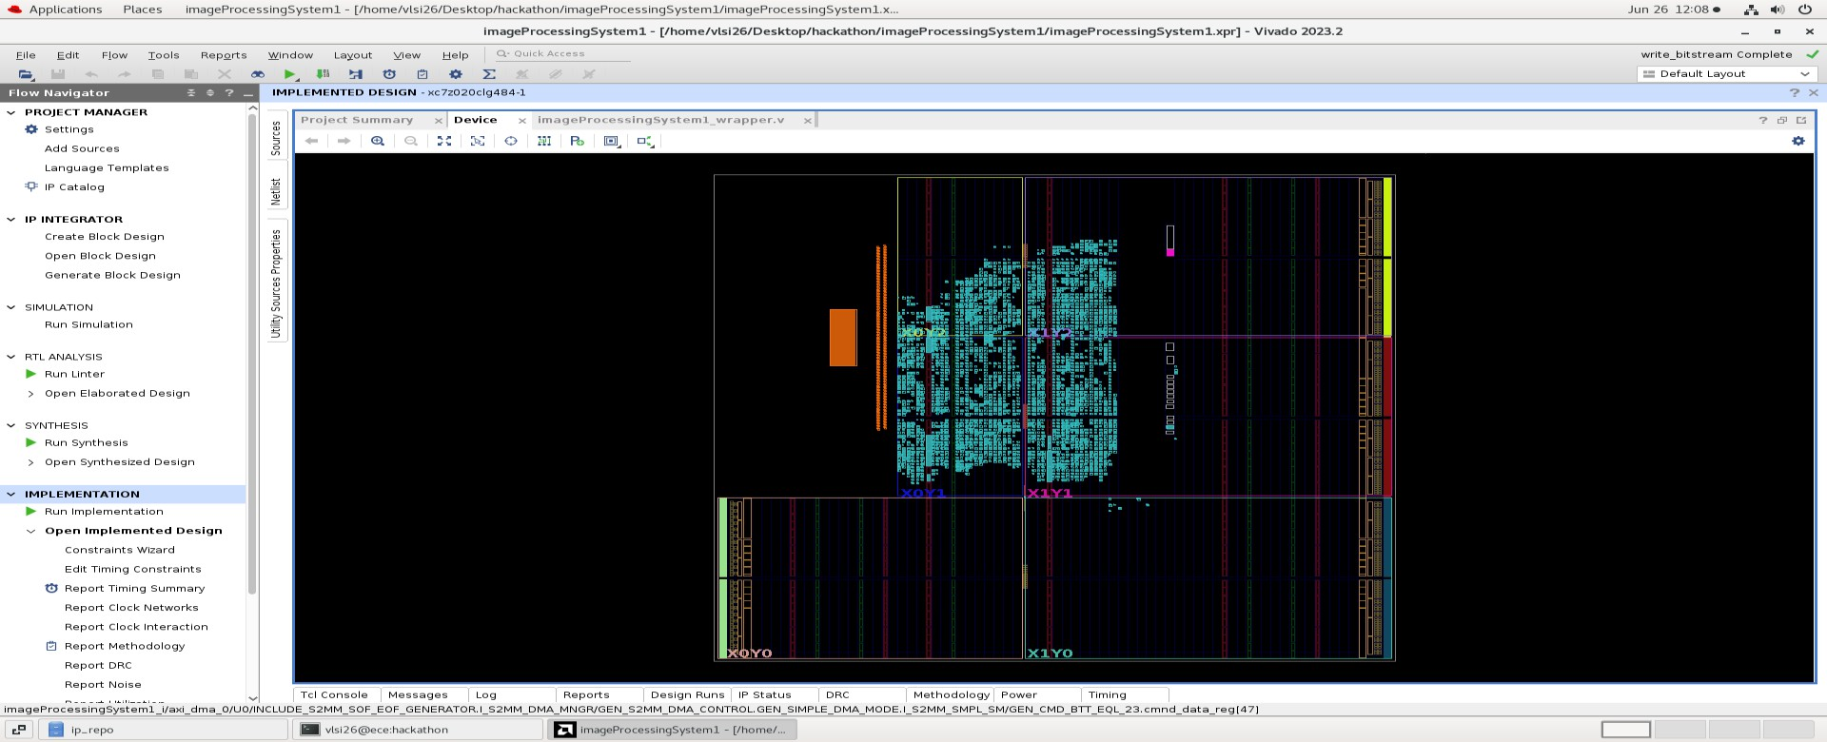
Verify design
Generate Wrapper [Sorce →select ImageProcessingSystem→create HDL wrapper]
Generate BitStream

Slide 10
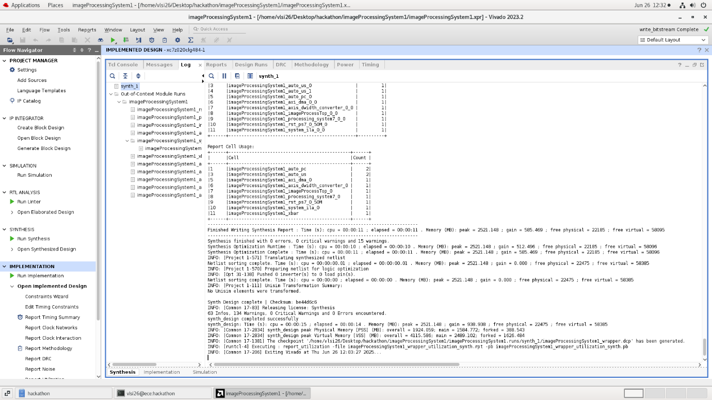
Log window: showing successful synthesis completion

Slide 11
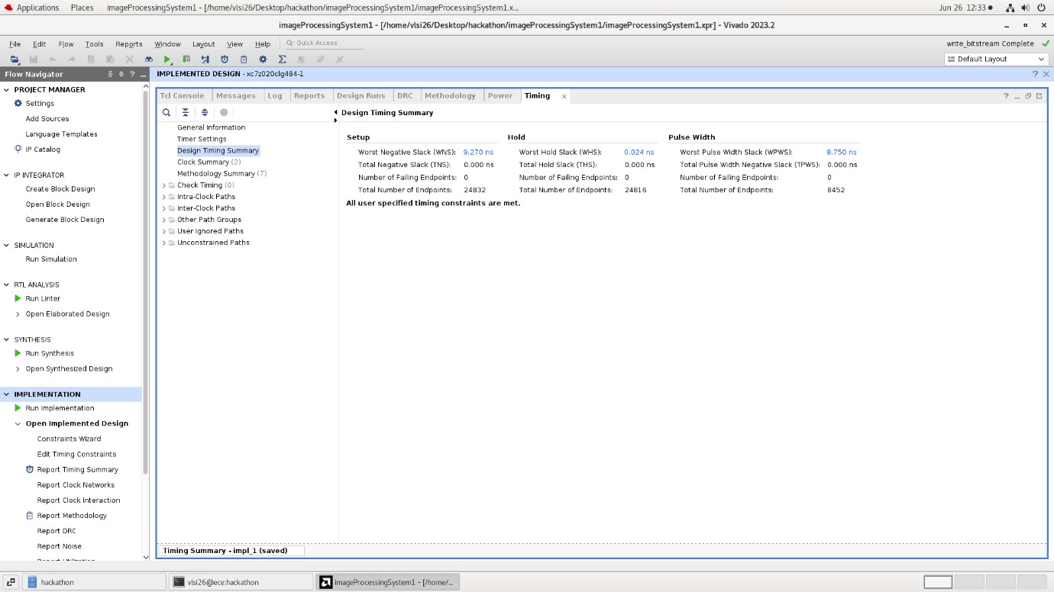
Timing Checks: Setup time & Hold Time

Slide 12
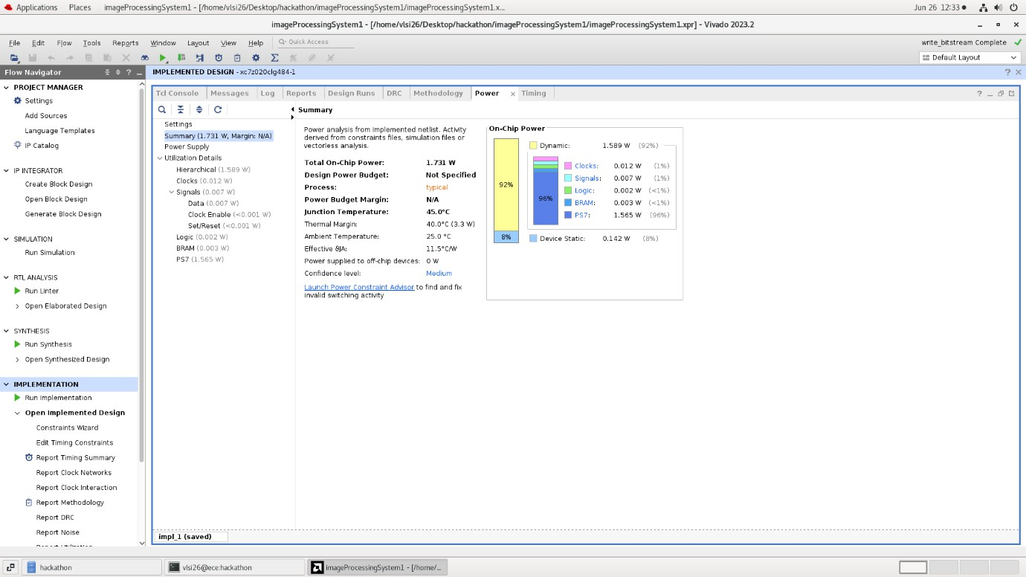
Power Analysis from the implemented netlist:

Slide 13
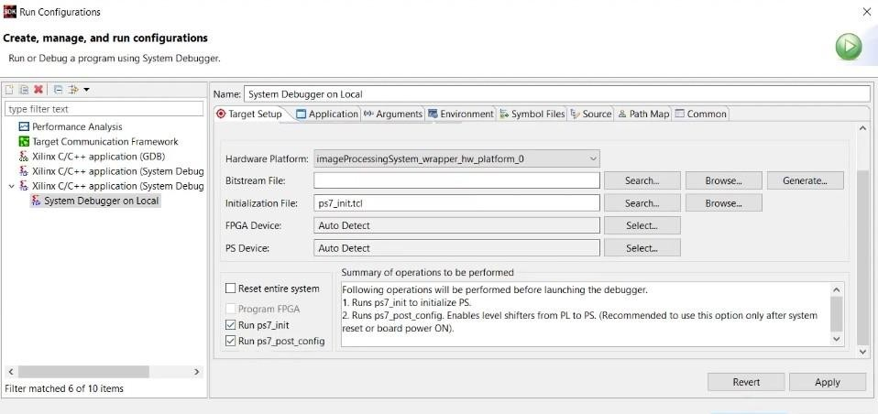
Step7: Software Development & Hardware Evaluation
We have completed the hardware design part of our system which uses our image processing IP. Next we have to go to software part of the system in order to verify it on hardware.
An image is simply a big array of numbers , so instead of sending image to external world we can create a static array of that big numbers & make it a part of our software source code.
Verilog can do filehandling also. So I will modify my testbench(tb.v) file to get the header file (imageData.h).
Link_of_imageData.h_file
Export hardware & launch vitis IDE tool.
Create a new application project & import file imageData.h file .Next go to source & create file imageTest.c file.
Link_of_imageTest.c_file
Now we will test it on hardware.
Go to vivado & program the device
Now actually the data is coming & the entire processing is over . It is sending back the processed data .Now we will get our image filtered output similar to simulation.

Slide 14

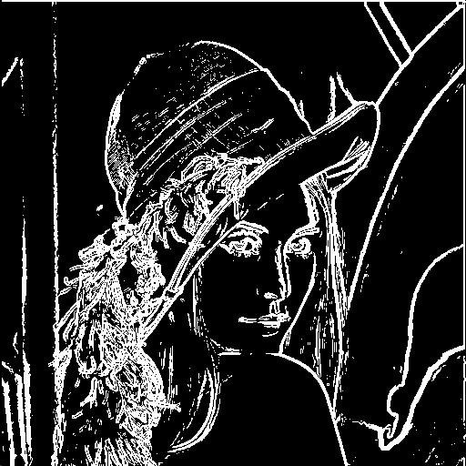
Step8: Edge Detection using Sobel operator.
Here we will use two kernels. In an image there is a sudden change in pixel intensity ,so that logic we are going to use for edge detection.
All the logic & code will remain same , we have to make changes in the convolution file.
Link_conv.v_file
Then go and simulate,we will get our edge detected image.
Edge Detection Image :
Image must be stored in .bmp format

Slide 15
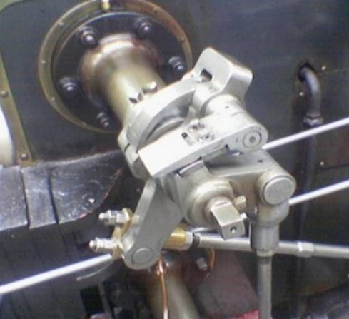
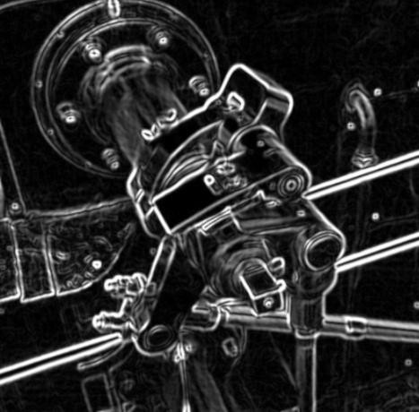
Some more images generated using sobel operator for reference :

