Slide 1

Samvaadhika
Bridging language barriers in BAIF's eLearning
Offline, open-source translation for Hindi, Marathi and English
Tech for Good Hackathon | Design submission

Slide 2





The problem
Today
BAIF's eLearning content lives mainly in one language
Learners range from head-office staff to field-based farmers
Many learners are most comfortable in Hindi or Marathi, not English
Mission
Bridge language barriers and expand access to learning and information in Indian regional languages.
Built for BAIF's real environment
No GPU needed
Runs on BAIF's existing low-spec PCs
Zero cost
100% open source, no licenses to buy
Centralised processing
Translation runs at BAIF's Pune office
Offline playback
Outputs work in the field with no internet

Slide 3
Solution architecture
Inputs: text · audio · video · documents
BAIF on-prem deployment — Pune office
Single Windows PC or file server · no GPU required
Input & access
AI pipeline
Storage & reuse
Upload, login, job queue
ASR, MT, TTS, OCR
SQLite cache + audit log
Outputs: text · speech (TTS) · subtitles · files
Processed at BAIF's Pune office; outputs are distributed for offline playback in the field.

Slide 4

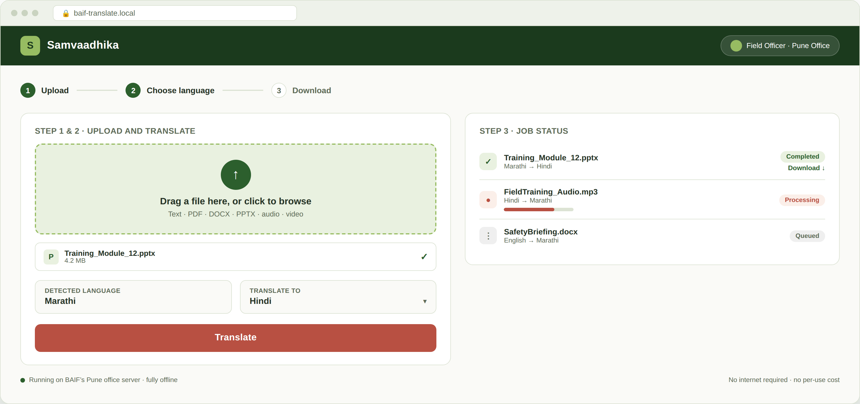
Simple by design
Three clicks: upload, choose a language, download — no manual, no IT training required
No prior training needed — a field officer can complete a translation in under two minutes

Slide 5

Tech stack — open source, CPU only
Function | Open-source tool | Why it fits BAIF
Speech-to-text (ASR) | faster-whisper / AI4Bharat IndicWhisper | Quantized for CPU; tuned for Indic accents
Translation (MT) | AI4Bharat IndicTrans2 (distilled) | Built for Hindi/Marathi/English, preserves meaning
Text-to-speech (TTS) | Indic Parler-TTS / Coqui TTS | Open Indic voices for dubbed audio output
OCR | Tesseract (Hindi + Marathi + English) | Scanned PDFs and on-screen video text
App & storage | FastAPI + SQLite + Windows Service | One lightweight process, no DB server, no GPU

Slide 6






Built to win on BAIF's terms
Impact
Directly solves BAIF's stated language-access problem for learners
Scalability & production readiness
Single-machine MVP, modular pipeline ready to grow
Usability & UX
Upload, translate, download — auto language detection
Tech safety, fairness & inclusivity
Privacy-first, bias-flagged review, accessible by design
Cost: zero
100% open source — no licences, no cloud fees
Differentiator: dedup cache, confidence-flagged translation, graceful offline degradation

