Slide 1
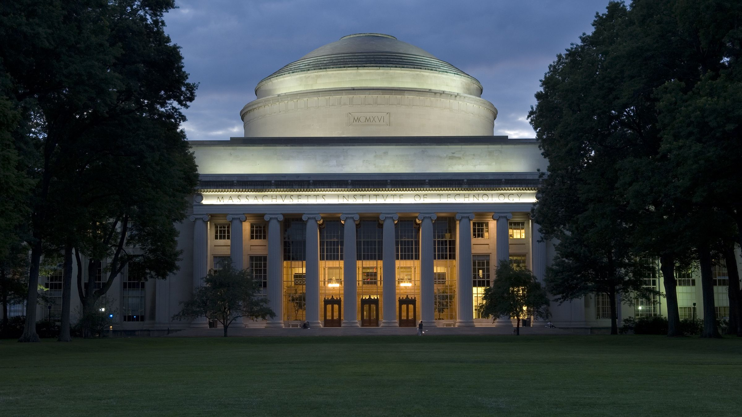
Massachusetts Institute of Technology
Hoboken, New Jersey

Slide 2
Massachusetts Institute of Technology
Hoboken, New Jersey

Slide 3
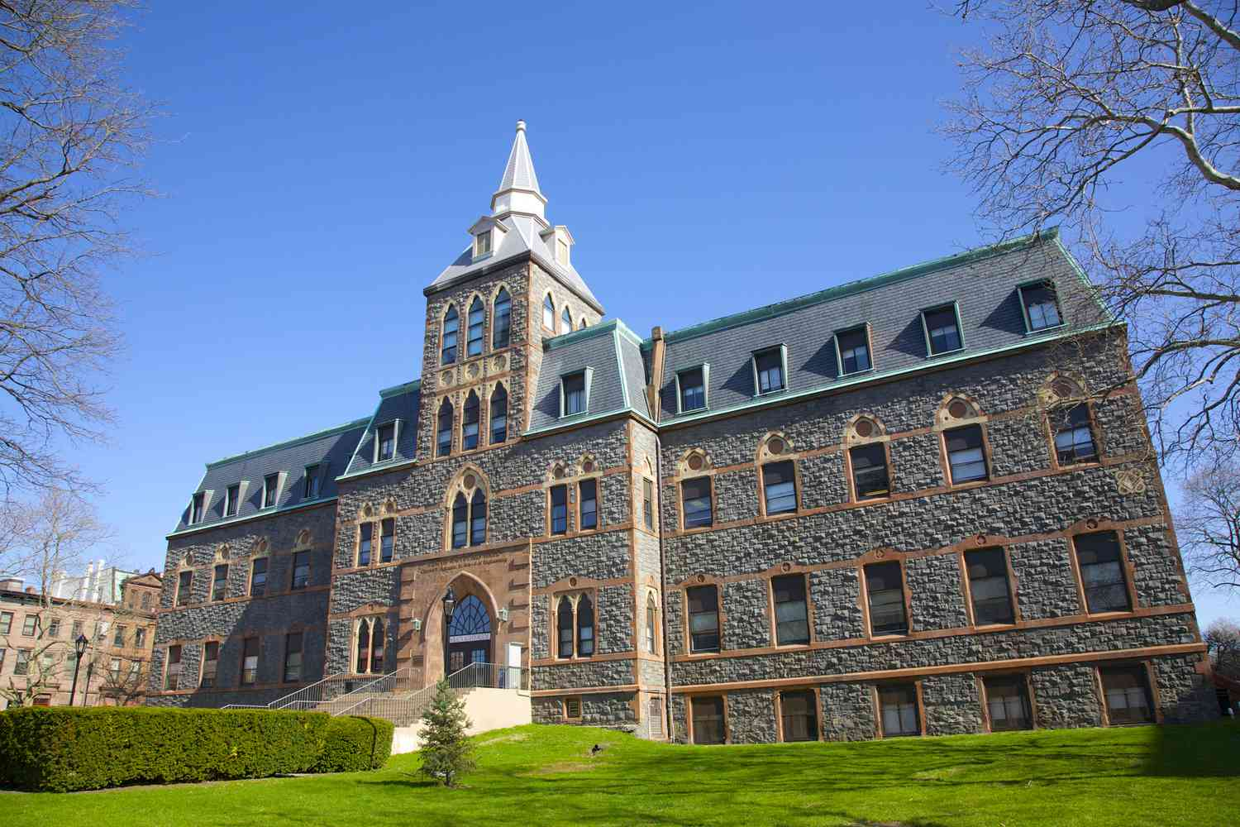
Massachusetts Institute of Technology
Hoboken, New Jersey

Slide 4
Stevens Institute of Technology
Hoboken, New Jersey

Slide 5
3,932
Undergraduate Enrollment
City

Slide 6
Stevens Institute of Technology was the first college in America solely dedicated to mechanical engineering.

Slide 7
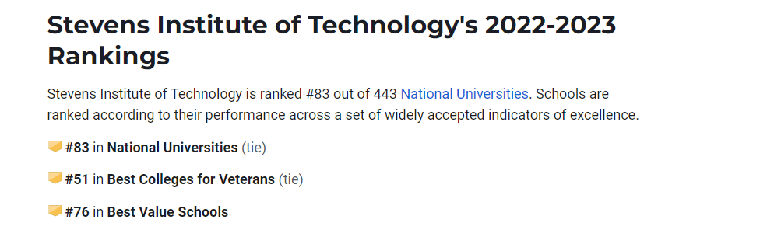
No application fees
Ranking:

Slide 8
SAT Scores 75th percentile
Acceptance rate
english | maths | Total
710 | 770 | 1480
ED | Regular
50% | 41%

Slide 9
Popular Majors:
Mechanical Engineering
Computer Science
Chemical Engineering
Civil Engineering
Biomedical Engineering
Electrical Engineering
.

Slide 10
Notable Alumni
.

Slide 11
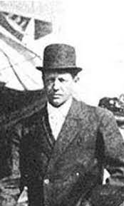
Notable Alumni
Augustus Moore Herring
Claimed to be the first true aviator of a motorized heavier-than-air aircraft.
.

Slide 12
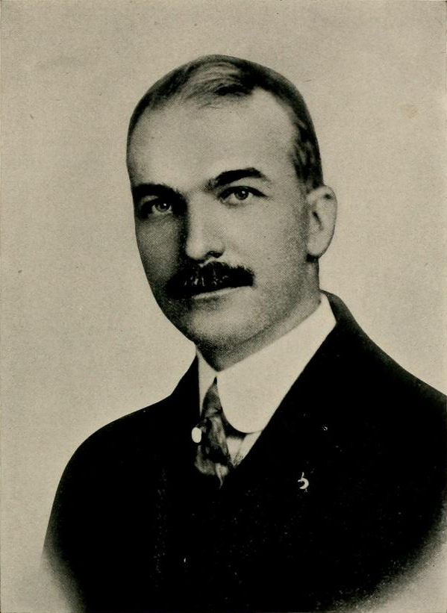
Notable Alumni
Charles Stewart Mott
co-founder of General Motors
.

Slide 13
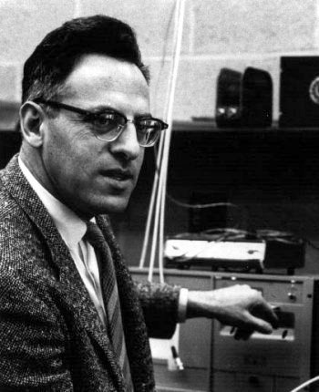
Notable Alumni
Frederick Reines
Nobel Prize winner in Physics for discovering Neutrino
.

Slide 14
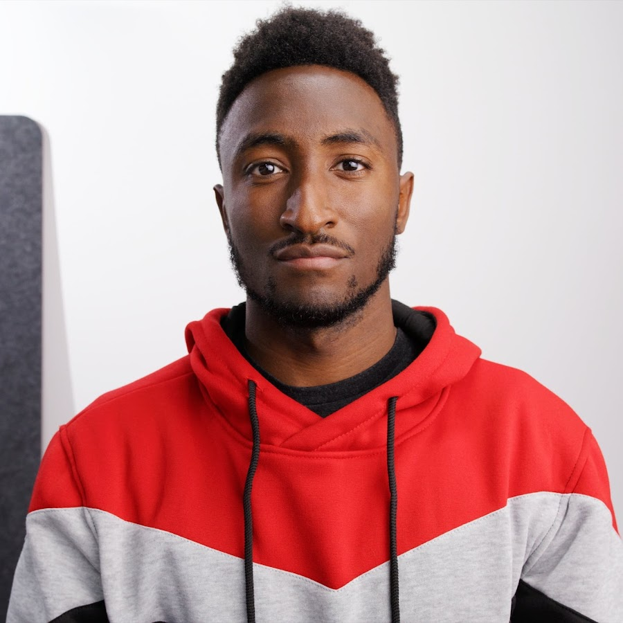
Notable Alumni
Marques Brownlee
He is an American YouTuber
.

Slide 15
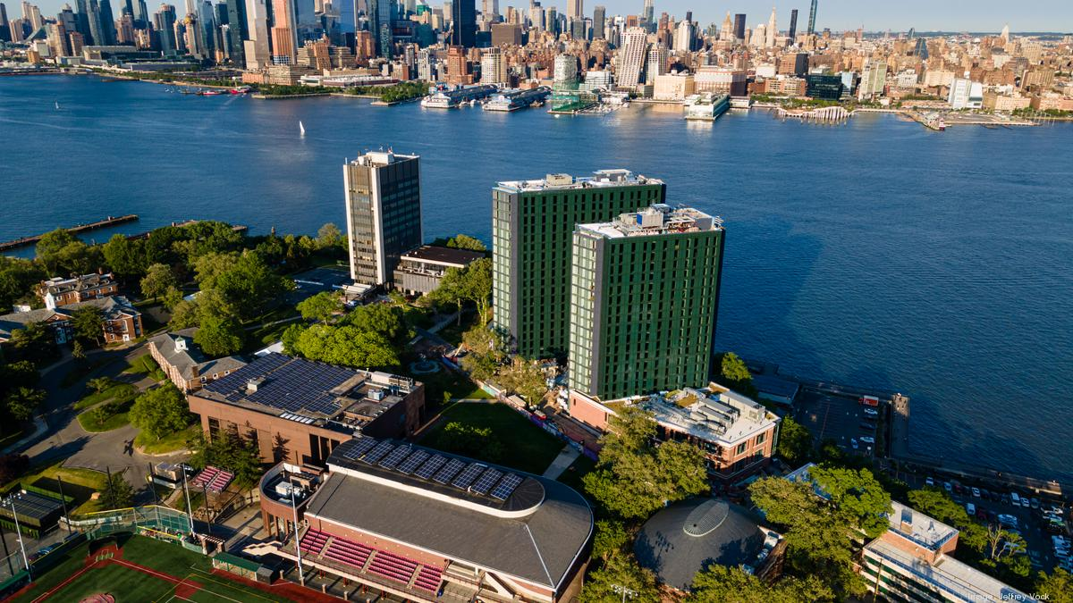
Scholarships?
→Stevens Institute of Technology awards several merit scholarships every year.
Applicants are automatically considered for Stevens merit scholarships when theyare admitted.
Merit scholarships range between $5,000 and full tuition.

Slide 16
Thank You

Slide 17
2 June, 2022

Slide 18
2 June, 2022
Time: 12 p.m.

Slide 19
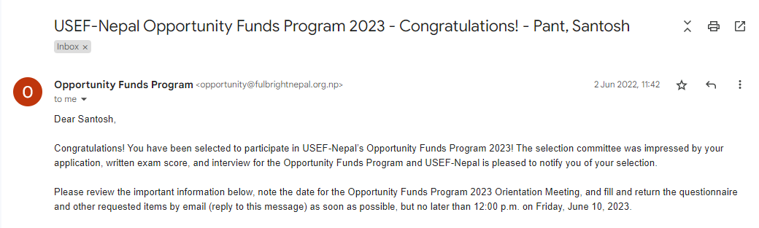
2 June, 2022
Time: 12 p.m.

Slide 20
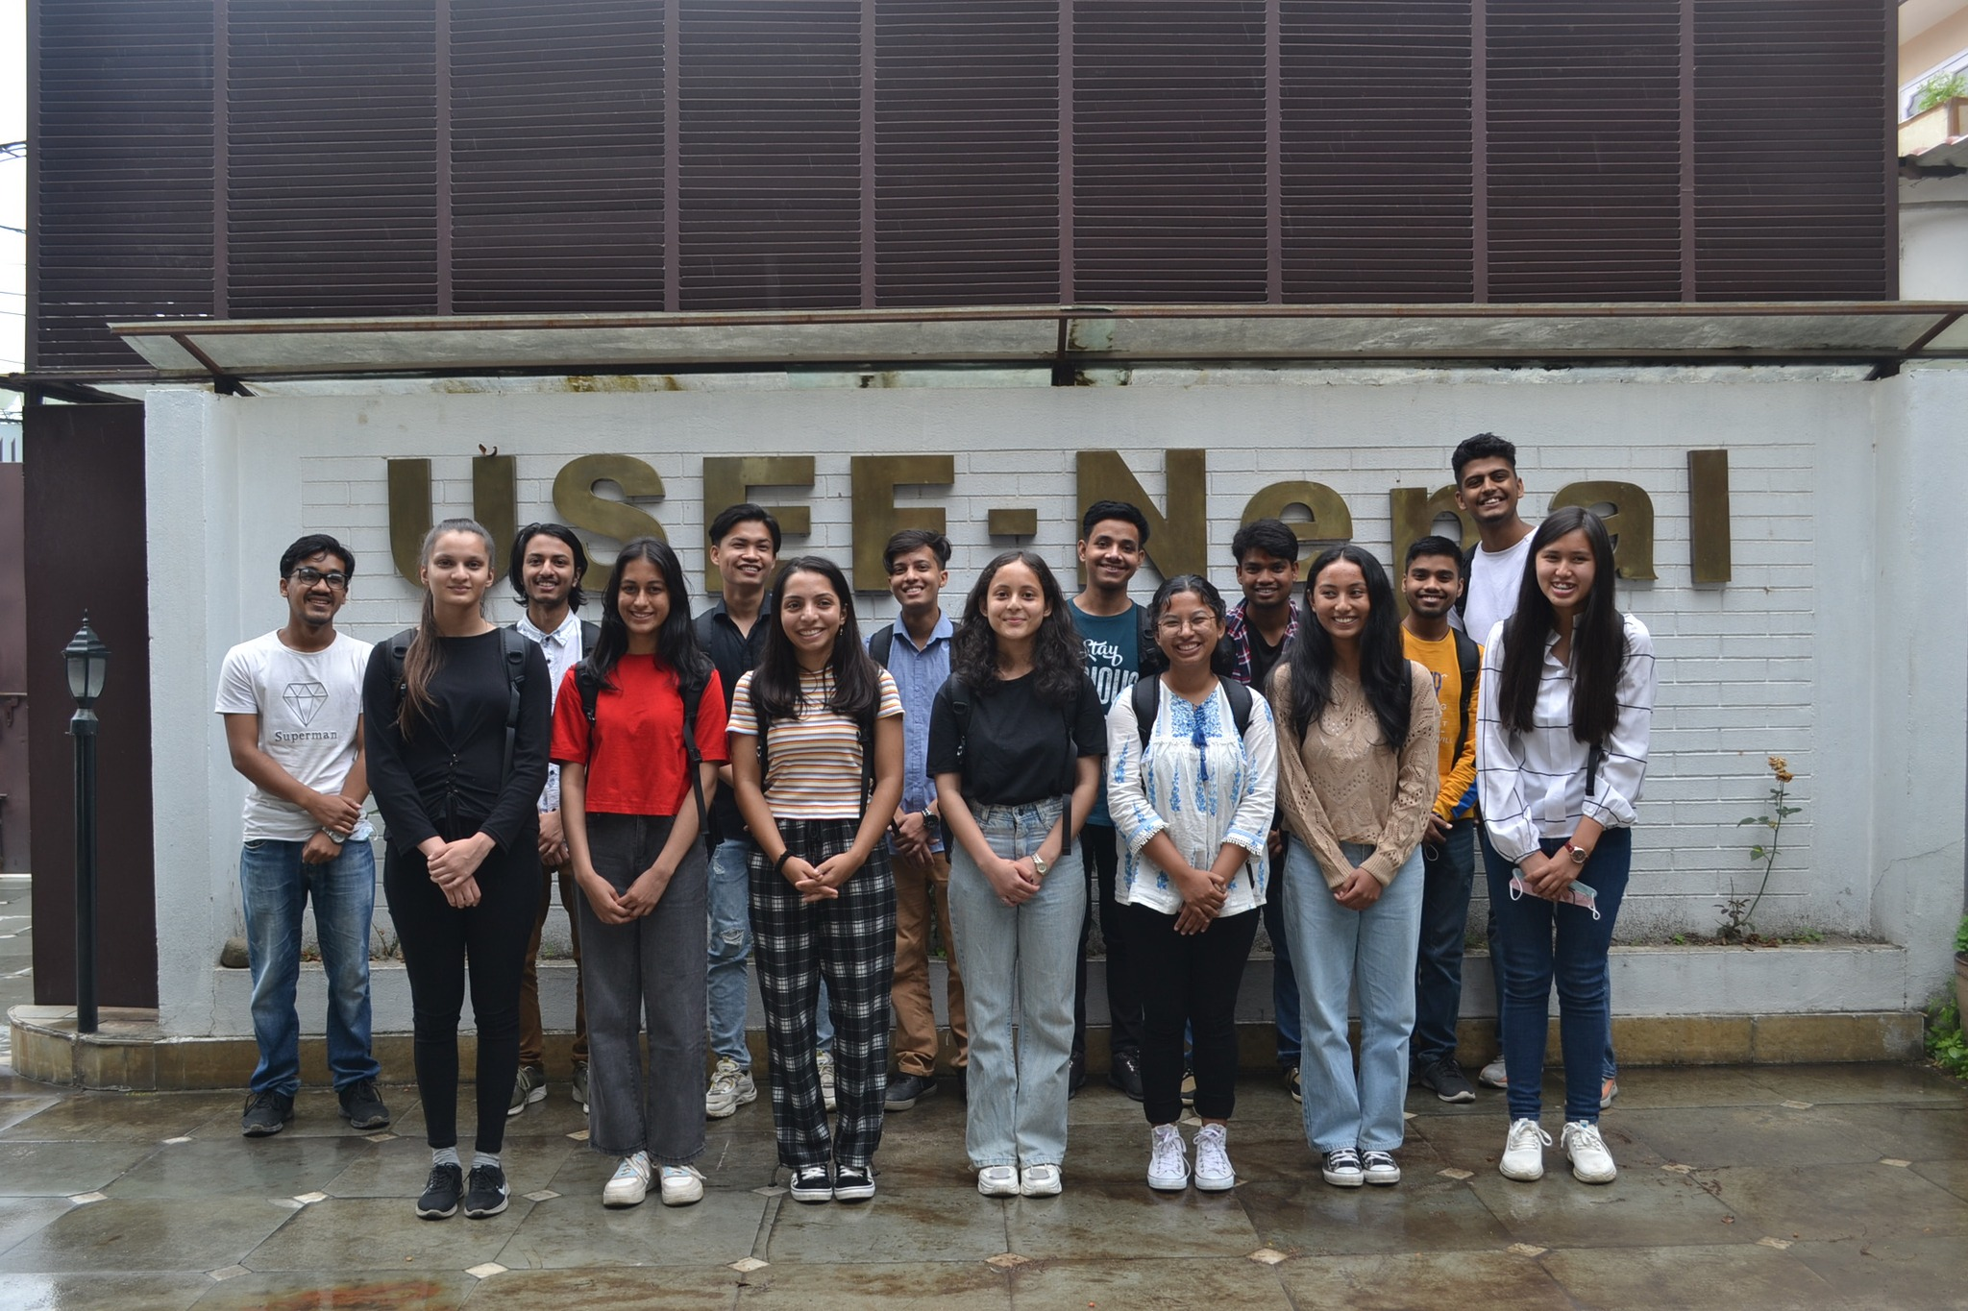
Thank You, Everyone

