Slide 1

University of Southern Mississippi

Slide 2
BASIC INFORMATION
History: Founded on March 30, 1910
Type: Public Research University
Location: Hattiesburg, Mississippi
Acceptance Rate: 96%
Offers 78 distinct undergraduate degrees, concentrated into 68 majors within 26 broad fields of study.
Number of students: 10,693 enrolled(35% male, 65% female)
International Students: 2.2%
Retention rate: 72%
Student to Faculty Ratio: 18:1

Slide 3
Average Scores
1070
23
3.29
SAT
ACT
GPA

Slide 4
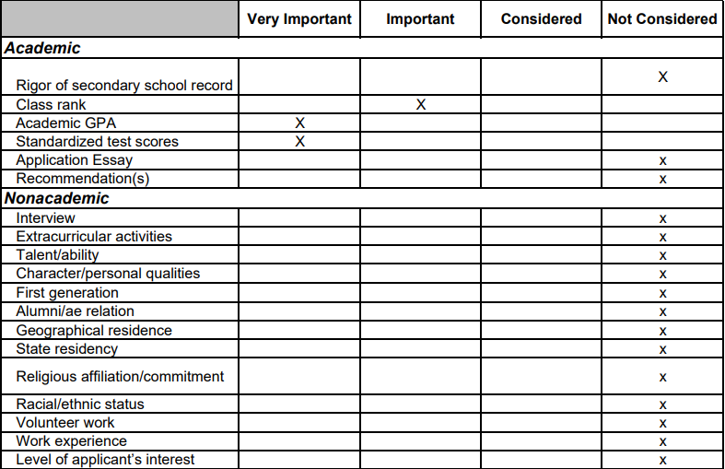
WHAT’S IMPORTANT?

Slide 5
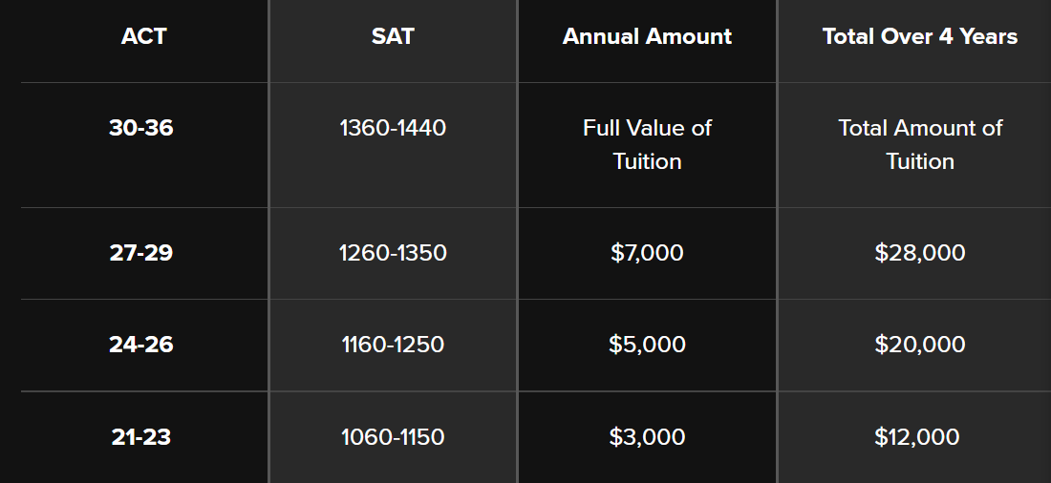
SCHOLARSHIPS
Academic Excellence Scholarships
Students must have a high school core gpa of 3.0 or higher.

Slide 6
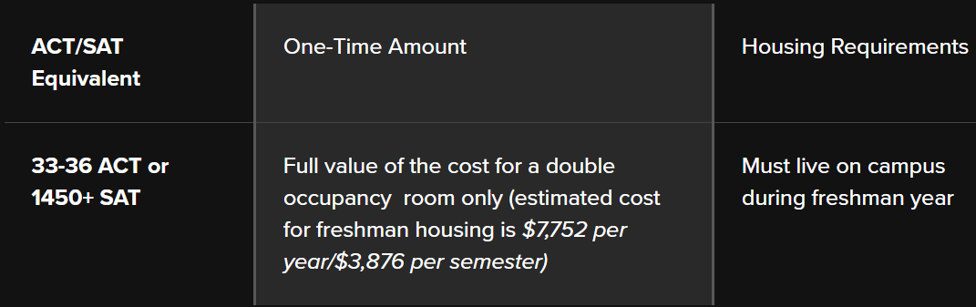
SCHOLARSHIPS
Freshman Academic Housing Scholarship
This scholarship does stack with Academic Excellence Scholarship.

Slide 7
Honors College Program Scholarships
HONORS SCHOLAR AWARD: $2,000 annual scholarship for 4 years
HONORS COLLEGE DISCOVERY SCHOLARSHIP:
Full tuition for four years
The cost of campus housing and meal plan for the fall and spring semesters of freshman year
A one-time $5,000 scholarship toward the USM study-abroad program of the recipient’s choice, to be used beginning in the summer following the freshman year.
A one-time $1,750 research grant designed to support Honors College thesis research, to be used once a student advances to the research portion of the curriculum.
HONORS COLLEGE PRESIDENTIAL SCHOLARSHIP:
Full tuition for four years
The cost of campus housing and a meal plan for four years
$500 per semester educational allowance

Slide 8
DEADLINES
Honors College Program:
December 1: University Admission
January 15: Honors College Application
For academic excellence scholarship consideration: March 1, 2023
For Fall 2023 general admission: June 30, 2023

Slide 9
THANK YOU

