Slide 1
AAHAAR
Zero Waste. Zero Hunger. Fully Verified.
A Unified B2B SaaS Enterprise Ecosystem Orchestrating Surplus Redirection, Cryptographic Verification, and Compliance Automation
Presenter: Santosh Patel | Department of Computer Science & Engineering
ABES Engineering College | Spark Fellowship Selection Challenge
IP Status: Patent-Pending Technology (System & Method for Secure Real-time Surplus Logistics Verification)

Slide 2

SECTION 01: STRATEGIC VISION
AAHAAR ENTERPRISE SYSTEM
The Food Waste & Trust Paradox
Solving the Operational Bottlenecks
• Traditional charity networks rely on manual entries, leading to data manipulation and food loss.
• Lack of proof-of-delivery creates verification disputes between donors and NGOs.
• Direct food donations typically fail to secure Section 80G corporate tax benefits.
• Aahaar resolves these limitations with blockchain trust, QR verification, and structured tax metrics.

Slide 3
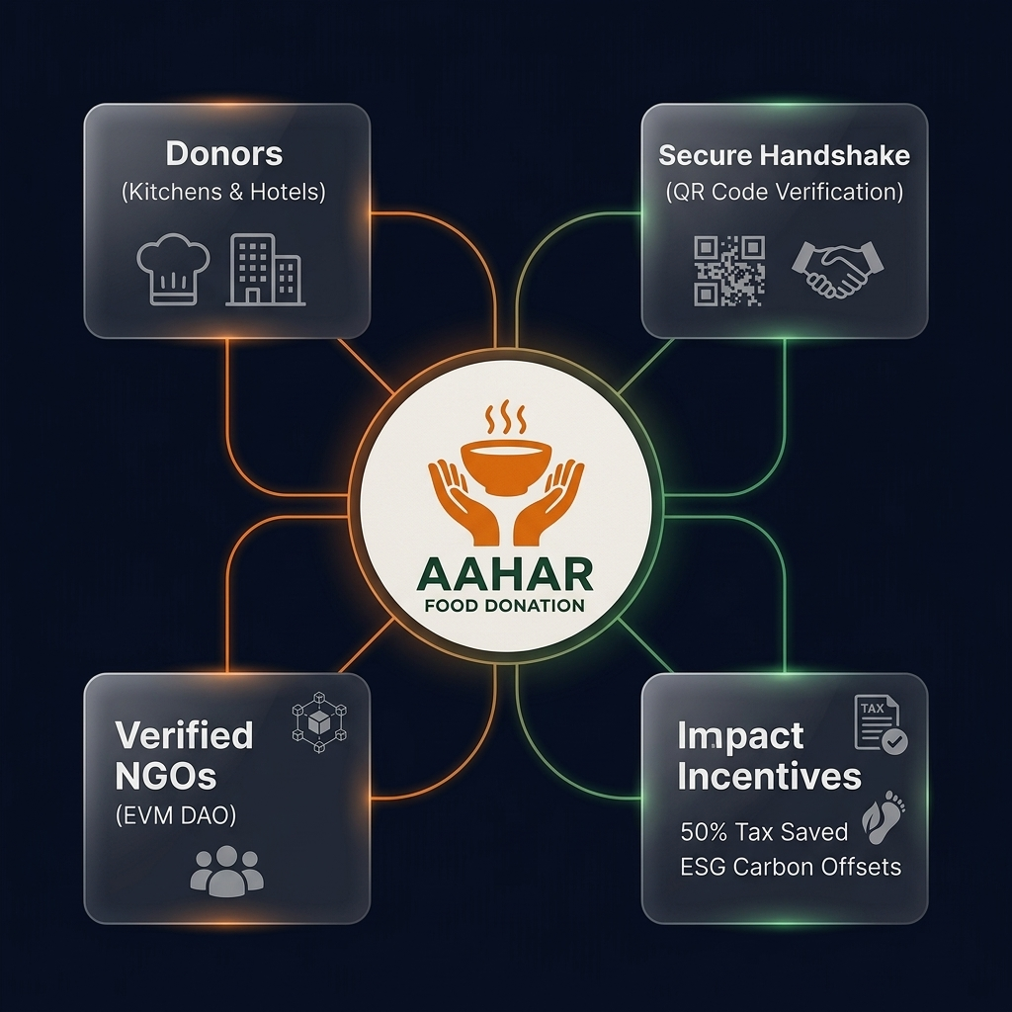
SECTION 01: STRATEGIC VISION
AAHAAR ENTERPRISE SYSTEM
Aahaar Platform Ecosystem Mind Map
Core Ecosystem Connections
• Donors: Corporate offices, hotels, and event venues list surplus food on the portal.
• Secure Handshake: Dual-party QR validation rules out pickup and transit delivery disputes.
• Verified NGOs: Credentials checked via administrative gates and managed by EVM DAO.
• Impact Incentives: Pre-populated Section 80G tax benefit files and live ESG carbon indexes.

Slide 4

SECTION 02: LOGISTICS VERIFICATION
AAHAAR ENTERPRISE SYSTEM
Zero-Leakage Handshake Verification
Proof of Physical Delivery
• System generates a dynamic QR code and 6-digit OTP code when claims are approved.
• NGO rider displays the QR code at the physical pickup site to verify arrival coordinates.
• Donor scans the QR code to sign off the transaction and commit verification to the blockchain.
• Solidity smart contract marks completion, awarding reputation scores on-chain.

Slide 5

SECTION 03: COMPLIANCE AUTOMATION
AAHAAR ENTERPRISE SYSTEM
Automated Tax Benefit Valuation
50% Tax Exemption Protocol
• System converts food category and weight weights into fair procurement values.
• Enables corporate donors to legally claim a 50% Section 80G tax deduction.
• Generates compliant, watermarked PDF certificates containing smart smartphone-scannable QR verification.
• Verification receipts are locked until admin verifies donor credentials to prevent fraud.

Slide 6
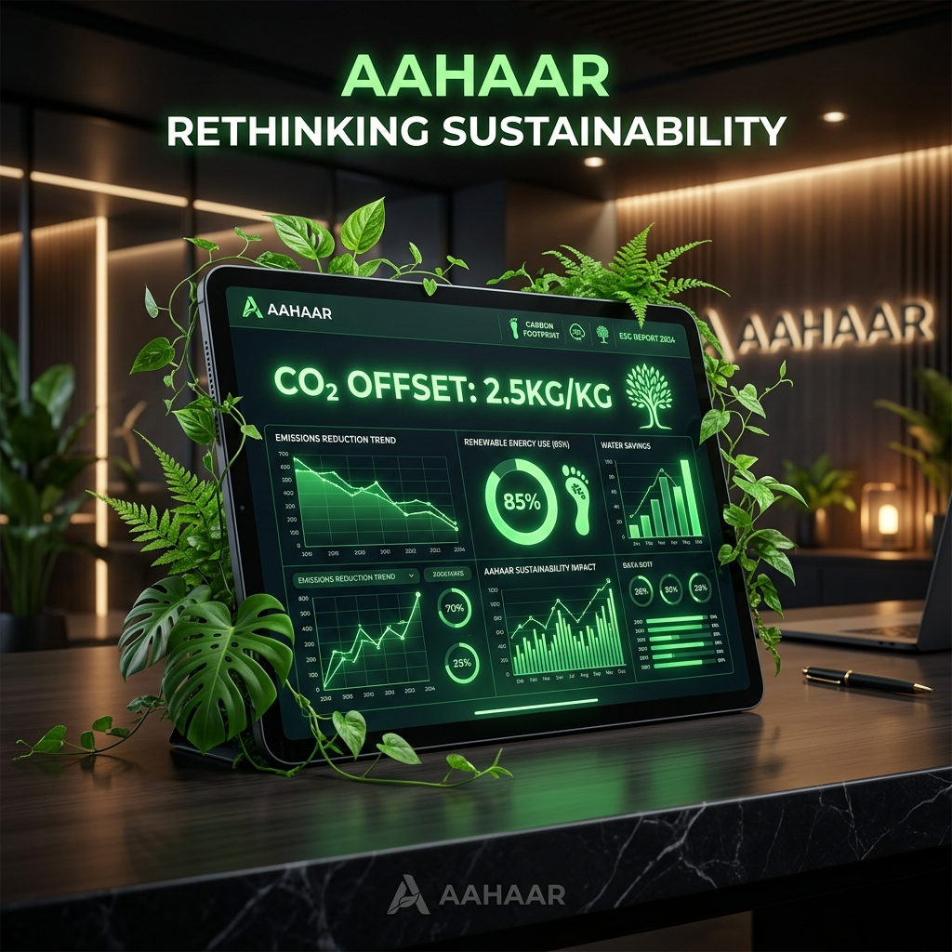
SECTION 03: COMPLIANCE AUTOMATION
AAHAAR ENTERPRISE SYSTEM
Real-Time Environmental & Carbon Offsets
ESG Footprint Tracking
• Diverting organic waste from landfills avoids anaerobic methane emissions.
• Applies scientific offset models: 2.5 kg CO₂ reduction per kg of surplus food rescued.
• Translates carbon numbers into mature tree equivalents (22 kg CO₂/tree/year).
• Prepares clean, board-ready sustainability metrics for annual CSR reports.

Slide 7
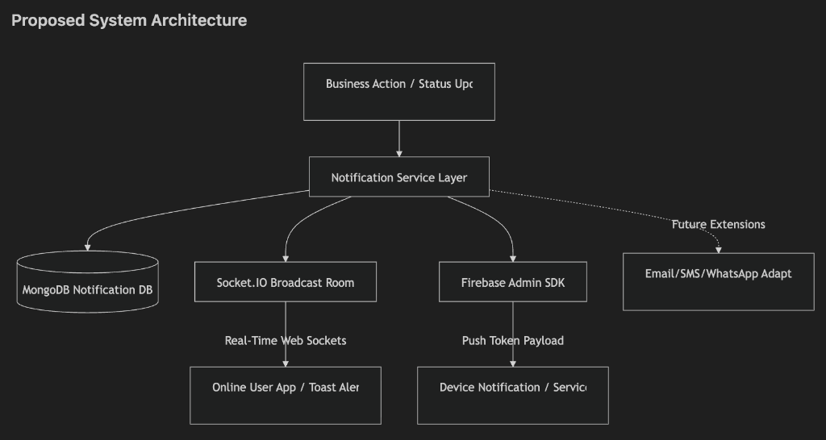
SECTION 04: TECHNICAL ARCHITECTURE
AAHAAR ENTERPRISE SYSTEM
Proposed System Architecture & Sync
Notification & Event Listeners
• Socket.IO connection feeds real-time updates directly to admin and user dashboards.
• Firebase Cloud Messaging (FCM) drives offline alerts to browser tabs.
• Twilio SMS gateway sends immediate OTP codes to logistics drivers.
• Node.js background event listener synchronizes EVM smart contract logs to MongoDB.

Slide 8
AAHAAR: DIGITIZING TRUST, FEEDING LIVES
Together, We Can Eliminate Food Waste, Empower Communities, and Build a Sustainable Future.
AAHAAR — Feeding People. Empowering NGOs. Transforming CSR. Protecting the Planet.
Enterprise Utility: Complete SaaS solution addressing corporate CSR and green ESG targets.
Operational Codebase: Deployed system integrating Express APIs, Socket.IO, and Solidity contracts.
Call to Action: Inviting foundations (like Reliance Foundation) and enterprise leaders to partner.
ABES Engineering College • Investor Pitch • Contact: santosh.patel@abes.ac.in

