Slide 1




Kalaakriti
BUY , SELL & LEARN the Art of the Orient

Slide 2
Features of Kalaakriti
Forget the hassle of registrations and start earning right away.
Direct and trustred transanctions. no more middlemen, just you and your talent.
Access to the India's rarest artforms and recipies as old as time.
Unlock the skills passed down from generations and also get access to trending viral performances.
Currency no bar.
No more exchange rates or taxes.

Slide 3


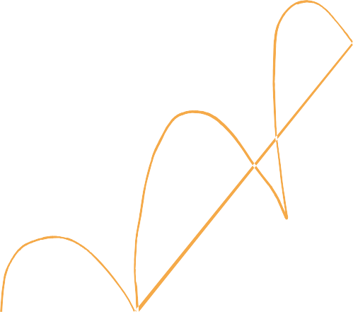
Workflow...
Put up the item for sale
Transfer of ownership to the marketplace
On purchase, price transfered from buyer to
seller
Video Content is transfered from
marketplace to buyer.

Slide 4

The Marketplace Logic...
The marketplace logic will consist of two smart contracts:
NFT Contract
Marketplace Contract
Recurring Revenue & Listing Fee

Slide 5

The Marketplace Logic...
When a user puts an item for sale, the ownership of the item will be transferred from the creator to the marketplace.
When a user purchases an item, the purchase price will be transferred from the buyer to the seller and the item will be transferred from the marketplace to the buyer.
The marketplace logic will consist of two smart contracts:
NFT Contract - ERC721 Standard.allows users to mint unique digital assets and have ownership of them.
Marketplace Contract - This contract allows users to put their digital assets for sale on an open
market.
The marketplace owner will be able to set a listing fee. This fee will be taken from the seller and transferred to the contract owner upon completion of any sale, enabling the owner of the marketplace to earn recurring revenue from any sale transacted in the marketplace.

