Slide 1
ValiJSON

Slide 2
TEAM MEMBERS
Bhanuj Gandhi (2022201068)
Harsimran Singh ( 2022201049)
Yash Maheshwari (2022201074)
Tarun Kumar (2022201008)

Slide 3
ABOUT
This JSON VALIDATOR is created to help with debugging the syntax and grammar in the form of JSON. As JSON data is often output without line breaks to save space, it can be extremely difficult to actually read and make sense of it.
It asks for the JSON data, verifies it and identify where the error is. This will help to identify and remove that error and can also be used in debugging.

Slide 4
TECH STACK
REACT JS
NODE JS
MONGODB
EXPRESS JS

Slide 5
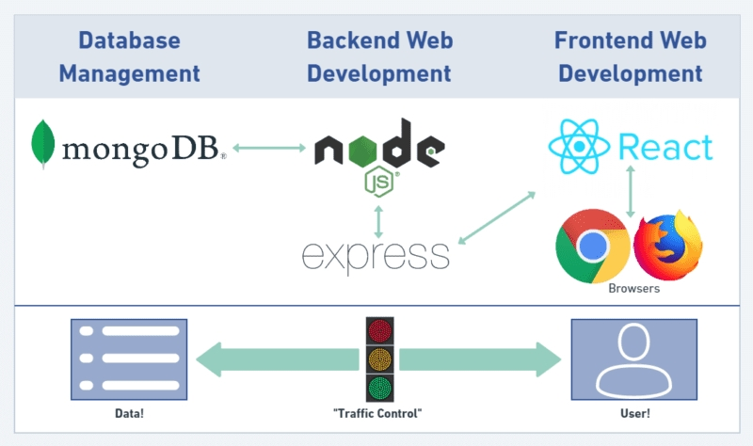
MERN STACK BASIC WORKING

Slide 6
IMPLEMENTATION
REACT JS:
React makes it painless to create interactive UIs.
It builds encapsulated components that manage their own state, then compose them to make complex UIs.
NODE JS:
As an asynchronous event-driven JavaScript runtime, Node.js is designed to build scalable network applications.Many connections can be handled concurrently.
EXPRESS JS:
Sits on top of NODE JS to make the routing, request handling, and responding easier to write.
MONGODB:
It is used for database because it is highly efficient and scalable

Slide 7
MOTIVATION
Software practitioners use a variety of Requirement engineering approaches to produce a well-defined product. These methods impact the software product’s ultimate traits and target a particular audience segment. Virtual Reality (VR) products are no different from such an influence. With the notable rise in product offerings across various fields, VR has become an essential technology for the future. Thus, we introduce a tool called VReqST - a requirement specification tool for VR system development. Requirement Specification of VR systems can be performed 5 steps:
a. Specifying VR Scene layout Properties
b. Specifying Object Properties that are used in VR scene
c. Action-Responses allowed between Objects in the given Scene
d. Custom Scripts to document custom tasks-responses, defining algorithms etc.
e. Specifying a timeline of events of all objects in the specified scene.

Slide 8
SYSTEM DESIGN
We are authenticating using JWT tokens.
We have made dashboard module which shows recent activities of the user and projects
User can also add file modules which gives user, the capability to add grammar file which can be used for validation in projects in the future.
Our project Module is a three phase module which includes Scene, Action and Asset. User can validate this file. Upon successful validation files are stored in the database and user can edit these files too.
Download file module is another module which lets user download separate file i.e., available for download after successful validation or all the files as a zip once project is done.

Slide 9
SYSTEM DESIGN
LOGIN MANAGEMENT:
To gain access to this tool, the user should register by accessing a registration page.
Registration data is stored in a Mongo database in the collection named person and user login.
These two collections are maintained separarely as userlogin will be busy with authentication API and person table will be busy with session and UI login management.

Slide 10
SYSTEM DESIGN
USER MANAGEMENT
There are two types of users based on their grant types and access capacity:
Requirement Specification User - This user can create multiple requirement specification projects and manage them at every specification step.
Super User- Who can view all Specification projects created by the other requirement specification users using emulation option.There is a read only mode and read-write mode for emulation option,

Slide 11
SYSTEM DESIGN
DASHBOARD MANAGEMENT
It shows activities of the user and projects. By default it shows name of the user and recent 3 projects.
It will also show the recent files on which we were woking upon.

Slide 12
SYSTEM DESIGN
SPECIFICATION MANAGEMENT
Requirement specification has 3 steps:
Scene Definition- A bare minimum Scene definition and all underlying properties of a Scene Class are made available in a JSON file format.A user should be able to fill in the values in this JSON file.This JSON file will be validated against a predefined JSON scene validator and allows user to move to next step.
Asset Definition- A bare minimum Asset definition and all the underlying properties of Asset class are made available in a JSON file format.The user should be able to fill the values in JSON file. The JSON file will be validated against a predefined JSON asset validator and allows user to move to next step.
Action-Response Definitions - This step allows users to provide an action-response relationship between the assets described in step2 in a JSON file format. This section provides clarity on possible interactions between assets with one-on-one and one-on-many in the scene described as per Step 1.

Slide 13
AUTHENTICATION
We are doing authentication by using JWT Tokens.
JSON Web Token is an open standard for securely transferring data within parties using a JSON object.
JWT is used for stateless authentication mechanisms for users and providers, this means maintaining session is on the client-side instead of storing sessions on the server.
Here, we have implemented the JWT authentication system in NodeJs.

Slide 14
FUTURE SCOPE
This project is helping us to validate the grammar of JSON as of now.
Going forward by making some tweaks in the logic this also can be used to validate more complex logics.
Moreover, it is grammar dependent so keeping the underlying architecture same we can simply make it to validate other languages' grammars.
It can also be extended to verify the syntaxes of any programming languages like C, C++ etc.

Slide 15
REFERENCES
https://reactjs.org/
https://nodejs.org/en/
https://www.mongodb.com/
https://www.npmjs.com/
https://www.json.org/
https://www.figma.com/proto/aNDqtWSaYI54PmGxySTpdB/VReqST?node-id=4%3A2&scaling=contain&page-id=0%3A1
https://expressjs.com/

Slide 16
THANK YOU

