Slide 1
In-swarm: utilization of 6G in-X subnetworks for controlling a swarm of drones
Santeri Kokkonen, Ugrasen Singh, and Olav Tirkkonen
Department of Information and Communications Engineering
School of Electrical Engineering
Aalto University
Notes:
Set up correct comment size according to this text

Slide 2
Project
Research tactical communication applications of in-X subnetworks
The research was completed during the summer of 2024
Literature review of publicly available research on in-X subnetworks and tactical communication
The scope of tactical communication was broadened beyond the typical command communications
One significant use case identified: in-swarm (swarm of UAVs)
Similarities with tactical bubbles presented in [1].
Further modifications/development of in-X subnetworks needed
[1]. M. Heikkilä, P. Koskela, J. Suomalainen, K. Lähetkangas, T. Kippola, P. Eteläaho, J. Erkkilä, and A. Pouttu, “Field trial with tactical bubbles for mission critical communications,” Transactions on Emerging Telecommunications Technologies, vol. 33, no. 1, p. e4385, 2022.

Slide 3
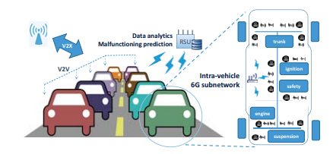
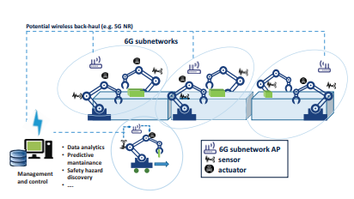
6G In-X Subnetworks
Short-range low power wireless subnetworks, where X = vehicle/body etc.
Projected key technology in 6G
Provide wired-level performance in short range subnetworks
Wireless deployment of In-X subnetworks avoid drawbacks of setting up wiring:
high cost, limited deployment flexibility, weight, maintenance
Notes:
Listed as one of six key technologies brought forward in 6G (extreme connectivity)
Extreme communication
Performance: latency 100 microseconds, nine nines reliability, throughput upto tens of Gbps
Range upto 10m
Coined about 2021
Source: Extreme Communication in 6G: Vision and Challenges for ‘in-X’ Subnetworks

Slide 4
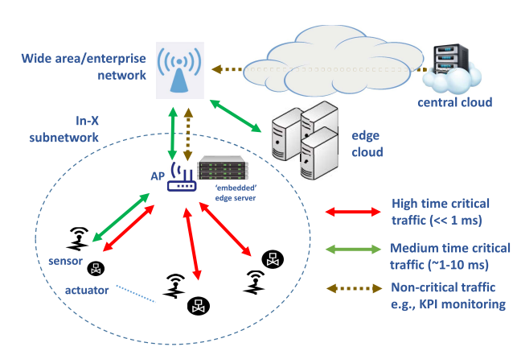
Characteristics of In-X Subnetworks
Support extreme communication requirements:
data rate, reliability and/or latency
Low transmit power in both uplink and downlink transmission
Star and Tree topology
Lack of mobility across subnetwork
Low delay spread
Handle the data flow with different characteristics
Fig. Data traffic flow in and out in X-subnetwork [2]
[2] Berardinelli et al. “Extreme communication in 6G: Vision and challenges for in X-Subnetwork’’
IEEE Open J. Comm. Society, 2021
Notes:
The in-X subnetwork aims to achieveperformance metrics not yet achievable by current technologiessuch as 5G, LTE, or Bluetooth.
For reference 5G urllc: 1-10^5 reliability, latency 1ms, Wireless Access in Ultra-Reliable Low-Latency Communication (URLLC),
Sensors and actuators communicate with eachother through the AP, multiple ap can be installed
The networks are static, meaning that the connected devices are connected to a single AP. Though, the networks themselves can be mobile.
Hybrid interference management: centralized when in coverage, distributed while out of coverage.
AI elements for interference management are considered
IM: Jamming: pilot/data transmission and pseudorandom blanking of frequency resources detection, conservative link adaption, frequency hopping, transmit pattern scrambling mitigation, communication requirement relaxation

Slide 5
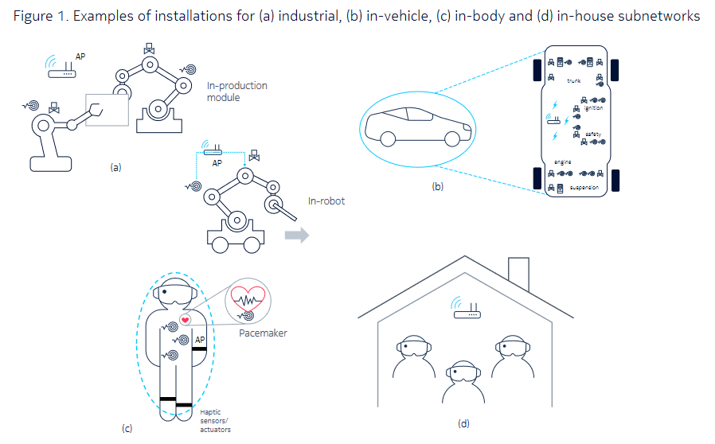
Proposed use cases of 6G in-X subnetworks
In-robot, in production module
Different controls: motion, torque, force, position
In-vehicle
Controls: Engine, steering, brakes
In-body
Heartbeat control, monitoring, insulin pumping
In-house
Entertainment, training, healthcare
Fig. Proposed use cases [2]
Notes:
Different performance needs → different types of subnetworks (configurable)
Healthcare: robotic-aided surgery (telesurgery)
Common theme: wireless solutions for life-critical applications
Some use cases such as in-body are power consumption critical

Slide 6
Challenges of in-X subnetworks for tactical communication
Unsignificant civil use cases
Unrelated benefits
Cable weight reduction unimportant in armoured equipment
Limited range of max. 10m
Restricts many applications
Limited topology options
Star/Tree topology → single point of failure

Slide 7
UAV swarms
UAVs are a major part of modern warfare
Collection of UAVs can achieve tasks that are impossible for single UAV
Only one operator is needed
Identified tactical use cases:
Intelligence, the swarm can sweep and map areas faster than an individual one [3].
Assault, the swarm can perform effective coordinated attacks
Communication, the swarm can be used to quickly establish ad hoc communication links between areas
Electronic warfare, with EW equipment the swarm can gather signal intelligence or jamming/anti-jamming [4].
[3]. Abdelkader, M., Güler, S., Jaleel, H., & Shamma, J. S. (2021). Aerial swarms: Recent applications and challenges. Current robotics reports, 2, 309-320.
[4]. Saab, “Sirius Compact” saab.com. https://www.saab.com/products/sirius-compact (accessed Aug. 9, 2024)
Notes:
Communication: communication links can be built between non-line-of-sight areas/groups, where a fiber/wired connection can not be built

Slide 8
In-swarm: utilization of 6G in-X subnetworks for controlling a swarm of drones
One UAV (AP) is possibly connected to the ground control system, the designated UAV controls the rest of the UAVs (sensors/actuators)
Different UAVs have different tasks in the swarm:
Supporting (signal relay, controller)
Operational (intelligence, assault, electronic warfare unit)
Projected advantages:
Control of swarm could be done through 6G mobile network
Built-in resistance to jamming and interference → allows for dense deployments
Support for different extreme communication requirements (latency, reliability, throughput) depending on the use case / needs
Notes:
Hybrid interference management: centralized when in coverage, distributed while out of coverage.
AI elements for interference management are considered
IM: Jamming: pilot/data transmission and pseudorandom blanking of frequency resources detection, conservative link adaption, frequency hopping, transmit pattern scrambling mitigation, communication requirement relaxation

Slide 9
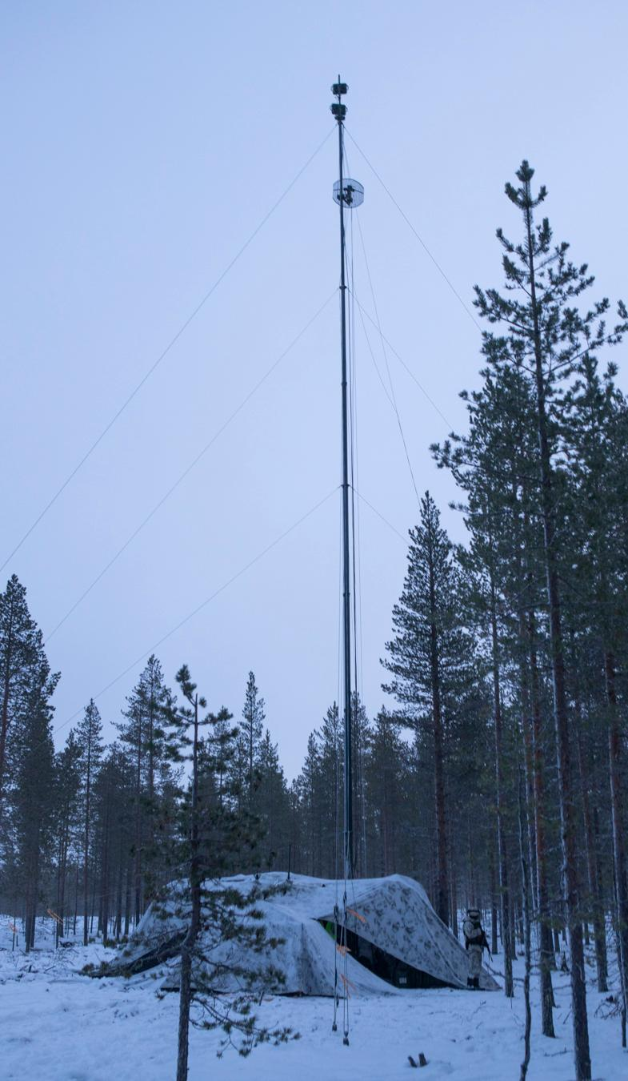
Highlight: Tactical communication links
Wireless communication link masts:
- Time cost to establish / take down
- Big targets for intelligence/artillery
- Line-of-sight dependency
+ Fast and reliable over a long distance with directed transmission
+ Over the air
Fiber/wired connection
- Time cost to establish / take down
- A physical wire must be laid, often requiring human involvement
- If found, can be tapped / destroyed easily
+ Covert
+ Impossible to jam
+ Non-line-of-sight
+ Fast and reliable connection
Fig. Wireless communication link mast [5]
[5]. Armén, “Viesti on taistelun selkäranka – "Ilman eivät tulikomennot pääsisi perille”” intti.fi
https://intti.fi/sv/-/1950813/viesti-on-taistelun-selkaranka-ilman-eivat-tulikomennot-paasisi-perille (accessed Aug. 8, 2024).
Notes:
Mast elements can be hard to establish in some environments
Establishing/operating/guarding the mast needs a lot of personnel
Human involvement: hard to cross minefields/barbed wire, other physical objects and features cliffs/lakes/roads

Slide 10
In-swarm communication link: using the swarm of UAVs to construct a communication channel
Support of many topologies: line, tree etc.
Fast and autonomous establishment
Low profile with self-camouflage
Non-line-of-sight connections
Responsive if found
Could be used in conjunction with masts or wired connections
Notes:
Individual UAVs stationed on trees/buildings/other
If the subnetwork detects that it has been found (motion sensors/one UAV gets destroyed), the subnetwork can disengage/repair the connection autonomously
In-swarm communications could be used to patch non-line-of-sight situations with masts, or help wired connections to traverse over contested areas/lakes/minefields

Slide 11
Challenges of in-swarm communication links
Operation time
Maintenance of the UAVs
Range
Latency
Reliability
Navigation of UAVs in GPS compromised situations
Notes:
How much power does the UAV use for flight, communication, possible disengagement
The UAVs constantly have to be charged → flying in-and-out of the line → breaks in service
Larger distance → more energy used for flight
As the number of hops grow, the latency and reliability worsens

Slide 12
Modification of in-X subnetworks for in-swarm applications
> 10 m range
For communication links range should be at least 100-200m
Topological flexibility
Multiple controllers → no single point of failure
Line topology for communication links
Directed transmission in UAV-to-UAV communication
Reduced signal emission → more covert
Reduced intra-cell interference → more communication channels
Harder to jam
Notes:
For intelligence/EW applications range should be ~100m
Support for multiple controller drones, signal relays
Beamforming to reduce emitting information to the environment. Also reduces the interference spatially → more channels

Slide 13
Further research
Power consumption of the UAV:
Flight
Operation equipment (cameras, object mapping/tracking)
Communication equipment
Non-GPS localization
Relative localization techniques based on signal fingerprints
Swarm navigation with computer vision
Reaction and recovery of losing controller drone
Benefits over existing technologies 5G Sidelink, Wi-Fi, Bluetooth

Slide 14

Thank you
Questions, comments?

