Slide 1


Team Details
Team name: Vaultkeepers
Team leader name: Santosh Ramesh
Problem Statement: BFSI: Intelligent Risk, Fraud & Financial Experiences
Solution: Financial Friday
Notes:
Financial Friday v0.39.0. Source: https://github.com/Santxsh27/financial-friday/blob/main/README.md ; release evidence: https://github.com/Santxsh27/financial-friday/blob/main/docs/CURRENT_RELEASE.json ; https://github.com/Santxsh27/financial-friday/blob/main/docs/FINAL_POLISH_0390.md . Evidence checked 18 October 2026. All displayed financial examples are artificial. No bank integration or guaranteed financial outcome.
Registered team name must match the final Hack2skill roster. Project title and team name are separate.

Slide 2

Note: Please download this template to make your edits and submit the final version.
To download, go to File > Download > Microsoft PowerPoint (.PPTX). Kindly refrain from sending edit requests.
Notes:
Financial Friday v0.39.0. Source: https://github.com/Santxsh27/financial-friday/blob/main/README.md ; release evidence: https://github.com/Santxsh27/financial-friday/blob/main/docs/CURRENT_RELEASE.json ; https://github.com/Santxsh27/financial-friday/blob/main/docs/FINAL_POLISH_0390.md . Evidence checked 18 October 2026. All displayed financial examples are artificial. No bank integration or guaranteed financial outcome.
Official template instruction retained. The organiser master remains unchanged.

Slide 3

Brief about the idea
Financial Friday
A financial buddy that turns statement history into a plan you can follow.
People can see past transactions, yet still struggle to decide what they can afford next. Friday connects reviewed history to a conversation about their next goal.
Reviewed history and a confirmed budget support a visual roadmap with clear assumptions.
India-first financial assistance. No bank credentials or payment authority.
03
Notes:
Financial Friday v0.39.0. Source: https://github.com/Santxsh27/financial-friday/blob/main/README.md ; release evidence: https://github.com/Santxsh27/financial-friday/blob/main/docs/CURRENT_RELEASE.json ; https://github.com/Santxsh27/financial-friday/blob/main/docs/FINAL_POLISH_0390.md . Evidence checked 18 October 2026. All displayed financial examples are artificial. No bank integration or guaranteed financial outcome.

Slide 4
Opportunities
How different is it from existing ideas?
Friday joins reviewed statement explanations and conversational goal planning in one private workspace. Exact code checks each visual cash plan before the user saves it.
How will it solve the problem?
A supported import organises transaction history. The user confirms budget facts in chat, then Friday tests the goal and its alternatives against that same budget.
USP of the proposed solution
Gemini handles language and documents. An independent INR calculation engine preserves the reserve, debt commitments and every monthly rupee. Users can inspect the assumptions.
Combination and execution are the differentiation. No world-first or patent claim.
04
Notes:
Financial Friday v0.39.0. Source: https://github.com/Santxsh27/financial-friday/blob/main/README.md ; release evidence: https://github.com/Santxsh27/financial-friday/blob/main/docs/CURRENT_RELEASE.json ; https://github.com/Santxsh27/financial-friday/blob/main/docs/FINAL_POLISH_0390.md . Evidence checked 18 October 2026. All displayed financial examples are artificial. No bank integration or guaranteed financial outcome.

Slide 5
List of features offered by the solution
Supported PDF/CSV statements with preview, source checks and reviewed categories.
Spending charts, transaction references and candidates for the user to review.
Chat-led purchase, savings and emergency-reserve goals with missing-fact questions.
Exact allocations, dated checkpoints, pressure scenarios and feasible alternatives.
Private saved roadmap, self-reported savings updates and Undo.
Optional Google voice turns and attributed public research, with explicit controls.
Current consumer journey: statements, money overview, goals and Ask Friday.
05
Notes:
Financial Friday v0.39.0. Source: https://github.com/Santxsh27/financial-friday/blob/main/README.md ; release evidence: https://github.com/Santxsh27/financial-friday/blob/main/docs/CURRENT_RELEASE.json ; https://github.com/Santxsh27/financial-friday/blob/main/docs/FINAL_POLISH_0390.md . Evidence checked 18 October 2026. All displayed financial examples are artificial. No bank integration or guaranteed financial outcome.

Slide 6
Process flow diagram or Use-case diagram
1. Add a supported
PDF or CSV statement
2. Review extracted rows
or confirm missing facts
3. Save reviewed history
with explicit consent
6. Save one roadmap
and report real savings
5. Inspect charts, dates
and pressure scenarios
4. Ask Friday for help
using permitted context
AI interprets the request. Exact code checks the result. A failed source check or missing fact returns to review.
A user can plan a goal without importing a statement. No money moves.
06
Notes:
Financial Friday v0.39.0. Source: https://github.com/Santxsh27/financial-friday/blob/main/README.md ; release evidence: https://github.com/Santxsh27/financial-friday/blob/main/docs/CURRENT_RELEASE.json ; https://github.com/Santxsh27/financial-friday/blob/main/docs/FINAL_POLISH_0390.md . Evidence checked 18 October 2026. All displayed financial examples are artificial. No bank integration or guaranteed financial outcome.

Slide 7
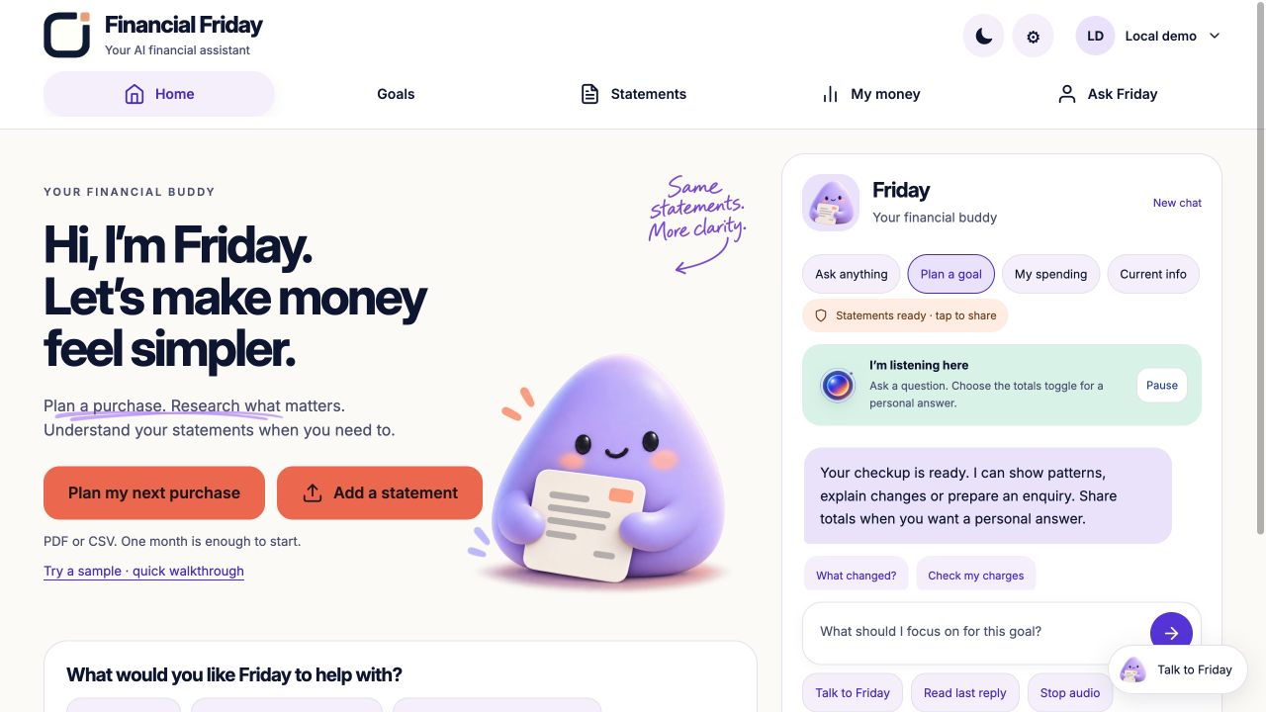
Wireframes/Mock diagrams of the proposed solution (optional)
Implemented UI
Clear starting actions
Persistent Friday chat
Visible voice controls
Account and privacy menu
Actual local product screen. Artificial workspace only.
07
Notes:
Financial Friday v0.39.0. Source: https://github.com/Santxsh27/financial-friday/blob/main/README.md ; release evidence: https://github.com/Santxsh27/financial-friday/blob/main/docs/CURRENT_RELEASE.json ; https://github.com/Santxsh27/financial-friday/blob/main/docs/FINAL_POLISH_0390.md . Evidence checked 18 October 2026. All displayed financial examples are artificial. No bank integration or guaranteed financial outcome.
Screenshot: docs/images and local 0.39.0 demonstration, artificial data. This is an implemented screen, not a proposed mockup.

Slide 8
Architecture diagram of the proposed solution
Browser
Charts, chat and voice
Google IAP sign-in
Cloud Run web gateway
Private Cloud Run API
FastAPI / Pydantic
Firestore
Private workspace
Gemini on Vertex AI
Interpretation, chat, voice
Google Search grounding
Checks within the private API
Evidence, INR, consent, revisions
Visual preview before save
Document AI
Supported scanned PDFs
Reviewed history and goals persist per user. Private totals reach Gemini only when the user permits them.
Public research excludes private statement data. Raw uploads are not archived.
08
Notes:
Financial Friday v0.39.0. Source: https://github.com/Santxsh27/financial-friday/blob/main/README.md ; release evidence: https://github.com/Santxsh27/financial-friday/blob/main/docs/CURRENT_RELEASE.json ; https://github.com/Santxsh27/financial-friday/blob/main/docs/FINAL_POLISH_0390.md . Evidence checked 18 October 2026. All displayed financial examples are artificial. No bank integration or guaranteed financial outcome.
Architecture: https://github.com/Santxsh27/financial-friday/blob/main/ARCHITECTURE_GUIDE.md . Cloud Tasks is a separate legacy journal-only recovery path, outside this consumer diagram. Firebase is not used.

Slide 9
Technologies to be used in the solution
Technology | Implemented purpose
Cloud Run | Web gateway and private Python API, deployed in asia-south1.
Gemini on Vertex AI | PDF interpretation, structured goal intake, grounded chat and voice.
Firestore | Tenant-scoped reviewed rows, preferences, roadmap state and revisions.
Document AI | OCR path for supported scanned statement PDFs.
IAM / IAP / Secret Manager | Google identity, service boundaries and server-side configuration.
Cloud Build / Artifact Registry | Container builds and immutable deployment images.
HTML / CSS / JS / Python | Responsive UI, FastAPI, Pydantic, local Docker and SQLite.
Gemini models power the AI. Firebase Hosting/Auth, BigQuery and model fine-tuning are not used.
09
Notes:
Financial Friday v0.39.0. Source: https://github.com/Santxsh27/financial-friday/blob/main/README.md ; release evidence: https://github.com/Santxsh27/financial-friday/blob/main/docs/CURRENT_RELEASE.json ; https://github.com/Santxsh27/financial-friday/blob/main/docs/FINAL_POLISH_0390.md . Evidence checked 18 October 2026. All displayed financial examples are artificial. No bank integration or guaranteed financial outcome.
Configured runtime: gemini-3.5-flash-lite, Gemini TTS gemini-2.5-flash-tts. Model availability and trial quota remain operational dependencies.

Slide 10
Estimated implementation cost (optional)
Usage-based prototype on a Google Cloud trial
Cost driver | Current control
PDF, chat, research and voice calls | Explicit opt-in, request limits and bounded context.
Known-format CSV analysis | Deterministic parsing and calculations need zero model calls.
Cloud Run and Firestore operations | Serverless services and bounded workspace sizes.
Repeated speech playback | Page-memory replay avoids another model call when cached.
A production per-user estimate still needs measured traffic, tokens, document pages and retention. Trial credits do not make the service permanently free.
Production pricing depends on measured usage and the selected provider services.
10
Notes:
Financial Friday v0.39.0. Source: https://github.com/Santxsh27/financial-friday/blob/main/README.md ; release evidence: https://github.com/Santxsh27/financial-friday/blob/main/docs/CURRENT_RELEASE.json ; https://github.com/Santxsh27/financial-friday/blob/main/docs/FINAL_POLISH_0390.md . Evidence checked 18 October 2026. All displayed financial examples are artificial. No bank integration or guaranteed financial outcome.
This optional cost section gives the cost model and implemented controls, not a provider quote. Current provider pricing must be checked before a production budget. No billing data or private credit balance is disclosed.

Slide 11
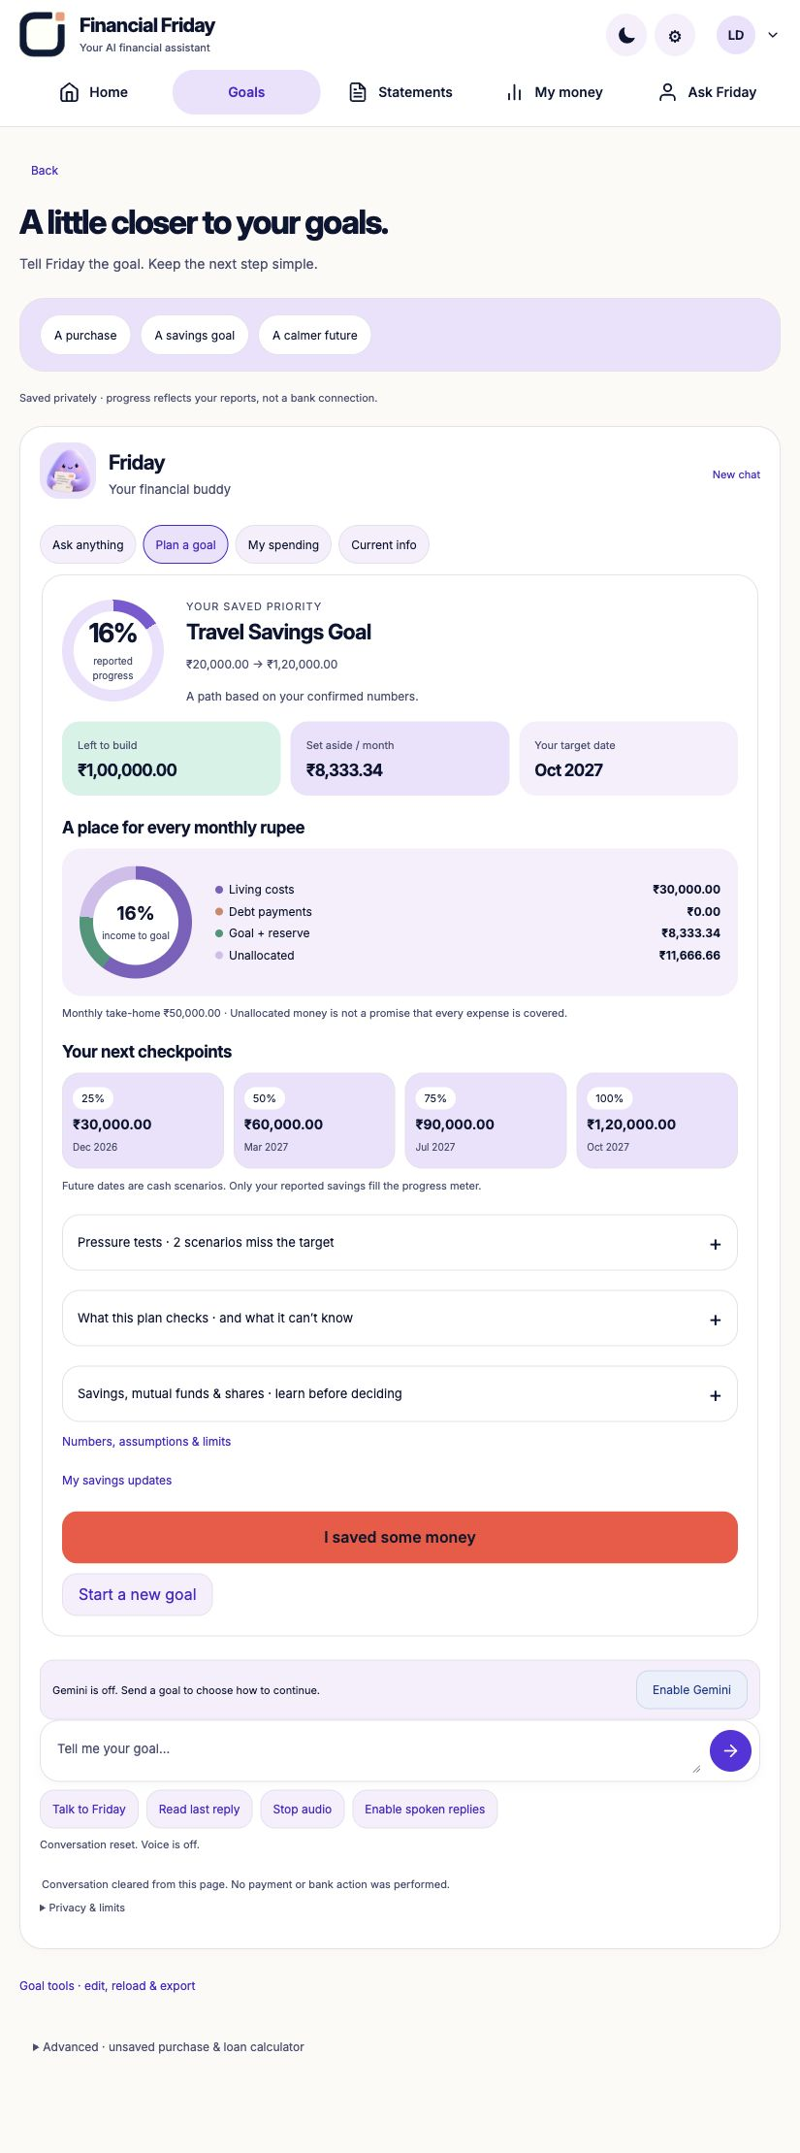
Snapshots of the prototype
A plan the user can inspect
Artificial travel goal | INR
Target in 12 months | 1,20,000
Starting pot after reserve | 20,000
Monthly saving step | 8,333.34
Protected cash reserve | 50,000
Friday also shows pressure cases and budget alternatives. Progress changes only when the user reports additional savings.
Actual product output. Scenario values are not forecasts or verified bank balances.
11
Notes:
Financial Friday v0.39.0. Source: https://github.com/Santxsh27/financial-friday/blob/main/README.md ; release evidence: https://github.com/Santxsh27/financial-friday/blob/main/docs/CURRENT_RELEASE.json ; https://github.com/Santxsh27/financial-friday/blob/main/docs/FINAL_POLISH_0390.md . Evidence checked 18 October 2026. All displayed financial examples are artificial. No bank integration or guaranteed financial outcome.
Example inputs: monthly income INR50000, living costs excluding debt INR30000, debt INR0, liquid savings INR70000, protected reserve INR50000. Goal INR120000 in12months. Integer paise arithmetic rounds the monthly step upward. Sources: judge-kit/README.md and docs/FINAL_POLISH_0390.md.

Slide 12
Prototype Performance report/Benchmarking
Evaluation scope | Recorded result
Native regression suite | 868 run: 867 passed, 1 optional integration skipped.
Container regression suite | 868 run: 818 passed, 50 environment-dependent skips.
Offline cloud tooling checks | 68 passed.
Isolated real-Google acceptance | 8 calls across voice, Search and goal persistence flows.
Authored 39-case review benchmark | 66.67% precision, 73.68% recall, 38.89% case-level FPR.
Software tests establish tested behaviour, not financial efficacy. The synthetic review benchmark still has misses and false warnings. Independent real-bank validation remains open.
Sources: CURRENT_RELEASE.json, FINAL_POLISH_0390.md and VALIDATION_HANDOFF.md in the public repository.
12
Notes:
Financial Friday v0.39.0. Source: https://github.com/Santxsh27/financial-friday/blob/main/README.md ; release evidence: https://github.com/Santxsh27/financial-friday/blob/main/docs/CURRENT_RELEASE.json ; https://github.com/Santxsh27/financial-friday/blob/main/docs/FINAL_POLISH_0390.md . Evidence checked 18 October 2026. All displayed financial examples are artificial. No bank integration or guaranteed financial outcome.
Counts are v0.39.0 release evidence. The 39-case dataset is authored synthetic review-candidate ground truth, not independently validated fraud labels. FPR is case-level. Eight isolated acceptance calls are additional to a canonical general-question and TTS browser check. Do not infer product accuracy from test counts.

Slide 13
Additional Details/Future Development (if any)
Next validation priorities
Current boundaries
Independent, authorised bank-layout and explanation evaluation.
Measure task completion, incorrect guidance and warning fatigue.
Test multilingual use, accessibility and account-policy variations.
Assess consented bank integrations only through authorised partners.
Supported INR PDF/CSV limits apply. Unknown evidence stays unknown.
No bank feeds, live balances, payment execution or automatic money recovery.
Education and cash planning exclude personalised securities trades.
Savings progress is self-reported. No guaranteed returns or outcomes.
Goal: a measured consumer pilot before claims of broad banking readiness.
13
Notes:
Financial Friday v0.39.0. Source: https://github.com/Santxsh27/financial-friday/blob/main/README.md ; release evidence: https://github.com/Santxsh27/financial-friday/blob/main/docs/CURRENT_RELEASE.json ; https://github.com/Santxsh27/financial-friday/blob/main/docs/FINAL_POLISH_0390.md . Evidence checked 18 October 2026. All displayed financial examples are artificial. No bank integration or guaranteed financial outcome.

Slide 14
Provide links to your:
GitHub Public Repository
https://github.com/Santxsh27/financial-friday
Final Product Link
https://financial-friday-web-171681243260.asia-south1.run.app/#home
Demo Video Link (3–4 minutes)
Video link will be supplied separately in the submission form after recording.
Walkthrough and artificial statement downloads
https://financial-friday-web-171681243260.asia-south1.run.app/assets/friday-judge-guide.html
Product requires Google sign-in. Source and judge samples are public.
14
Notes:
Financial Friday v0.39.0. Source: https://github.com/Santxsh27/financial-friday/blob/main/README.md ; release evidence: https://github.com/Santxsh27/financial-friday/blob/main/docs/CURRENT_RELEASE.json ; https://github.com/Santxsh27/financial-friday/blob/main/docs/FINAL_POLISH_0390.md . Evidence checked 18 October 2026. All displayed financial examples are artificial. No bank integration or guaranteed financial outcome.
The participant is creating the video separately. The dashboard supplied on18October requires3–4minutes and takes precedence over the older3-minute template label. Add the final public videoURL here before the final submission if available. Official requirements: https://aibuildercup.com/themes.html .

Slide 15
Judge quick start
Five-minute walkthrough with artificial data
Open the product and sign in with a Google account. Check My account.
Use Try a sample, then add one six-month artificial CSV and review the rows.
Compare 42 entries, INR3,00,000 in and INR1,64,694 out before saving.
Ask Friday about spending, or describe a goal and continue with Gemini.
Review the visual roadmap. Confirm saving only if you want to keep it.
The judge kit contains five header families for the same invented activity. Test one at a time. Bank labels describe illustrative layouts, not certified exports.
Never upload real private banking records for a public demonstration.
15
Notes:
Financial Friday v0.39.0. Source: https://github.com/Santxsh27/financial-friday/blob/main/README.md ; release evidence: https://github.com/Santxsh27/financial-friday/blob/main/docs/CURRENT_RELEASE.json ; https://github.com/Santxsh27/financial-friday/blob/main/docs/FINAL_POLISH_0390.md . Evidence checked 18 October 2026. All displayed financial examples are artificial. No bank integration or guaranteed financial outcome.
Judge guide https://financial-friday-web-171681243260.asia-south1.run.app/assets/friday-judge-guide.html . Public samples https://github.com/Santxsh27/financial-friday/tree/main/judge-kit . Sample sha and controls appear in judge-kit/manifest.json.

Slide 16

Notes:
Financial Friday v0.39.0. Source: https://github.com/Santxsh27/financial-friday/blob/main/README.md ; release evidence: https://github.com/Santxsh27/financial-friday/blob/main/docs/CURRENT_RELEASE.json ; https://github.com/Santxsh27/financial-friday/blob/main/docs/FINAL_POLISH_0390.md . Evidence checked 18 October 2026. All displayed financial examples are artificial. No bank integration or guaranteed financial outcome.

