Slide 1
Matrix Factorization & Latent Embeddings via SVD for Recommendation
CS 550: Massive Data Mining — Semester Project
Santhosh Janakiraman (sj1230) · Mohammed Faisal Khan (mk2480)· Jacob Sze (jms1200)
Rutgers University, New Brunswick,NJ
MACHINE LEARNING
RECOMMENDER SYSTEMS
SVD
MOVIELENS 1M

Slide 2

Project Overview
What We Built & How We Evaluated It
Core Objectives
Central Question
Built two recommender systems from scratch using only NumPy/SciPy primitives — no out-of-the-box monolithic recommender libraries.
Can we prove that SVD's latent structure is simultaneously powerful and exploitable?
Dataset: MovieLens 1M — 100,000+ ratings across 610 users and ~9,700 movies.
Beyond accuracy: addressed three Trustworthiness rubric options — Option A (Transparency), Option C (Controllability), and Option E (Robustness) — demonstrated via an interactive Streamlit dashboard.
Evaluation: strict 80/20 per-user holdout split to prevent data leakage — not a random global split.

Slide 3
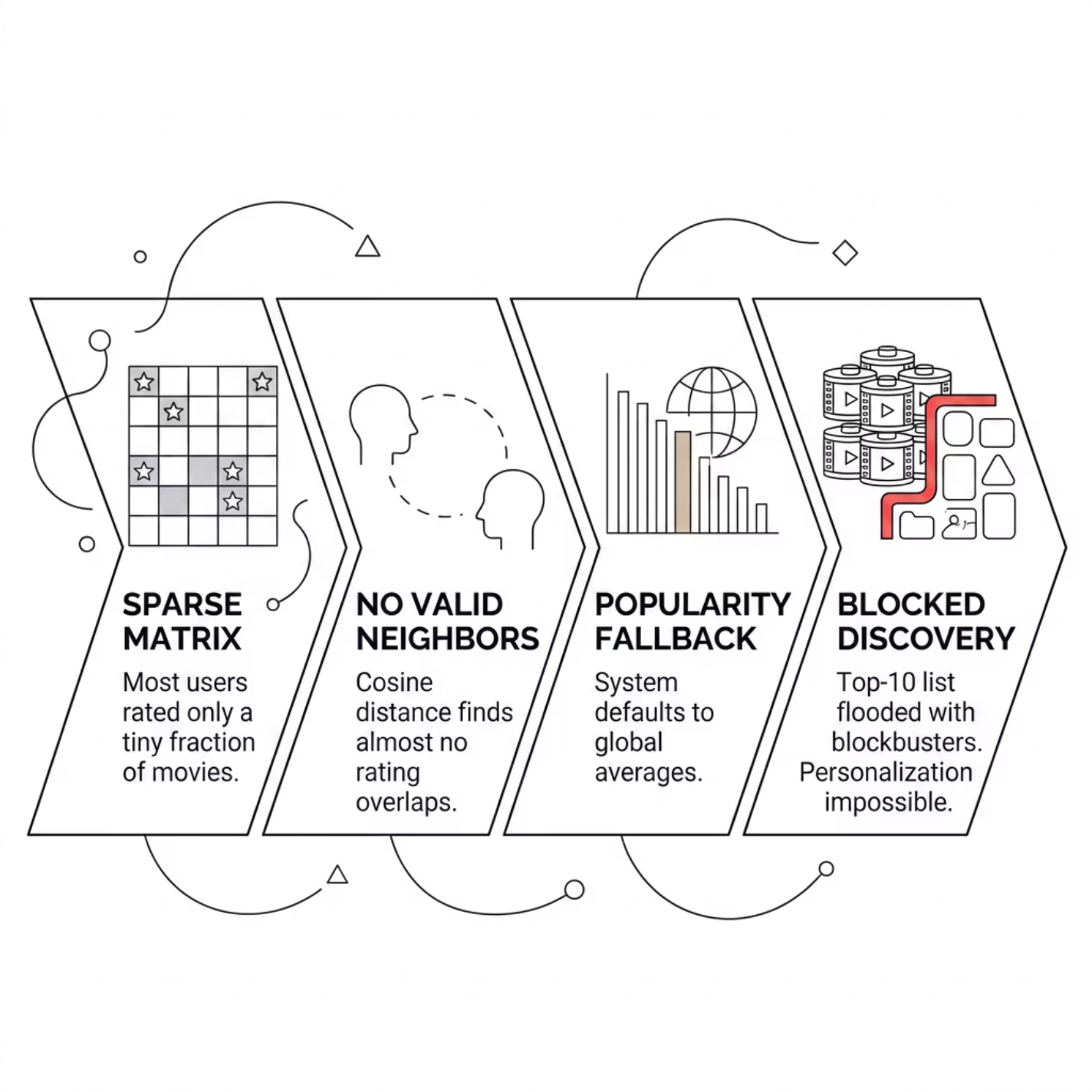


The Problem
Sparsity & Popularity Bias: Why Naive Recommendation Systems Break
The user-item rating matrix is overwhelmingly empty — most users have rated only a tiny fraction of ~9,700 available movies. This creates a cascade of failures that makes personalized discovery nearly impossible.
This is the Cold Start + Popularity Bias trap, and it demands a fundamentally different mathematical approach.

Slide 4

Algorithm 1
Memory-Based Collaborative Filtering — The Baseline
How It Works
MAE Score
NDCG@10
For each unrated movie, compute the Pearson-Cosine similarity between the target user and every user who has rated it. Prediction is a weighted average of neighbor ratings:
0.8173
0.0047
sim(u,v) = (r_u · r_v) / (||r_u|| ||r_v||)
Above the critical single-star variation threshold
Near-total failure on personalized ranking
Conceptually simple and interpretable, but structurally fragile under data sparsity. When no valid neighbors exist, the system has no fallback — it collapses into useless popularity-based averages.

Slide 5
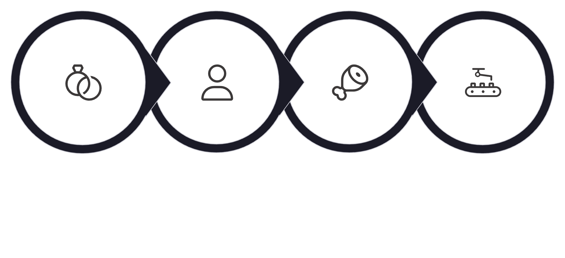

Algorithm 2
Model-Based SVD — Compressing the Matrix into Latent Dimensions
Sparse Input
Decompose k=50
Add Global Mean
Dense Predictions
SVD decomposes the sparse matrix into k = 50 dense orthogonal latent dimensions, encoding hidden user taste patterns and hidden movie characteristics simultaneously. By operating in latent space rather than raw rating space, SVD naturally escapes the popularity trap and surfaces obscure, long-tail content — acting as an AI "smoothing" function that infers relationships even for movies with near-zero interaction history.
0.7262
0.4643
50
MAE
NDCG@10
Latent Dims
Below the critical single-star threshold — dramatic improvement
Personalized ranking quality — a transformational leap
Dense orthogonal dimensions encoding taste & movie characteristics

Slide 6
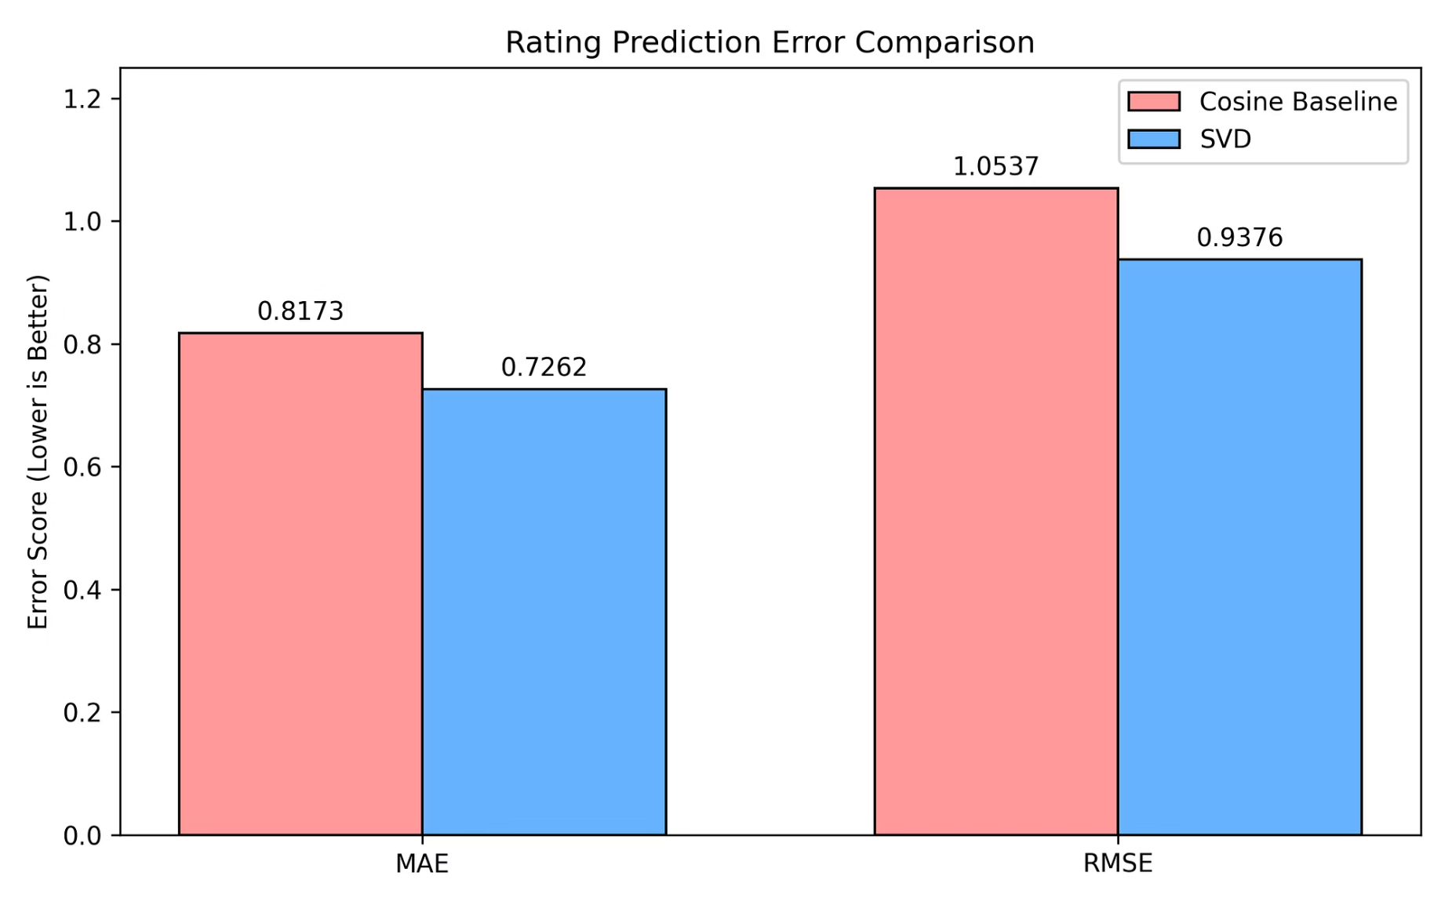

Results
Rating Prediction Accuracy: MAE & RMSE Comparison
Key Takeaways
MAE: SVD 0.7262 vs. Baseline 0.8173 — SVD drops below the critical single-star variation threshold; the Baseline does not
RMSE: SVD 0.9376 vs. Baseline 1.0537 — SVD stays under 1.0, meaning worst-case errors are meaningfully smaller
The Baseline's high MAE directly reflects the Cold Start collapse — when neighbors don't exist, every prediction falls back to a useless global average
SVD's 50-dimensional latent compression acts as a natural noise filter
Lower is better on both axes — SVD wins on every rating accuracy metric

Slide 7
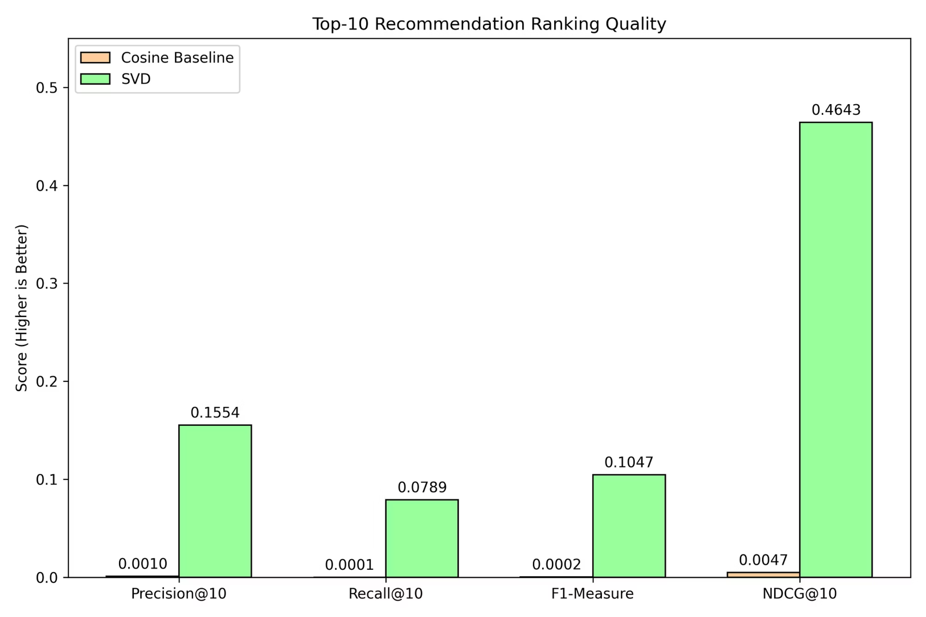
Results
Top-10 Ranking Quality: Precision, Recall, F1 & NDCG
The Baseline bars are nearly invisible across all four metrics — this is a structural failure of Memory-Based CF, not a marginal gap. SVD's Top-10 lists contain ~155x more relevant movies per recommendation served (Precision@10), and NDCG@10 shows a 9,757% improvement — NDCG heavily penalizes any system that fails to rank the most relevant items at the very top. The F1-Measure confirms SVD's gains are balanced, not inflated by one metric alone.

Slide 8
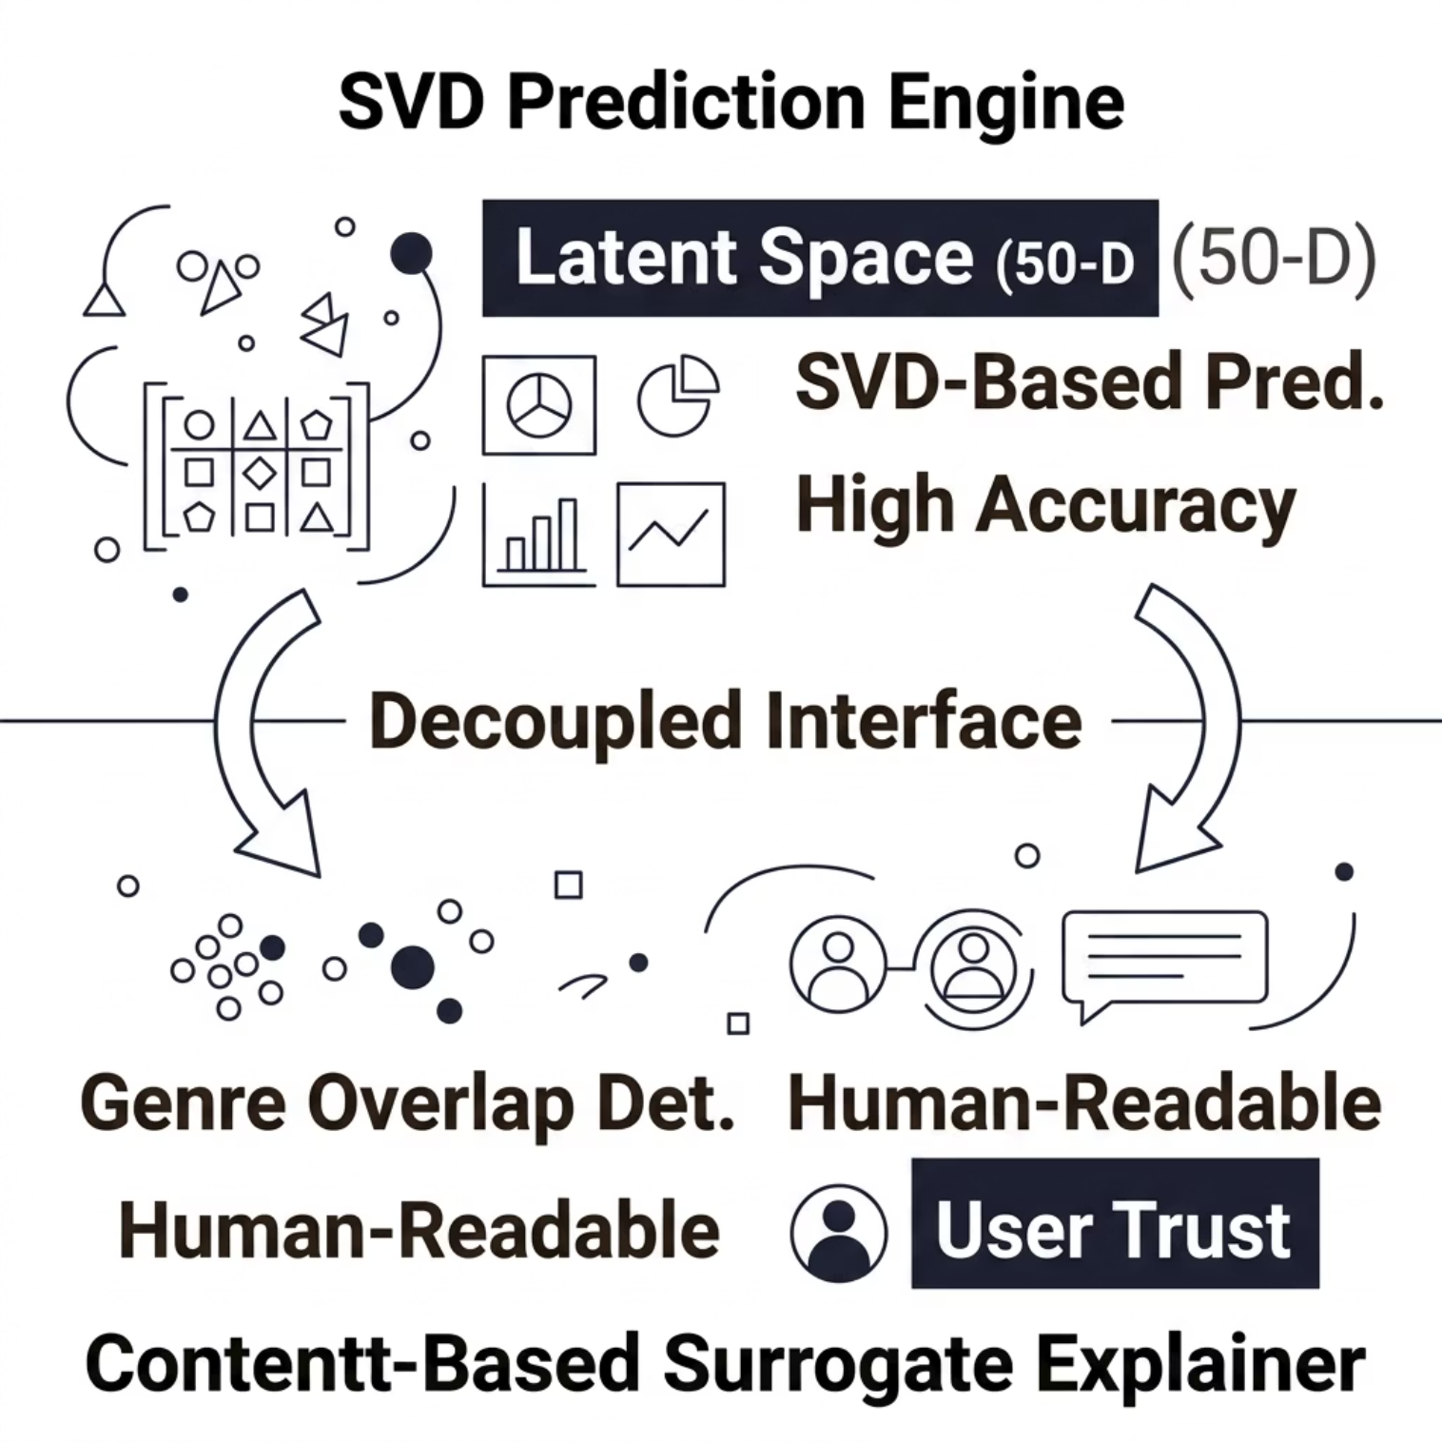


Trustworthiness — Option A
Transparency & Explainability: Cracking Open the Black Box
The Problem
Raw 50-dimensional latent vectors are completely uninterpretable — SVD is a mathematical black box that users fundamentally distrust. There is no intuitive way to explain why a particular movie was recommended from raw latent coordinates alone.
The Solution
A hybrid Surrogate Explanation architecture — SVD handles prediction; a separate Content-Based layer generates the human-readable justification. The surrogate automatically identifies genre overlaps between the SVD recommendation and the user's historical favorites.
UI output: "Because you enjoyed [Movie X], our AI found strong thematic overlaps here."
Prediction and explanation are fully decoupled — the SVD engine is never compromised for the sake of interpretability.

Slide 9
Trustworthiness — Option C
Controllability: Putting the User Back in Control
🚫 The Problem
🎛️ The Solution
Traditional Matrix Factorization gives users zero ability to steer or override what the algorithm serves them. The system is a closed loop — opaque, unresponsive, and paternalistic by design.
An interactive genre-filter dropdown built directly into the Streamlit UI. Users can globally strip specific genres (e.g., "Remove all Sci-Fi recommendations") from the active SVD output in real time.
⚙️ Technical Integrity
🏭 Industry Alignment
The filter applies post-prediction, fully preserving the mathematical integrity of the underlying SVD tensor. The latent space is never altered — only the final output layer is filtered.
Mirrors intent-driven steering modules used in commercial streaming applications — trustworthiness requires giving users meaningful, transparent agency over algorithmic outputs.

Slide 10
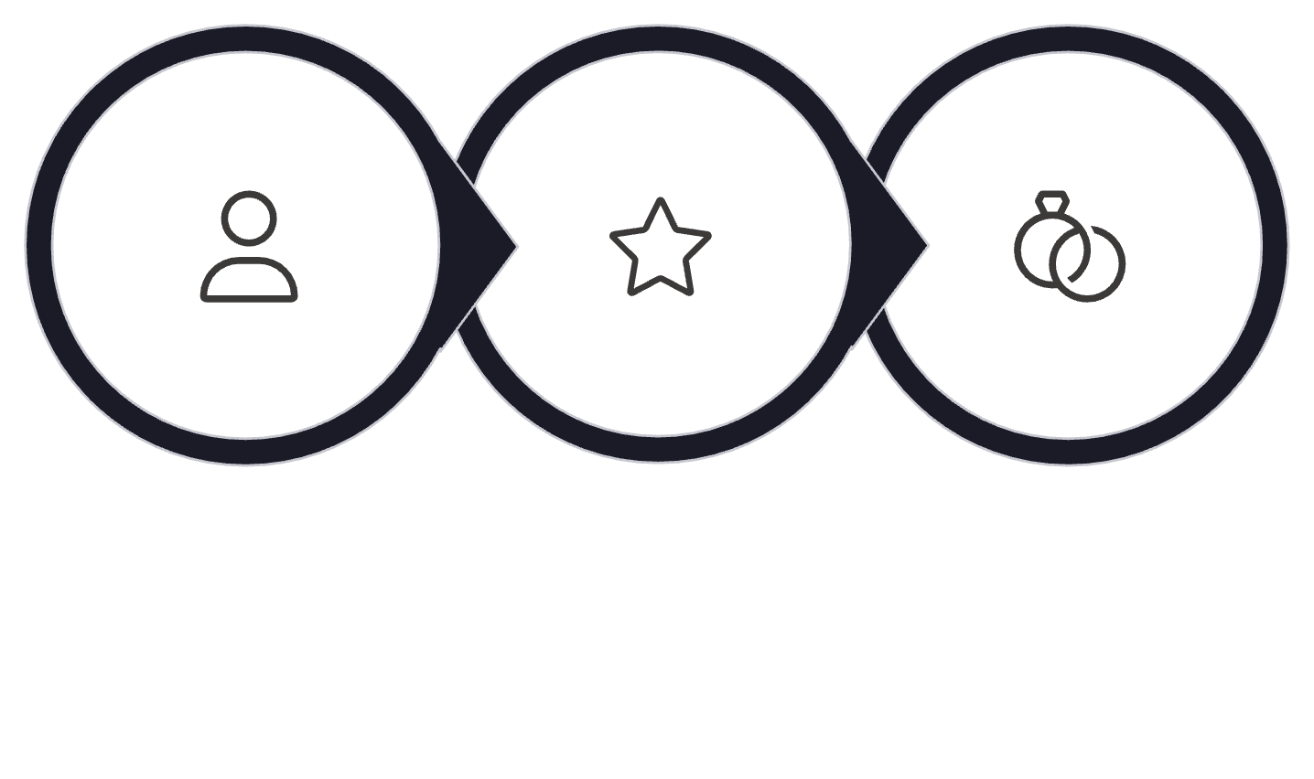

Trustworthiness — Option E
The Targeted Clone Swarm Attack: Designing an Advanced Shilling Attack
Why Standard Attacks Fail
Standard bot attacks inject random noisy ratings — SVD naturally filters these out as statistical noise because they don't align with any coherent latent behavioral cluster.
Our Novel Attack Vector
A Targeted Clone Swarm of 500 bots engineered to perfectly replicate one victim user's exact viewing history. Each cloned profile embedded a single maximum 5-star rating for a low-profile payload movie (e.g., Catwoman).
500 clones + 1 victim = 501 statistically identical profiles suddenly dominating the entire user cluster. When SVD retrains on the poisoned matrix, it is mathematically compelled to warp its k=50 principal dimensions — the target movie rises sharply into the victim's Top-10.
Embed Payload
Clone Profiles
Warp SVD

Slide 11
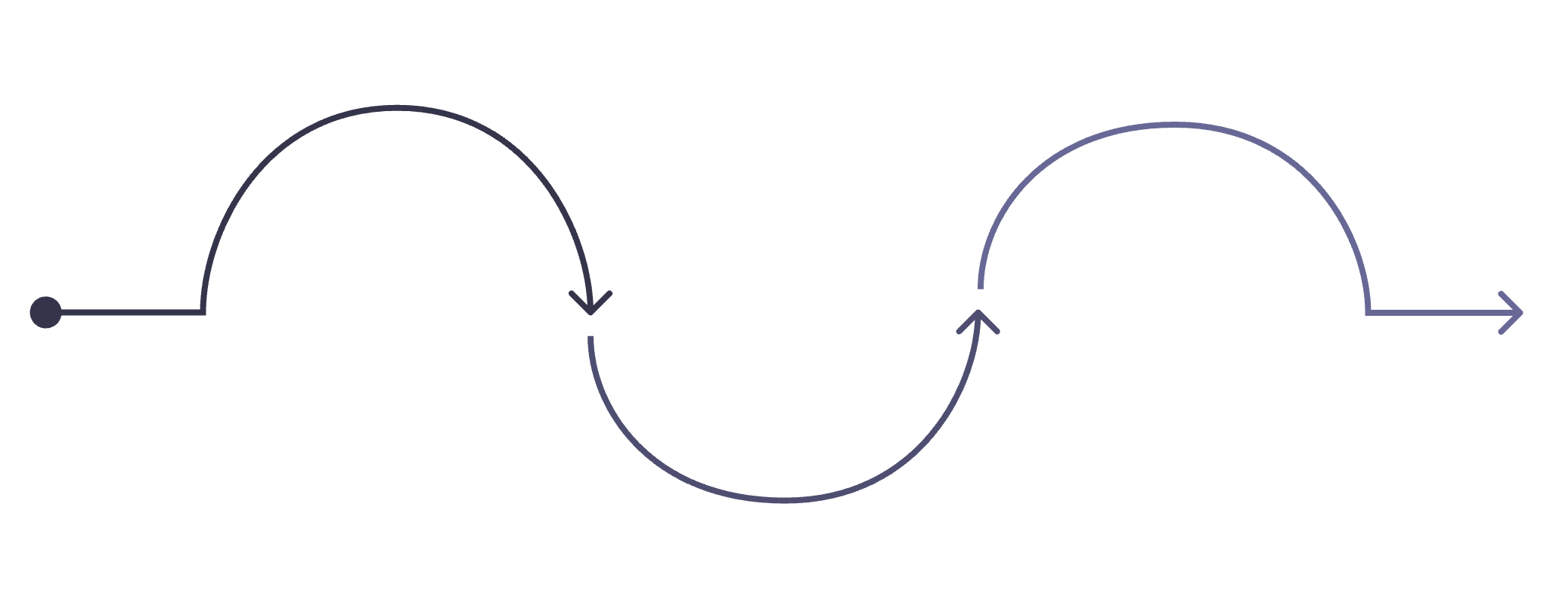
SLIDE 11
The Mathematical Collateral Damage
The most significant discovery from poisoning SVD: the attack did not only elevate the intended target movie — it violently reshuffled the entire global latent ecosystem.
🎯 The Core Finding
Core Proof
Because SVD globally reconfigured its 50 dimensions to minimize variance against the clone swarm, completely unrelated, un-targeted movies were dragged into the victim's Top-10 as well.
Poisoning an SVD matrix doesn't surgically elevate one movie.
It violently reshuffles the entire global latent ecosystem — every dimension, every embedding, every recommendation.
Mathematical Collateral Damage is a verifiable, novel security risk for any production recommender system built on matrix factorization.
🏴‍☠️ Collateral Movies
Movies like Pirates of the Caribbean were never targeted — they simply shared vague latent structural DNA with the victim's profile and got caught in the gravitational pull of the tensor warp.
⚠️ Production Safety Implication
Any recommender system built on matrix factorization is structurally vulnerable to this class of coordinated attack — poisoning is not surgical, it is systemic.
Clone Swarm Injected
Collateral Movies Dragged
Poisoned inputs introduced into training
SVD Reconfigures
Many titles pulled into top-10
Global shift in 50 latent dimensions
The diagram above illustrates how a targeted clone swarm injection cascades through SVD's global compression mechanism, producing unintended collateral damage far beyond the original attack target.

Slide 12

SLIDE 12
Conclusions & Key Takeaways
What We Built. What We Proved. A comprehensive evaluation of SVD-based matrix factorization — its superiority, its trustworthiness gaps, and its structural vulnerabilities.
SVD Dominance
Trustworthiness Rubric
The Dual-Edged Sword
SVD outperforms Memory-Based CF on every single metric — latent dimensionality is the correct and proven solution to Cold Start, sparsity, and popularity bias problems.
Options A, C, and E address complementary gaps — interpretability, user agency, and adversarial robustness. No single option is sufficient alone.
SVD's greatest mathematical strength — global latent compression — is simultaneously its greatest structural vulnerability when facing coordinated clone swarm attacks.
Verified Security Risk
Future Work
Mathematical Collateral Damage is not theoretical — it is a verifiable, novel security risk for any production recommender system built on matrix factorization. The Targeted Clone Swarm attack demonstrates this conclusively.
01
Differential Privacy
Apply differential privacy constraints on SVD training to limit the influence of injected clone profiles.
No matrix factorization system should be deployed in production without adversarial robustness evaluation.
02
Adversarial Retraining
Retrain models on poisoned matrices to build structural resistance to clone swarm injection attacks.
03
Explainability Layer
Extend the surrogate explainability layer to produce user-facing confidence scores for every recommendation.

