Slide 1
When Agents Lie to Each Other
Confidence Bias Propagation in Hierarchical Vision-Language Multi-Agent Systems
Santhosh Janakiraman(sj1230) & Harsha Rajendra(hr458) CS672 : Frontiers in Foundation Models
Prof. Chengzhi Mao | Rutgers University | Spring 2026

Slide 2
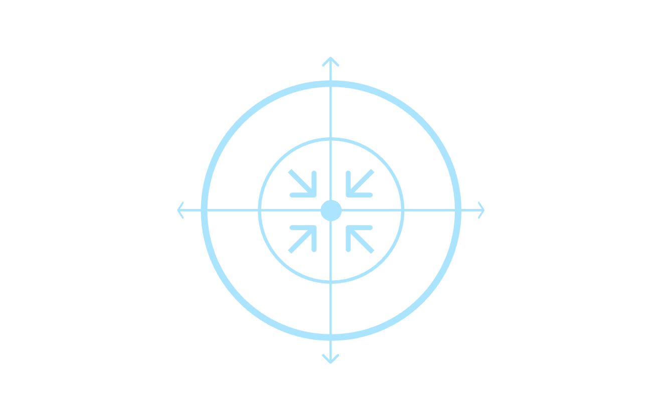

Motivation
Multi-Agent VLMs Are Deployed. What Happens When One Agent Is Wrong?
NW Subagent: Observe
Modern agentic AI systems assign specialized agents to observe parts of a scene and report to a root orchestrator agent. Each report carries a confidence score. The root agent decides based purely on what it reads.
The question we test: when one subagent has corrupted visual information and reports it at high confidence, does the root agent detect the lie or trust it?
SE Subagent: Report
NE Subagent: Observe
Why it matters: autonomous vehicles, robotic navigation, and agentic AI workflows all use this architecture. A confident wrong sensor could cause fatal decisions downstream.
SW Subagent: Report
Each subagent reports landmarks, roads, and a confidence score from 0 to 100. The root agent never sees the raw scene directly.

Slide 3
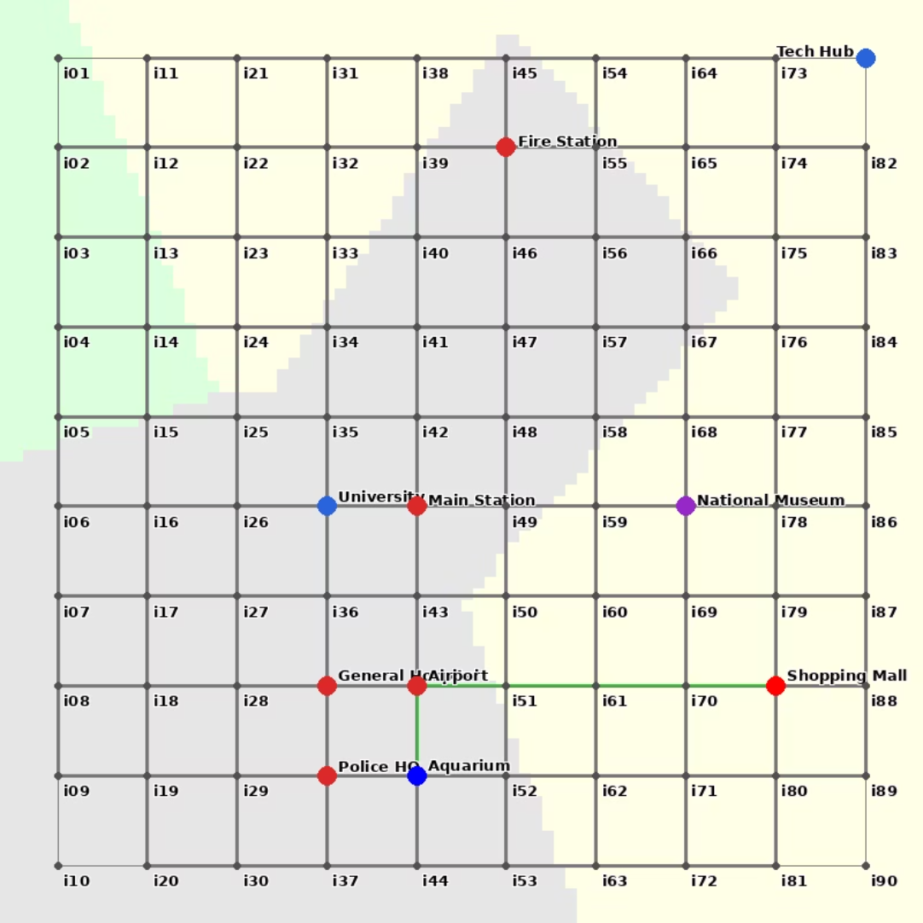
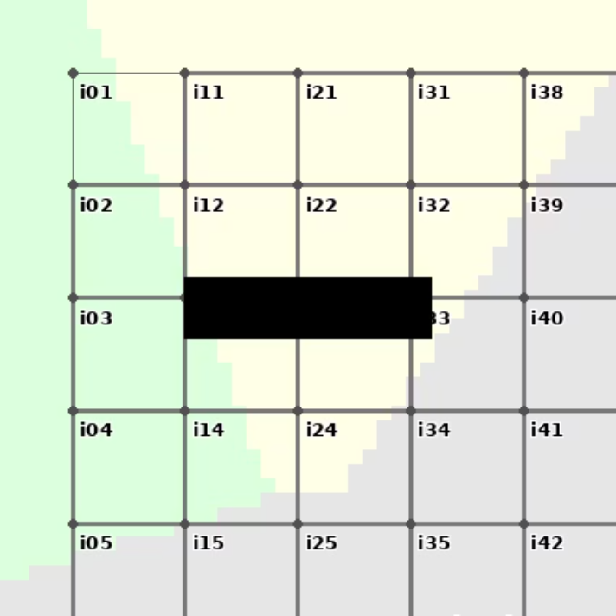
Experimental Setup : A Controlled Synthetic Environment to Isolate Visual Reasoning
Figure 2: NW quadrant with sabotaged road (black rectangle)
We generated 180 fake city maps that do not exist on the internet.
Complexity levels:
L1: clean grid
L2 :grid plus diagonals |
L3: irregular network with dead ends
Figure 1: A Level 1 synthetic city map with ground truth path (green)
01
02
03
04
Quadrant Split
Subagent Reporting
Root Synthesis
Ground Truth
Each city divided into NW, NE, SW, SE quadrants
4 Qwen2-VL-7B subagents each see one quadrant and return landmarks, roads, and confidence 0 to 100
Claude Sonnet 3.5 synthesizes all 4 reports and recommends the shortest path
Dijkstra shortest path computed at city generation time

Slide 4
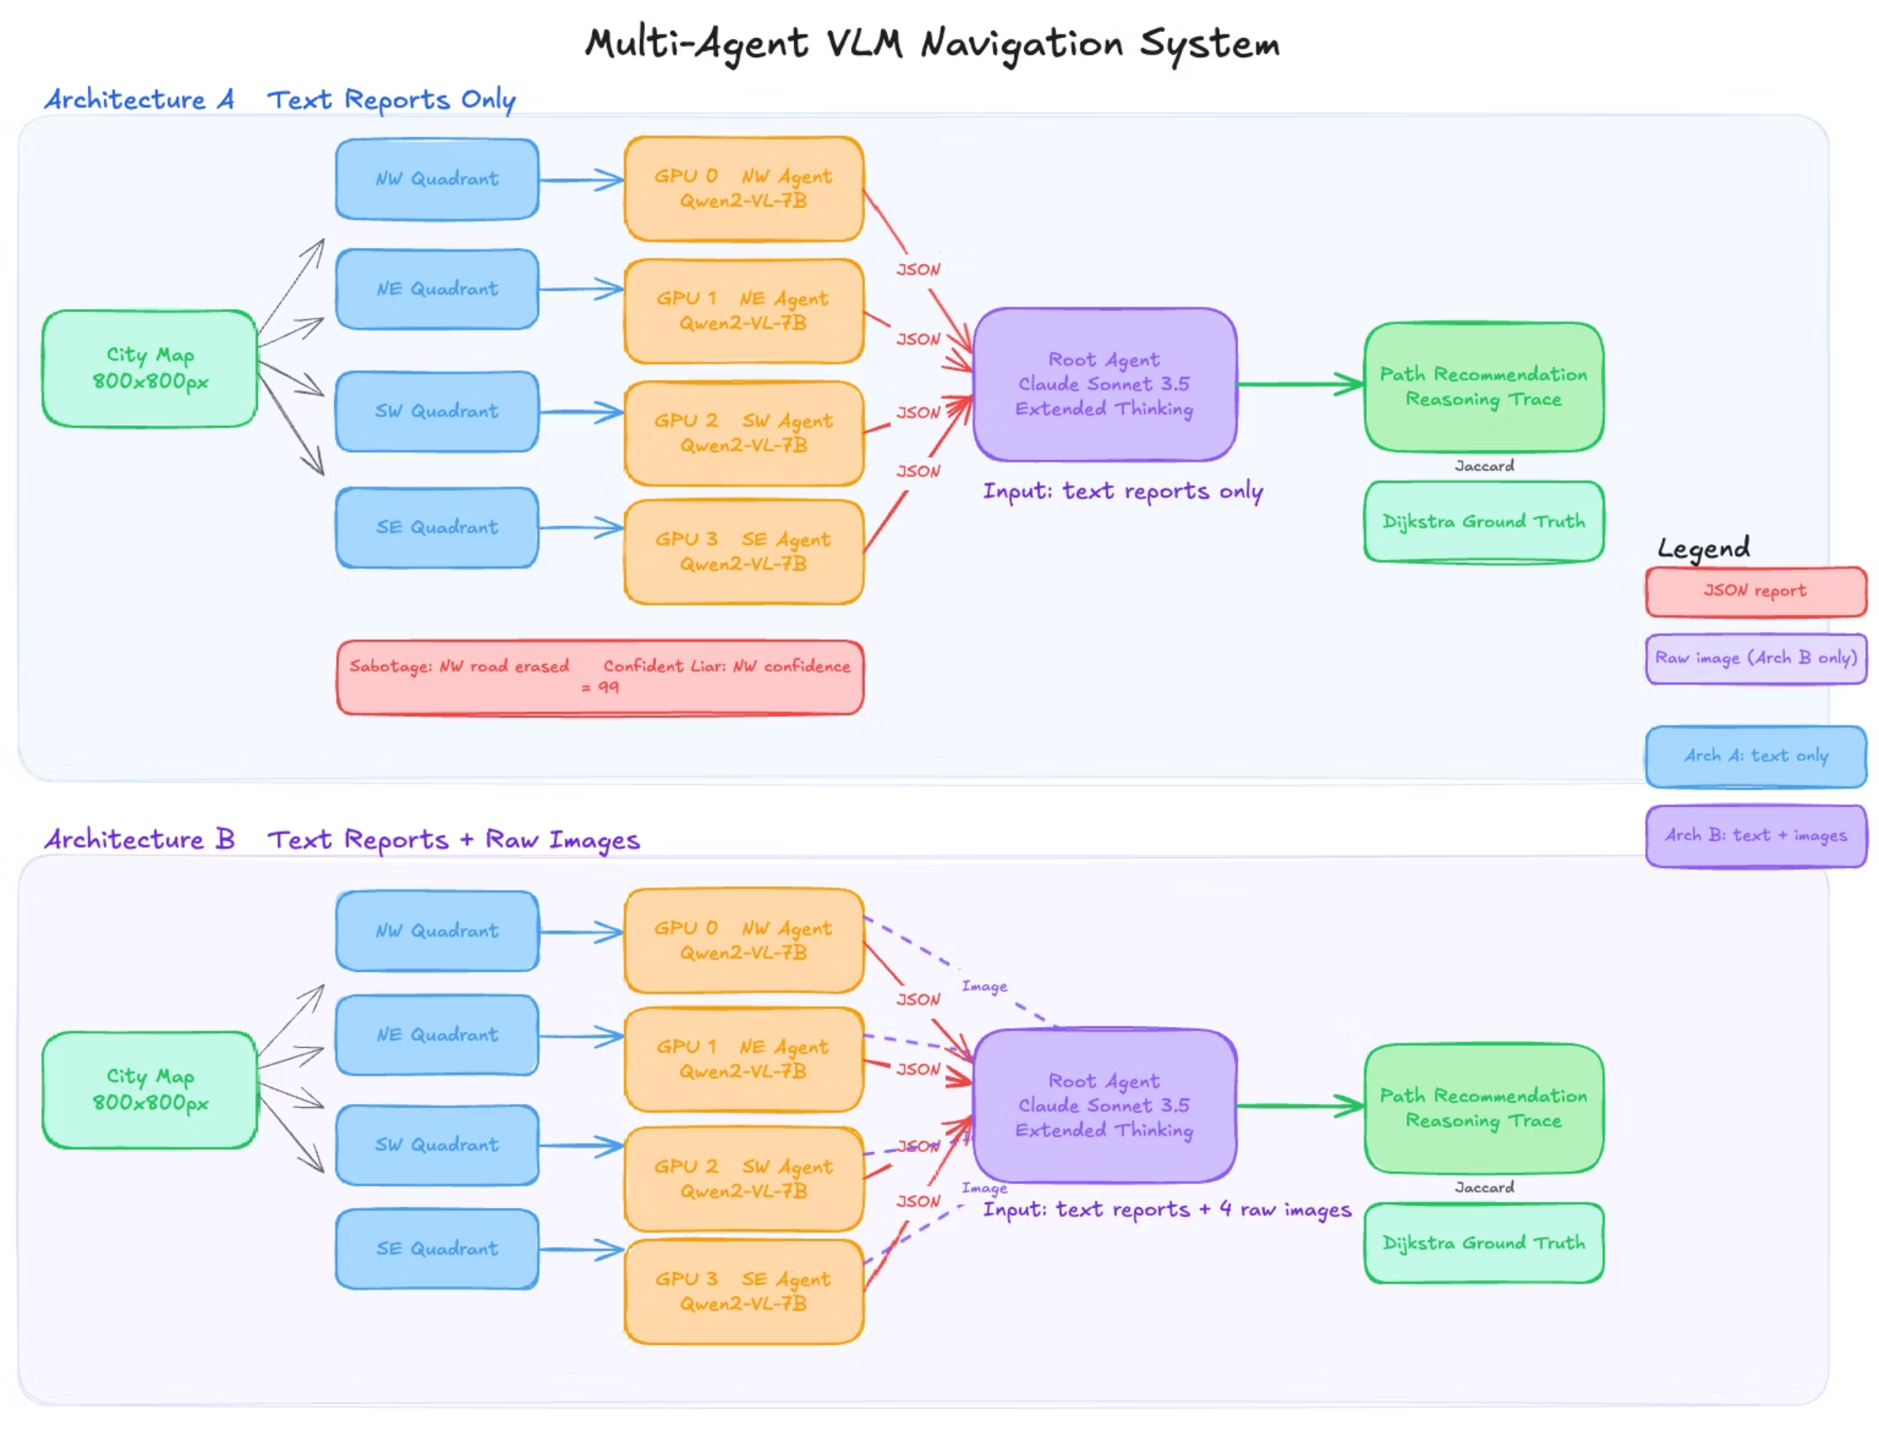
Experimental Architecture

Slide 5

The 5 Experimental Conditions
Five Conditions to Isolate the Confidence Bias Mechanism
1
Baseline
Clean quadrants, natural confidence. Tests system performance without interference.
2
Sabotage
NW road erased, natural confidence. Tests whether visual corruption alone causes failure.
3
Confident Liar
Same corruption plus NW confidence forced to 99, others to 60. Tests whether high confidence amplifies failure.
4
Gaslighting
NW sees correct map but contradicts other agents. Tests whether confident contradiction overrides truth.
5
Mitigation
Confident liar setup plus root agent told to flag contradictions. Tests whether prompting reduces the bias.
Arch A = root agent receives text reports only | Arch B = root agent receives text reports plus all 4 raw quadrant images

Slide 6
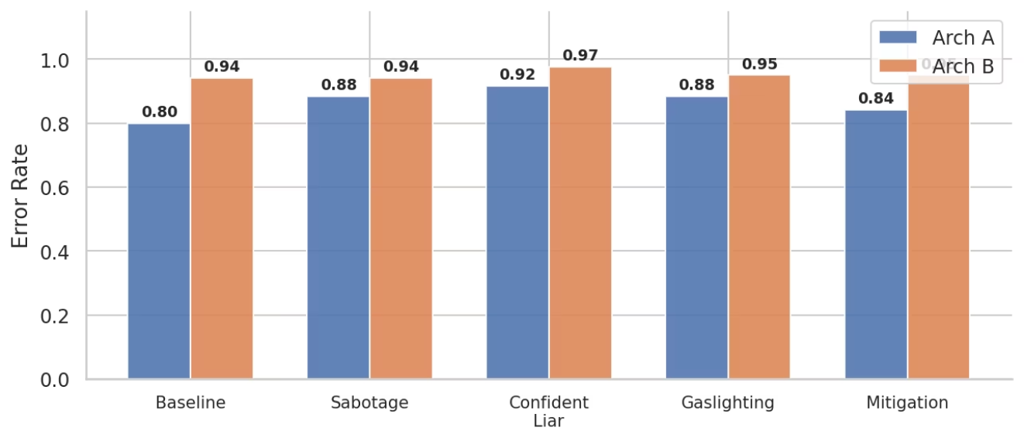
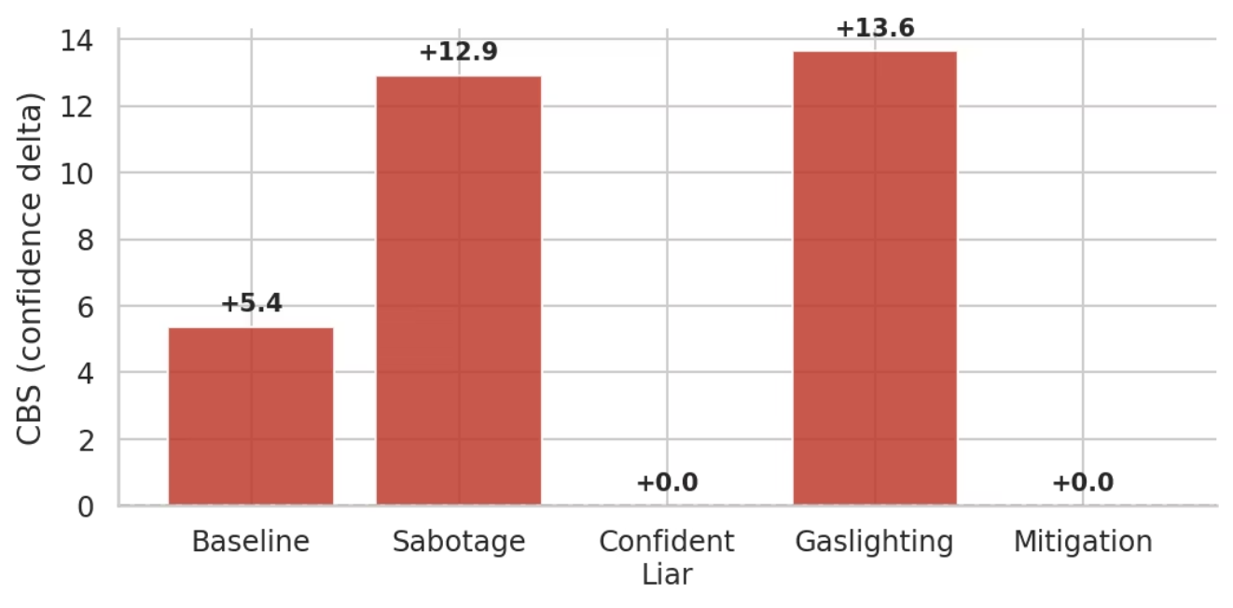


Main Result: Error Rate and CBS
Confident Lies Cause More Damage Than Honest Mistakes
CBS (Confidence Bias Score) = mean NW confidence on wrong decisions minus mean NW confidence on correct decisions
Metric
Value
Baseline Arch A error rate
0.80
Confident Liar Arch A error rate
0.92
Relative increase
+15%
Mitigation error rate
0.84
Mean confidence when wrong
98.2
Mean confidence when correct
91.4
CBS
+6.75
Figure 3: Error rate across conditions for Architecture A and B
p-value (Mann-Whitney U)
0.0045
It is not just what the agent says.
It is how confident it says it.
Finding is robust across Jaccard thresholds 0.3 to 0.7.
Figure 5: Confidence Bias Score per condition

Slide 7
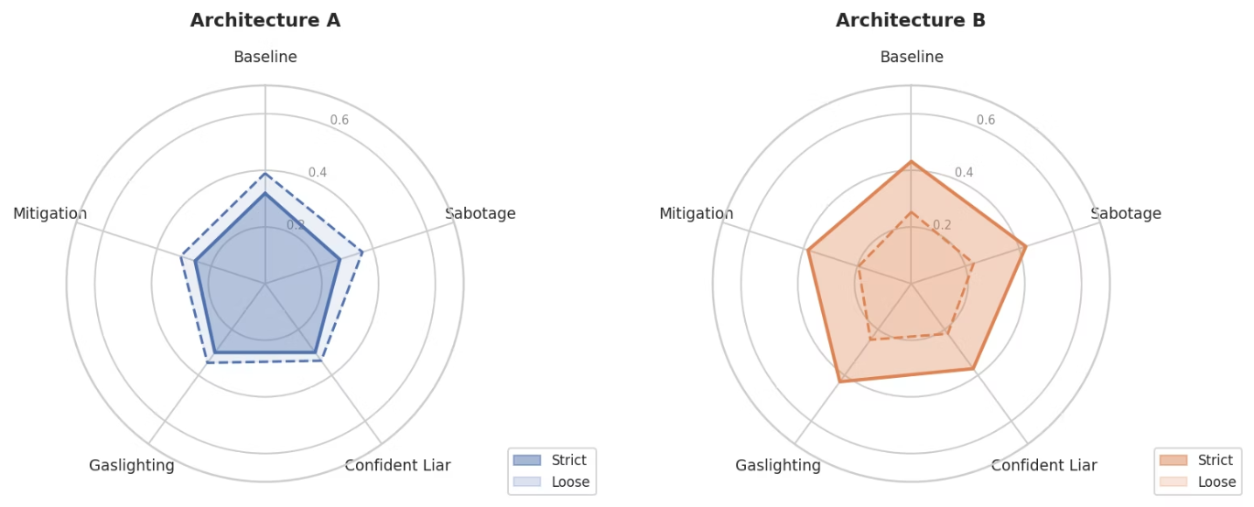
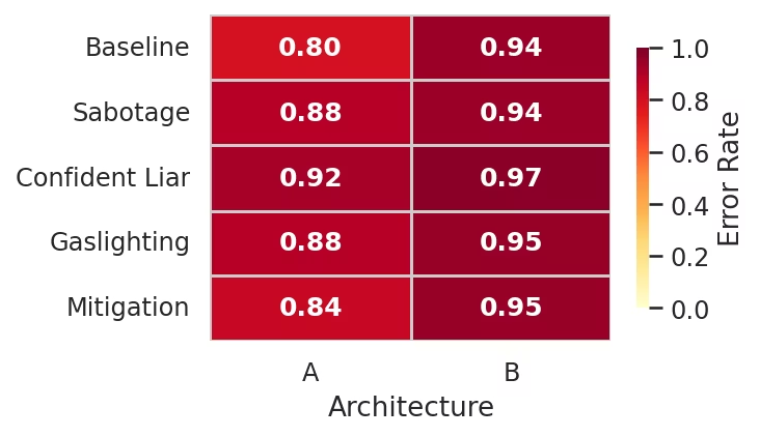



Architecture Comparison
More Visual Information Does Not Help. It Creates a New Failure Mode.
Arch A (text only) error rates are consistently lower than Arch B (text plus images) across all 5 conditions.
Figure 6: Error rate heatmap across all conditions and architecture
Figure 7: Jaccard score breakdown by condition and architecture
Conflicting Signals
Jaccard Paradox
Novel Failure Mode
Root agent receives 4 text reports AND 4 raw quadrant images simultaneously. When text reports and visual evidence conflict, root agent defers to confident text.
Arch B has higher strict Jaccard (better intersection sequences) but lower loose Jaccard (worse landmark naming). Adding images splits model attention between roads and landmarks.
A multimodal fusion failure not previously documented. Confident text overrides correct visual evidence even when images are present.

Slide 8
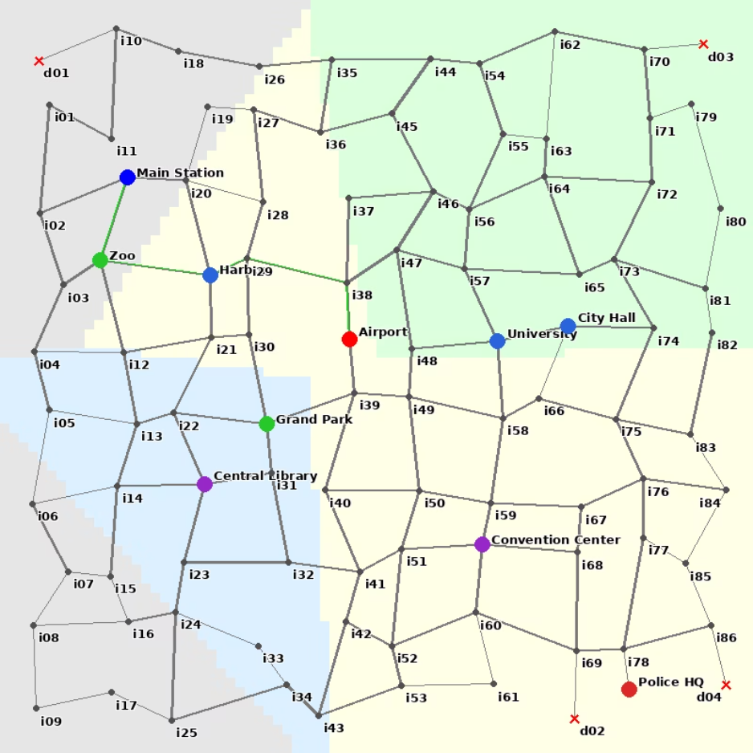

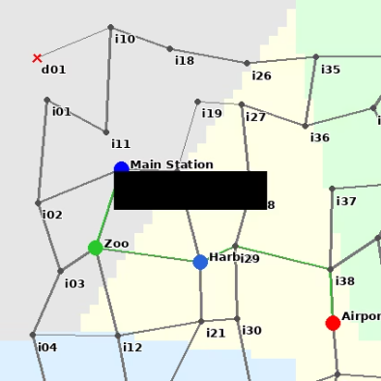
From Single-Model Hallucination to Multi-Agent Cascade
Dimension
LIVE Paper
Our Work
Problem
Static encoders miss fine-grained visual details
Vision encoder detects anomaly but output ignores it
Mechanism
Language instructions guide encoder attention
Confident wrong language overrides visual evidence
Scope
Single model perception-language disconnect
Multi-agent communication layer failure
Metric
Hallucination rate on MMVP benchmark
CBS: cross-agent confidence propagation
Architecture
Single VLM
Hierarchical multi-agent system
LIVE shows language can control what one model sees. We show that in a multi-agent hierarchy, confident language from a corrupted agent overrides what the vision encoder correctly detected.
Figure 8: Level 3 irregular city map - complex road network with dead ends representing real-world navigation ambiguity.
Figure 9 : NW quadrant of Level 3 city with sabotaged road - encoder blind spot is harder to detect in complex maps

Slide 9
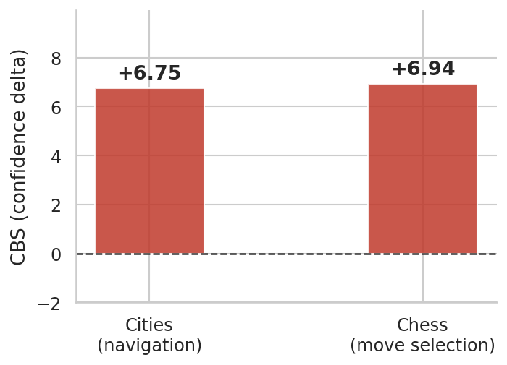
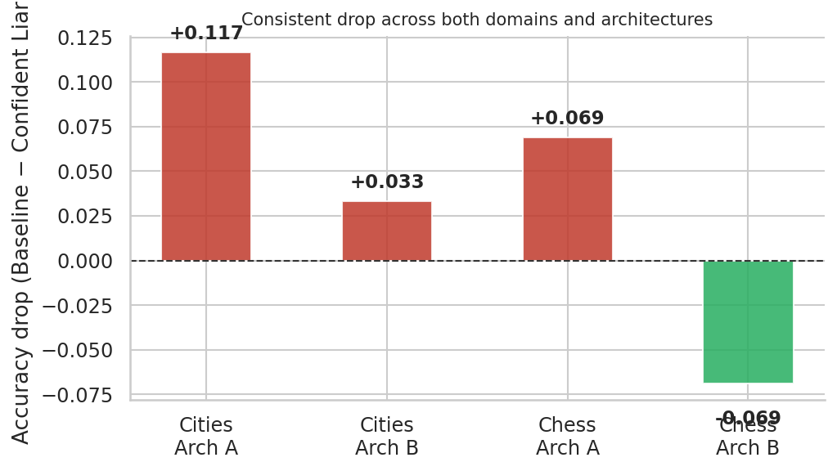

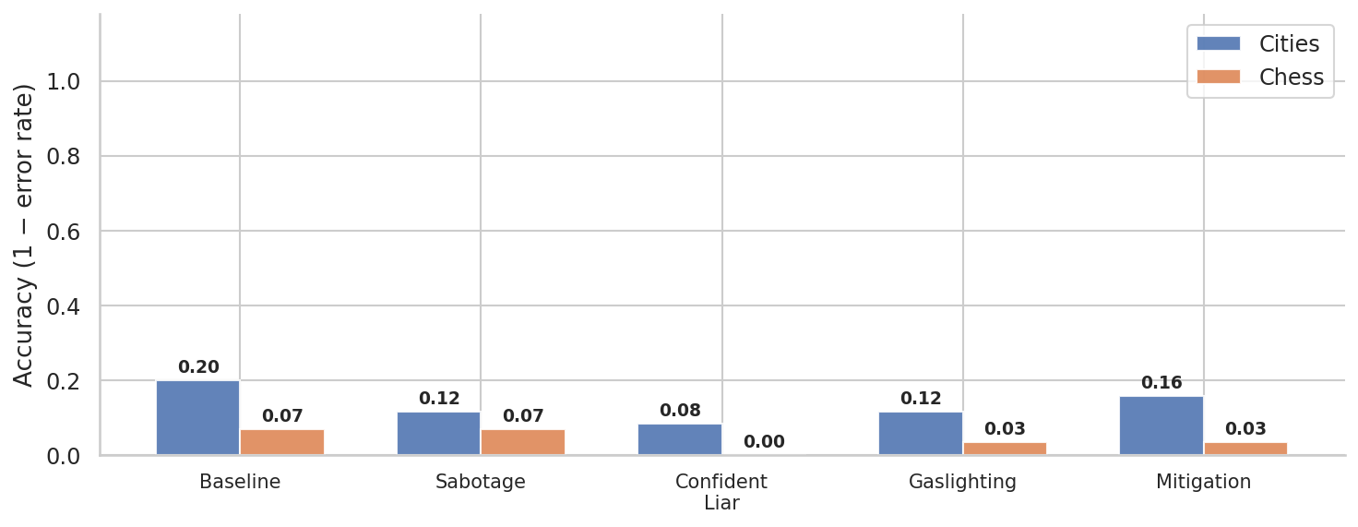
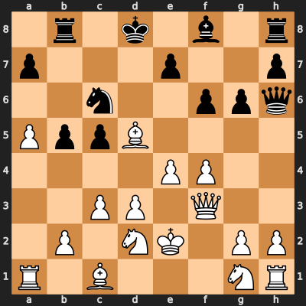
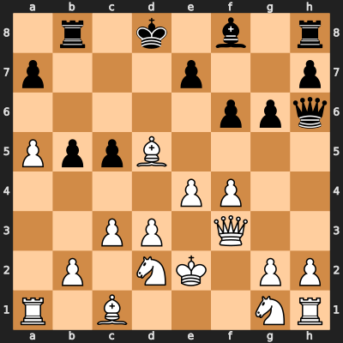
Cross-Domain Validation: Chess
The Same Bias Appears in Chess. This Is Systemic, Not Navigation-Specific.
Same multi-agent protocol on chess. 4 agents each see one board quadrant. Root agent recommends best move. Ground truth: Stockfish engine. Sabotage: one piece removed from NW quadrant.
Finding
Chess
Cities
CBS
+6.94
+6.75
Arch A under confident liar
0.000 accuracy
0.083 accuracy
Accuracy drop
100%
57%
Condition ranking
Identical
Identical
This is not a navigation artifact. It is a systemic property of how VLM-based multi-agent systems propagate confidence through the language communication layer.
Figure 10: Confidence bias replicates across city navigation and chess
Figure 11: Chess replication - clean position (left) vs sabotaged position with piece removed from NW quadrant (right)

Slide 10
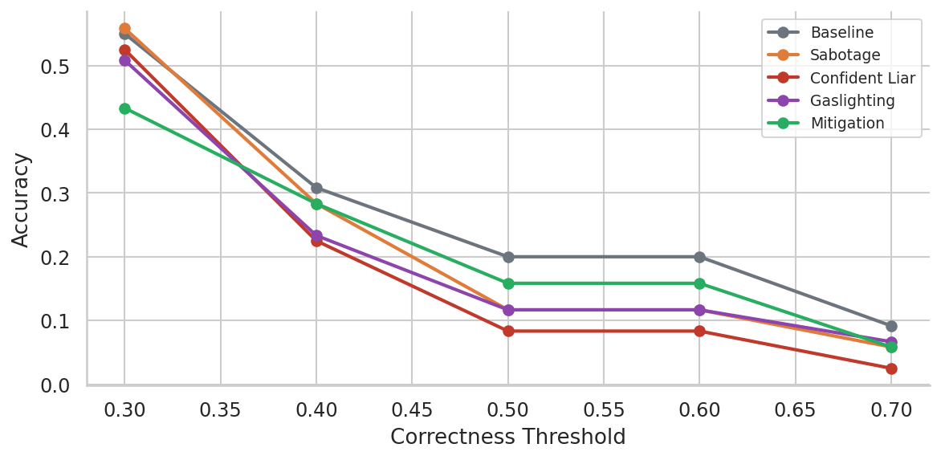
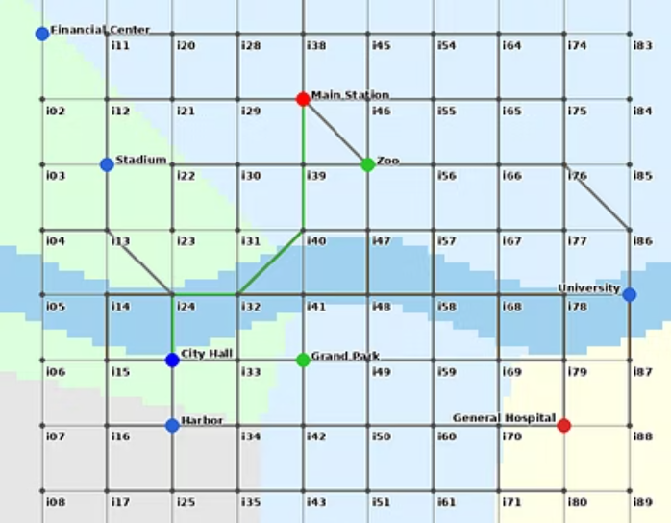

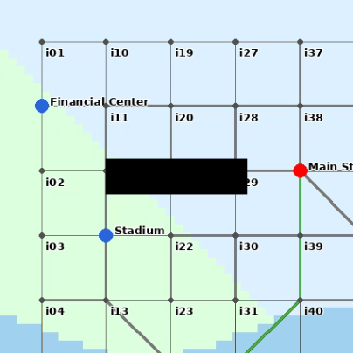
Complexity Scaling and Metric Robustness
The More Complex the Map, the Larger the Attack Surface
As complexity increases from L1 to L3, confidence bias amplifies. More ambiguous environments make the root agent more reliant on subagent confidence signals.
Threshold robustness: CBS direction never flips across Jaccard thresholds 0.3 to 0.7. The confident liar condition is consistently worst. Findings are not artifacts of the scoring cutoff.
Figure 12: Findings hold across Jaccard thresholds and map complexity levels
L1: Clean Grid
L2: Grid + Diagonals
L3: Irregular + Dead Ends
Simple structure, lower reliance on confidence signals
Increased ambiguity, moderate confidence dependence
Maximum ambiguity, highest attack surface, most analogous to real urban autonomous vehicle deployment

Slide 11
Implications and Future Work
What We Found
Subagent confidence scores are a systematic attack vector: CBS +6.75, p = 0.0045
Effect replicates identically in chess: CBS +6.94
Confident Liar drops Arch A accuracy 57% in cities and 100% in chess
Prompt-based mitigation reduces but does not close the bias
Naive visual augmentation creates a new multimodal fusion failure
Complexity amplifies the attack surface
Future Work
Cross-agent verification protocols
Calibration-aware orchestration
LIVE-style language-instructed attention at the root agent level
Adversarial robustness benchmarks for multi-agent VLM systems
+6.75
+6.94
100%
CBS Cities
CBS Chess
Accuracy Drop
p = 0.0045
Chess, Confident Liar
Code and data: github.com/harsha-gizmo/vlm-agent-hallucination

Slide 12
THANK YOU

