Slide 1


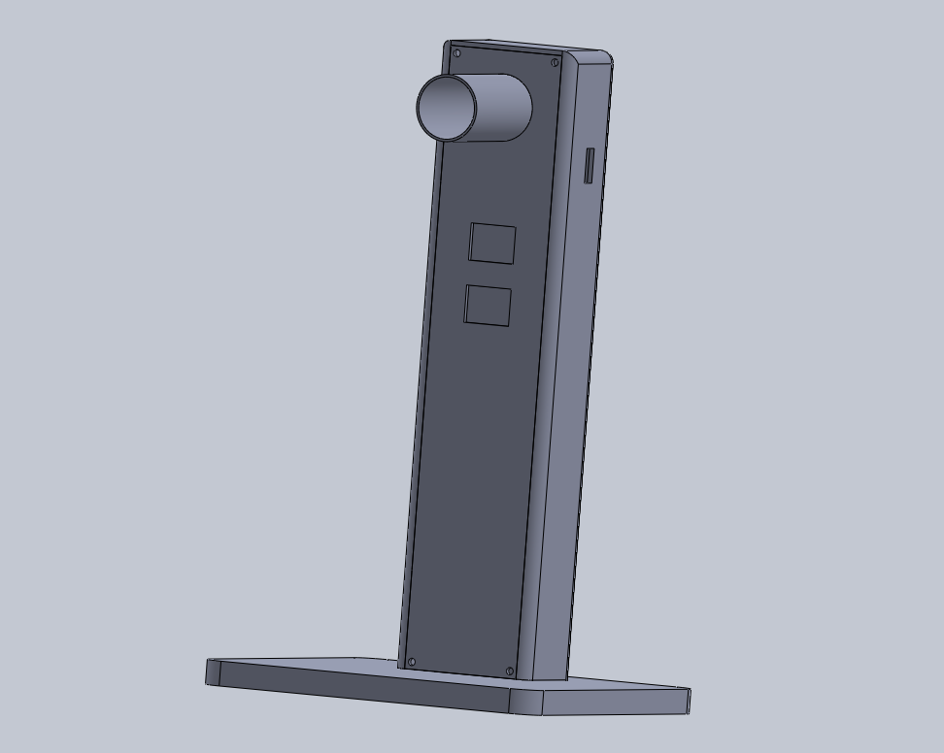

Team
EyeCan
Table-mounted
Fundoscope

Slide 2
Table of
Contents
01
Problem
05
Component Selection
02
Need Statement
06
Design Process
03
Our Solution
07
Budget
04
Initial Concept
08
Conclusions and Possible Future Improvements

Slide 3
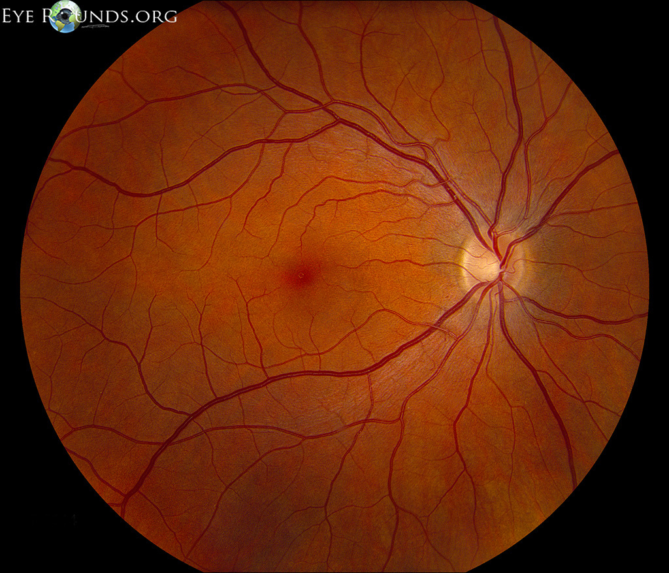
Problem
Fundoscopic examination, or ophthalmoscopy, is a common procedure in routine eye examinations. This procedure allows doctors to scan the back of the eye (retina), which is crucial for diagnosing many human eye diseases. However, the main problem with this examination is that even the slightest movement of the patient can lead to blurred images, resulting in an inaccurate diagnosis. Additionally, due to the need for close contact during the procedure, healthcare professionals encounter a significant risk.

Slide 4
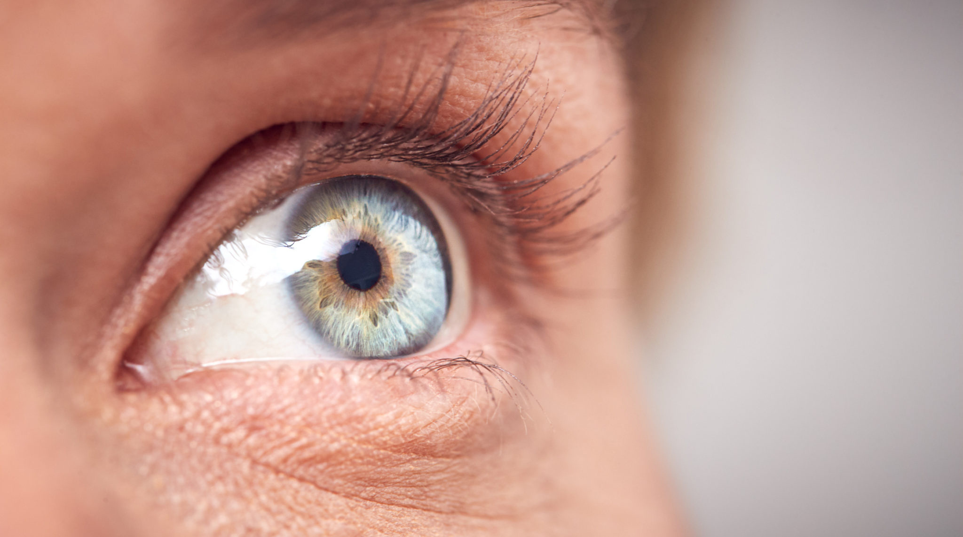
Borcelle Company
Need Statement
"Improve the fundoscopic examination equipment so that small movements of the patient do not affect the accuracy of the diagnosis and healthcare professionals can perform this procedure keeping a safe distance with the patient."

Slide 5
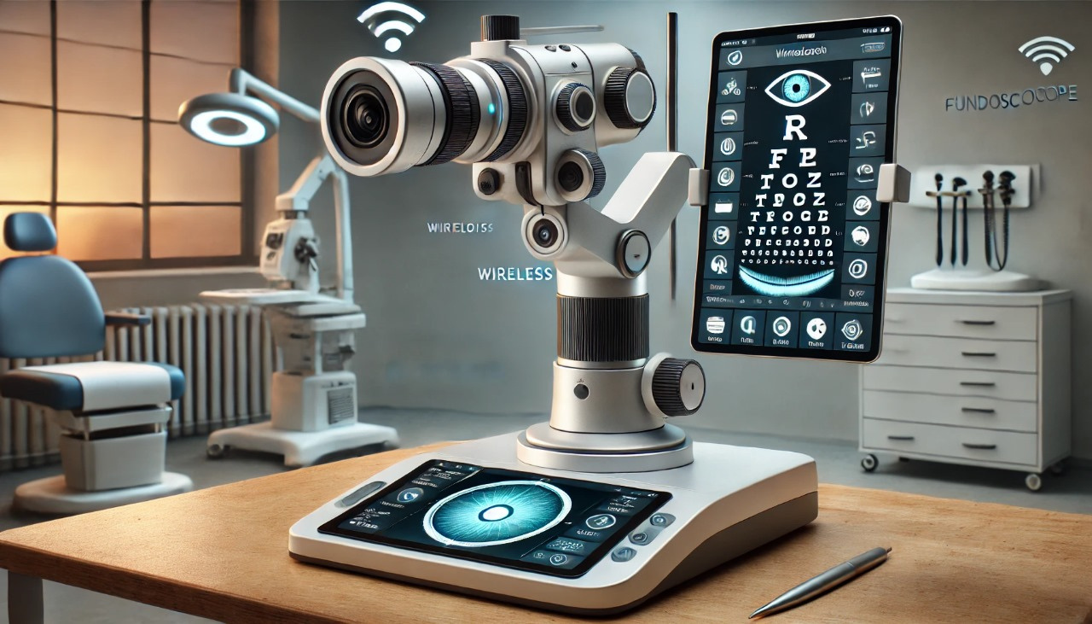


Our Solution
Wireless table-mounted Fundoscope with WiFi Connectivity and ML integration

Slide 6

Features
1. A table-mounted fundoscope - No need
from the movements of the patient and doctor is minimized.
2. Wi-Fi connectivity - Wireless transmission of the retina image to the computer
3. UI integrated Machine Learning system - The doctor can easily upload the image and get a diagnosis of the disease, which can be sent for further analysis later.

Slide 7
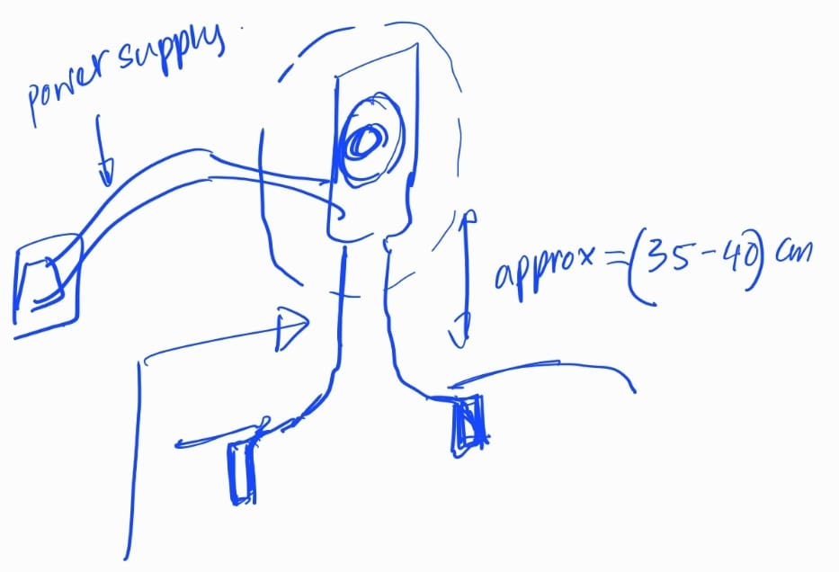
Initial Concept

Slide 8
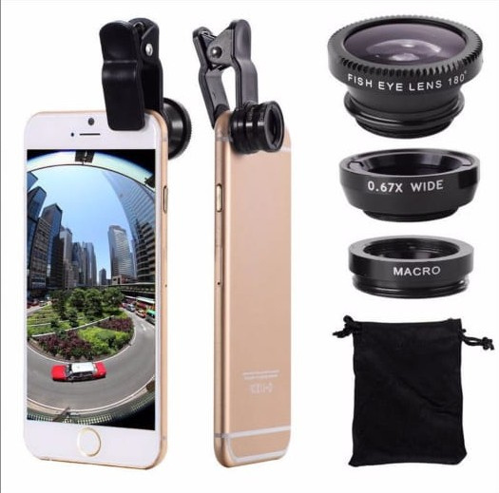
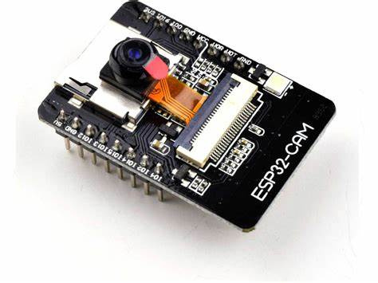
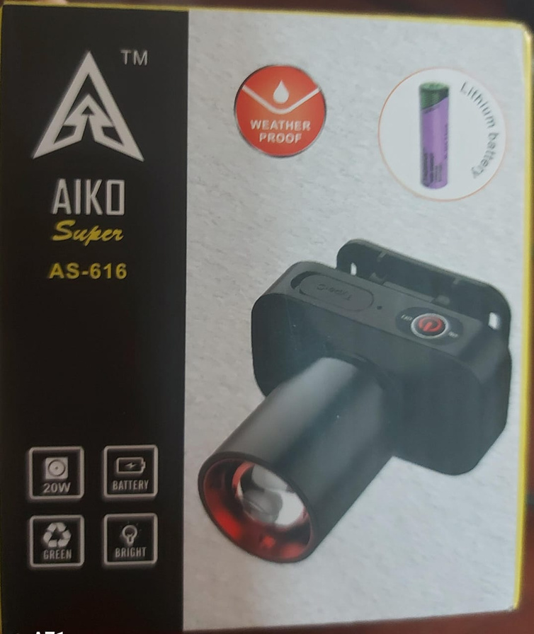
Component Selection
Light
20w light
Lens
Camera Module
Macro Lens
ESP32 camera module

Slide 9
Design
Process

Slide 10
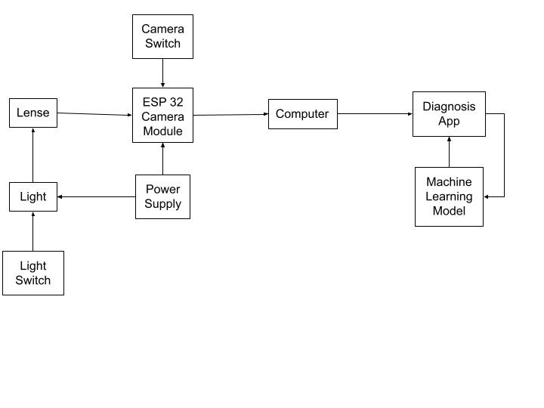
Block Diagram

Slide 11
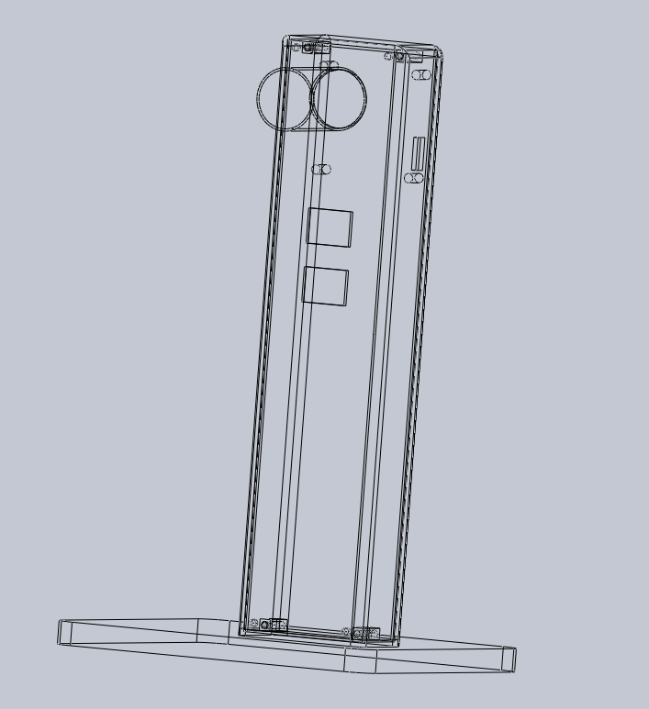
Enclosure Design

Slide 12
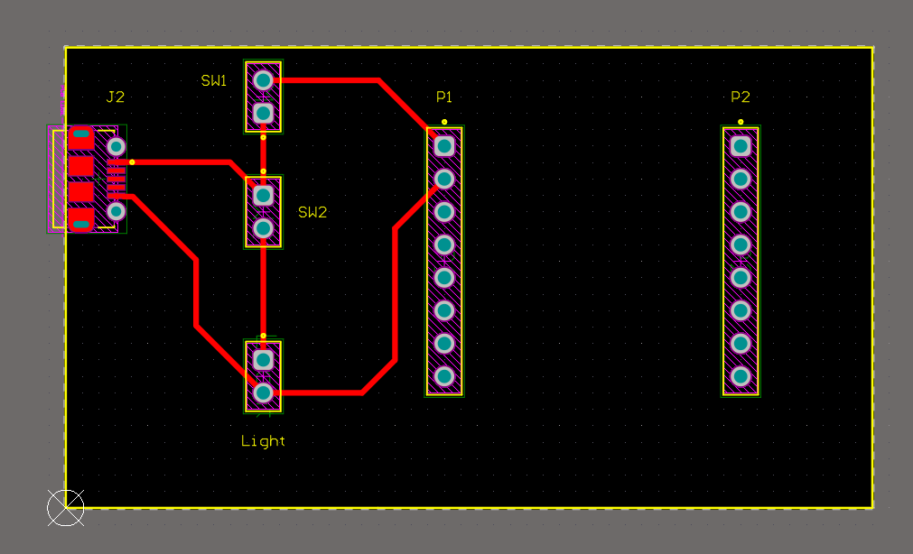
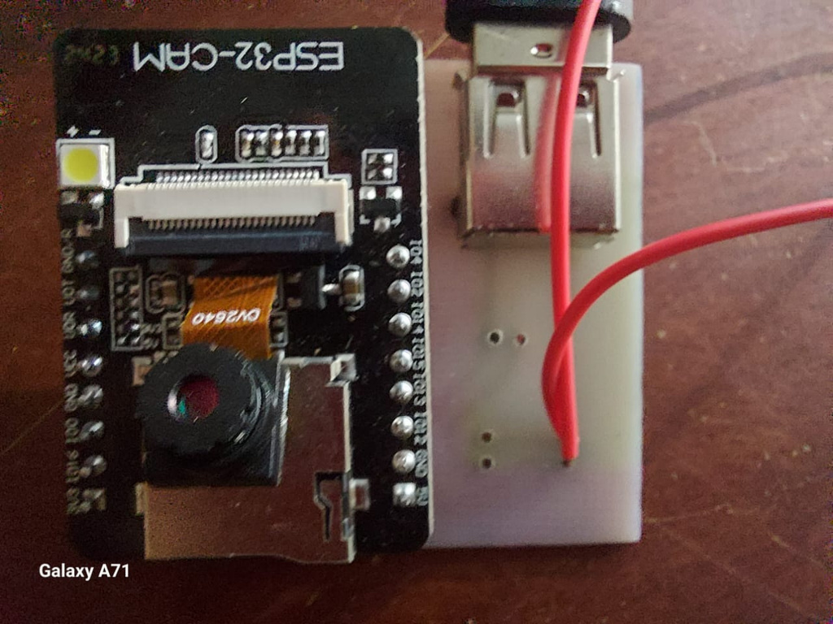
PCB Design

Slide 13
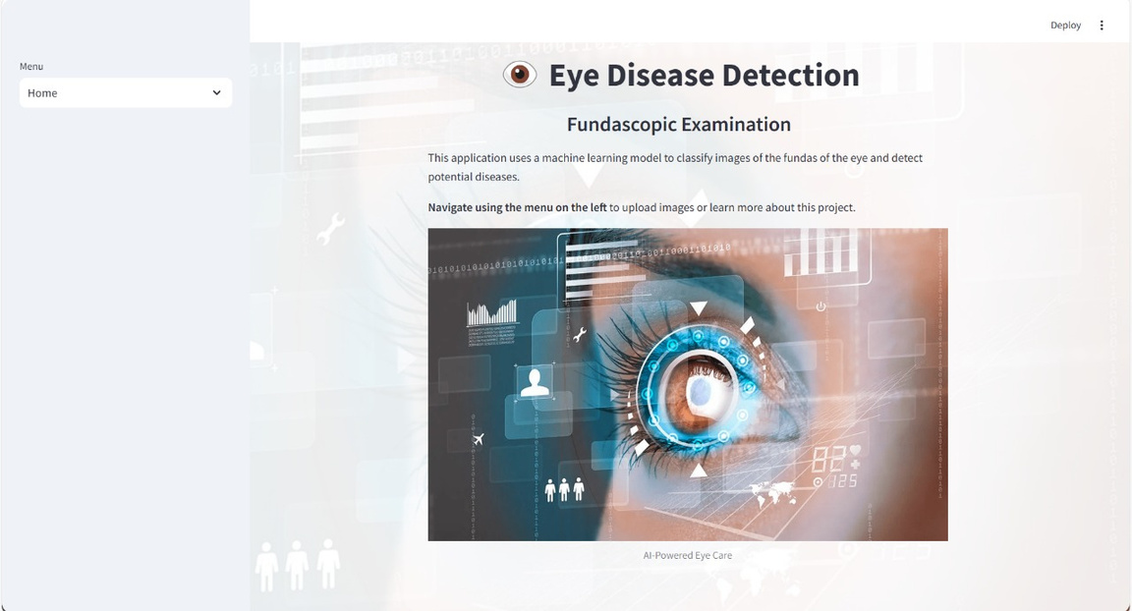
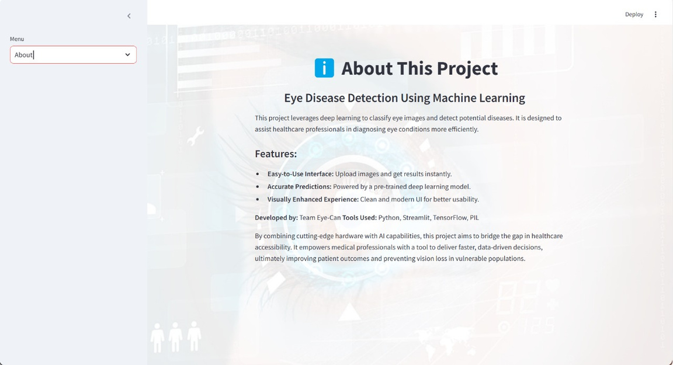
UI Design

Slide 14
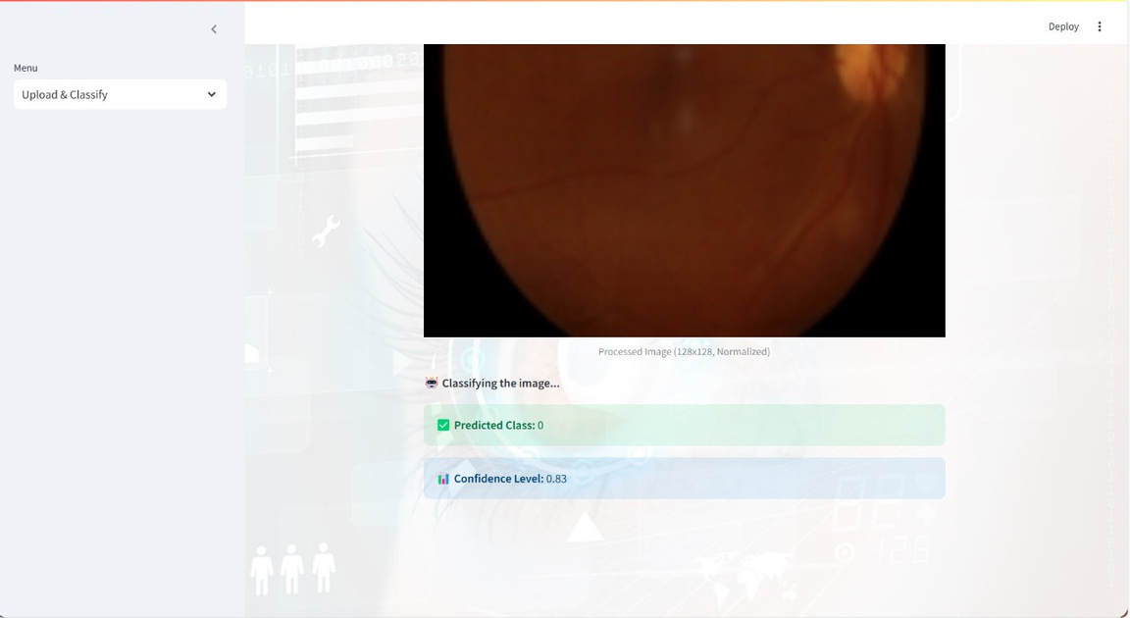
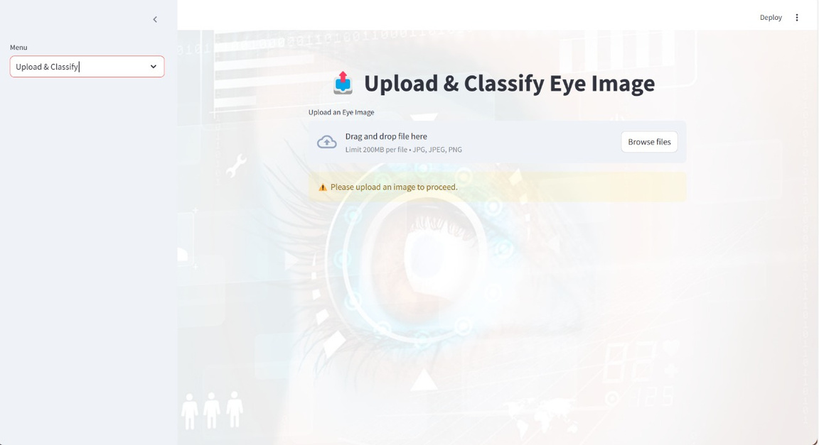
UI Design

Slide 15
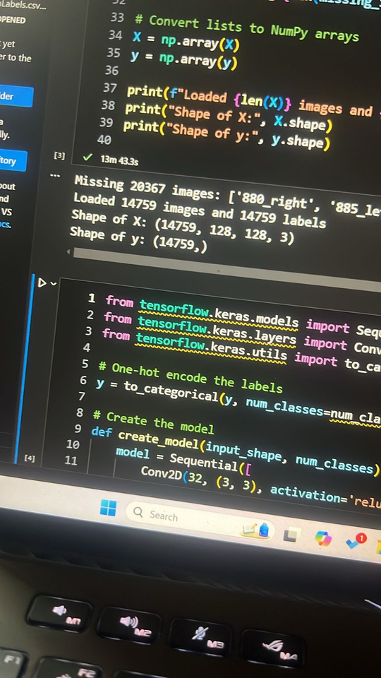
ML Integration
The model will train itself from a pre-added data set of around 20000 images of different levels of the eye fundas.
The model is pre trained no live training.
Using tensors/numpy arrays to represent images using tensorflow. (Based on Nural Networks)

Slide 16
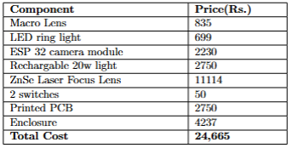
Budget

Slide 17
Conclusions
We need to choose a better lens, with a power of more than 20D.
We need to choose a better lightening system.
Our model can predict the diabetic level of the patient with a confidence more than 70%.

Slide 18
Further Iimprovements
High-Resolution Images
• Upgrade the lens to capture higher-resolution fundus images
• Use advanced image stabilization to reduce blurring from patient or operator
2. Multimodal Imaging
• Integrate additional imaging modalities like fluorescein angiography or optical coherence tomography (OCT) for a more comprehensive diagnostic tool.
3. Larger Dataset Training
• Collaborate with hospitals to collect and annotate diverse datasets, improving ML model’s performance
4. Integration with Wearables
• Combine the fundoscope with wearable devices for continuous monitoring and early warning systems

Slide 19
Reference
Stanford Medicine 25. "The Fundoscopic Exam." Stanford Medicine, Stanford University, https://stanfordmedicine25.stanford.edu/the25/fundoscopic.html.
Espressif Systems, ESP32 Technical Reference Manual. [Online]. Available: https://www.espressif.com/sites/default/files/documentation/esp32_technical_reference_manual_en.pdf

Slide 20

Team
EyeCan
Thank You!

