Slide 1

E-Commerce Recommendation pipeline
REVIEW – 2
Batch 19 - Section 4
Team members
Roll No Name
2420030427 Y. Nimisha
2420030498 K. Sanuhya
2420030516 R. Sarvajith varma
Under the guidance of
Dr. Nalla Shirisha
Associate Professor
Department of Computer Science and Engineering
Koneru Lakshmaiah Education Foundation
(Deemed to be University estd. u/s. 3 of the UGC Act, 1956)
Off-Campus: Bachupally-Gandimaisamma Road, Bowrampet, Hyderabad, Telangana - 500 043.
Phone No: 7815926816, www.klh.edu.in

Slide 2
Table of contents
Abstract
Introduction
Objectives
Literature Survey
System architecture

Slide 3
Abstract
E-commerce platforms provide a very large number of products, which can make it difficult for customers to find products that match their needs and interests. To solve this problem, recommendation systems study different types of user activities, such as searches, clicks, product views, ratings, cart activity, and previous purchases. These activities help the system understand what a customer is interested in. The collected information is then processed through a recommendation pipeline, where the data is collected, cleaned, prepared, and analyzed. Based on this processed data, suitable products are identified, ranked according to their relevance, and recommended to the customer. The recommendations are personalized because they are based on the individual customer's interests and behavior. This project focuses on understanding how an e-commerce recommendation system works, the different stages involved in its data pipeline, and how these personalized recommendations can improve product discovery, customer experience, and make online shopping easier and more convenient.

Slide 4
Introduction
E-commerce has become a major part of everyday shopping, with platforms offering thousands or even millions of products. With so many choices available, customers may find it difficult to identify products that are relevant to their needs.
An e-commerce recommendation system helps solve this problem by understanding customer interests and suggesting products that they are likely to prefer. It uses information such as search history, product views, clicks, ratings, cart activity, and previous purchases.
Behind these recommendations is a recommendation pipeline. It takes user and product data, processes the information, finds relevant products, ranks them, and finally displays the most suitable recommendations to the customer.
Therefore, recommendation systems help make online shopping more personalized, convenient, and efficient, while also helping e-commerce platforms improve customer engagement and product discovery.

Slide 5
Objectives
Generate relevant product recommendations
Rank products based on user behavior
Provide personalized recommendations
Improve product discovery and customer experience

Slide 6
Literature Survey
S.No | Research Paper | Author(s) | Actual Link | Drawback
1. | Toward the Next Generation of Recommender Systems: A Survey | Gediminas Adomavicius, Alexander Tuzhilin | https://doi.org/10.1109/TKDE.2005.99 | Provides a broad overview of recommendation techniques, but does not focus on one specific e-commerce application. (Wikipedia)
2. | Amazon.com Recommendations: Item-to-Item Collaborative Filtering | Greg Linden, Brent Smith, Jeremy York | https://doi.org/10.1109/MIC.2003.1167344 | Works well for large-scale recommendations, but mainly focuses on item-to-item relationships and may not fully capture complex user preferences. (IEEE Xplore)
3. | Collaborative Filtering for Implicit Feedback Datasets | Yifan Hu, Yehuda Koren, Chris Volinsky | https://doi.org/10.1109/ICDM.2008.22 | Uses implicit user feedback such as views and purchases, but implicit feedback does not always indicate whether a user actually liked a product. (CiNii Research)
4. | Matrix Factorization Techniques for Recommender Systems | Yehuda Koren, Robert Bell, Chris Volinsky | https://doi.org/10.1109/MC.2009.263 | Provides effective recommendations, but matrix factorization can have difficulty with new users or new products due to the cold-start problem. (OA Monitor Ireland)
5. | Deep Neural Networks for YouTube Recommendations | Paul Covington, Jay Adams, Emre Sargin | https://doi.org/10.1145/2959100.2959190 | Uses deep learning for candidate generation and ranking, but requires large amounts of data and computational resources. (DOI)
6. | Neural Collaborative Filtering | Xiangnan He, Lizi Liao, Hanwang Zhang, Liqiang Nie, Xia Hu, Tat-Seng Chua | https://doi.org/10.1145/3038912.3052569 | Improves recommendation using neural networks, but the model is more complex and requires more computation than traditional methods. (ACM Digital Library)

Slide 7
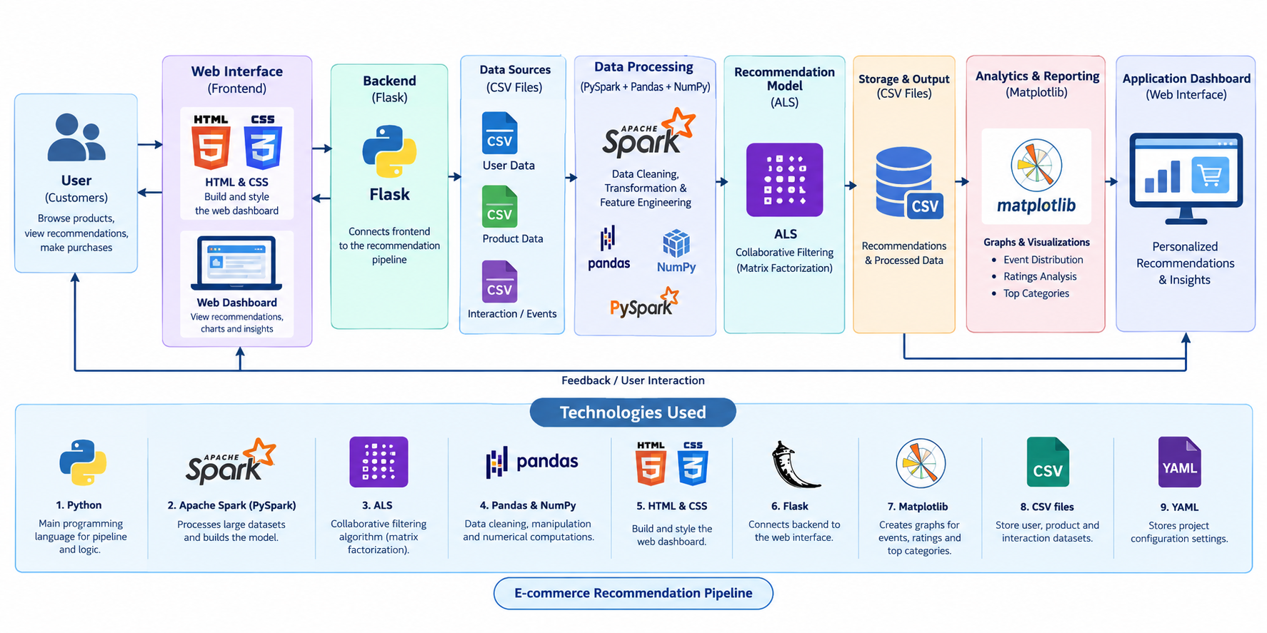
System Architecture

