Slide 1

AI- Based Adaptive Fitness and Workout Planner
Batch 7 - Section 5
Team members
Roll No Name
2420030498 K. Sanuhya
2420030516 R. Sarvajith varma
2420030678 G. Gopi Krishna
Under the guidance of
Chandra Shekar Rendla
Department of Computer Science and Engineering
Koneru Lakshmaiah Education Foundation
(Deemed to be University estd. u/s. 3 of the UGC Act, 1956)
Off-Campus: Bachupally-Gandimaisamma Road, Bowrampet, Hyderabad, Telangana - 500 043.
Phone No: 7815926816, www.klh.edu.in

Slide 2
Table of contents
Problem Statement
Objectives
Existing System
Proposed System
Technology Used
Workflow / Architecture
Modules
Implementation Progress & Screenshots
Conclusion & Future Scope

Slide 3
Problem statement
Many users follow the same workout plans without considering their individual fitness needs.
Workout requirements differ based on fitness goals, fitness level, available time, and preferences.
Fixed workout plans do not adapt when the user's performance changes.
Users may find workouts too difficult or too easy.
There is a need for an intelligent and personalized workout planning system.
Our project aims to solve this problem by providing adaptive and personalized workout recommendations.

Slide 4
Objectives
To collect user information such as:
  Fitness goal
  Fitness level
  Preferred workout type
  Available workout time
To generate personalized workout plans.
To use AI and recommendation techniques for workout selection.
To adapt workout intensity, duration, and exercises based on performance.
To track workout progress and history.
To provide relevant recommendations based on user feedback.

Slide 5
Existing System
Most existing fitness applications provide predefined workout plans.
Users generally select workouts based on their goals or fitness level.
Plans may not continuously change according to actual user performance.
Limited personalization may result in workouts that are:
  Too difficult
  Too easy
  Not suitable for the user's available time
Limitations
Less adaptive
Limited personalization
Manual workout selection
Less consideration of previous performance

Slide 6
Proposed System
The proposed system is an AI-Based Adaptive Fitness and Workout Planner.
Key Features
Collects individual user information.
Generates personalized workout plans.
Uses workout history and performance data.
Adjusts workout intensity and duration.
Modifies exercises based on performance and feedback.
Tracks user progress.
Provides personalized workout recommendations.

Slide 7
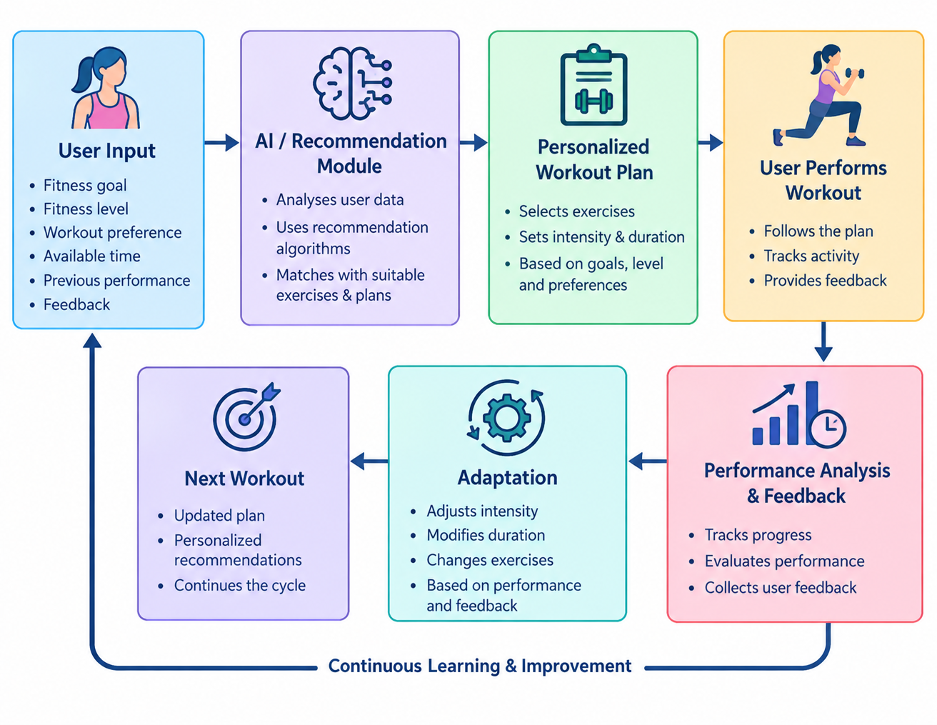

Slide 8
Technologies used
1. Frontend — HTML, CSS, JavaScript
_{User fitness details form}
_{Workout plan display}
_{Progress dashboard}
_{2. Backend — Python and Flask}
_{Processes user inputs}
_{Generates workout plans}
Connects the frontend, AI logic, and database
3. AI — Python-based intelligent recommendation logic
Recommends exercises based on fitness goals and level
Adjusts workout difficulty based on user performance
Uses feedback to improve subsequent workout plans
_{4. Database — MySQL}
Stores user profiles and fitness goals
Stores exercises and workout plans
Records workout history, progress, and feedback
5. Development Tool — Visual Studio Code
Writing, running, and debugging the project

Slide 9
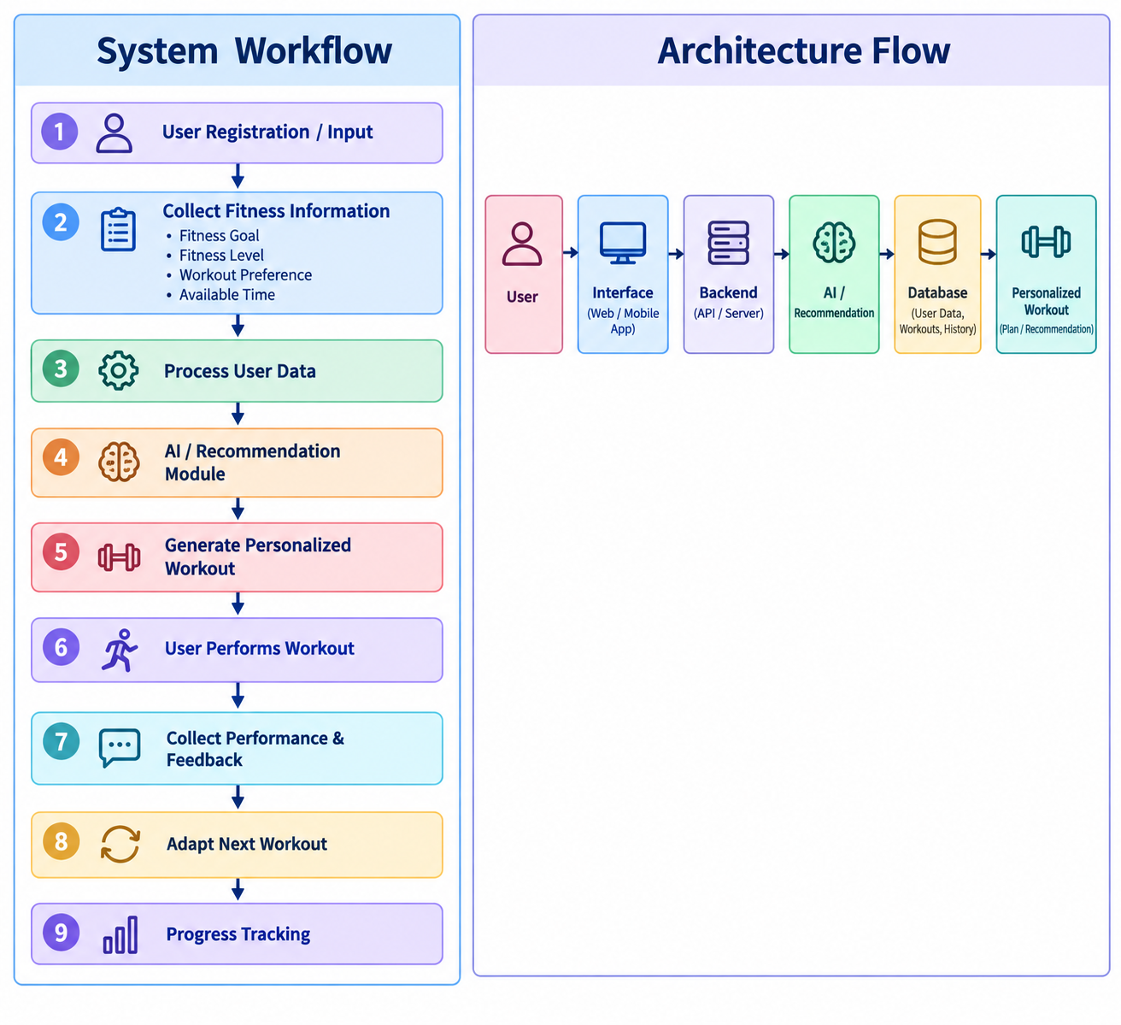
Workflow/ Architecture

Slide 10
Modules
1. User Profile Module
Stores user fitness details and preferences.
2. Fitness Assessment Module
Collects fitness level, goals and available workout time.
3. Workout Recommendation Module
Generates suitable exercises and workout plans.
4. Adaptive Workout Module
Adjusts intensity, duration and exercises based on performance.
5. Workout Tracking Module
Records workout history and progress.
6. Feedback Module
Collects user feedback about workout difficulty and performance.
7. Progress & Recommendation Module
Uses previous performance to provide improved recommendations.

Slide 11
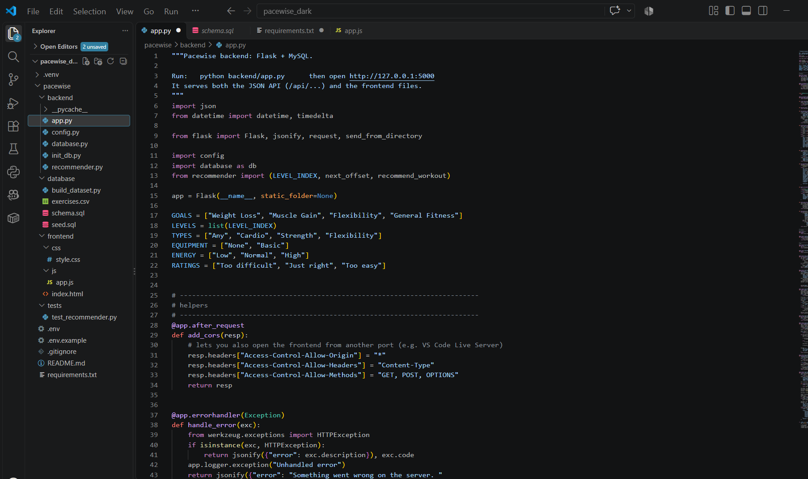
Implementation Progress and screenshots

Slide 12
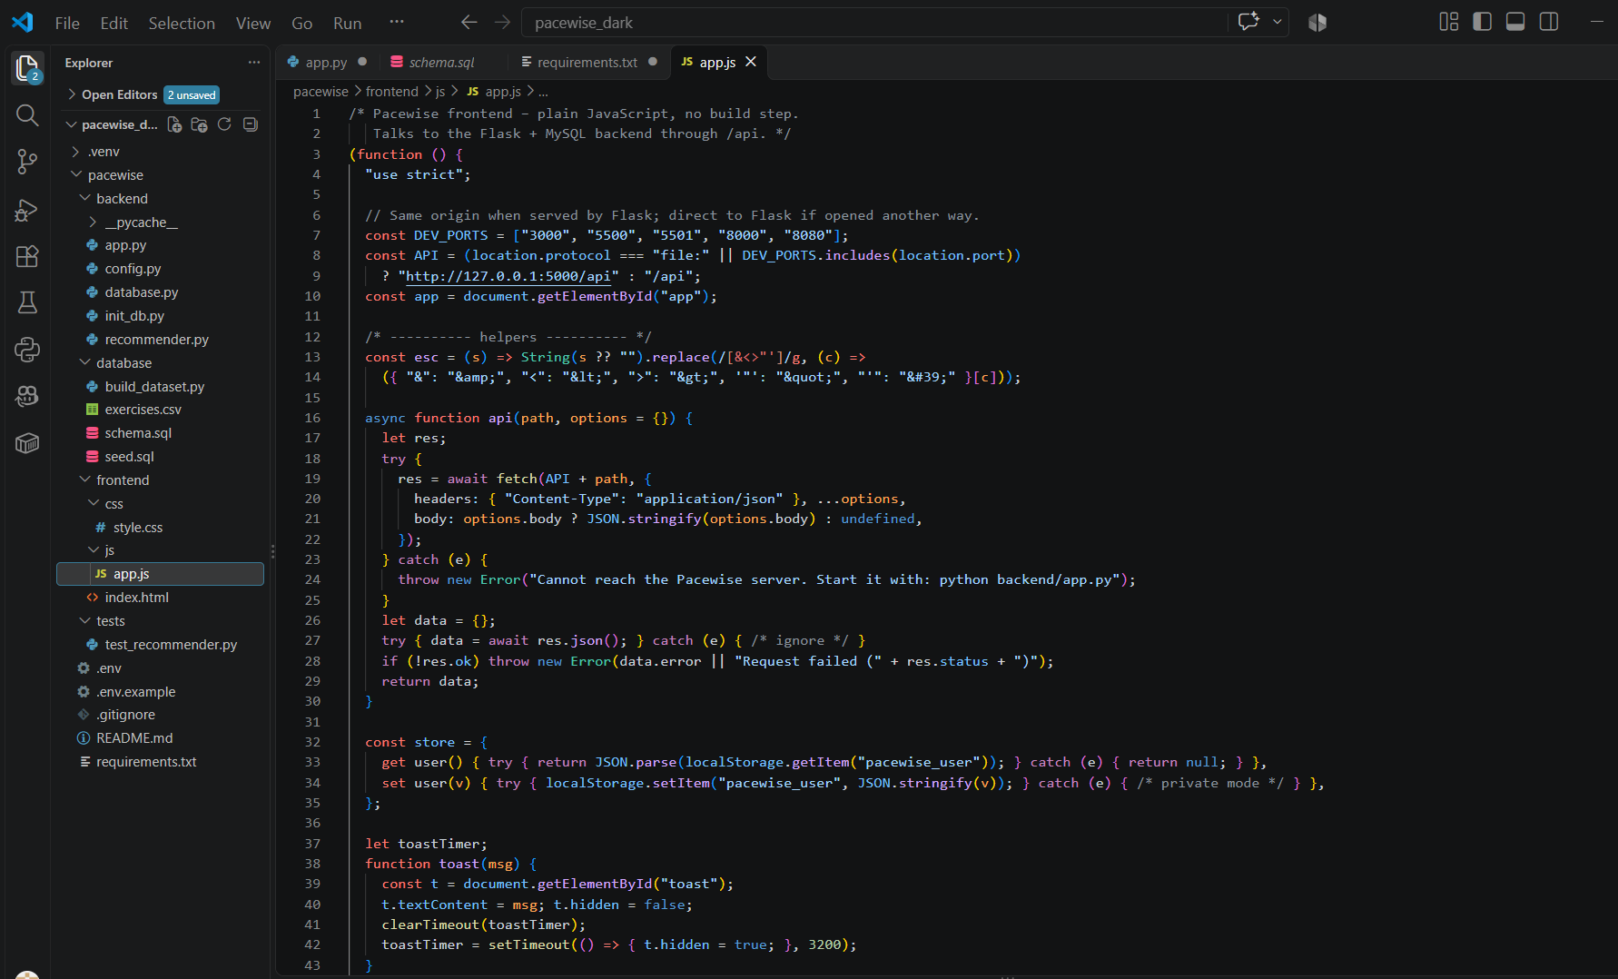
Implementation Progress and screenshots

Slide 13
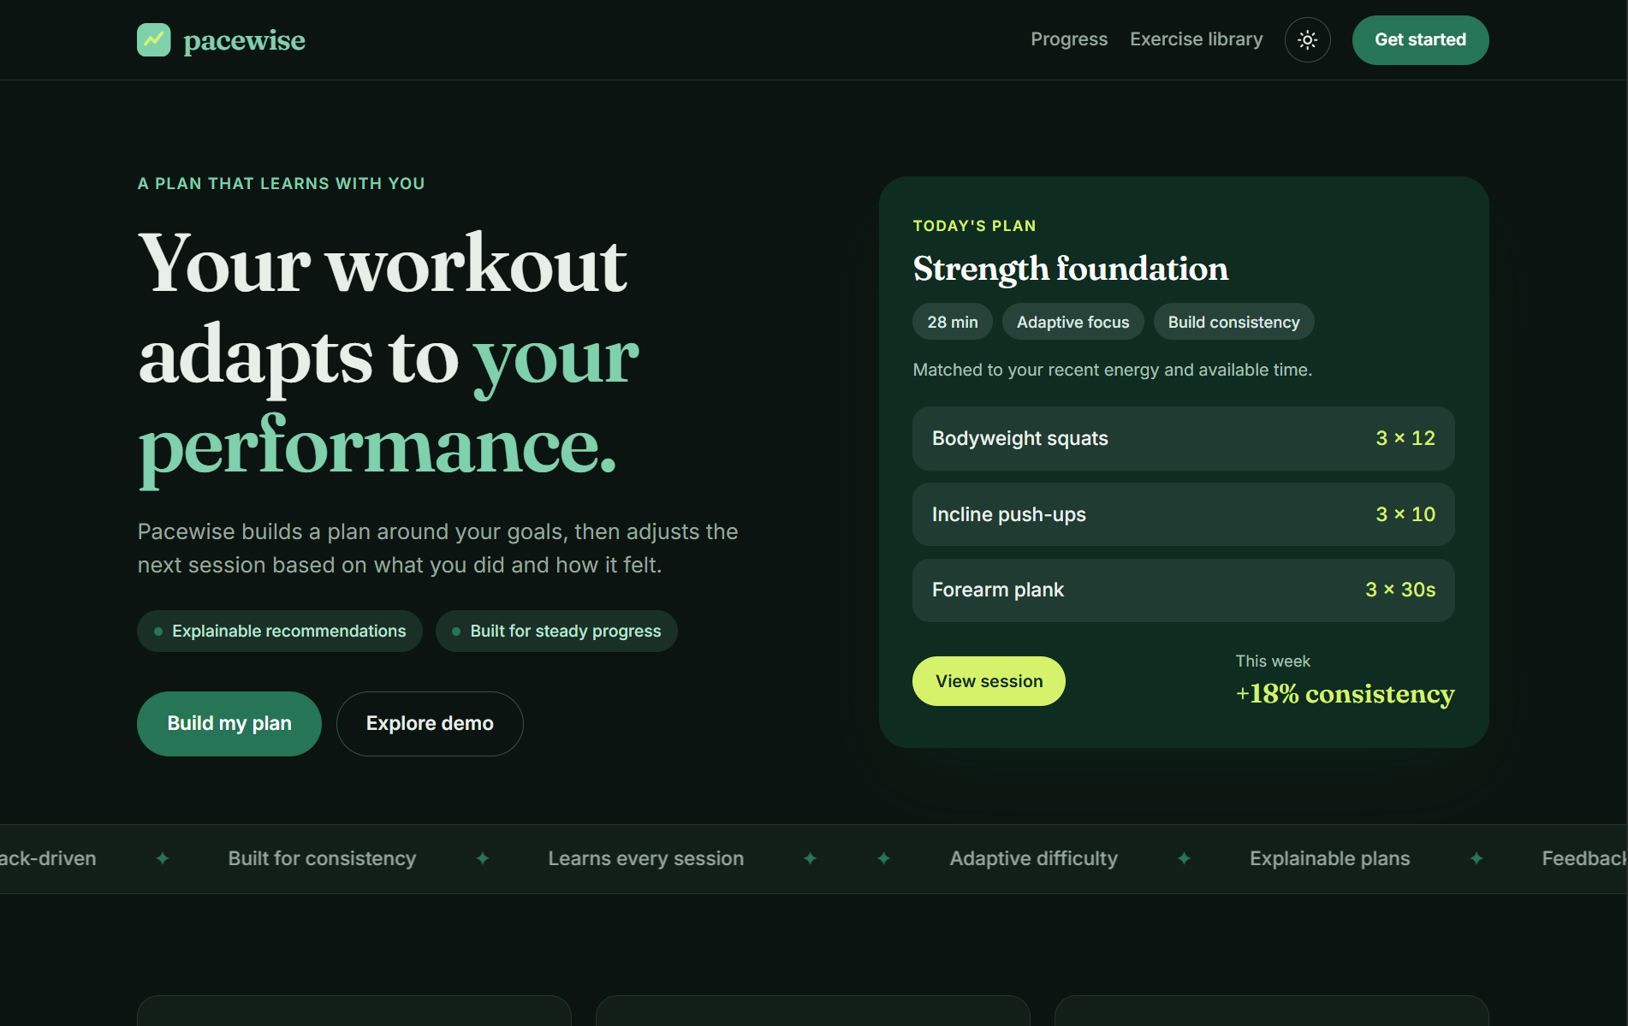
Implementation Progress and screenshots

Slide 14
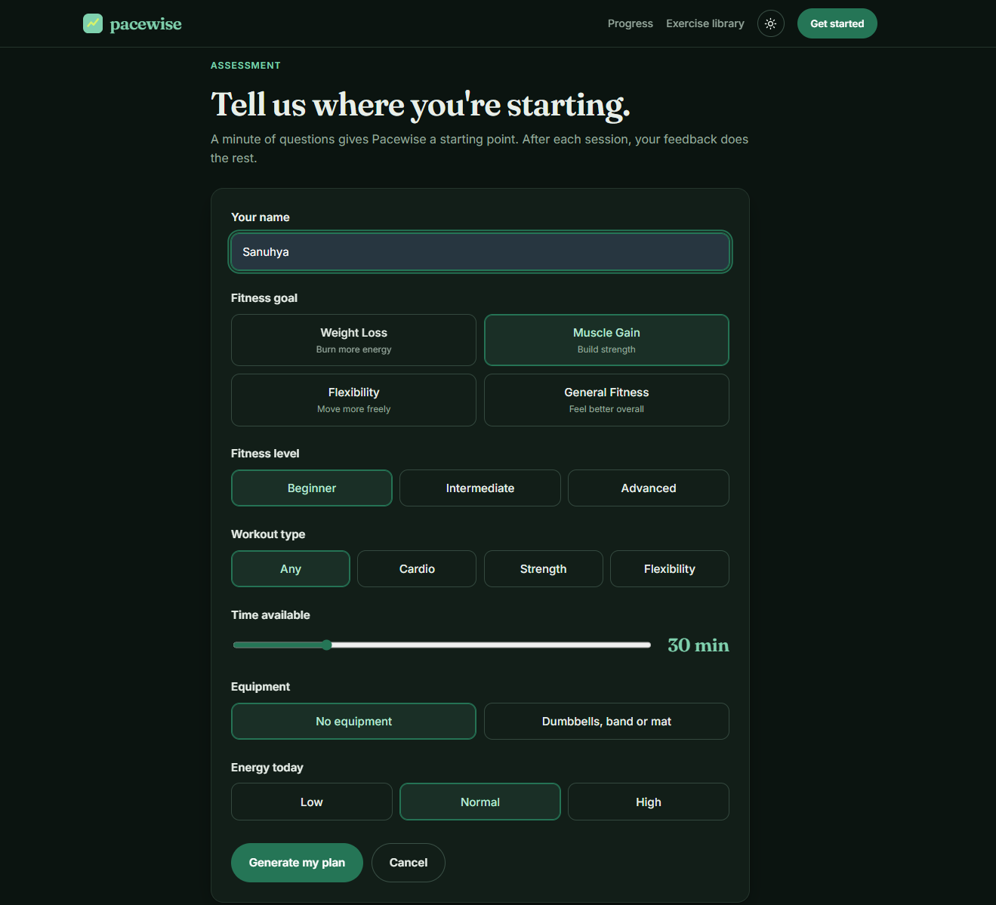
Implementation Progress and screenshots

Slide 15
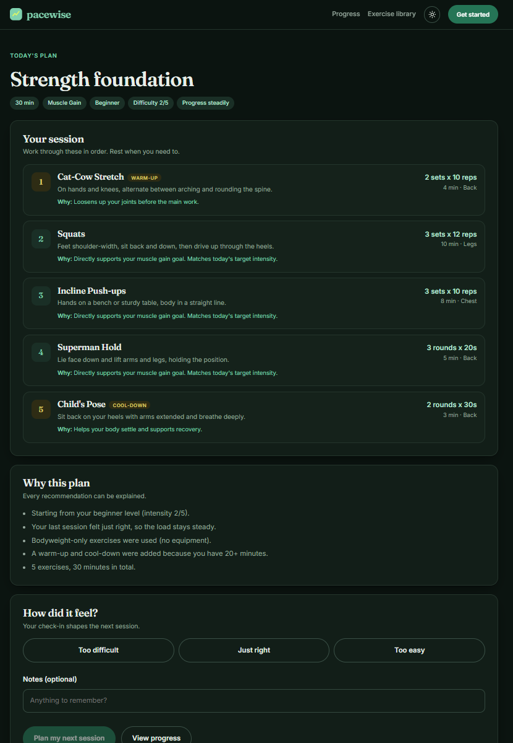
Implementation Progress and screenshots

Slide 16
Conclusion and Future scope
Conclusion
The AI-Based Adaptive Fitness and Workout Planner provides personalized workout recommendations based on individual fitness goals, fitness levels, preferences, and available time. It uses AI-based recommendation logic to adjust workout intensity, duration, and exercises according to user performance and feedback. The system also tracks workout history and progress, helping users follow suitable and effective workout plans.
Future Scope
Real-Time Adaptation: Improve workout plans dynamically based on user performance.
Wearable Integration: Connect smartwatches and fitness bands to collect activity and health data.
AI Improvements: Use advanced machine learning techniques to provide more accurate recommendations.
Nutrition Planning: Add personalized diet and nutrition recommendations.
Progress Visualization: Provide detailed progress charts and fitness reports.
Mobile Application: Develop a mobile app for convenient access to workout plans and progress tracking.

Slide 17
THANK YOU

