Slide 1
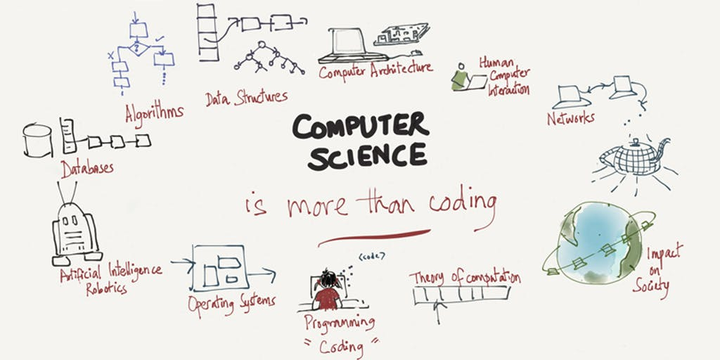

Slide 2
Introduction to Computer Programming

Slide 3
Outline of Topics
Hardware/Software interface
  Layers of the Machine
  Kinds of Software
Computer Languages
Syntax, Semantics, Grammars
What happens to your program?
  Compilation, Linking, Execution
  Program errors
Compilation vs. Interpretation etc.

Slide 4
Software Categories
System SW
  Programs written for computer systems
    Compilers, operating systems, …
Application SW
  Programs written for computer users
    Word-processors, spreadsheets, & other application packages

Slide 5
A Layered View of the Computer
Application Programs
Word-Processors, Spreadsheets,
Database Software, IDEs,
etc…
System Software
Compilers, Interpreters,Preprocessors, etc.
Operating System, Device Drivers
Machine with all its hardware

Slide 6
Operating System (OS)
Provides several essential services:
  Loading & running application programs
  Allocating memory & processor time
  Providing input & output facilities
  Managing files of information

Slide 7
Programs
Programs are written in programming languages
  PL = programming language
  Pieces of the same program can be written in different PLs
    Languages closer to the machine can be more efficient
    As long as they agree on how to communicate
A PL is
  A special purpose and limited language
  A set of rules and symbols used to construct a computer program
  A language used to interact with the computer

Slide 8
Computer Languages
Machine Language
  Uses binary code
  Machine-dependent
  Not portable
Assembly Language
  Uses mnemonics
  Machine-dependent
  Not usually portable
High-Level Language (HLL)
  Uses English-like language
  Machine independent
  Portable (but must be compiled for different platforms)
  Examples: Pascal, C, C++, Java, Fortran, . . .

Slide 9
Machine Language
The representation of a computer program which is actually read and understood by the computer.
  A program in machine code consists of a sequence of machine instructions.
Instructions:
  Machine instructions are in binary code
  Instructions specify operations and memory cells involved in the operation
Example:
Operation | Address
0010 | 0000 0000 0100
0100 | 0000 0000 0101
0011 | 0000 0000 0110

Slide 10
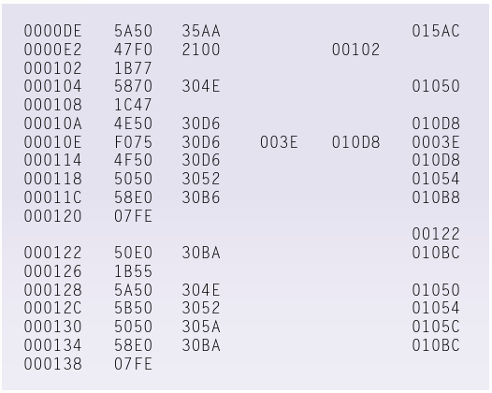

Slide 11
Assembly Language
A symbolic representation of the machine language of a specific processor.
Is converted to machine code by an assembler.
Usually, each line of assembly code produces one machine instruction (One-to-one correspondence).
Programming in assembly language is slow and error-prone but is more efficient in terms of hardware performance.
Mnemonic representation of the instructions and data
Example:
  Load Price
  Add Tax
  Store Cost

Slide 12
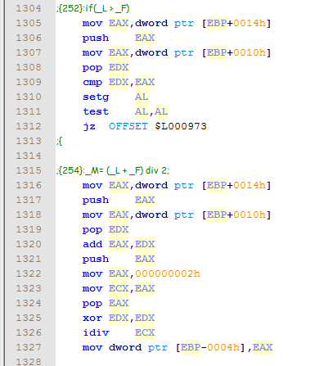

Slide 13
High-level language
A programming language which use statements consisting of English-like keywords such as "FOR", "PRINT" or “IF“, ... etc.
Each statement corresponds to several machine language instructions (one-to-many correspondence).
Much easier to program than in assembly language.
Data are referenced using descriptive names
Operations can be described using familiar symbols
Example:
Cost := Price + Tax

Slide 14
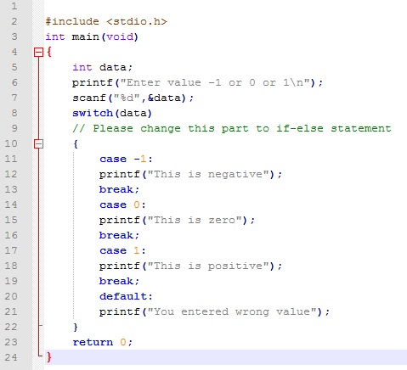

Slide 15
Syntax & Semantics
Syntax:
  The structure of strings in some language. A language's syntax is described by a grammar.
  Examples:
    Binary number
      <binary_number> = <bit> | <bit> <binary_number>
      <bit> = 0 | 1
    Identifier
      <identifier> = <letter> {<letter> | <digit> }
      <letter> = a | b | . . . | z
      <digit = 0 | 1 | . . . | 9
Semantics:
  The meaning of the language

Slide 16
Compilers & Programs
Compiler
  A program that converts another program from some source language (or high-level programming language / HLL) to machine language (object code).
  Some compilers output assembly language which is then converted to machine language by a separate assembler.
  Is distinguished from an assembler by the fact that each input statement, in general, correspond to more than one machine instruction.

Slide 17
Compilation into Assembly L
Assembly Language
Source
Program
Compiler
Assembly Language
Machine
Language
Assembler
Notes:
Instead of to ML
Facilitates debugging
Isolates compiler from changes in format of ML (new OS)
Only assembler must be changed!

Slide 18
Compilers & Programs
Source program
  The form in which a computer program, written in some formal programming language, is written by the programmer.
  Can be compiled automatically into object code or machine code or executed by an interpreter.
  Pascal source programs have extension ‘.pas’

Slide 19
Compilers & Programs
Object program
  Output from the compiler
  Equivalent machine language translation of the source program
  Files usually have extension ‘.obj’
Executable program
  Output from linker/loader
  Machine language program linked with necessary libraries & other files
  Files usually have extension ‘.exe’

Slide 20
Program Errors
Syntax Errors:
  Errors in grammar of the language
Runtime error:
  When there are no syntax errors, but the program can’t complete execution
    Divide by zero
    Invalid input data
Logical errors:
  The program completes execution, but delivers incorrect results
  Incorrect usage of parentheses

Slide 21
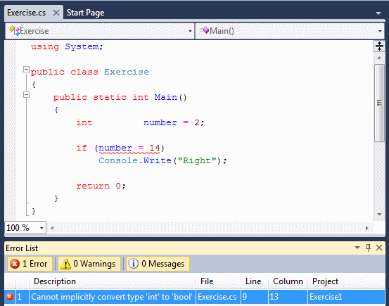
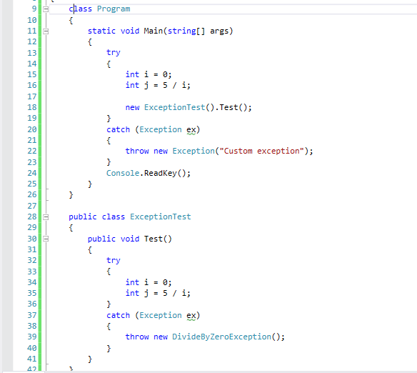
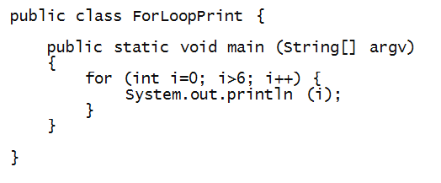

Slide 22
Compilation
Source
Program
Compiler
Target
Program
Input
Target Program
Output
Compiler translates source into target (a machine language program)
Compiler goes away at execution time
Compiler is itself a machine language program, presumably created by compiling some other high-level program
Machine language, when written in a format understood by the OS is object code

Slide 23
Interpretation
Source
Program
Interpreter
Output
Input
The interpreter stays around during execution
It reads and executes statements one at a time

Slide 24
Compilation vs. Interpretation
Compilation:
  Syntax errors caught before running the program
  Better performance
  Decisions made once, at compile time
Interpretation:
  Better diagnostics (error messages)
  More flexibility
  Supports late binding (delaying decisions about program implementation until runtime)
    Can better cope with PLs where type and size of variables depend on input
  Supports creation/modification of program code on the fly (e.g. Lisp, Prolog)

Slide 25
Mixture of C & I
Source
Program
Translator
Intermediate
Program
Intermediate
Program
VM
Output
Input
Many programming languages implement this
Interpreter implements a Virtual Machine (VM).

Slide 26
JAVA
  For portability:
Java
Compiler
bytecode
ML
Interpreter
  For flexibility: Just In Time (JIT) compiler translates bytecode into ML just before execution

Slide 27


Slide 28
Dr. M. Shafraz shafraz@nsbm.ac.lk

