Slide 1
5COSC019W – Object Oriented Programming Week 2

Slide 2
Outline
Static methods and variables
Static, non-static context
Differences: instance, class and local variable
Using Java Predefined Classes
String class and Packages
UML diagrams

Slide 3
Last week…
Objects and Classes
Class declaration
Object as instance of a class
Constructors
Object Assignment
Overloading methods

Slide 4
RECAP – A Class
A class is the collection of related data and functions under a single name
When related data and functions are kept under a class, it helps to visualize the complex problem efficiently and effectively.
Person
- name: String
surname:String
age: int
+ Person(String: name)
+ Person(String:name, String:surname)
+ setSurname(s: String): void
+ setAge(int n): void
+ getSurname(): String
+ getAge(): int
Notes:
Object − Objects have states and behaviors. Example: A dog has states - color, name, breed as well as behaviors – wagging the tail, barking, eating. An object is an instance of a class.
Class − A class can be defined as a template/blueprint that describes the behavior/state that the object of its type support.

Slide 5
Defining the class
public class Person{
attributes/data/variables for Person
Constructors: to instantiate objects
Methods: to interact with the object
}
}

Slide 6
Example
^{class Person {}
^{private String name;}
^{private String surname;}
^{private int age;}
^{public Person(String n) {}
^{name= n;}
}
public Person(String n, String s) {
^{name= n;}
^{surname = s;}
}
^{public String getSurname() {}
^{return surname;}
}
^{public int getAge() {}
^{Return age;}
}
… }
Attributes of the class Person
Constructors
Methods

Slide 7
Keywords: private and public
Private variables and methods are accessible inside that class only
Public variables and methods are accessible both inside and outside the class.
This feature in OOP is known as data hiding. If programmer mistakenly tries to access private data outside the class, compiler shows error which prevents the misuse of data.

Slide 8
Accessing variables and methods
Variables and methods can be accessed in similar way using member operator (.)
Example: method1() can be called using code:
object_name.method1();
Similarly a variable can be accessed:
Object_name.nameVariable
They can be accessed outside the class only if they are not private!

Slide 9
Dynamic Variables and Methods
All instance variables and methods we have created so far have been dynamic
Note: There is no “dynamic” keyword in Java
Dynamic by default
In general, dynamic refers to things created at
“run time” i.e. when the program is running
Every object gets its own (dynamic) instance variables.
The absence of the keyword static before non-local variables and methods means dynamic (one per object/instance)

Slide 10
Static Variables
Static means “pertaining to the class in general”, not to an individual object
A variable may be declared (outside of a method) with the static keyword:
E.g. static int numTicketsSold;
A static variable is shared by all instances (if any).
All instances may be able to read/write it
A static variable that is public may be accessed by:
ClassName.variableName
Example: Math.PI

Slide 11
Static methods
A method may be declared with the static keyword
Static methods live at class level, not at object level
Static methods may access static variables and
methods, but not dynamic ones
Example:
public static int getNumSold(){
return numTicketsSold;
}
Static variable

Slide 12
Static Methods
A static method that is public can be accessed
ClassName.methodName(args)
Examples:
double result = Math.sqrt(25.0);
int numSold = Ticket.getNumberSold();
Notes:
https://docs.oracle.com/javase/7/docs/api/java/lang/Math.html

Slide 13
Example
public class Ticket{
private static int numTicketsSold = 0; // shared
private int ticketNum; // one per object
public Ticket(){
numTicketsSold++;
ticketNum = numTicketsSold;
}
public static int getNumberSold() {
return numTicketsSold;
}
public int getTicketNumber() {
return ticketNum;
}
public String getInfo(){
return "ticket # " + ticketNum + "; " +
numTicketsSold + " ticket(s) sold.";
}
}

Slide 14
Example - output
> Ticket.getNumberSold()
0
> Ticket t1 = new Ticket();
> t1.getTicketNum()
1
> t1.getInfo()
"ticket # 1; 1 ticket(s) sold."
> t1.getNumberSold()
1
> Ticket t2 = new Ticket();
> t2.getTicketNum()
2
> t2.getInfo()
"ticket # 2; 2 ticket(s) sold."
> t2.getInfo()
"ticket # 2; 2 ticket(s) sold."
> t1.getInfo()
"ticket # 1; 2 ticket(s) sold."
> Ticket.getNumberSold()
2

Slide 15

Ticket t1
Ticket t2
Instance
Variable
numTicketSold
0
1
ticketNumber
1
2
ticketNumber
2
0
0
Static
Variable

Slide 16
Static context
To have standalone Java Application we need a
public static void main(String args[]) method
The main method belongs to the class in which it is written
It must be static because, before your program starts, there aren’t any objects to send messages to
This is a static context (a class method)
You can send messages to objects, if you have some objects: d1.bark();
You cannot send a message to yourself, or use any instance variables - this is a static context, not an object
Non-static variable cannot be referenced from a static context

Slide 17
A wrong example
public class JustAdd {
int x;
int y;
int z;
public static void main(String args[]) {
x = 5;
y = 10;
z = x + y;
}
}

Slide 18
Solution
public class JustAdd { int x; int y; int z;
public static void main(String args[]) { JustAdd myAdd = new JustAdd();
myAdd.doItAll();
}
void doItAll() {
x = 5;
y = 10;
z = x + y;
} }

Slide 19
When to use static
A variable should be static if:
It logically describes the class as a whole
There should be only one copy of it
A method should be static if:
It does not use or affect the objects

Slide 20
Static – Non-static
We can access static variables without creating an instance of the class
As they are already available at class loading time, we can use them in any of our non static methods.
We cannot use non static methods and variables without creating an instance of the class as they are bound to the instance of the class.
They are initialized by the constructor when we create the object using new operator.

Slide 21
Example
Class staticDemo{
public static int a = 100; // All instances of staticDemo have this // variable as a common variable
public int b =2 ;
public static void showA(){
System.out.println(“A is ” +a);
}
}
Class exerciseClass{
public static void main(String args[]){
staticDemo.a = 35; // when we use the class name, the class is // loaded, direct access to a without any instance
staticDemo.b = 22;
staticDemo demo = new staticDemo();
demo.b = 200; // valid to set a value for a non static variable after // creating an instance.
staticDemo.showA(); //prints 35
}
}
// ERROR this is not valid for non static variable

Slide 22
Why do we need this?
Static methods are identified to be mostly used when we are writing any utility methods.
We can also use static variables when sharing data.
When sharing data do keep in mind about multithreading can cause inconsistency in the value. (synchronize the variable) WE WILL SEE LATER DURING THE MODULE

Slide 23
Recap: Class variables and methods
We saw that:
Instance variables belong to a specific instance.
Instance methods are invoked by an instance of the class.
We can also define:
Class variables are shared by all the instances of the class.
Class methods are not tied to a specific object.
To declare class variables and methods, use the static modifier.

Slide 24
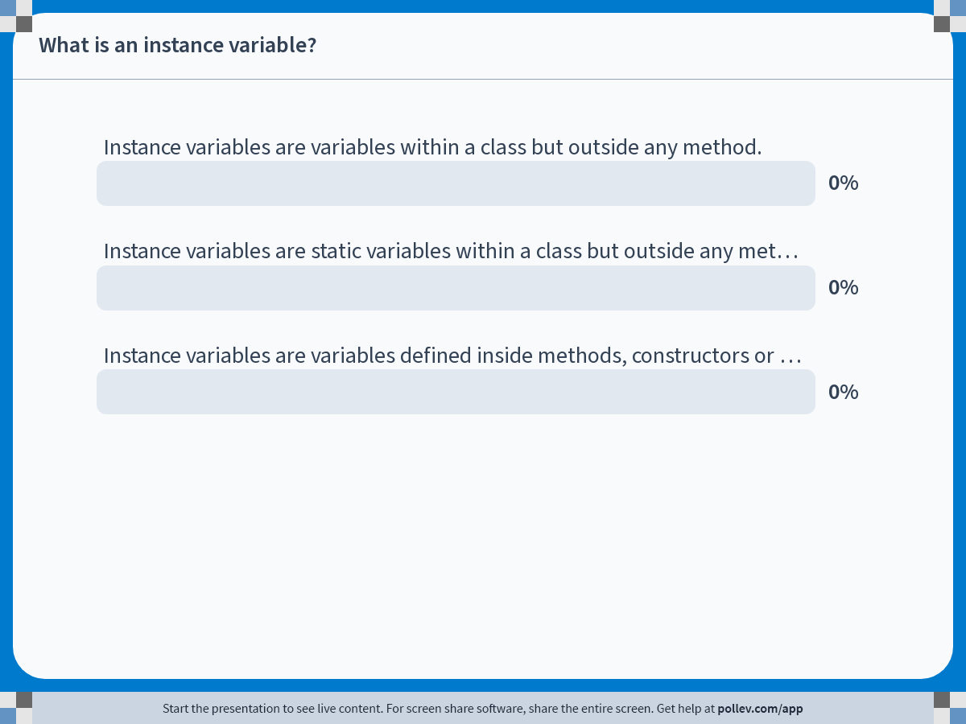
Notes:
Do not modify the notes in this section to avoid tampering with the Poll Everywhere activity. More info at polleverywhere.com/support What is an instance variable?
https://www.polleverywhere.com/multiple_choice_polls/HjpMG9ytPUrmaEebfhx07

Slide 25
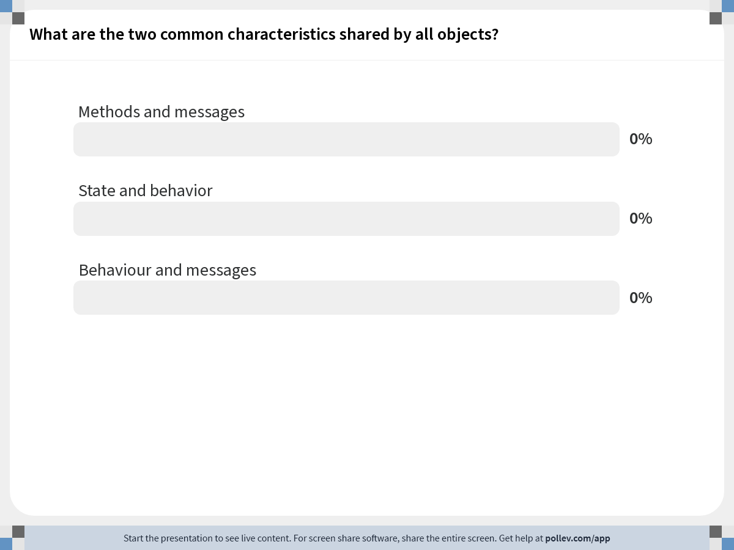
Notes:
Do not modify the notes in this section to avoid tampering with the Poll Everywhere activity. More info at polleverywhere.com/support What are the two common characteristics shared by all objects?
https://www.polleverywhere.com/multiple_choice_polls/XdJh0GpvsiFtV2U

Slide 26
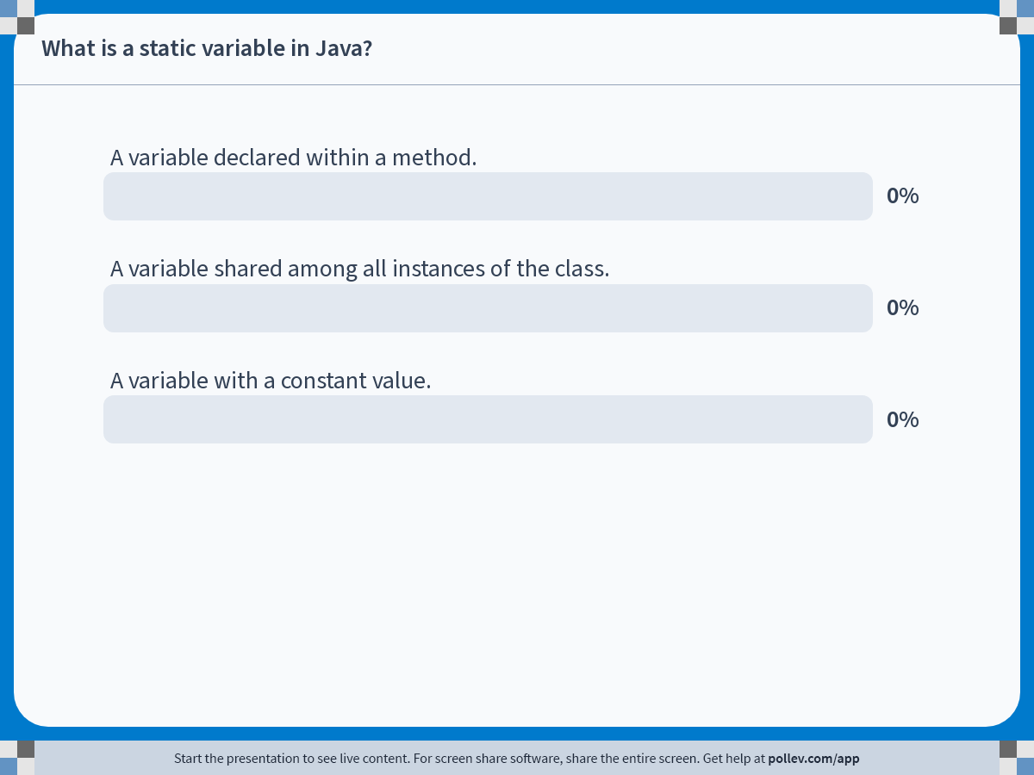
Notes:
Do not modify the notes in this section to avoid tampering with the Poll Everywhere activity. More info at polleverywhere.com/support What is a static variable in Java?
https://www.polleverywhere.com/multiple_choice_polls/eGQoIG8bpIsqQPsqPPl8U

Slide 27
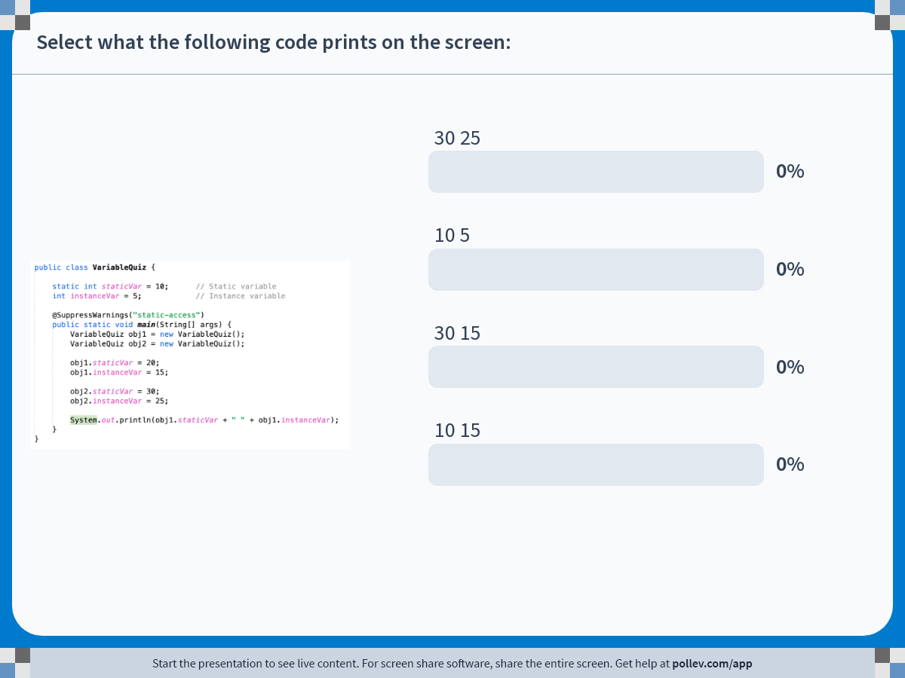
Notes:
Do not modify the notes in this section to avoid tampering with the Poll Everywhere activity. More info at polleverywhere.com/support Select what the following code prints on the screen:
https://www.polleverywhere.com/multiple_choice_polls/9YUA3sBIWTwbvUVm2DhfV

Slide 28
Using Java Predefined Classes

Slide 29
Using Java Predefined Classes
Java Packages
The String Class
The Math Class

Slide 30
Java Predefined Classes
Included in the Java SDK are more than 2,000 classes that can be used to add functionality to our programs
APIs for Java classes are published on the Oracle web site:
https://docs.oracle.com/javase/7/docs/api/

Slide 31
Java Packages
Classes are grouped in packages according to functionality
Package | Categories of Classes
java.lang | Basic functionality common to many programs, such as the String class and Math class
java.awt | Graphics classes for drawing and using colors
javax.swing | User-interface components
java.text | Classes for formatting numeric output
java.util | The Scanner class and other miscellaneous classes

Slide 32
Using a Class From a Package
Classes in java.lang are automatically available to use
Classes in other packages need to be "imported" using this syntax:
import package.ClassName;
or
import package.*;
Example
import java.text.DecimalFormat;
or
import java.text.*;

Slide 33
The String Class
Represents a sequence of characters
String constructors:
String( String str ) allocates a String object with the value of str, which can be String object or a String literal
String( ) allocates an empty String

Slide 34
Constructing Strings
String newString = new String(stringLiteral);
String message = new String("Welcome to Java");
Since strings are used frequently, Java provides a shorthand initializer for creating a string:
String message = "Welcome to Java";

Slide 35
The length Method
Return type | Method name and argument list
int | length( ) returns the number of characters in the String
Example:
String hello = "Hello";
int len = hello.length( );
The value of len is 5

Slide 36
The Math Class Constants
Two static constants
PI - the value of pi
E - the base of the natural logarithm
Example:
System.out.println( Math.PI );
System.out.println( Math.E );
output is:
3.141592653589793
2.718281828459045

Slide 37
Methods of the Math Class
All methods are static
Return type | Method name and argument list
dataTypeOfArg | abs( dataType arg ) returns the absolute value of the argument arg, which can be a double, float, int or long.
double | log( double a ) returns the natural logarithm (in base e) of its argument.
double | sqrt( double a ) returns the positive square root of a
double | pow( double base, double exp ) returns the value of base raised to the power of exp

Slide 38
UML - The Unified Modeling Language

Slide 39

UML
De-facto standard notation – A small subset introduced in COMP1008.
– Maintained by the OMG (Object Management Group), see www.uml.org
UML provides a complete language for describing object-oriented models (like a programming language).
Also provides a visual notation for displaying models. – This is what we are interested in here.

Slide 40
Building Blocks of UML
Things -- abstraction
Relations -- tie things together
Diagrams -- group interesting collections of things

Slide 41
Objects and Classes
 | Interpretation in the Real World | Interpretation in the Model
Object | An object is a thing that can be distinctly identified. | An object has an identity, a state, and a behavior.
Class | A class represents a set of objects with similar characteristics and behavior. This objects are called the instances of the class. | A class characterizes the structure of states and behaviors that are shared by all instances.

Slide 42
UML Notation for Classes
ClassName | The top compartment shows the class name.
field₁ … field_{n} | The middle compartment contains the declarations of the fields of the class.
method₁ … method_{m} | The bottom compartment contains the declarations of the methods

Slide 43
Field Declaration
The name of the field is required in the field declaration.
Field declaration may include:
[Visibility]Name[[Multiplicity]][:Type][=InitialValue]
Visibility or accessibility defines the scope:
Public -- the feature is accessible to any class
Protected -- the feature is accessible to the class itself, all the classes in the same package, and all its subclasses.
Package -- the feature is accessible to the class itself and all classes in the same package.
Private -- the feature is only accessible within the class itself.

Slide 44
Visibility syntax in Java and UML
Visibilty | Java Syntax | UML Syntax
public | public | +
protected | protected | #
package |  | ~
private | private | -

Slide 45
Examples
Java Syntax | UML Syntax
Date birthday | Birthday:Date
public int duration = 100 | +duration:int = 100
private Student students[MAX_Size] | -students[0..MAX_Size]:Student

Slide 46
Method Declaration
The name of the method is required in the method declaration.
Method declaration may include:
[Visibility]Name([Parameter, ...])[:Type]

Slide 47
Examples
Java Syntax | UML Syntax
void move(int dx, int dy) | move(dx:int, dy:int): void
public int getSize() | + getSize():int

Slide 48
Example
Class name: Point class Point {
Fields: x, y int x, y;
Method: move public void move
(int dx, int dy){
// implementation
}

Slide 49
Example
Point
private int x private int y
public void move(int dx,int dy)
UML Standard
Point
-x:int -y:int
+move(dx:int,dy:int)

Slide 50
UML Notation for Object
ObjectName : ClassName | The top compartment shows the object name and its class.
field₁ = value₁ … field_{n} = value_{n} | The bottom compartment contains a list of the fields and their values.

Slide 51
Example
P1:Point | Point p1 = new Point();
x = 0 y = 0 | p1.x = 0; P1.y = 0;

Slide 52
Association
Solid line that connects two classes represents an association
numbers near end of each line are multiplicity values
Student
1..* enroll
1..1
Course
1..*
teach
1..1
School

Slide 53
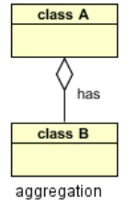
Aggregation
It is a special form of association. It represents Has-A relationship.
It is a unidirectional association i.e. a one way relationship.
Both the entries can survive individually which means ending one entity will not effect the other entity
School
Student

Slide 54
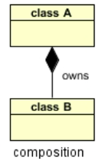
Composition
The composition link shows that a class (container, whole) has exclusive ownership over other class/s (parts).
It represents owns relationship
It implies a relationship where the child cannot exist independent of the parent.
Car
When the Person object is destroyed the Leg object get destroyed with it.
Wh

Slide 55
Modeling Requirements with Use Cases
Use cases describes the externally observable behavior of system functions in the form of interactions between the system to be developed and the external entities -- Actors.
Actors may represent roles played by users of the system or other systems.

Slide 56
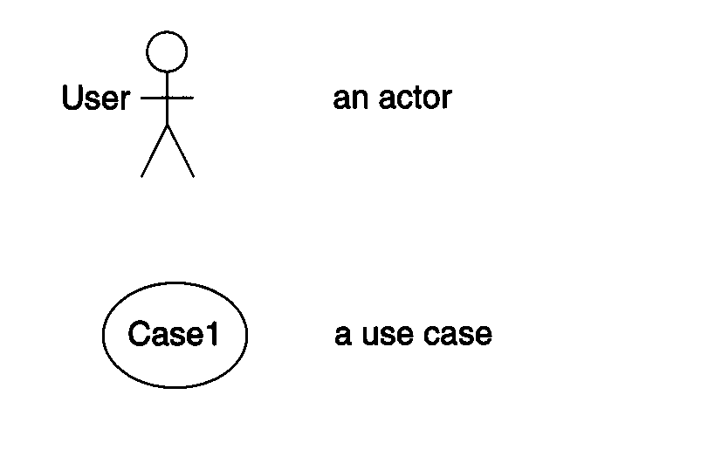
Use Case Diagram
Consist of:
Use cases
Actors
Associations between actors and use cases are indicated in use case diagrams by solid lines

Slide 57
Example
Open Account
Bank Employee
<<extend>>
Deposit Fund
Calculate Bonus
Customer
<<include>>
Withdraw Fund
Update Balance
<<include>>
Extend relationship:
The use case connected by extend can supplement the base use case
Include relationship:
It indicates that the use case to which the arrow points is included in the use case on the other side of the arrow

