Slide 1
React + Redux + TypeScript + .NET

Slide 2
React Fundamentals

Slide 3
React
Open source JavaScript library for building dynamic user interfaces
The ‘V’ in MVC
Can build Single Page Applications (SPA), fast & interactive UIs
ReactNative - allows to create native mobile applications using React
Other alternatives - Angular, Vue.js
React uses ES6 (ECMAScript 6)
React uses virtual DOM (JavaScript object), which improves the performance of the app
Virtual DOM - lightweight, in-memory representation of the UI. Different from the real browser DOM.
JavaScript virtual DOM is faster than the regular DOM.

Slide 4
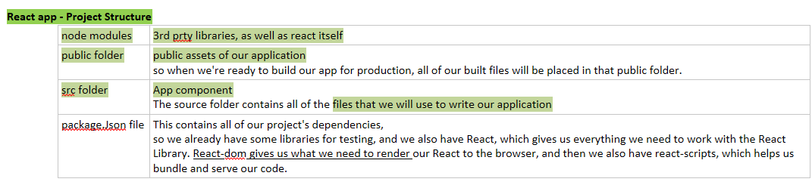

Slide 5
React Elements
The most atomic unit in a React application.
Create element calls – to render React elements to the DOM

Slide 6
JSX
JavaScript as XML
Is a language extension that allows to write HTML tags directly in the JavaScript.
Special type of syntax - that makes coding easy
JSX expressions get compiled to react elements calls
Babel
JavaScript compiler & transpiler used to convert one source code to another
It compiles React JSX and ES6 to ES5 JavaScript (plain JavaScript) which can be run on all browsers or code that browsers cn understand

Slide 7
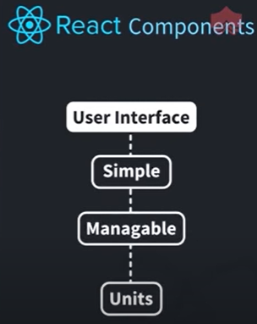
React Components
Class components
a class component has its lifecycle methods
Function components, unlike class components do not provide state management features
To incorporate state in function components React offers an API called Hooks
Root component
every react app has at least 1 component - app component
Represents the internal application & contains other child components (ex: nav bar)
So every react app is essentially a tree of components
React.Fragment - to avoid creating another HTML tag

Slide 8
States
States can change
Basically it's an object tht holds any data that a component needs
It can hold complex objects too
State changes are automatically updated in the DOM
getInitialState() - Returns an object of states
States are accessible via – this.state.stateName
Should never write to a state variable directly
Can mutate a state variable via – this.setState()

Slide 9
Lifecycle Methods
componentDidMount() - Invokes immediately after a component is mounted
componentWillMount()

Slide 10
Props
With props we can display dynamic data within a component
Properties of the component
It's common to see values from the props object de-structured for brevity
Accessible via – this.props.propName

Slide 11
Destructuring
Array destructuring
Object destructuring (props)

Slide 12
Hooks API
A hook is a function that allows you to add some functionality to a component.
React has a number of built-in hooks to handle common use cases
useState - to incorporate state in a function component
useEffect hook
The second argument that is sent to useEffect is called the dependency array.
In that array we will use the state variable that we want to listen for changes in.
To fetch data
useReducer hook
Takes in the current state, and it returns a new state.

Slide 13
Handling APIs
Fetch
Returns a promise
Gives a result tht we need to map to JSON
Axios
Promised-based HDP library to make API calls.
It's syntax simplifies how to make the calls, and one of it's biggest advantage is automatic transformation of JSON data.

Slide 14
React Router
Routing - process of directing a user to different pages based on their action or request
In React.js the process of routing is used for developing Single Page Web Applications, mainly to define multiple routes in the application.
React has a standard library system to create routing in the React application using React Router Package.
Use React Router to route to pages based on URL

Slide 15

Styled Components
CSS-in-JS (combination of JavaScript & CSS)
A library built for React & React Native developers
With styled-components, there is no need to map your created components to external CSS styles
Allows to use component level customized styles
Helps to keep the code organized
Install styled components & then import it

Slide 16
Server Side Rendering (SSR)
Client-side rendering
Browser downloads a minimal HTML page. It renders the JavaScript and fills the content into it.
Server-side rendering
renders the React components on the server. The output is HTML content.
Can combine these two to create an isomorphic app
React server side rendering can be done with Node.js, Express.js

Slide 17
Redux Fundamentals

Slide 18
State Management
One of the most important decisions you'll make when deciding how to architect your React application is figuring out which state management solution to use.
Most popular options - React, Redux, MobX and Apollo GraphQL
Choosing the right approach is the difference between having unmaintainable, difficult-to-comprehend code versus code that is easy to navigate and update.
Necessity of keeping a single, global application state

Slide 19
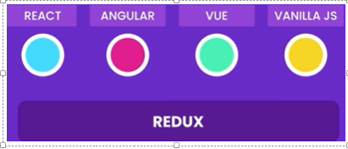
Redux
Redux is about state management
State management library for JavaScript applications
Uses the Flux architecture
Based on functional programming principles

Slide 20
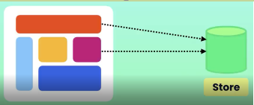
Redux Architecture
Instead of gathering application state in various parts of the UI, you store all the application state inside a central repository
This is a single JavaScript object called Store
Store holds all the data or state in our application - globalized state
This store is accessible by all parts of the UI
Having a single source of truth - having one state that you can send to all ur components
So all data in the application is in sync, as we have a single store

Slide 21
Redux (Cont.)
It's beneficial for large applications
In large applications we get lot of components that need to interact with each other to share the same state
In React we have components which have their own state
When u have a large application with lot of different components, managing state of individual components is very difficult & gets very messy
That’s where Redux or any state management tool comes in

Slide 22
Actions
Simply actions that the user can perform in the application
Simple function that returns an object
We dispatch the action to the reducer

Slide 23
We create an action object & dispatch it
The store object has a dispatch method, it takes an action
Then forward this action to the reducer
We do not call the reducer directly, we jst work with the store
The store is incharge of calling the reducer
The reducer computes the new state & returns it
Next, the store will set this state internally & thn notify the UI components about the update
Then the UI components will put out the updated data & refresh themselves

Slide 24
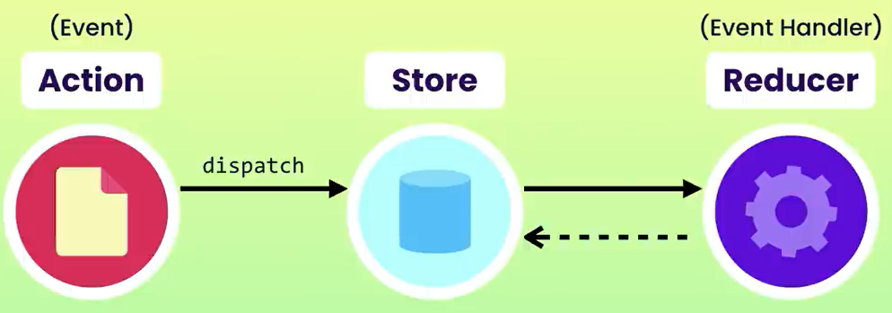

Slide 25
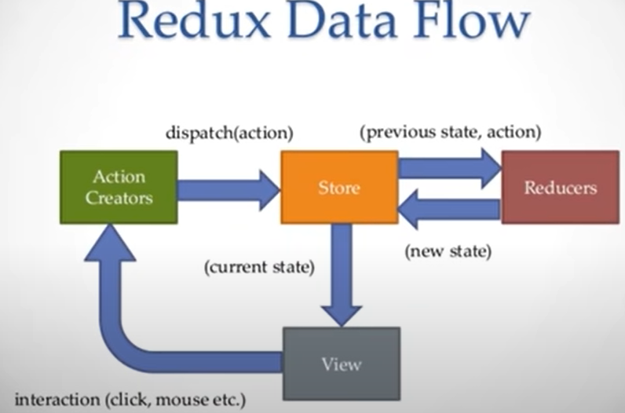

Slide 26
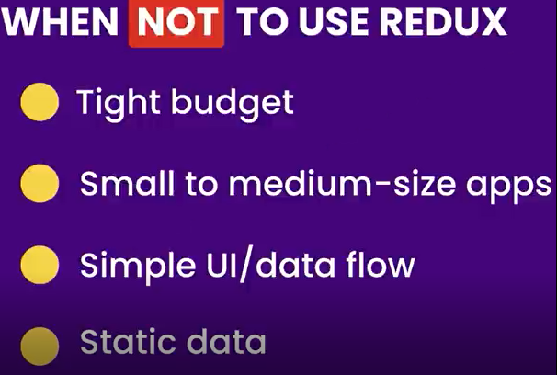

Slide 27

Additional Tools
Redux dev tools chrome extension - very helpful as you can see ur component state, when you submit an action

Slide 28
React + TypeScript Fundamentals

Slide 29
TypeScript Data Types
string
number
boolean
Array – is of object type
Tuple - type of array to which you can insert multiple types
Enum
Any
Void
Add type inspection with TypeScript to make sure everything works

Slide 30
HOC
Higher-order components (HOCs)
Functions that take your component and returns a new one
When you have components that are similar, but have slight differences, this would be an ideal case for it
In large applications, these patterns will happen over and over. Where your components have similar structure with a few minor differences.
Writing each functions might not be the most effective way of approaching the situation.
This is where HOCs would be ideal.
So we can write a function to create new components where we pass the differences for each and the similarities are created with the HOC.

Slide 31
React + TypeScript Together
tsconfig.json file
Can integrate props and start checking the types of the props you're passing into a component
Can integrate typescript with your hooks
Create & render prop component with typescript and making it type safe

Slide 32
.NET

Slide 33
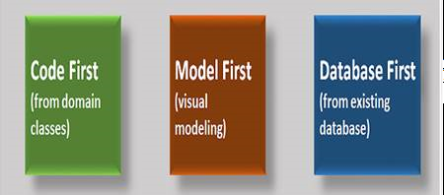
Entity Framework (EF)
Entity Framework is an open source object-relational mapping framework for .NET.
Supports LINQ queries, change tracking, updates, and schema migrations. EF Core works with many databases, including SQL Database (on-premises and Azure), SQLite, MySQL, PostgreSQL, and Azure Cosmos DB.
EF has 3 approaches to create an entity model

Slide 34
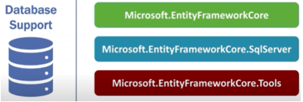
DbContext class
Used to interact with the underlying database
Manages the database connection & is used to retrieve and save data in the database

Slide 35
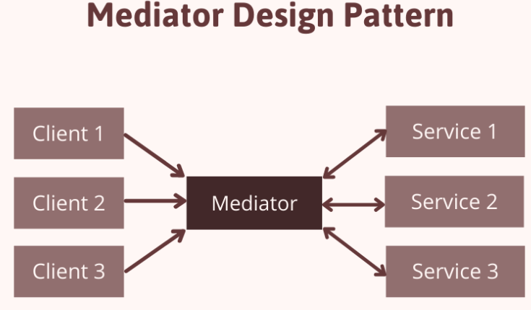
Mediator Pattern

Slide 36
Mediator Pattern (Cont.)
Is a behavioral design pattern
It defines how the objects can communicate with each other.
Restricts direct communications between objects & forces them to collaborate only via a mediator object
With the mediator pattern, communication between objects is encapsulated within a mediator object.
Objects no longer communicate directly with each other, but instead, communicate through the mediator
Supports easy maintenance of code by loose coupling
Helps in achieving clean architecture

Slide 37
CQRS Pattern
Separates read & write operations of a data source
Commands - used for insert, update, delete operations or refers to a DB command
Queries - used to fetch data from DB or querying data from a source
Highly scalable
Added complexity & more code
Used for implementing APIs
Install - MediatR, MediatR.Extensions.Microsoft.DependencyInjection NuGet package

Slide 38
