Slide 1
INTRODUCTION TO NUMPY
AI + CLUB UI
Odeajo Israel
Software Dev, Zindi Ambassador

Slide 2
What is the NumPy library in Python?
NumPy stands for Numerical Python and is one of the most useful scientific libraries in Python programming. It provides support for large multidimensional array objects and various tools to work with them. Various other libraries like Pandas, Matplotlib, and Scikit-learn are built on top of this amazing library.
Arrays are a collection of elements/values, that can have one or more dimensions. An array of one dimension is called a Vector while having two dimensions is called a Matrix.
NumPy arrays are called ndarray or N-dimensional arrays and they store elements of the same type and size. It is known for its high-performance and provides efficient storage and data operations as arrays grow in size.
NumPy comes pre-installed when you download Anaconda. But if you want to install NumPy separately on your machine, just type the below command on your terminal:

Slide 3
Numpy
pip install numpy
import numpy as np
// to install
// to import library

Slide 4
Python Lists vs NumPy Arrays – What’s the Difference?
To overcome this problem, we use NumPy arrays that contain only homogeneous elements, i.e. elements having the same data type. This makes it more efficient at storing and manipulating the array. This difference becomes apparent when the array has a large number of elements, say thousands or millions.
Also, with NumPy arrays, you can perform element-wise operations, something which is not possible using Python lists!
This is the reason why NumPy arrays are preferred over Python lists when performing mathematical operations on a large amount of data.
If you’re familiar with Python, you might be wondering why use NumPy arrays when we already have Python lists? After all, these Python lists act as an array that can store elements of various types. This is a perfectly valid question and the answer to this is hidden in the way Python stores an object in memory.
Python lists are essentially an array of pointers, each pointing to a location that contains the information related to the element. This adds a lot of overhead in terms of memory and computation. And most of this information is rendered redundant when all the objects stored in the list are of the same type!

Slide 5
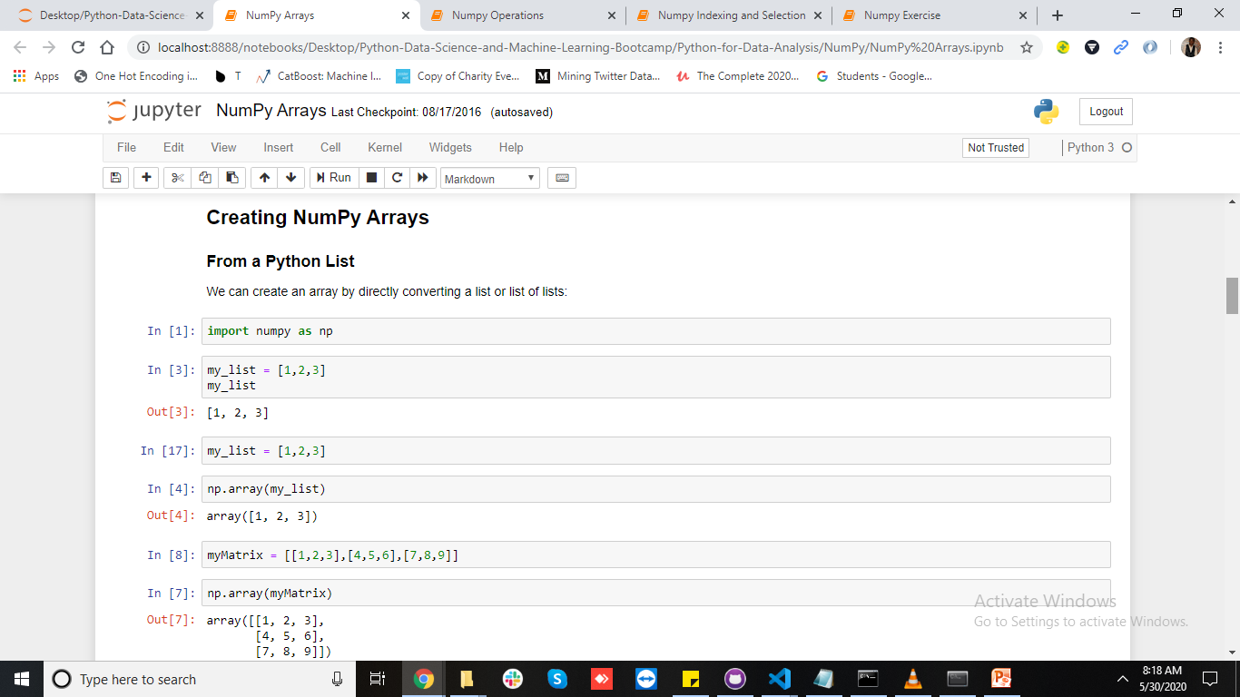
Hands-on now

