Slide 1
Coronavirus Analysis

Slide 2
Contents
Introduction
Overview
Objective
Dataset
Analysis

Slide 3
INTRODUCTION
The COVID-19 pandemic had a profound effect on the health systems, economies, and daily life worldwide. In this challenging context, data analysis has become essential for understanding and managing the spread of the virus. I undertook this project to apply my SQL and data analysis skills to a real-world problem. By examining a comprehensive dataset, I aimed to uncover trends, identify hotspots, and derive insights that could help public health officials make informed decisions. This presentation will walk you through the project’s key aspects and findings, highlighting how data-driven approaches are crucial in tackling global health crises.

Slide 4
OVERVIEW
The Coronavirus pandemic has underscored the need for comprehensive data analysis to monitor and understand its trajectory. This project involved a detailed analysis of a COVID-19 dataset, which included essential metrics such as confirmed cases, deaths, and recoveries. Using SQL, I conducted an in-depth examination of the data to identify geographic and temporal patterns, assess the impact on different regions, and highlight critical insights. The analysis aimed to provide a granular understanding of the pandemic's dynamics, from pinpointing hotspots to tracking the virus's spread over time. By transforming raw data into meaningful information, this project demonstrates the power of data analysis in guiding public health strategies and mitigating the impact of the pandemic. The insights derived from this project can support policymakers and health professionals in developing targeted interventions and response plans.

Slide 5
OBJECTIVE
The primary objective of this project was to leverage data analysis to extract meaningful insights from a Coronavirus dataset. By addressing 16 detailed questions through SQL queries, I aimed to achieve the following:
Identify Geographic Hotspots: Pinpoint regions with high transmission rates and analyze their characteristics.
Understand Temporal Trends: Examine how the number of cases, deaths, and recoveries evolved.
Highlight Country-Specific Variations: Identify countries with significant differences in case numbers, death rates, and recovery rates.
Support Public Health Strategies: Provide actionable insights to inform and enhance public health interventions and strategies, contributing to the global effort to combat the pandemic.
These objectives guided the project's analytical approach, ensuring a comprehensive and insightful examination of the data.

Slide 6
DATASET
Description of each column in the dataset:
Province: Geographic subdivision within a country/region. Country/Region: Geographic entity where data is recorded.
Latitude: North-south position on Earth's surface.
Longitude: East-west position on Earth's surface.
Date: Recorded date of CORONA VIRUS data.
Confirmed: Number of diagnosed CORONA VIRUS cases.
Deaths: Number of CORONA VIRUS-related deaths.
Recovered: Number of recovered CORONA VIRUS cases.
There are 16 questions that are answered using the data mentioned above. The detailed analysis of them is described in the upcoming slides.

Slide 7
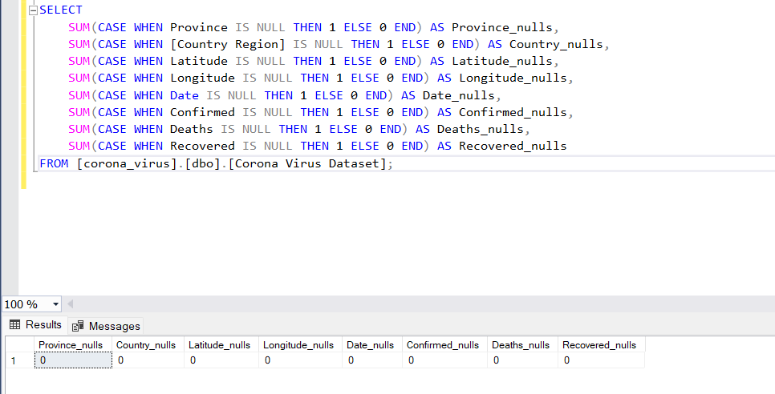
Q1: Write a code to check NULL values

Slide 8
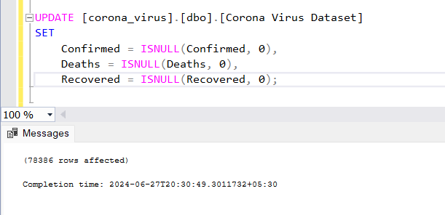
Q2: If NULL values are present, update them with zeros for all columns

Slide 9
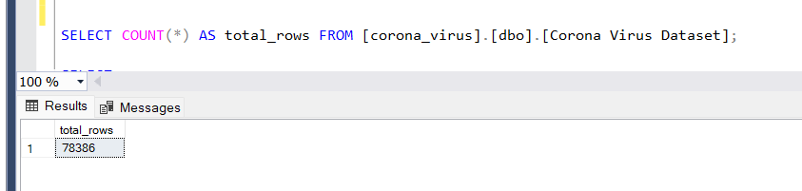
Q3: Check the total number of rows

Slide 10
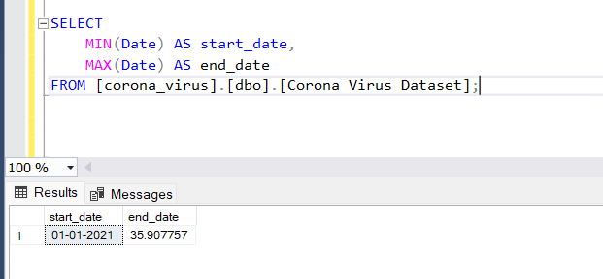
Q4: Check what is start_date and end_date

Slide 11
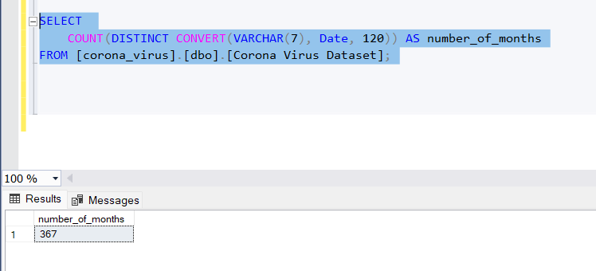
Q5: Number of months present in the dataset

Slide 12
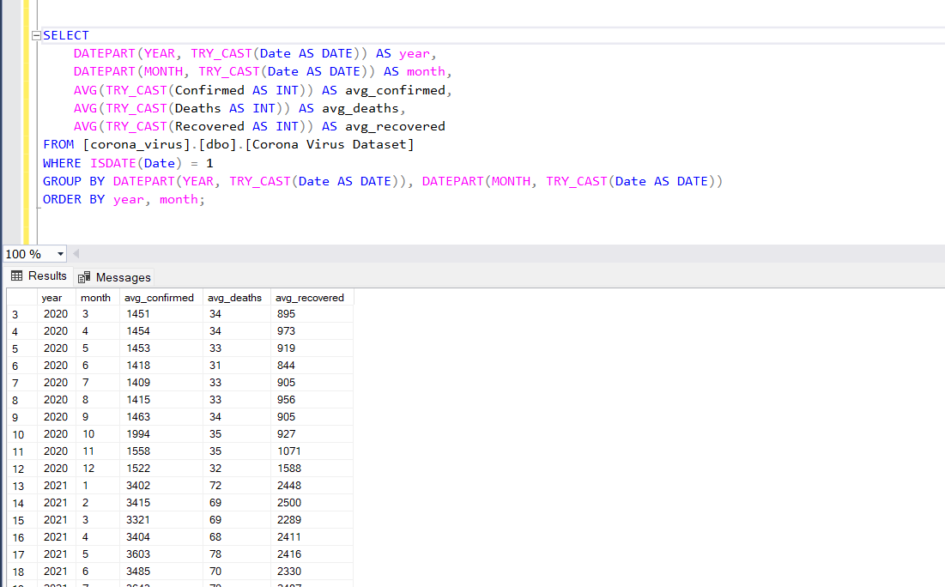
Q6: Find the monthly average for confirmed, deaths, recovered

Slide 13
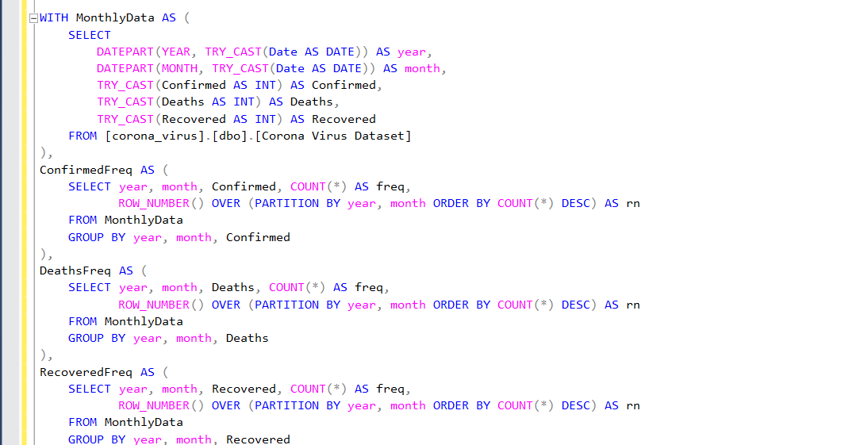
Q7: Find the most frequent value for confirmed, deaths, recovered each month

Slide 14
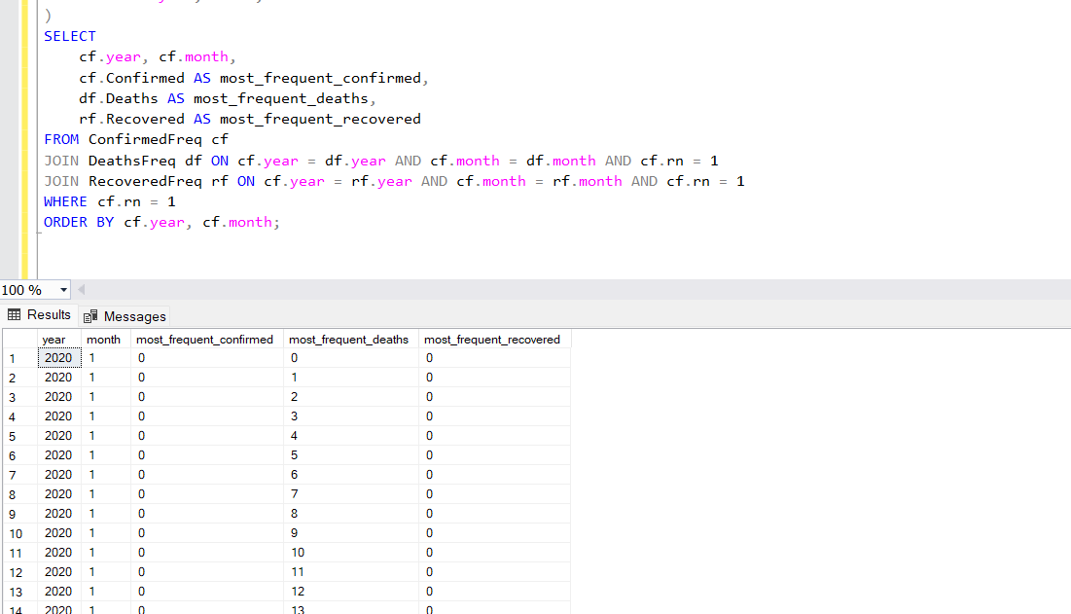

Slide 15
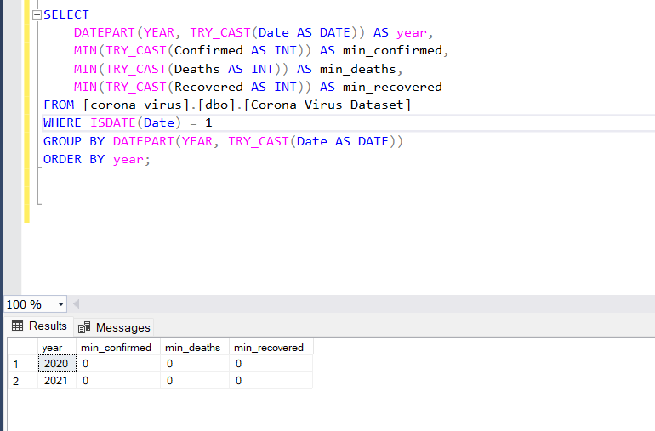
Q8: Find minimum values for confirmed, deaths, recovered per year

Slide 16
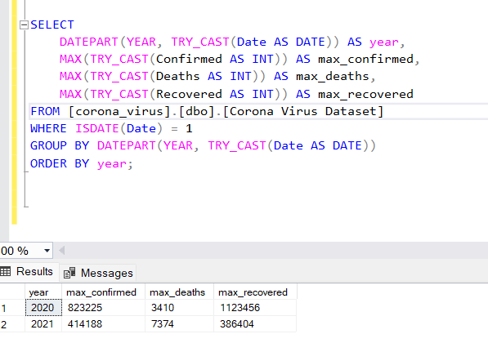
Q9: Find maximum values of confirmed, deaths, recovered per year

Slide 17
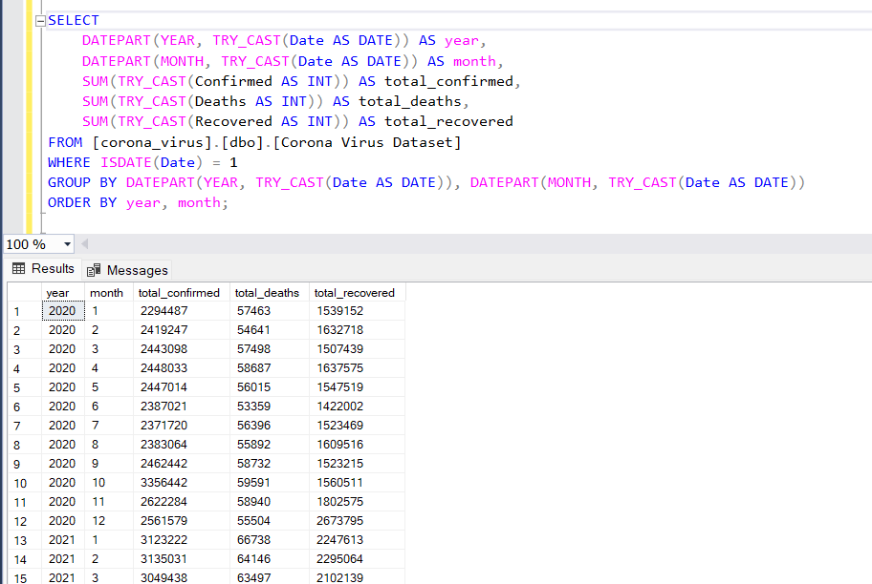
Q10: The total number of cases of confirmed, deaths, recovered each month

Slide 18
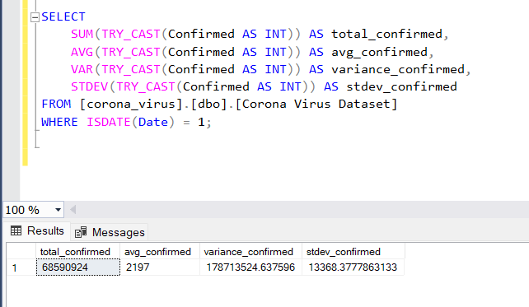
Q11: Check how coronavirus spread out with respect to confirmed cases

Slide 19
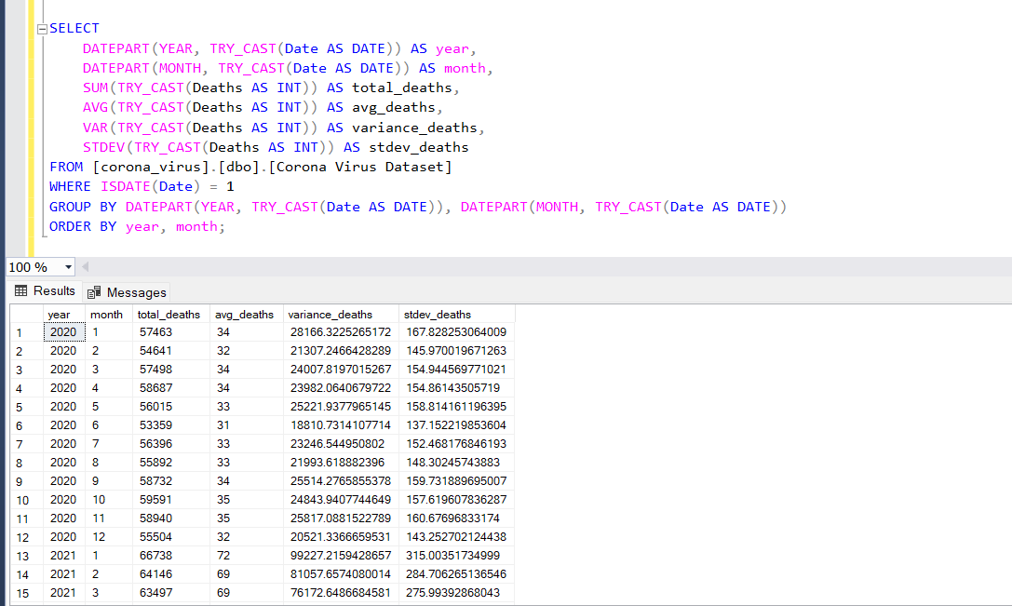
Q12: Check how coronavirus spread out with respect to death cases per month

Slide 20
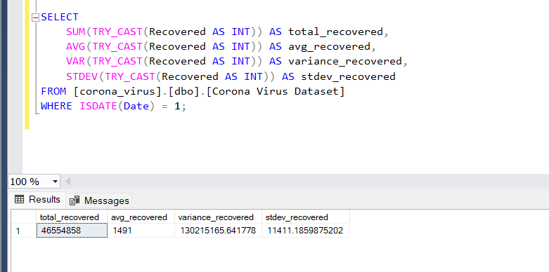
Q13: Check how coronavirus spread out with respect to recovered cases

Slide 21
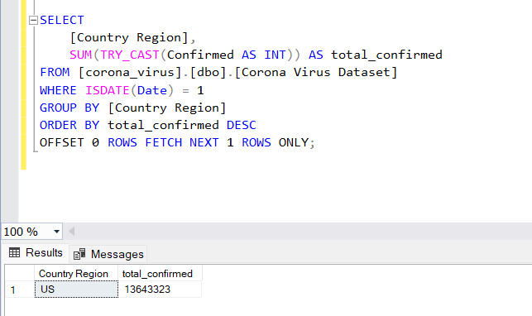
Q14: Find the country having the highest number of confirmed cases

Slide 22
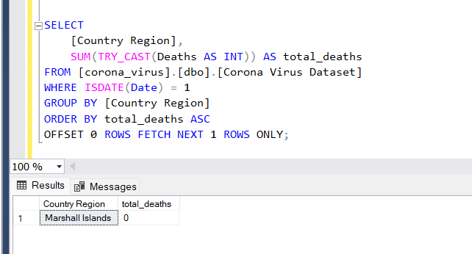
Q15: Find the country having the lowest number of death cases

Slide 23
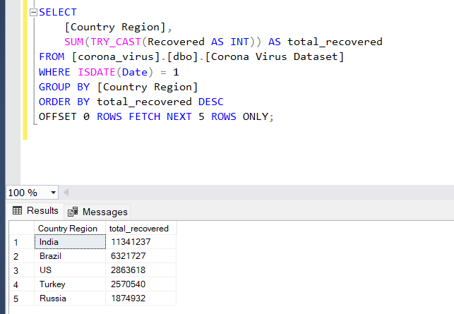
Q16: Find the top 5 countries having the highest recovered cases

Slide 24
THANK YOU

