Slide 1

Detection of stress via Facial expression
By Sanveer for the HYP

Slide 2

Outline
Introduction
Research problem
Similar work
Model
Results
conclusion

Slide 3
Introduction
What is stress?
What is a facial expression ?
Why students in a learning environment?
Intrusiveness, and cost effectiveness.

Slide 4
Research problem
How can facial expression recognition be used to help teachers/ educator get better feedback during online learning?
Effectiveness?
Our goal is to find a scale invariant, rotation invariant, illumination invariant method of classifying facial expressions .

Slide 5
Experimental setup
Dataset :
Subset of CK+( the 327 emotion labelled pictures In the set)
Libraries :
OpenCv(via emgu) version 3.
Accord.net was visited
Visual C# built in bitmap and drawing libraries.

Slide 6
Similar work
Face Identification (Localization)
Viola Jones- Haar features and adaboost
Rahman et al - Skin colour modelling using pixel representations (RGB, H, CBCR)
Preprocessing (based on chosen features)
Liu et al – extended local binary patterns for texture classification
Shakoor et al – Radial mean LBP for noisy texture classification
Features
Liu et al and Shakoor et al
Similar projects
M. paschero et all – real time emotion and stress recognition for drivers
H. Gao, A. Yüce and J. Thiran-Detecting emotional stress from facial expressions for driving safety.
Ghimire & Lee – used multiclass adaboost and an svm to classify the displacement of landmarks in continuous frames.
M.Suk and B.Prabhakaran -used an svm with shape model fitting and landmarks and displacement

Slide 7
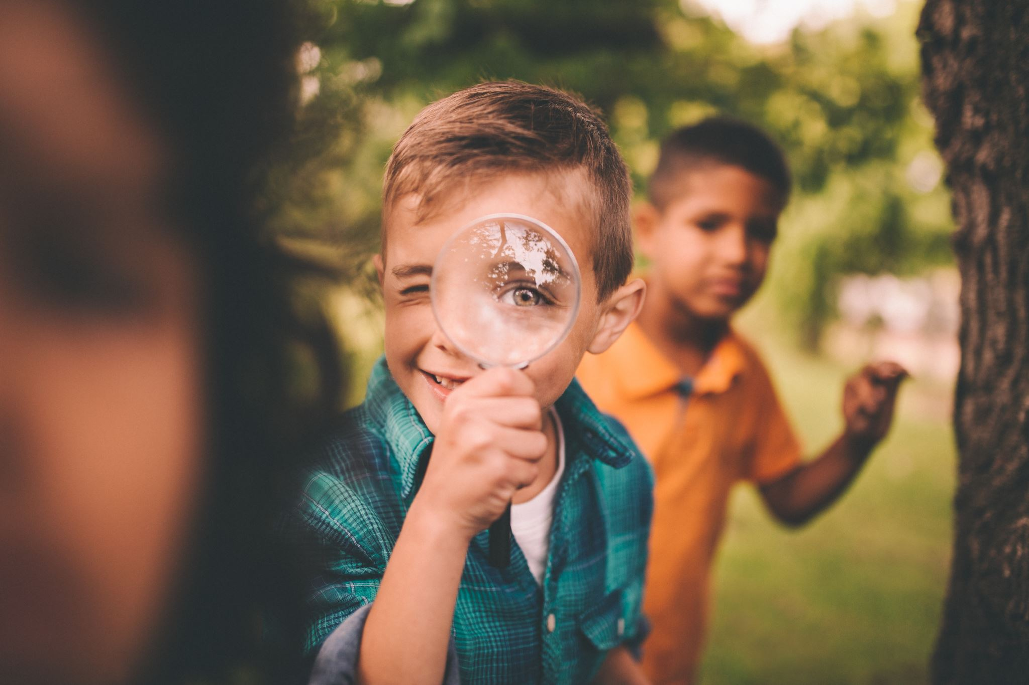
Pipeline /Model
Pre-processing
Feature extraction
Classification of emotions
detection of stress
Localization
Via skin colour modelling (From scratch)
Via Viola-Jones (Emgucv)
Via Gray scaling (From scratch)
Via mean filtering (Circular and square)
Extended LBP
Histograms
Via k-nearest neighbour
Scored decision

Slide 8
Results
Localization via skin colour modelling classifies too much of the background as skin, adding a lot of noise.
Localization via skin colour modelling with CbCr doesn’t work well with darker skin tones.

Slide 9
Conclusion
Thank you for listening.

