Slide 1

Top Ranked B.Tech/Medical/MBA Colleges
Presented by: Anwar basha
Batch Number: 374
Date: 4-07-2025

Slide 2
Problem Statement
To analyze top ranked B.Tech, MBA, and Medical colleges based on:
Fee structure
Placement salary
Placement ratings
Goal: Help students make better decisions when choosing a course or college.

Slide 3
Objective
Understand which courses provide better salary and placements.
Compare fees vs. return (salary).
Identify high-value colleges with strong placements.

Slide 4
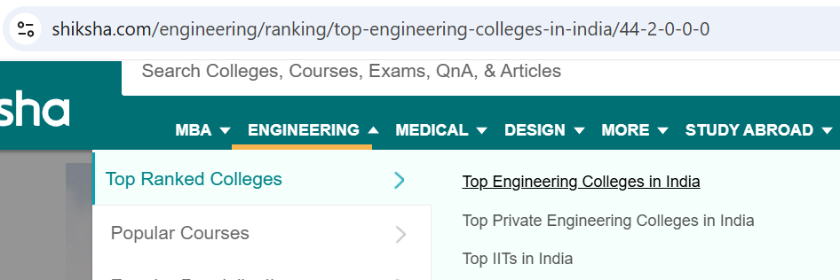
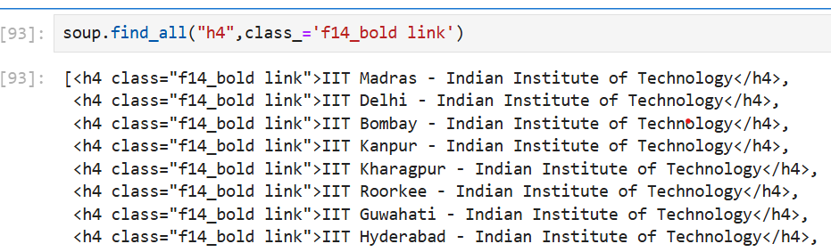
Data Collection
Source: Scraped from Shiksha.com
Tools: Requests, BeautifulSoup, re
Total records: [428 rows, 12 columns]
Variables collected:
Institute
Courses
Fees
Salary
Placement rating
Infrastructure rating
Total reviews

Slide 5
Data Cleaning & Preparation
Removed missing / Null values
Converted data types
Standardized formats (₹ symbol, commas)
Filtered necessary columns

Slide 6
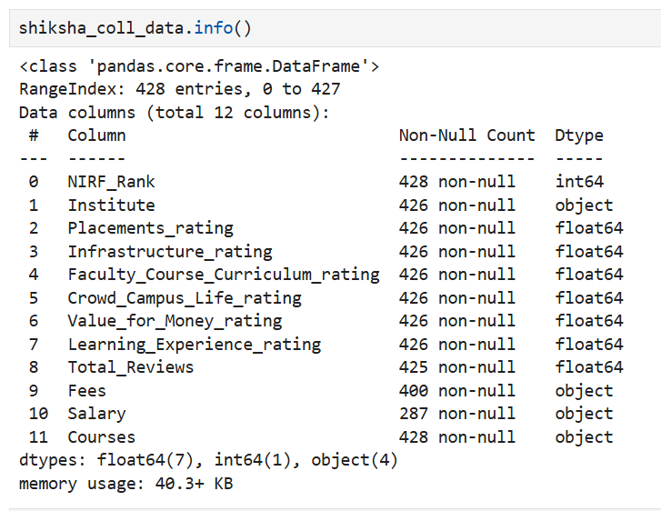
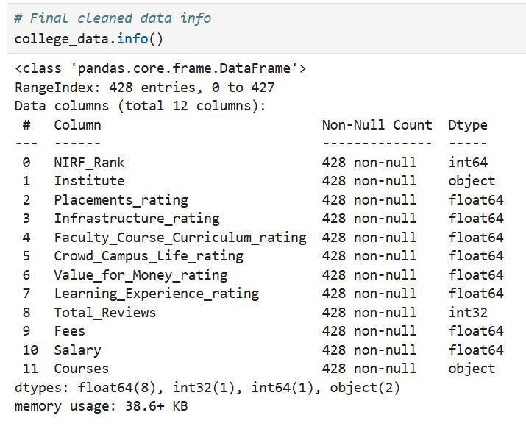
Before and after (Messy vs Clean)
Messy
Clean

Slide 7
Univariate Analysis
Analyzed distribution of:
Fees
Salary
Placement Ratings
Used Histograms, Boxplots, KDE and Violin plots

Slide 8
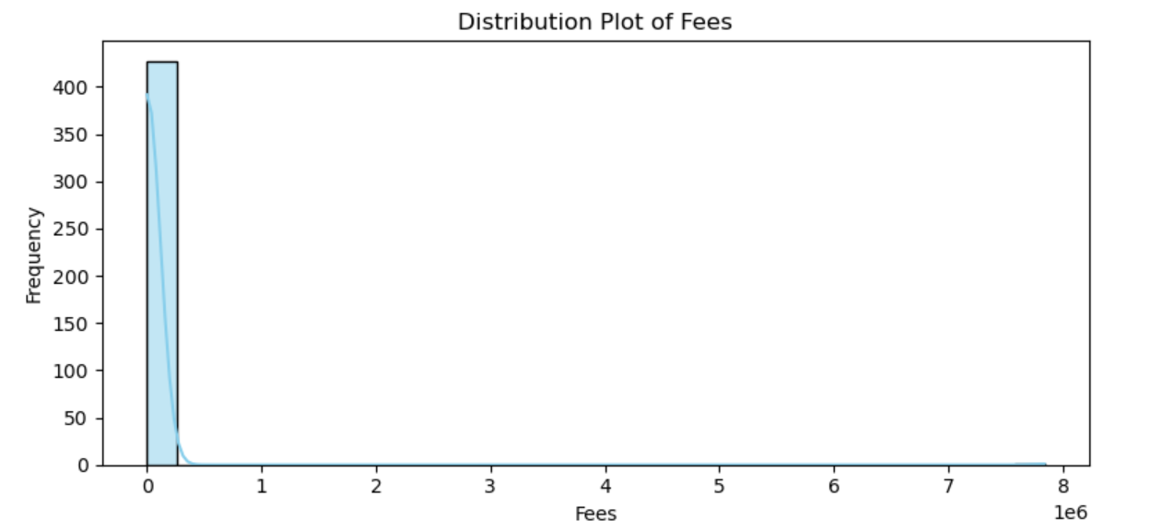
Histogram for Fees
Here most colleges have low to medium fees,
Some have very high
Few colleges are very expensive, most are affordable

Slide 9
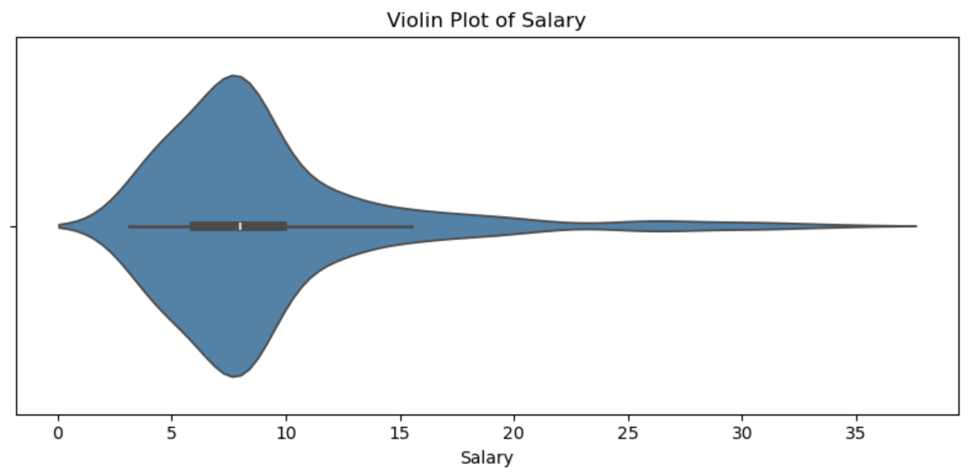
Violin for Salary
Long tail on the right
Some colleges offers very high salaries,
But most offer average packages

Slide 10
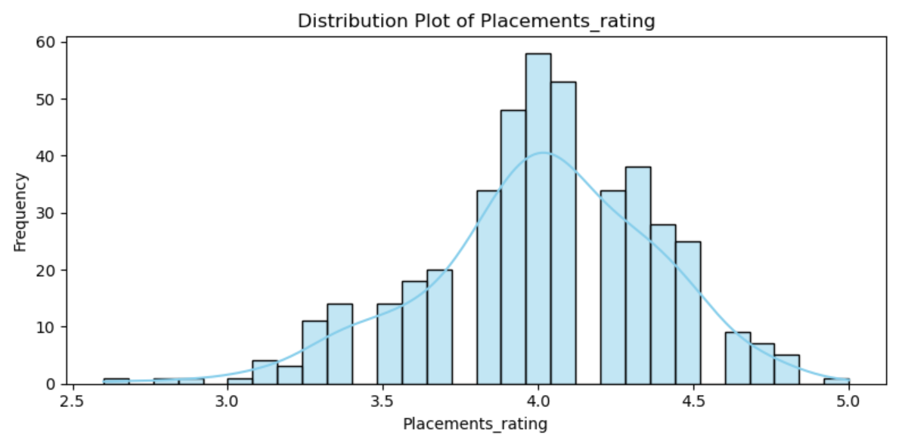
Histogram for Placement ratings
Most colleges have ratings between 3.5 to 4.5
Students are mostly happy with place ments.

Slide 11
Bivariate Analysis
Compared Courses vs Salary by Course
Compared Courses vs Placement Rating
Compared course vs Total reviews

Slide 12
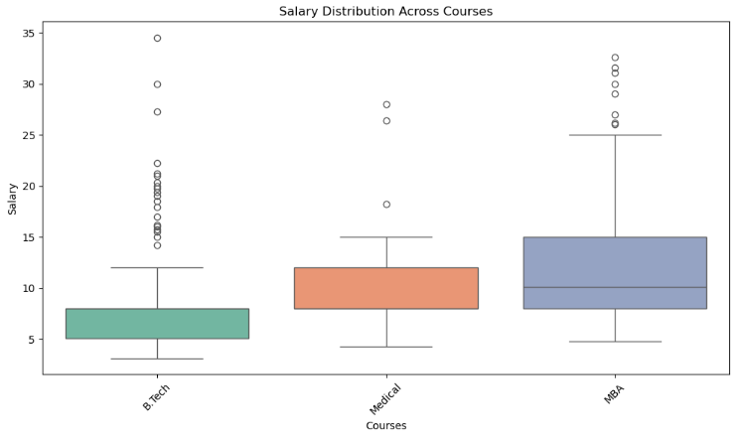
Compared courses vs Salary by Course
Salary is not same for every course
B.tech or MBA may have better salary offers.
Some colleges give very high salaries, but they are few.
This helps students see which course gives better salary after graduation

Slide 13
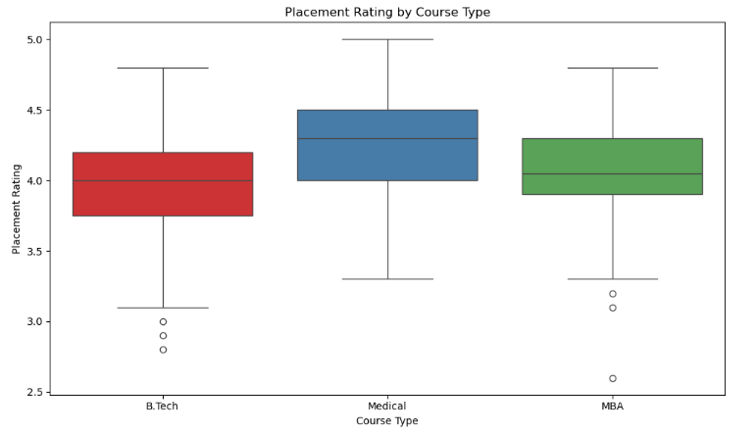
Compared Courses vs Placement Rating
Placement ratings are different for each course
Some courses are rated better for placements than others
Some students in the same course had different experiences with placements
This helps students understand which courses have better job opportunities

Slide 14
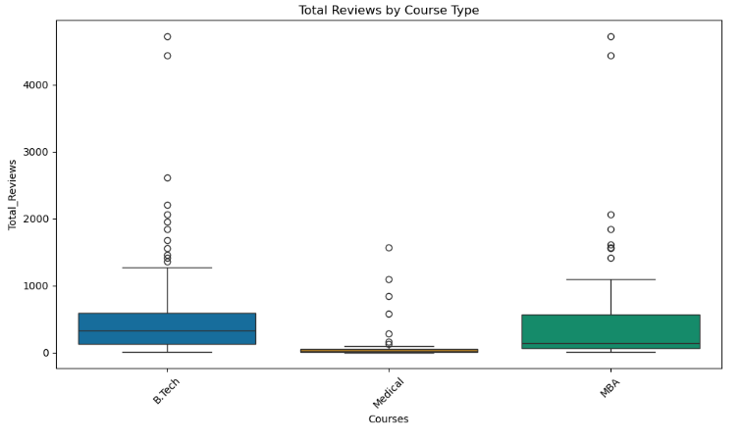
Compared course vs Total reviews
B.Tech and MBA may be popular, as they have more reviews
Medical or other courses may have fewer students or colleges
Some colleges get a lot of reviews, others get very few even for the same course

Slide 15
Multivariate Analysis
Categorical + Continuous group by
Average Salary & Fees by Course
Pivot Table for Median Salary & Fees
Continuous + Continuous: Correlation Heatmap
Course Distribution by Top Institutes

Slide 16
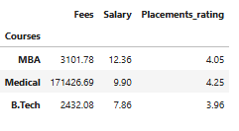
Average Salary & Fees by Course
Some courses like MBA or B.tech may give higher salaries after graduation
Courses with salaries often have higher fees too
A course with good placement rating usually gives better job chances
Good salary, Reasonable fee, High placement rating

Slide 17
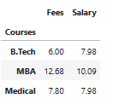
Pivot Table for Median Salary & Fees
Some courses like MBA or B.tech may have a higher median salary
A few might have high fees, but thesalary is not high not good value
Some courses give better salary for lower fees better return to investment
This helps students see which course gives good jobs for reasonable cost

Slide 18
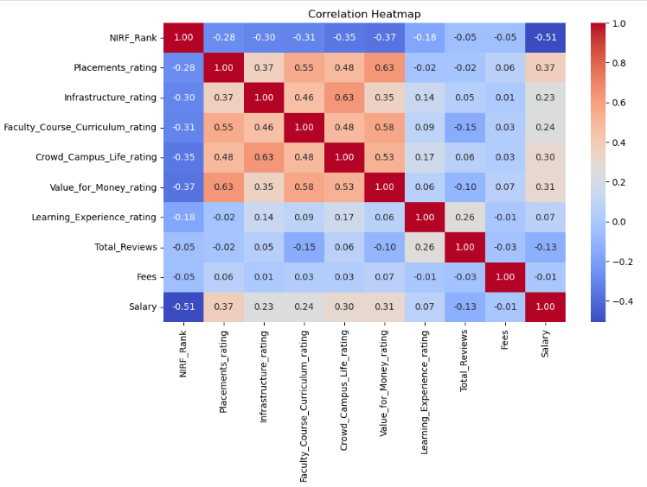
Correlation Heatmap

Slide 19
Dark red Strong positive relation
Dark blue strong negative relation
Light color weak or no relation
If salary and placements ratings have high positive number (like 0.7 or more)
Better placement lead to high salary
Value for Money_rating may have a good relation with fees or Salary
Students feel it’s worth it when salary is good

Slide 20
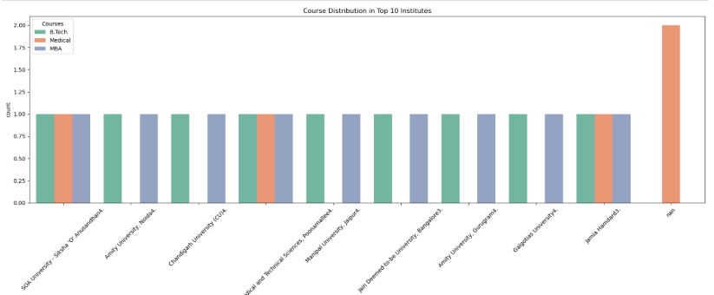
Course distribution by top Institutes
Some are top colleges more than one course B.tech and MBA.
Some colleges focus only course like only B.tech or only Medical.
Its helps students choose the right college based on the course options

Slide 21
Key Insights
B.Tech is most common
MBA shows highest salary potential
MBBS has high fees, but lower average salary
Some colleges offer high salary with moderate fees

Slide 22
Conclusion
Higher fees don’t always mean higher salary
Placement rating strongly linked to salary
Best colleges offer good placements at reasonable fees
Students should compare Fees + Salary + Ratings before choosing

Slide 23
Limitations
Data limited to what was available on the website
Some records may be outdated or missing
Salaries may vary by region and job role

Slide 24
Thank You
Thank you for your attention!
Questions & Answers

