Slide 1
FINAL YEAR DESIGN PROJECT (FYDP) DEFENCE
Pediatric vs Adult Dengue Severity Prediction with Subgroup-Specific SHAP Explanations
SUBMITTED BY
• Md. Aftabul Islam
ID: 22070103
• Mohammad Mazharul Alam
ID: 22070116
SUPERVISED BY
Mohammad Arif Hasan Chowdhury
Assistant Professor Department of Computer Science and Engineering (CSE) Faculty of Science, Engineering & Technology (FSET) University of Science and Technology Chittagong (USTC)
Department of Computer Science & Engineering (CSE) | University of Science and Technology Chittagong (USTC) Foy's Lake, Khulshi, Chattogram-4202, Bangladesh • July / August 2026

Slide 2
FYDP FINAL DEFENCE
Presentation Overview
01. Introduction & Background
Dengue clinical burden, pediatric vs adult physiological divergence
02. Problem Statement & Gaps
Age-pooled ML limits, global SHAP aggregation, missing longitudinal tools
03. Research Objectives & Questions
Four specific objectives (SO1-SO4) and research questions (RQ1-RQ4)
04. Literature Review & Benchmark
Review of state-of-the-art dengue ML models and age stratification gap
05. Methodology & Architecture
Analytical pipeline, NS1 cohorting, leakage prevention & feature engineering
06. Model Evaluation & Results
Pooled, pediatric, and adult classifier performance (15 models benchmarked)
07. Subgroup-Specific SHAP & Splits
SHAP TreeExplainer, Kendall's tau-b rank agreement, depth-1 tree splits
08. Explainable Dashboard Demo
Interactive web application with snapshot routing, SHAP & snapshot timeline
09. Discussion, Limits & Future Scope
Clinical interpretations, model caveats, prospective roadmap & conclusions
Department of CSE, USTC | Pediatric vs Adult Dengue Severity Prediction with SHAP | Slide 2

Slide 3
BACKGROUND & CONTEXT
Introduction & Clinical Motivation
Dengue Infection Burden
• Global Threat: Transmitted by Aedes mosquitoes; poses severe epidemic threats in tropical regions like Bangladesh.
• Clinical Progression: Ranges from uncomplicated febrile illness to severe dengue (plasma leakage, hemorrhage, organ failure).
• Early Triage Need: Early prediction of critical-phase deterioration is vital for timely intravenous fluid management.
• Current ML Approach: Most supervised ML models pool children and adults into a single dataset, treating Age as just another continuous column.
The Pediatric vs. Adult Divergence
Pediatric Patients (≤ 18 years):
- Higher microvascular permeability & baseline metabolic rate.
- Prone to rapid, profound plasma leakage & Dengue Shock Syndrome (DSS).
- Distinct normal ranges for hematology (e.g. lymphocytes, baseline WBC).
Adult Patients (> 18 years):
- Higher incidence of severe hemorrhagic manifestations and multi-organ impairment.
- Frequent confounding from chronic comorbidities (hypertension, diabetes).
- Different transaminase and hematocrit elevation dynamics.
Department of CSE, USTC | Pediatric vs Adult Dengue Severity Prediction with SHAP | Slide 3

Slide 4
FYDP FINAL DEFENCE
Problem Statement & Research Questions
Key Problem Statements
1. Age-Pooled Model Bias: Combining age cohorts assumes identical underlying mathematical relationships between clinical indicators and severity.
2. Global Feature Averaging: Global SHAP explanations compute cohort-wide averages, obscuring age-specific biomarker dynamics.
3. Lack of Discrete Decision Splits: Black-box SHAP values lack explicit, interpretable laboratory split thresholds for comparative inspection.
4. Disconnect from Clinical Tools: Analytical ML models rarely translate into explainable tools supporting structured longitudinal data recording.
Research Questions (RQs)
RQ1 (Predictive Performance): How does the classification performance of age-stratified models compare to an age-pooled baseline across multiple ML architectures?
RQ2 (Feature Attribution Divergence): Do the primary clinical features driving severe dengue predictions differ between pediatric and adult subgroups?
RQ3 (Model-Derived Decision Splits): Can model-derived SHAP values identify distinct, age-specific feature thresholds associated with elevated severity risk?
RQ4 (Interactive Explainable Translation): How can trained age-specific models and SHAP explanations be integrated into a dashboard supporting structured snapshot data storage?
Department of CSE, USTC | Pediatric vs Adult Dengue Severity Prediction with SHAP | Slide 4

Slide 5
FYDP FINAL DEFENCE
Objectives of the Study
MAIN RESEARCH OBJECTIVE
To evaluate age-stratified machine learning models and subgroup-conditioned SHAP feature attributions for PLT-derived severe-dengue proxy prediction, programmatically extract age-specific decision splits, and integrate the framework into an explainable risk dashboard.
SO1: Model Development
Develop and tune supervised machine learning classifiers (Logistic Regression, Random Forest, XGBoost, LightGBM, and Stacking Ensemble) across pooled and age-stratified (pediatric vs. adult) cohorts.
SO2: Comparative Evaluation & SHAP
Perform rigorous comparative evaluation of classification performance and generate subgroup-conditioned SHAP feature attributions to quantify feature influence across cohorts.
SO3: Decision Split Extraction
Programmatically extract and compare age-specific clinical feature decision splits associated with positive severity risk using depth-1 decision trees and Kendall's tau-b rank correlation.
SO4: Explainable Dashboard Implementation
Design and deploy an early-stage explainable risk-assessment dashboard that integrates age-specific model routing, patient-level SHAP explanations, and structured longitudinal snapshot storage.
Department of CSE, USTC | Pediatric vs Adult Dengue Severity Prediction with SHAP | Slide 5

Slide 6
FYDP FINAL DEFENCE
Literature Review & Research Gaps
Author & Year | Cohort / Dataset | Methods / Models | Outcome Definition | Key Limitation / Gap
Tanner et al. (2008) | Singapore (Pediatric) | Decision Trees | Early phase outcome | Pre-SHAP; no adult comparison
Potts et al. (2010) | Thailand (Pediatric) | Logistic ML (cost ratio) | Early lab severity | Pediatric-only; no adult comparison
Chowdhury et al. (2022) | Vietnam & Bangladesh | XGBoost + SHAP | WHO severity classes | Pooled cohort; global SHAP only
Huang et al. (2020) | Taiwan (n=798) | ANN, RF, GBM + SHAP | Severe dengue (binary) | Pooled cohort; no subgroup XAI
Masum / Tuhin (2025) | Bangladesh (n=1523) | Stacking + SHAP/LIME | Dengue severity | Age used as standard feature only
Niazi & Momand (2026) | Public Hematology (n=1450) | LR, RF, SVM, XGB | PLT proxy severity | Global evaluation; no age stratification
KEY IDENTIFIED RESEARCH GAP:
Prior works either train exclusively on a single cohort or pool all ages into one dataset, masking age-specific feature attributions and diagnostic thresholds. Furthermore, none translate age-stratified XAI into an interactive application capable of structured longitudinal snapshot storage.
Department of CSE, USTC | Pediatric vs Adult Dengue Severity Prediction with SHAP | Slide 6

Slide 7
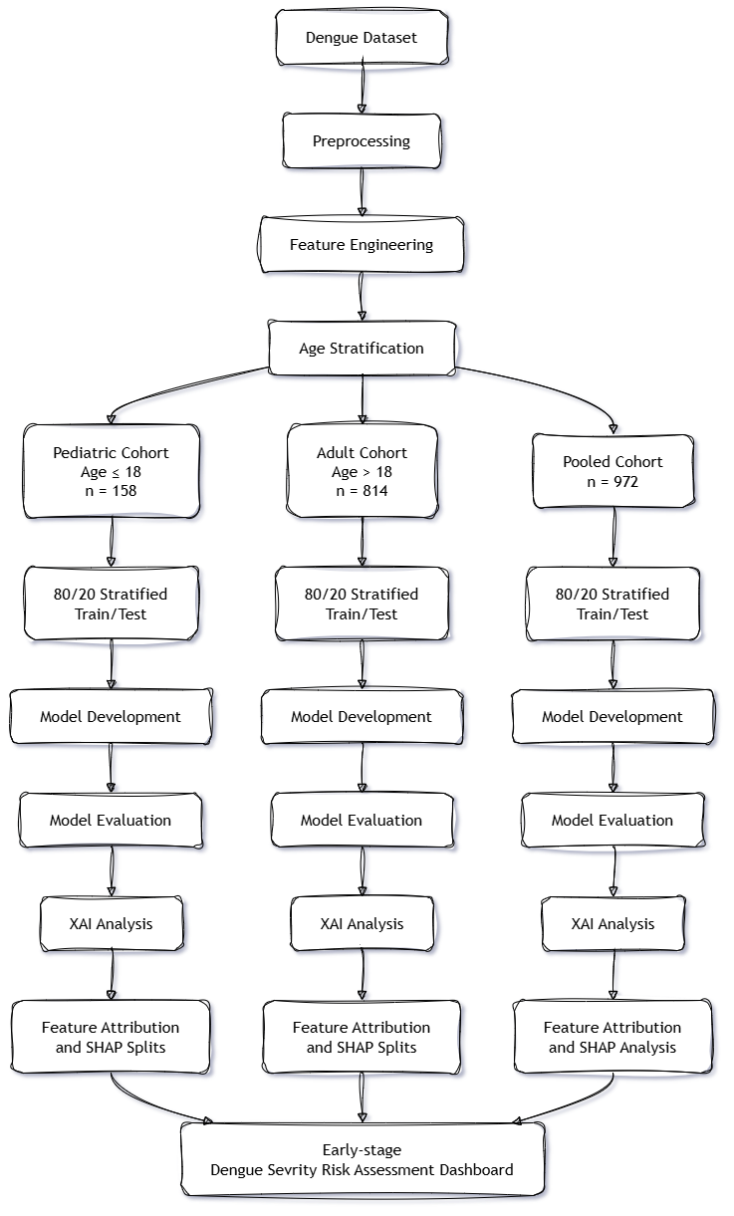
FYDP FINAL DEFENCE
Proposed Methodology & System Architecture
Two-Layer Integrated Framework
Layer 1: Analytical Machine Learning & XAI Pipeline
• Data Ingestion & Filtering: Retrospective dataset (n=1,329) filtered for laboratory-confirmed Dengue NS1 positivity (n=972).
• Cohort Stratification: Separated into Pediatric (≤ 18 yrs, n=158) and Adult (> 18 yrs, n=814) plus Pooled baseline.
• Target Leakage Elimination: Platelet count (PLT) strictly isolated for proxy target construction (< 50,000/μL); excluded from predictors.
• Stratified Training: 5 classifiers per cohort using stratified 80/20 train-test splitting with class weighting.
• Subgroup XAI & Split Mining: XGBoost TreeExplainer SHAP attribution + depth-1 decision trees for positive SHAP split extraction.
Layer 2: Early-Stage Explainable Dashboard Application
• Full-Stack Integration: React/Vite frontend + Python FastAPI inference engine + PostgreSQL relational/JSONB store.
• Dynamic Age-Based Routing: Automated evaluation using cohort-specific trained models and patient-level SHAP explanation.
• Structured Snapshot Tracking: Independent storage of repeated patient visits (Day 1, Day 2, etc.) for longitudinal research.
Department of CSE, USTC | Pediatric vs Adult Dengue Severity Prediction with SHAP | Slide 7

Slide 8
FYDP FINAL DEFENCE
Dataset & Clinically Grounded Feature Engineering
Dataset & Cohort Formulation
• Source: Mendeley Comprehensive Dengue Hematology Dataset (Bangladesh, 2026).
• NS1 Filtering: Filtered to 972 laboratory-confirmed NS1-positive cases (eliminating negative/missing cases).
• Subgroups: Pediatric (≤ 18 yrs: n=158, 16.3%) | Adult (> 18 yrs: n=814, 83.7%).
• Target Variable: Binary Severe Proxy (PLT < 50,000/μL) following Niazi & Momand (2026).
• Leakage Prevention: PLT, PLT critical flags, and PLT/WBC ratios completely removed from predictor space to avoid artificial target inflation.
Clinically Engineered Features (WHO 2009 Grounded)
• Leukopenia Flag (WBC < 4.0 × 10³/μL): Bone marrow suppression during early febrile phase; standard WHO 2009 diagnostic criterion.
• Lymphopenia (< 20%) & Neutrophilia (> 70%): Captures the phase-dependent inflammatory leukocyte shift (Yap et al., 2011).
• AST / ALT Ratio: Encodes preferential AST elevation (AST > ALT) characteristic of dengue-induced hepatic injury (Souza et al., 2004).
• Transaminase Flag (AST or ALT > 40 U/L): Upper Limit of Normal (ULN) proxy indicating hepatic cellular damage and severe progression risk.
• Age Decade & Gender × Age Interaction: Captures non-linear age-severity curves and demographic exposure variations.
Department of CSE, USTC | Pediatric vs Adult Dengue Severity Prediction with SHAP | Slide 8

Slide 9
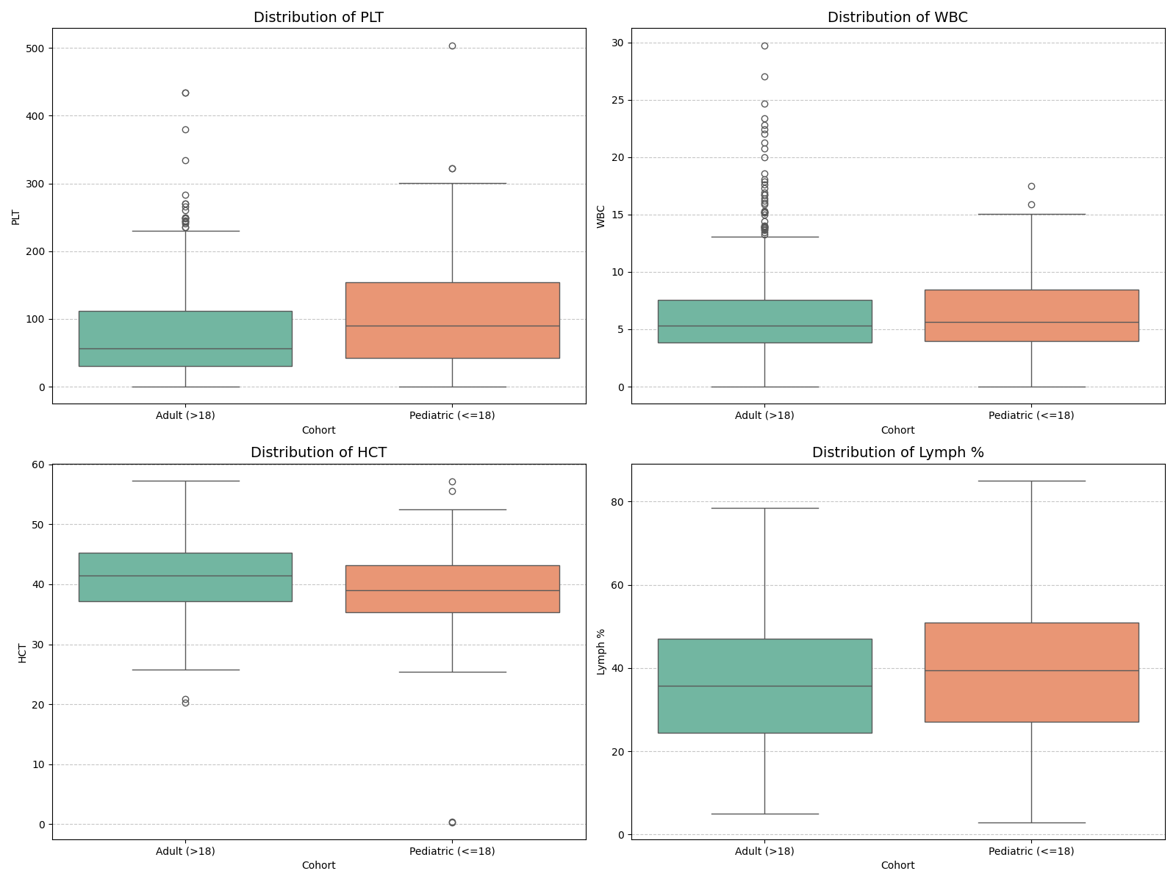
FYDP FINAL DEFENCE
Exploratory Data Analysis: Cohort Distributions
Key EDA Observations
• Lymphocyte % Disparity: Pediatric cases exhibit significantly higher baseline median lymphocyte percentages compared to adults, reflecting differing baseline immune dynamics.
• WBC Distribution: Both cohorts show high prevalence of leukopenia, but pediatric WBC distributions exhibit wider variance.
• Hematocrit & Plasma Leakage: Adults show elevated median hematocrit (HCT) values, while children demonstrate sharper hemoconcentration spikes during critical phases.
• Liver Transaminases: AST levels consistently exceed ALT across both age groups, confirming hepatic involvement in both subgroups.
• Analytical Implication: Distinct baseline distributions strongly support the necessity of evaluating age-stratified modeling over global pooling.
Department of CSE, USTC | Pediatric vs Adult Dengue Severity Prediction with SHAP | Slide 9

Slide 10
FYDP FINAL DEFENCE
Machine Learning Framework & Experimental Setup
Classification Algorithms
• Logistic Regression (LR): Linear baseline with class weighting.
• Random Forest (RF): Bagging ensemble with 100 trees & balanced class weights.
• XGBoost (XGB): Gradient-boosted trees optimized with scale_pos_weight.
• LightGBM (LGBM): Leaf-wise gradient boosting with balanced weights.
• Stacking Classifier: Meta-ensemble combining all 4 base models with LR meta-learner.
Evaluation Protocol
• Dataset Split: Stratified 80/20 train-test partition per cohort.
• Reproducibility: Random Seed = 42 fixed across all pipelines.
• Subgroups Evaluated: Pooled (n=972), Pediatric (n=158), Adult (n=814).
• Single-Split Validation: Explicitly acknowledged limitation due to pediatric sample size.
Class Imbalance Handling
• Target Severe Proportions: ~40% severe in dataset.
• Balanced Class Weights: Applied across LR, RF, and LightGBM.
• Scale Pos Weight: Applied to XGBoost (negative/positive ratio).
• Prevents majority class dominance without synthetic artifact generation.
Comprehensive Metrics
• Accuracy & AUC-ROC: Overall discrimination & ranking capability.
• Sensitivity (Recall): Ability to detect high-risk severe cases.
• Specificity: Minimizing false-positive severe triage.
• F1-Score & MCC: Harmonic mean & Matthews Correlation Coefficient.
Department of CSE, USTC | Pediatric vs Adult Dengue Severity Prediction with SHAP | Slide 10

Slide 11
FYDP FINAL DEFENCE
Results: Full Classification Performance Table
Cohort | Model | Accuracy | AUC-ROC | Sensitivity | Specificity | F1-Score | MCC
Pooled (n=972) | Logistic Regression | 0.636 | 0.711 | 0.663 | 0.616 | 0.608 | 0.276
Pooled (n=972) | Random Forest | 0.790 | 0.860 | 0.699 | 0.857 | 0.739 | 0.566
Pooled (n=972) | XGBoost | 0.733 | 0.834 | 0.699 | 0.759 | 0.690 | 0.456
Pooled (n=972) | LightGBM | 0.769 | 0.828 | 0.699 | 0.821 | 0.720 | 0.525
Pooled (n=972) | Stacking Ensemble | 0.759 | 0.856 | 0.675 | 0.821 | 0.704 | 0.503
Pediatric (n=158) | Logistic Regression | 0.719 | 0.681 | 0.556 | 0.783 | 0.526 | 0.328
Pediatric (n=158) | Random Forest | 0.906 | 0.961 | 0.667 | 1.000 | 0.800 | 0.768
Pediatric (n=158) | XGBoost | 0.844 | 0.899 | 0.778 | 0.870 | 0.737 | 0.628
Pediatric (n=158) | LightGBM | 0.875 | 0.884 | 0.778 | 0.913 | 0.778 | 0.691
Pediatric (n=158) | Stacking Ensemble | 0.906 | 0.947 | 0.667 | 1.000 | 0.800 | 0.768
Adult (n=814) | Logistic Regression | 0.699 | 0.779 | 0.699 | 0.700 | 0.675 | 0.397
Adult (n=814) | Random Forest | 0.847 | 0.892 | 0.781 | 0.900 | 0.820 | 0.690
Adult (n=814) | XGBoost | 0.785 | 0.856 | 0.795 | 0.778 | 0.768 | 0.570
Adult (n=814) | LightGBM | 0.791 | 0.853 | 0.753 | 0.822 | 0.764 | 0.577
Adult (n=814) | Stacking Ensemble | 0.834 | 0.882 | 0.795 | 0.867 | 0.811 | 0.664
Key Takeaway: Stacking & Random Forest achieve 90.6% Accuracy & 0.961 AUC in Pediatric cases (100% Specificity), and Random Forest achieves 84.7% Accuracy & 0.892 AUC in Adults. Subgroup models adapt effectively to age-specific feature profiles.
Department of CSE, USTC | Pediatric vs Adult Dengue Severity Prediction with SHAP | Slide 11

Slide 12
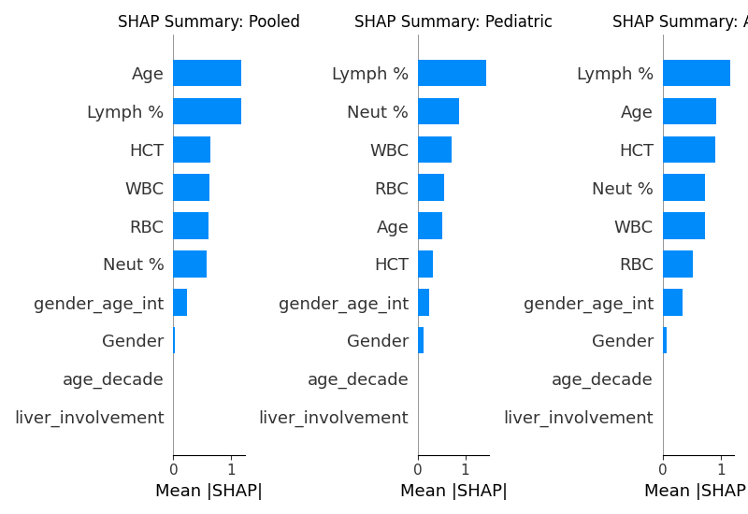
FYDP FINAL DEFENCE
Explainable AI: Subgroup-Conditioned SHAP Analysis
SHAP Attribution & Rank Agreement
• Kendall's tau-b Correlation = 0.900: High relative rank agreement between pediatric and adult SHAP rankings, showing shared fundamental clinical priorities rather than biological divergence.
• Top Ranked Clinical Features: Lymphocyte %, WBC count, AST, and Neutrophil % consistently dominate predictive importance across all cohorts.
• Magnitude & Spread Differences: While relative ranks align, the absolute SHAP contribution magnitude and distribution densities vary markedly across age groups.
• Subgroup-Conditioned Clarity: Stratified SHAP reveals subtle feature influences (e.g., transaminase spikes and hematocrit shifts) that are blurred in pooled summaries.
Department of CSE, USTC | Pediatric vs Adult Dengue Severity Prediction with SHAP | Slide 12

Slide 13
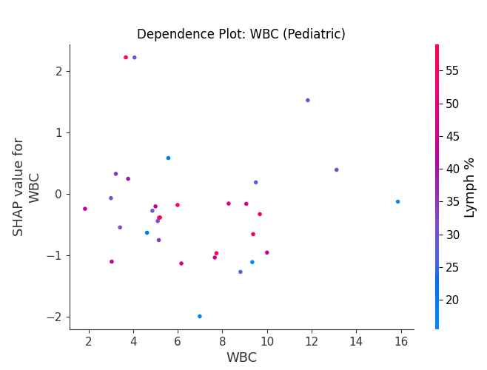
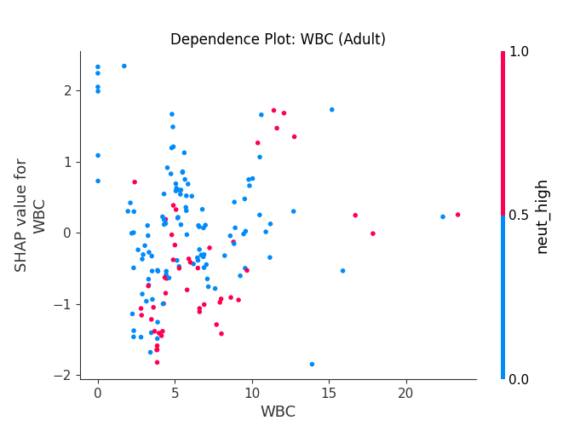
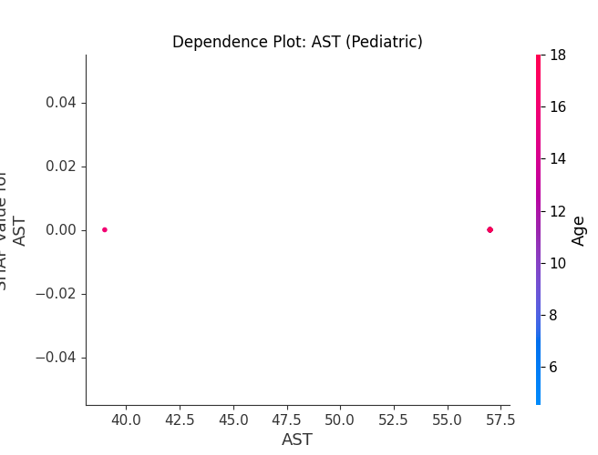
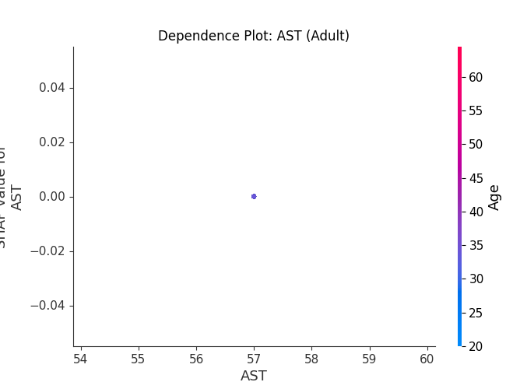
FYDP FINAL DEFENCE
Model-Derived SHAP Decision Splits (Depth-1 Trees)
Pediatric Decision Splits (SHAP > 0)
• Lymphocyte %: > 44.50% (Markedly higher threshold than adults; prominent atypical reactive lymphocytosis.)
• Neutrophil %: ≤ 48.00% (Early relative neutropenia corresponding with severe illness state.)
• WBC Count: ≤ 4.34 × 10³/μL (Clear bone marrow suppression / leukopenic cutoff in children.)
Adult Decision Splits (SHAP > 0)
• Lymphocyte %: > 24.99% (Lower threshold sufficient to elevate predicted severity risk in adults.)
• Hematocrit (HCT): > 40.65% (Hemoconcentration threshold reflecting active plasma leakage.)
• Age: > 31.00 years (Older adults exhibit elevated risk contribution due to comorbidity factors.)
Department of CSE, USTC | Pediatric vs Adult Dengue Severity Prediction with SHAP | Slide 13

Slide 14
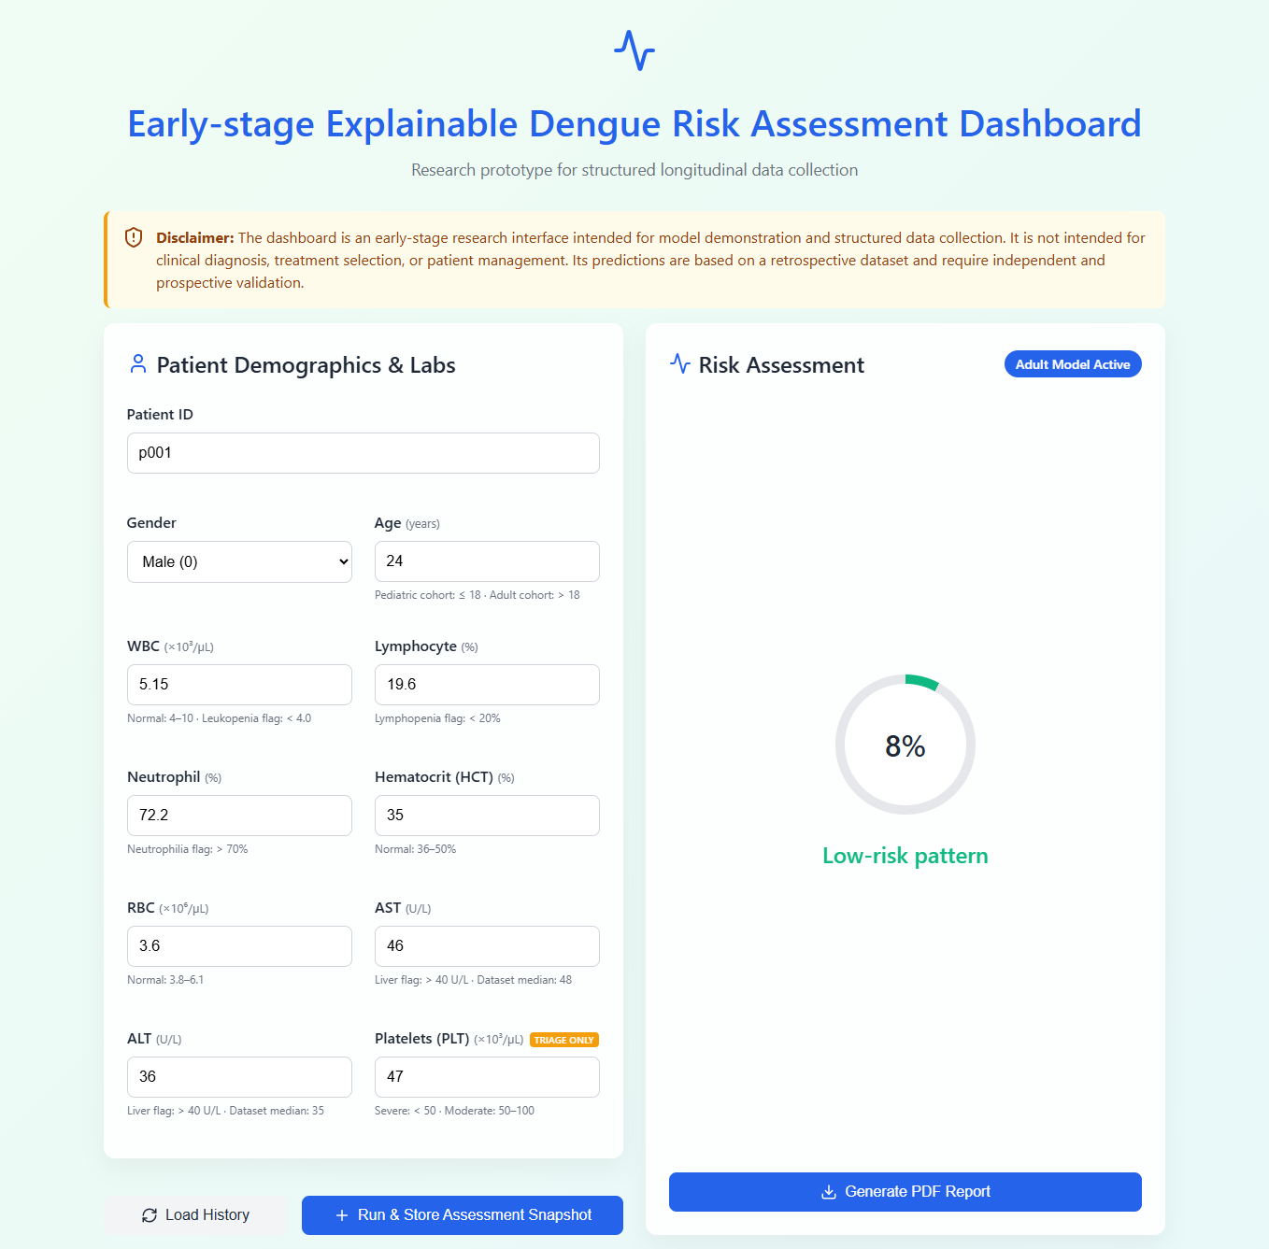
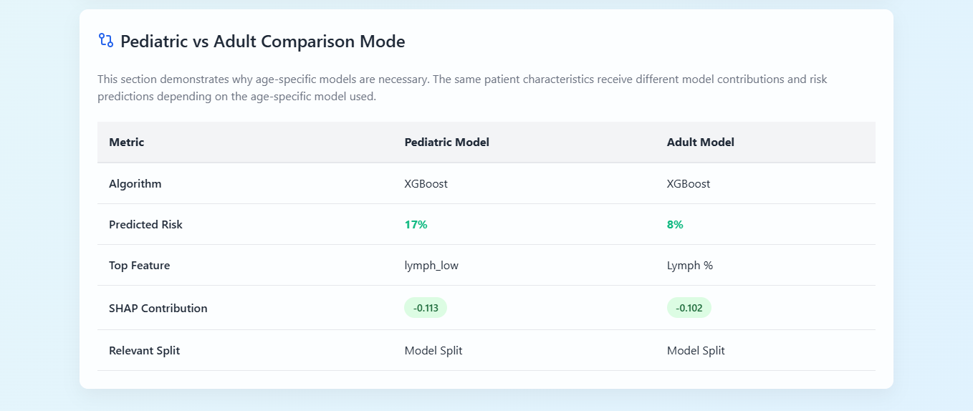
APPLICATION LAYER
Explainable Dashboard: Assessment & Model Routing
Automated Cohort Routing & Inference
• Automated Subgroup Selection: Entering patient age automatically routes data to the trained Pediatric (≤ 18) or Adult (> 18) model.
• Real-Time Risk Calculation: Delivers calibrated snapshot probability of PLT-derived severe risk class.
• Dual-Model Comparison: Allows comparative side-by-side execution of both cohort models on the same input vector.
Department of CSE, USTC | Pediatric vs Adult Dengue Severity Prediction with SHAP | Slide 14

Slide 15
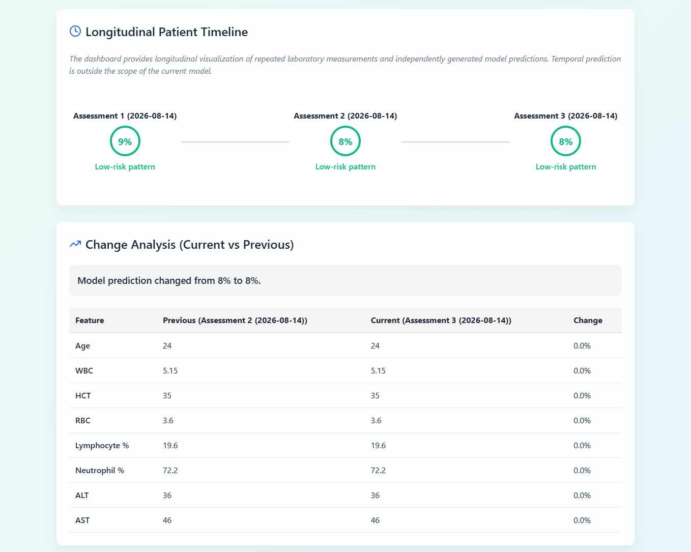
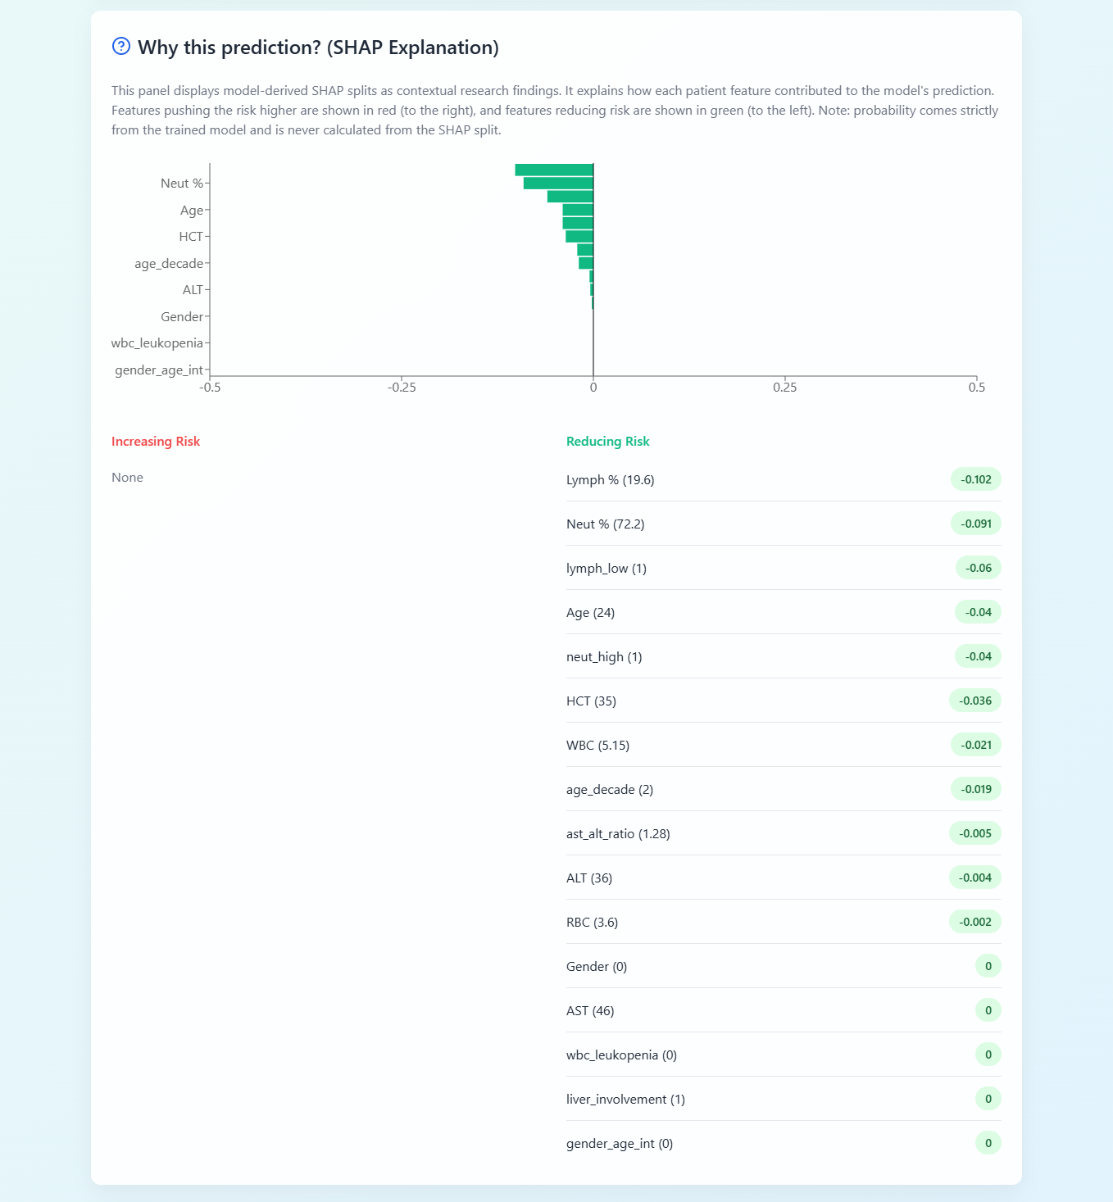
APPLICATION LAYER
Explainable Dashboard: Longitudinal Tracking & SHAP
Department of CSE, USTC | Pediatric vs Adult Dengue Severity Prediction with SHAP | Slide 15

Slide 16
FYDP FINAL DEFENCE
Discussion & Practical Significance
Subgroup Modeling vs. Global Pooling
• Age-stratified models demonstrate superior adaptation to subgroup-specific clinical distributions.
• Ensemble classifiers (RF & Stacking) excel in both cohorts, maintaining 100% specificity in pediatric testing.
• Confirms that collapsing pediatric cases into large adult datasets masks critical early risk indicators.
Clinical Interpretation of SHAP Splits
• Lymphocyte thresholds (> 44.5% ped vs > 25.0% adult) align with pediatric atypical reactive lymphocytosis literature.
• Decision splits represent programmatic model-derived behaviors, not definitive medical treatment rules.
• Provides transparent, interpretable guidance for clinicians reviewing AI risk assessments.
Bridging the Retrospective-Prospective Gap
• Addresses the literature's common shortfall by providing a working software translation layer.
• Enables structured collection of repeated patient laboratory assessments for future temporal modeling.
• Emphasizes transparent disclaimers: early-stage research prototype requiring prospective validation.
Department of CSE, USTC | Pediatric vs Adult Dengue Severity Prediction with SHAP | Slide 16

Slide 17
FYDP FINAL DEFENCE
Limitations & Future Research Directions
Current Study Limitations
• Retrospective Single-Center Dataset: Analysis based on historical records from Bangladesh without external geographic cross-validation.
• Platelet-Derived Severity Proxy: Severity defined via PLT < 50,000/μL rather than independently adjudicated WHO clinical outcome labels.
• Constrained Pediatric Sample (n=158): Limits complex deep architectures and necessitates reliance on single stratified 80/20 train-test splits.
• Snapshot Inference Scope: Current ML models evaluate isolated time snapshots; longitudinal visualization is descriptive, not sequential prediction.
Future Research Roadmap
1. Multi-Center Prospective Validation: Validate age-stratified models and SHAP thresholds on independent prospective cohorts across diverse clinical centers.
2. WHO-Adjudicated Clinical Outcomes: Incorporate definitive clinical severity endpoints (plasma leakage grade, shock, severe hemorrhage) beyond laboratory proxies.
3. Sequential / Temporal Deep Learning: Leverage structured longitudinal assessment storage in the dashboard to train Recurrent Neural Networks (LSTMs / Transformers) for true trajectory forecasting.
4. Clinical Workflow Integration: Perform usability and decision-support impact trials with pediatric and adult clinicians in hospital emergency departments.
Department of CSE, USTC | Pediatric vs Adult Dengue Severity Prediction with SHAP | Slide 17

Slide 18
FYDP FINAL DEFENCE
Conclusion & Key Contributions
Contribution 1: Age-Stratified Dengue ML Framework
Demonstrated that training age-stratified models (Pediatric Stacking Acc 90.6%, AUC 0.947; Adult RF Acc 84.7%, AUC 0.892) captures subgroup-specific patterns obscured by global pooling.
Contribution 2: Subgroup-Specific SHAP & Rank Agreement
Established high relative feature ranking similarity (Kendall's tau-b = 0.900) while revealing distinct absolute contribution magnitudes and feature densities across age cohorts.
Contribution 3: Programmatic Decision Split Mining
Extracted explicit, interpretable clinical split points using depth-1 decision trees (e.g. Lymphocyte > 44.5% in pediatric vs > 25.0% in adults), providing actionable insight into model behavior.
Contribution 4: Operational Explainable Risk Dashboard
Designed and deployed a full-stack dashboard featuring automated age routing, real-time SHAP explanations, descriptive change analysis, and structured repeated assessment storage for future longitudinal research.
Department of CSE, USTC | Pediatric vs Adult Dengue Severity Prediction with SHAP | Slide 18

Slide 19
FYDP FINAL DEFENCE
Key References
1. World Health Organization (WHO), "Dengue: Guidelines for Diagnosis, Treatment, Prevention and Control," Geneva, 2009.
2. S. B. Halstead, "Dengue," The Lancet, vol. 370, no. 9599, pp. 1644-1652, 2007.
3. S. M. Lundberg and S. I. Lee, "A unified approach to interpreting model predictions," in Advances in Neural Information Processing Systems (NeurIPS), vol. 30, 2017.
4. J. A. Potts et al., "Prediction of Dengue Disease Severity among Pediatric Thai Patients Using Early Clinical Laboratory Indicators," PLOS Neglected Tropical Diseases, vol. 4, no. 8, p. e769, 2010.
5. L. B. Tanner et al., "Decision Tree Algorithms Predict Diagnosis and Outcome of Dengue in Early Phase," PLOS NTD, 2008.
6. M. Niazi and S. Momand, "Dengue Severity Level Prediction Using Hematology-Driven Machine Learning Models," Scientific Journal of Engineering and Technology, vol. 3, no. 1, 2026.
7. S. U. Chowdhury et al., "Shapley-Additive-Explanations-Based Factor Analysis for Dengue Severity Prediction," Journal of Imaging, vol. 8, no. 9, p. 229, 2022.
8. A. K. M. Masum et al., "Enhancing Dengue Fever Diagnosis: Machine Learning with Stacking Ensemble and SHAP," IEEE QPAIN, 2025.
9. G. Yap et al., "Lymphopenia as a predictor of dengue fever," PLOS Neglected Tropical Diseases, vol. 5, no. 1, e988, 2011.
10. L. J. Souza et al., "Aminotransferase changes and acute hepatitis in patients with dengue fever," Rev. Inst. Med. Trop. São Paulo, 2004.
Department of CSE, USTC | Pediatric vs Adult Dengue Severity Prediction with SHAP | Slide 19

Slide 20
Thank You!
Pediatric vs Adult Dengue Severity Prediction with Subgroup-Specific SHAP Explanations
Questions & Discussion
Md. Aftabul Islam (ID: 22070103) | Mohammad Mazharul Alam (ID: 22070116) Supervised by: Mohammad Arif Hasan Chowdhury, Assistant Professor Department of CSE, FSET, USTC

