Slide 1
LPG Distribution Management System Using PHP and Laravel
Shahidul Alam- 1530790042
Sany Mohammad Khaled- 1711853042
Course : CSE499A
Section : 01
Faculty name: Dr. k.m.a Salam

Slide 2
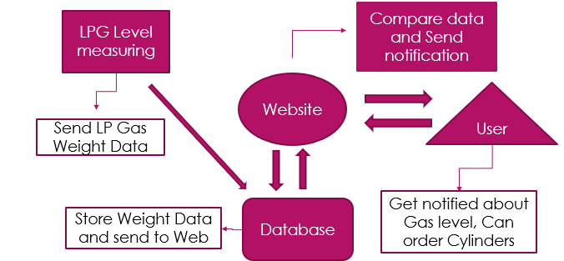
Previous work (499A)
Objective and Motivation
LPG distribution is a large management system
With an analog system.
After literature review and talking with providers,
‘We proposed a smart LPG Distribution management system with refill Automation.’

Slide 3
Progress(499A)
Software Part
We’ve started Website Design. This website is the base of whole project. We will execute all the
features through this website.
We’ve designed 4 pages
Home
Registration
Login/Logout
My Profile

Slide 4
Update (499B)
Hardware Part
We’ve are working with ESP8266 module with Load cell and HX711 amplifier to design the
hardware part.
Timeline | Expected Outcome | Status
Week 2-4 | Prototype design, Purchase Equipment, Assemble Hardware | Done
Week 5 | Hardware to Database Connection | Pending…..
Week 6-9 | Software Modification based on hardware data
Week 10 | Project submission

Slide 5
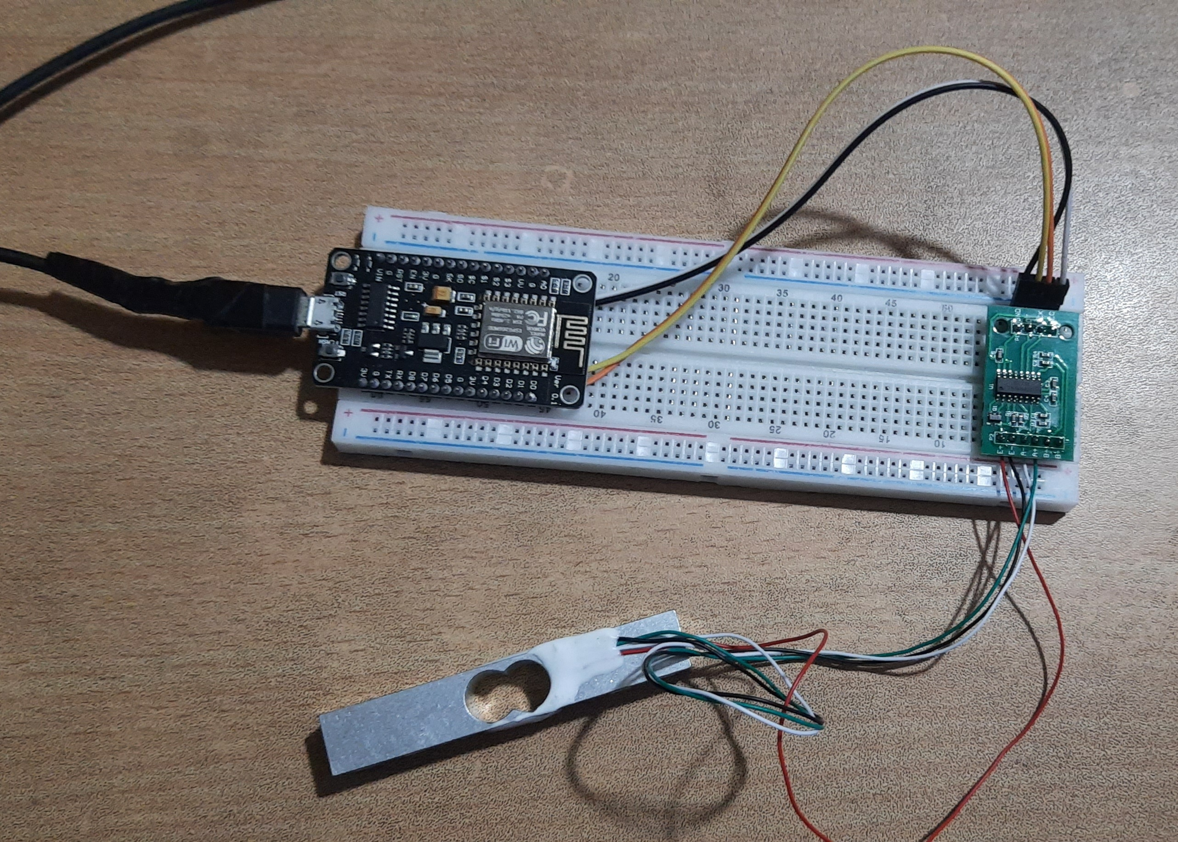
Hardware

Slide 6
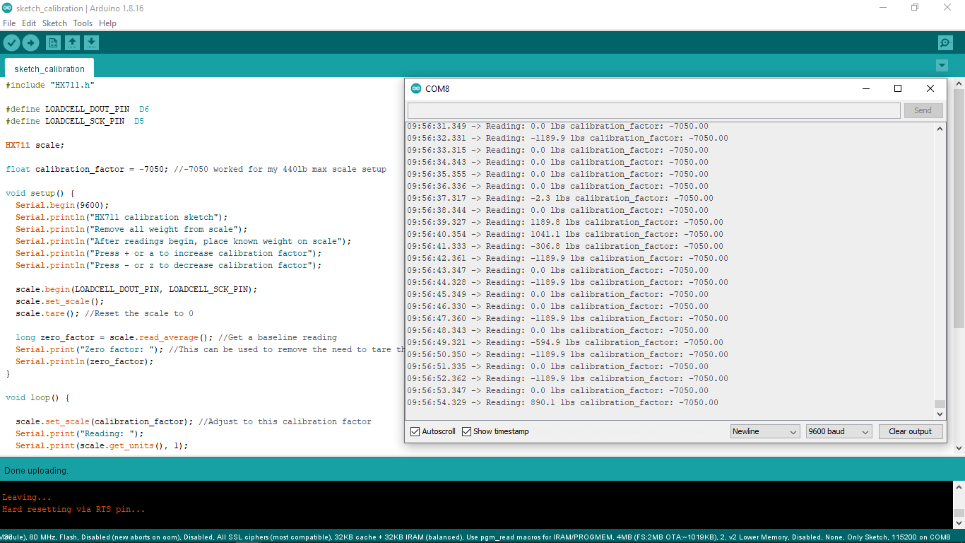
Sensor Data

Slide 7
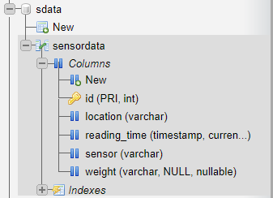
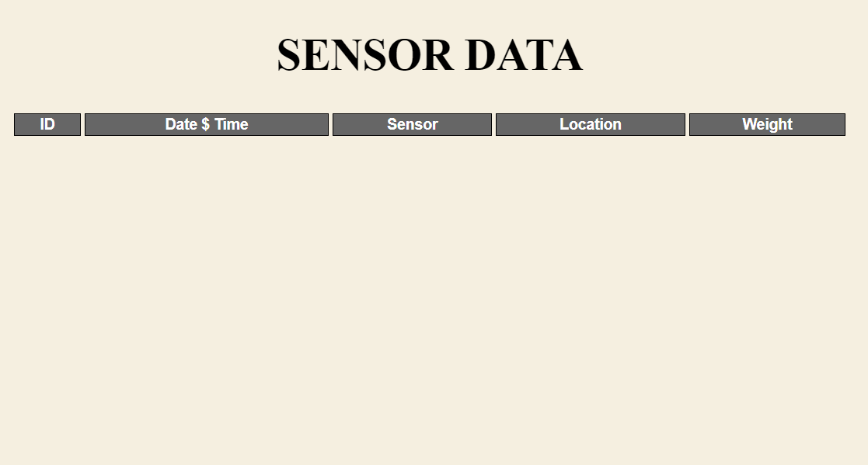
Database and webpage to receive data from sensor

Slide 8
Thank You

