Slide 1
LPG Distribution management System using Php and
Shahidul Alam – 1530790042
Sany Mohammad Khaled – 1711853042

Slide 2
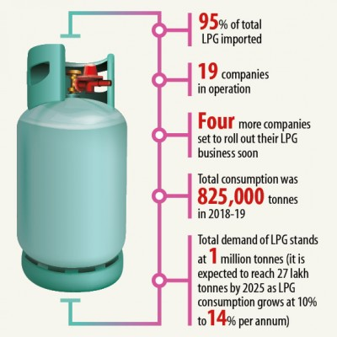
LPG is the next generation of fuel
Abstract
Bangladesh is one of the densely populated countries in the world. The energy consumer is increasing gradually in the country. The key energy source in the country is natural gas but the supply is less than the demand.The government is no longer allowing the pipeline gas connection for household chores.
The demand for LPG is growing exponentially in the country. Till last year, the number of LPG consumers was 38 lakh against 2.5 lakh in the year 2009, according to the annual report of the Energy and Mineral Resources Division (EMRD) of 2018-19. It will goes up to around 90 lakh by the time of 2025.
With these kind of huge consumers, this business is running with old analog system. We will build an automated web application to manage and increase the business of this sector.

Slide 3
Features
Check booking history
Advance booking
Track Cylinder
Payment system
Customer support
Check availability of LPG
Order New cylinder
Refill cylinder
Ask for servicing

Slide 4
Key Functions
Consumer Dashboard
Dealer Dashboard
Delivery man dashboard
Product Page
Servicing Page
User Registration
Ajax search
Payment Method

Slide 5

Technology
We decided to go with the latest technologies to develop this application to give users a better experience.
Frontend
For the UI, we will be using,
HTML,CSS
BOOTSTRAP
JavaScript
Backend
PHP
Database
MySQL
Hardware :
ESP 8266
Loadcell

Slide 6
Thank You

