Slide 1
Automated Marketing Insights Report

Slide 2
Executive Insight
Here are 4 concise but detailed executive insights:

Slide 3
Executive Insight
The mean CTR of 2.63% is a good baseline, indicating some relevance. This engagement drives potential traffic. A/B test ad creatives and CTAs to optimize engagement and increase qualified clicks.

Slide 4
Executive Insight
The CPC of $1.51 is efficient, maximizing value for ad spend by acquiring clicks affordably. Continue optimizing targeting and ad relevance to maintain or reduce CPC, enhancing ROI.

Slide 5
Executive Insight
Massive impressions (78.5M) indicate broad reach but likely insufficient targeting. This leads to wasted ad spend on irrelevant audiences. Refine targeting to reach more qualified audiences, improving relevance and click volume.

Slide 6
Executive Insight
A very low CPM of $0.26 indicates highly cost-effective impression delivery. This efficiently builds brand awareness across a wide audience. Leverage this for broad reach, segmenting for conversion-focused efforts.

Slide 7
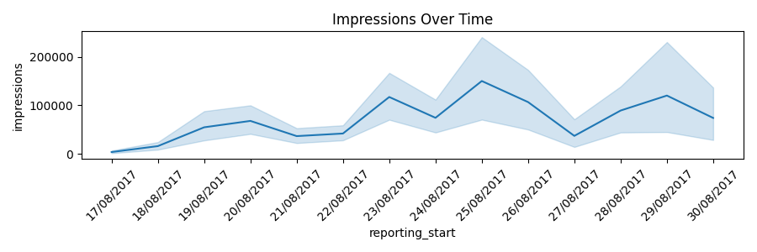
impressions_timeseries.png

Slide 8
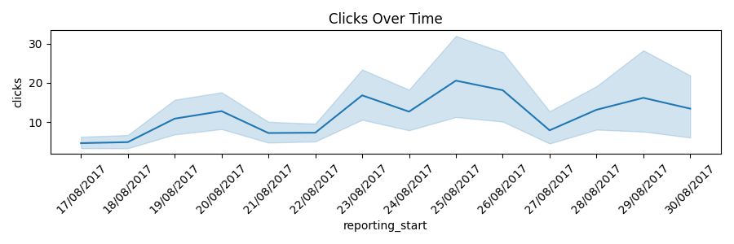
clicks_timeseries.png

Slide 9
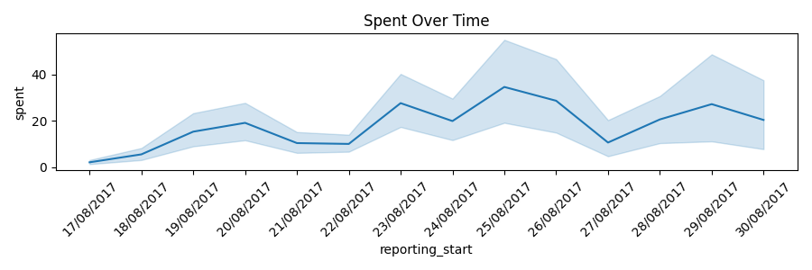
spent_timeseries.png

Slide 10
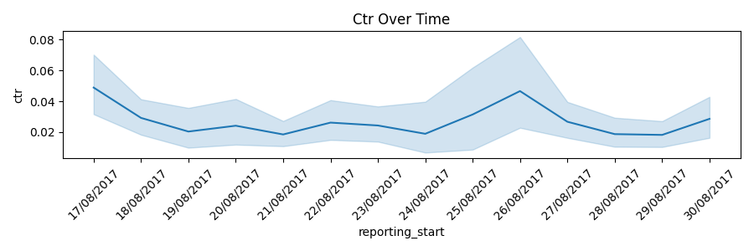
ctr_timeseries.png

Slide 11
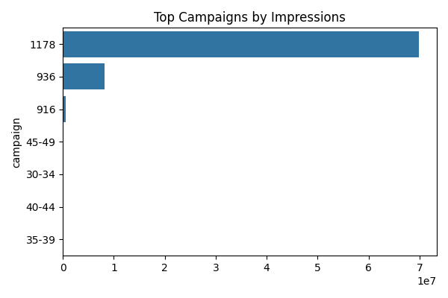
top_campaigns_impressions.png

Slide 12
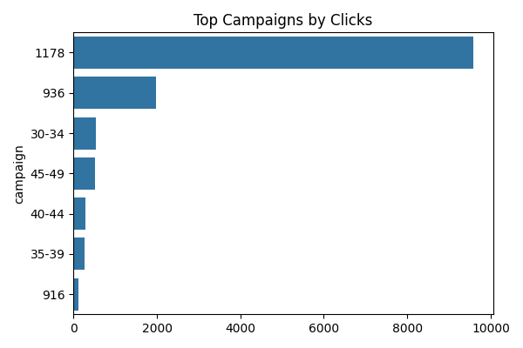
top_campaigns_clicks.png

Slide 13
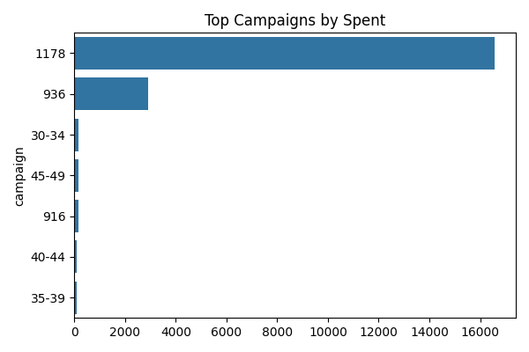
top_campaigns_spent.png

Slide 14
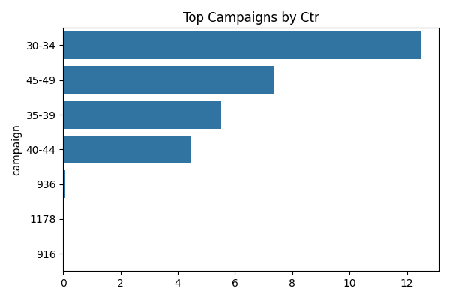
top_campaigns_ctr.png

