Slide 1



Project Title
Jaypee University of Information Technology
Department of Computer Science and Engineering and Information Technology
Major Project - I (18B19CI791) | AY 2025-26
Mid-Term Evaluation | Sept 29 – Oct 03, 2025.
Group No.: 57
Team Member (s)
Sanya Sharma (221030213)
Vaibhav Raj (221030155)
Aashwin Thakur (221030093)
Bhawani Shankar (221030413)
Supervisor
Name: Dr. Ravindara Bhatt
Designation: Associate Professor

Slide 2
Outline
Introduction
Problem Statement
Objectives
Literature Review
Project Design
Tools, Technologies and Languages
Work Plan till End-Term Evaluation
Project Plan
Work Contribution and Attendance
Supervisor Interactions
References

Slide 3
Introduction
Healthcare plays a vital role in keeping society healthy and productive. But even today, many people face delays in getting medical help because of overcrowded hospitals, lack of doctors, and the long distance to proper healthcare facilities.
This project presents an AI-Powered Healthcare Chatbot, designed to make healthcare more accessible by giving people quick and reliable medical support.
Instant Health Support – Answers health questions, checks symptoms, and provides preventive tips.
Smart Recommendations – Suggests nearby hospitals and clinics based on the user’s location.
Easy-to-Use Platform – A web-based system that allows users to get help anytime.

Slide 4
Problem Statement
Timely and affordable medical care is a major challenge in India
Rural areas face long distances, few doctors, high costs, and crowded hospitals
Delayed treatment often puts lives at risk in emergencies
No single, easy-to-use platform for instant guidance, symptom checking, and nearby facility suggestions
People remain dependent on slow or limited healthcare systems

Slide 5
Objectives
The project has three main objectives:
Offer Personalized Healthcare Support that can respond to general health inquiries, offer preventative advice, and give users accurate information right away.
To create a modular user-admin system that lets users communicate with the chatbot and lets administrators handle inquiries, train the model, and keep an eye on registered users.
To incorporate location-based services through APIs (like the Google Places API) that assist users in locating hospitals, clinics, and doctors in their area, particularly during emergencies.

Slide 6
Literature Review
S. No. | Author & Paper Title [Citation] | Journal/ Conference (Year) | Tools/ Techniques/ Dataset | Key Findings/ Results | Limitations/ Gaps Identified
1. | Sara A. Alsalamah et al. [2025] Virtual healthcare bot (VHC‐Bot): a Person‐ centered AI chatbot for transforming patient care and healthcare workforce dynamics | Network Modeling Analysis in Health Informatics and Bioinformatics (2025) | Patient–clinician surveys, simulation cases, consultation records. (Not publicly available due to privacy restrictions) | Improved diagnostic accuracy, consultation speed, and patient satisfaction. Enhanced clinician–patient communication and collaboration | Limited evaluation sample size. Overly general diagnoses needing refinement.
2. | Ashish Zagade, Vedant Killedar, Onkar Mane, Ganesh Nitalikar, Smita Bhosale [2024]AI-Based Medical Chatbot for Disease Prediction | International Journal for Multidisciplinary Research (IJFMR) Volume 6, Issue 3, May-June 2024 | A pre‑trained knowledge base containing disease, symptom, and preventive‑measure records is leveraged for model training and inference. | Demonstrates the potential of AI chatbots to provide accurate medical information, early disease detection, personalized recommendation, and increased healthcare efficiency and accessibility. | Limited to predefined dataset.Basic disease prediction. Narrow coverage( infectious/common diseases). Raises ethical & privacy concerns if integrated with sensitive health data.
3. | Qiming Bao, Lin Ni, Jiamou Liu [2020] HHH: An Online Medical Chatbot System based on Knowledge Graph and Hierarchical Bi-Directional Attention | Australasian Computer Science Week Multiconference (ACSW) 2020 | The knowledge graph stores more than 600 disease records and a large dataset of 29,287 medical question-and-answer pairs | HBAM achieved superior performance in text similarity, with an 81.2% accuracy, outperforming BERT (78.2%) and MaLSTM. | Single-turn Q&A (no multi-turn conversations), System depends on predefined medical dictionaries for filtering

Slide 7
Literature Review
S. No. | Author & Paper Title [Citation] | Journal/ Conference (Year) | Tools/ Techniques/ Dataset | Key Findings/ Results | Limitations/ Gaps Identified
4. | Basma M. Hassan, Shahd Mohamed Elagamy [2025] Personalized medical recommendation system with machine learning | Neural Computing and Applications 2025 | Collected from Arabic medical forums, articles, and Q&A websites | First Arabic-focused medical chatbot, accurate with AraBERT, accessible to Arabic speakers. | The dataset is much smaller compared to large English medical datasets, only basic Q&A, no multi-turn dialogue, needs expert validation.
5. | A. K. Sahoo, C. Pradhan, R. K. Barik et al., [2019] DeepReco: Deep Learning Based Health Recommender System Using Collaborative Filtering | Computation 2019 | Real‑world health‑care ratings: 10000 patients rating 500 hospitals on a 1–5 scale; split 75 %/25 % for training/testing and evaluated with 10‑fold cross‑validation. | Achieves the lowest error rates among compared techniques, demonstrating higher recommendation accuracy and more personalized tele‑health suggestions. | Highly sensitive to the neighbor ‑count parameter K, privacy preservation remains a challenge.
6. | Tamar Sharon [2025] Techno-Solutionism and the empathetic medical chatbot | AI & Society (Springer) 2025 | No primary dataset; relies on review of existing empirical studies (e.g., Ayers et al. 2023, Tu et al. 2024, Chen et al. 2024) and conceptual framework of techno solutionism | Highlights that chatbots can simulate empathy, sometimes rated more empathetic than physicians, potentially improving patient trust, satisfaction, and perception of care. | Chatbots only simulate empathy, risk misleading patients, oversimplify empathy, and may shift focus from systemic issues in healthcare.

Slide 8
Literature Review (cont…)
S. No. | Author & Paper Title [Citation] | Journal/ Conference (Year) | Tools/ Techniques/ Dataset | Key Findings/ Results | Limitations/ Gaps Identified
7. | Tao Tu et al. [2024] Towards Conversational Diagnostic AI | Nature (Article) 2025 | Real-world medical QA (USMLE, HealthSearchQA, MultiMedBench), MIMIC-III note summaries, 98k clinical dialogues, simulated dialogues from 5,000+ conditions, plus 149 OSCE cases with patient actors from Canada, UK, India. | Achieved higher diagnostic accuracy and rated more empathetic than physicians by both specialists and patient actors; showed potential for scalable, consistent diagnostic support | Conducted only in text-chat OSCE, not real-world; limited specialties; excluded pediatrics/psychiatry; may miss non-verbal cues; potential bias, overreliance, and ethical risks.
8. | Nishita Rai, Saumya Bansal, Smriti Sharma [2024] Medibot | IC3 2024, August 08–10, 2024, Noida, India | Vector Database (e.g., Chroma) Chroma’s indexing and similarity search capabilities enable fast and scalable data access, crucial for real-time chatbot responses. | The chatbot interface features responsive design principles, ensuring seamless user interaction across desktop and mobile de- vices. Bootstrap components enhance UI consistency and usability, facilitating intuitive navigation and engagement. | No feedback Mechanism, Authenticity of response given by chatbot is missing, Interaction is simple.

Slide 9
Literature Review (cont…)
S. No. | Author & Paper Title [Citation] | Journal/ Conference (Year) | Tools/ Techniques/ Dataset | Key Findings/ Results | Limitations/ Gaps Identified
9. | Urmil Bharti, Deepali Bajaj, Hunar Batra, Shreya Lalit [2020] Medbot: Conversational Artificial Intelligence Powered Chatbot for Delivering Tele-Health after COVID-19 | Proceedings of the Fifth International Conference on Communication and Electronics Systems (ICCES 2020) | 255 intents are created and each of them are trained with multiple user utterances that were collected during user-testing.A database of responses are created by using information from the National Health Portal. | Conversational User Interfaces of the messaging apps allow us to invoke a text chat by just a simple button click Text-based messaging services are relatively cheaper, faster, and democratic as well as popular. | Complex working, No feedback mechanism, Limited sample size(National Health Portal)
10. | Achtaich Khadija, Fagroud Fatima Zahra, Achtaich Naceur [2021] AI-Powered Health Chatbots: Toward a general architecture | The 2nd International Workshop on Artificial Intelligence & Internet of Things (A2IOT) August 9-12, 2021, Leuven, Belgium August 9-12, 2021, Leuven, Belgium | Dataset:Doctor’s prescriptions,advice and record of conversation between them for symptoms analysis. Also real time query resolution from the doctors. | Optimized chatbot responses to improve healthcare decisions, Used for virtual consultations, diagnosis support, Improved AI chatbots’ ability to provide mental health support, Reducing OOPE on healthcare. | High development cost, balancing automation with human input, Language barriers, accuracy in symptom detection, Training chatbot on diverse healthcare data, Data quality, addressing user emotional needs.

Slide 10
Literature Review (cont…)
S. No. | Author & Paper Title [Citation] | Journal/ Conference (Year) | Tools/ Techniques/ Dataset | Key Findings/ Results | Limitations/ Gaps Identified
11. | Duckki Lee [2023] AI-based Healthcare Chatbot | International Research Journal of Engineering and Technology (IRJET) | UK National Health Service medical databases | 24-hour service, Personalized Services:more accurate and efficient, Low cost, Quick Response, Large-scale services. | Accuracy of question responses:vast quantities of data, poor data quality leads to less accurate predictions. Privacy concerns, Limitations of medical diagnosis.
12. | Arun Babu et al. [2024] BERT-Based Medical Chatbot: Enhancing Healthcare Communication | Exploratory Research in Clinical and Social Pharmacy | Field deployment with patient interactions; limited-scale pilot data (India). | Improved access to information, reduced pressure on health staff, increased patient satisfaction and awareness. | Limited scale, not validated clinically, accuracy concerns, dependency risks, and challenges with language diversity.
13. | Yu He Ke et al. [2024] (PEACH) - a Large Language Model Chatbot for Perioperative Medicine | npj Digital Medicine 2025 | Tested on medical dialogue datasets; evaluated with both automatic metrics and human raters. | Showed higher empathy, personalization, and satisfaction compared to baseline chatbots. | Limited to text-based chats; potential risks of bias, hallucinations, privacy issues, and not yet validated in real-world clinical settings.
14. | Antoine Lizée et al. [2024] Conversational Medical AI: Ready for Practice | Preprint on arXiv as a large-scale evaluation of physician-supervised LLM conversational agent[2024] | 926 real patient cases over 3 weeks; Mo handled 298 complete interactions; outcomes evaluated by patients and supervising physicians. | Improved clarity of information, higher patient satisfaction and maintained trust/empathy; 95% of conversations rated “good” or “excellent” by GPs. | Limited to short-term trial (3 weeks); physician supervision required for safety; tested in one healthcare setting,so generalizability is uncertain.

Slide 11
Literature Review (cont…)
S. No. | Author & Paper Title [Citation] | Journal/ Conference (Year) | Tools/ Techniques/ Dataset | Key Findings/ Results | Limitations/ Gaps Identified
15. | Ms. Reshma Ashreen, Ms. Preethi M, Ms. Rukmini Bhat B [2024] Innovative Healthcare Chatbot Using Artificial Intelligence and Machine Learning | International Journal For Research in Applied Science And Engineering Technology(IJRASET) [2024] | Dataset consists of 41 unique diseases and 133 columns of symptoms. This dataset was obtained from a Kaggle Repository which was utilized for training the mode. This dataset consists of disease information from various healthcare related resources. | For future enhancements, integrating more advanced natural language processing (NLP) models could enhance the chatbot\'s understanding of user queries, improving accuracy and response quality | Face challenges related to accessibility, especially in remote or underserved areas where access to medical professionals may be limited.
16. | Abhishek Aggarwal , Cheuk Chi Tam , Dezhi Wu, Xiaoming Li, Shan Qiao [2023] Artificial Intelligence-Based Chatbots for Promoting Health Behavioral Changes: Systematic Review. | National Library of Medicine;National Center for Biotechnology Information(NIH) [2023] | The Mohr’s Model of Supportive accountability, which states that the inclusion of human support in digital interventions increase engagement and Used to develop the reminder system in Healthy Lifestyle Coaching Chatbot (HLCC) | AI chatbots have immense potential to be integrated into existing behavior change services owing to their (1) the ease of integration (2) potential for affordability, accessibility, scalability, and sustainability (3) delivery of services to vulnerable populations on sensitive issues. | The selected studies focused on only 3 behavioral outcomes: healthy lifestyle (physical activity and diet), smoking cessation, and treatment or medication adherence.

Slide 12
Literature Review (cont…)
S. No. | Author & Paper Title [Citation] | Journal/ Conference (Year) | Tools/ Techniques/ Dataset | Key Findings/ Results | Limitations/ Gaps Identified
17. | Sri Lalitha.Y, Ganapathi Raju .N .V, Ram TejaVanimireddy,Venkata Sai Kiran Mothe, Anil Nayak Nenavath [2023] Conversational AI Chatbot for Healthcare | E3S Web of Conferences 391 [2023] | The dataset is designed for symptom recognition from text. By mapping symptoms to intents and tags, it helps in identifying the type of sickness based on described symptoms. | Using text and/or voice, chatbots are pieces of computer software that mimic real-world discussions at any time of day, thousands of individuals can converse with chatbots at once. | User may discover more about their illness and the medical professionals who specialised in it. The use of speech and facial recognition by counsellors to forge closer connections with patients will be replicated by future technologies
18. | Jack Ng Kok Wah [2025] Revolutionizing e-health: the transformative role of AI-Powered hybrid chatbot in healthcare solutions | Frontiers Public Health [2025] | Information on sample populations and settings was extracted to understand the study scope and its relevance to diverse healthcare contexts.To ensure data accuracy and reliability, all extracted information was reviewed and validated by a secondary reviewer. | Used for improving patient engagement in preventive care Used in real-time monitoring of chronic conditions Explored hybrid AI platforms combining human and AI elements Enhanced customer service in healthcare and other sectors | Limitations in processing power and data requirements, AI chatbots offer vast potential in enhancing healthcare delivery, challenges remain in terms of user trust, data privacy, integration, and ensuring accuracy in complex medical scenarios.

Slide 13
Literature Review (cont…)
S. No. | Author & Paper Title [Citation] | Journal/ Conference (Year) | Tools/ Techniques/ Dataset | Key Findings/ Results | Limitations/ Gaps Identified
19. | Elia Grassini,MarinaBuzzi, Barbara Leporin,Alina Vozna[2024] A systematic review of chatbots in inclusive healthcare: insights from the last 5 years | Universal Access in the Information Society [2024] | Confirm that chatbots applied to the healthcare sector are formidable tools, constantly evolving, both in terms of the services offered and in terms of the technologies used. | Guaranteeing vocal and visual answers or inputs but also facilitating their navigation in the best possible way and designed keeping accessibility. | Some refers to the symptoms but others are only based on the input parameters,However, a part of these is aimed at a more specific category of users focusing precisely on a single disease.
20. | Jitendra Singh, Brandi Sillerud, Advitya Singh [2023] Artificial Intelligence, chatbot and ChatGPT in healthcare - narrative review of historical evolution, current application, and change management approach to increase adoption | Journal of Medical Artificial Intelligence [2023] | Compiled English‑language peer‑reviewed manuscripts (2012‑2023) identified via the search strategy; no primary patient data were generated. | AI achieves ~99% accuracy in mammogram interpretation, surpassing experts in image diagnoses. AI tools could reduce US healthcare spending by up to 10% (~$360 billion), and chatbots like ChatGPT streamline administrative tasks, easing clinician workload. | Adoption is hampered by limited access to high‑quality data, strict privacy and regulatory barriers, lack of model transparency and bias that reduce trust, plus security risks and potential job displacement for repetitive‑task role.

Slide 14
Project Design
1. User Access & Authentication
User opens chatbot and logs in/signs up.
System verifies credentials and grants access.
2. Query Submission & Processing
User submits a health query.
System decides whether to:
Predict disease (symptoms),
Provide health advice (knowledge base),
Find nearby hospitals (location service).
3. Response Delivery
System generates response.
Chatbot displays disease info, advice, or hospital details.
User can continue chatting or save info.

Slide 15
Project Design (cont…)
Admin Management & Continuous Learning
Manage diseases, Q&A pairs, and keywords.
Monitor user queries and system usage.
Retrain the model to improve accuracy.
Keeps medical knowledge updated and relevant.
Final User Experience
Instant, personalized healthcare guidance.
Location-based hospital/clinic recommendations.
Preventive advice and symptom checks.
Quick, reliable access to health information.

Slide 16
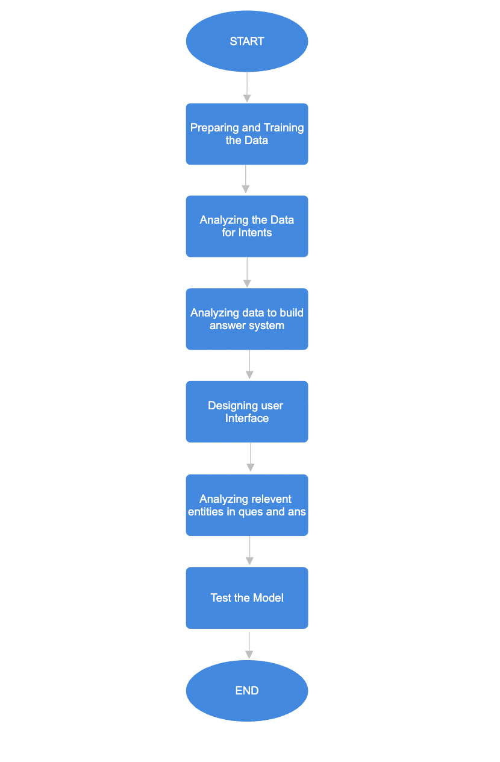
Project Design (cont…)
Fig1:Project Flowchart

Slide 17
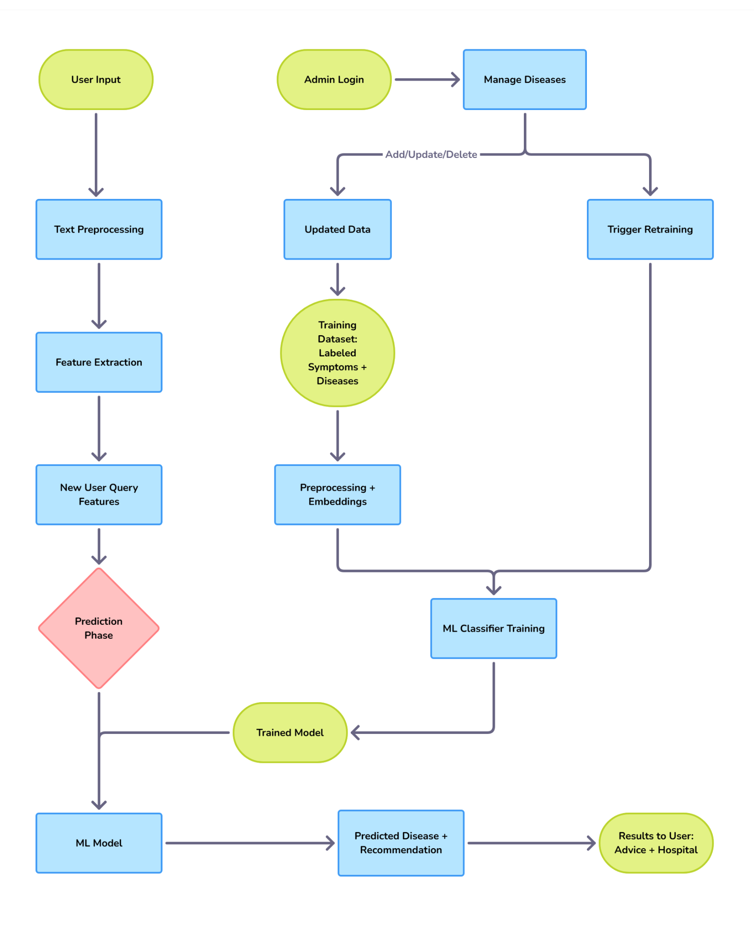
Project Design (cont…)
Fig2. Activity Diagram

Slide 18
Tools, Technologies and Languages
Programming
Python (ML, chatbot logic)
Django/Flask (Backend)
HTML, CSS, JavaScript (Frontend)
Machine Learning & NLP
Scikit-learn (Random Forest, preprocessing)
NLP (text processing & understanding)
Libraries
NumPy, Pandas (data handling)
Matplotlib/Seaborn (visualization)

Slide 19
Work Plan till End-Term Evaluation
Dataset & Model TrainingCollect healthcare Q&A and symptom–disease datasets, clean, preprocess, and train ML/NLP model.
Backend Integration – Develop backend, connect ML model, implement intent detection, knowledge base retrieval, and hospital search API.
Frontend Development – Build chatbot interface (login/signup, query submission, real-time responses, user dashboard).
Testing & Admin Module – Test with queries, fine-tune responses, and set up admin dashboard for managing Q&A, monitoring, and retraining.

Slide 20
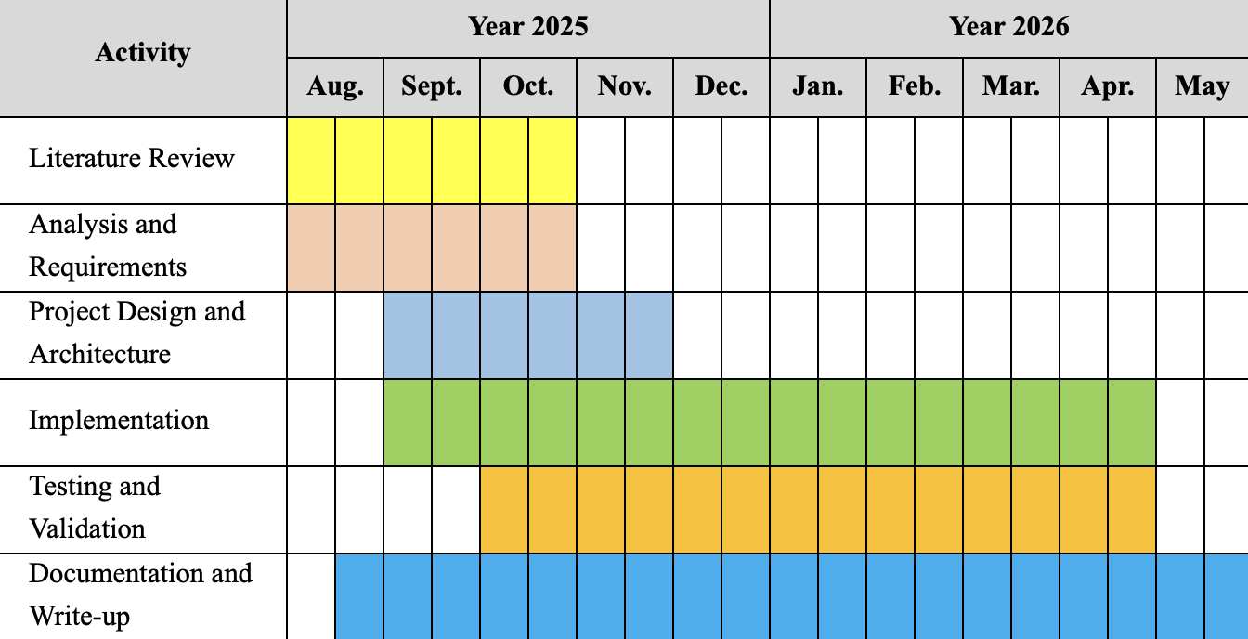
Project Plan

Slide 21
Work Contribution and Attendance
GitHub Repository URL: https://github.com/Sanya528/AI-powered-healthcare-chatbot-system.git
Team Member | Roll No. | Work Done (provide complete details) | Work Contribution (%) | Lab Attendance (%)
1.Sanya Sharma | 221030213 | Literature Review (5 Research papers) Report writing | 25% | 100%
2. Vaibhav Raj | 221030155 | Literature Review (5 Research papers) Report writing | 25% | 100%
3.Aashwin Thakur | 221030093 | Literature Review (5 Research papers) PPT Design | 25% | 100%
4. Bhawani Shankar | 221030413 | Literature Review (5 Research papers) PPT Design | 25% | 100%

Slide 22
Supervisor Interactions
No. of Meetings with Supervisor: 4
Week No. | Duration | Remarks (as mentioned in the weekly log) | Incorporated (Yes/No)
1. | 25/8/2025 to 31/8/2025 | Finalised project and its title Laid out the major objectives of the project | Yes
2. | 08/9/2025 to 14/9/2025 | Project review related work & technologies Read and analyse 1-2 research papers each | Yes
3. | 15/9/2025 to 21/9/2025 | Review 2-3 research papers more Prepare PPT for the mid term evaluation Work on first draft of project report | Yes
4. | 22/9/2025 to 28/9/2025 | Make final changes in the PPT for final submission Completion of first draft of report Maintaining the github repository | Yes

Slide 23
References
[1] S. A. Alsalamah, S. Alsalamah, H. Alsalamah, H. Alsalamah, and C.-T. Lu, "Virtual healthcare bot (VHC-Bot): a person-centered AI chatbot for transforming patient care and healthcare workforce dynamics," Network Modeling Analysis in Health Informatics and Bioinformatics, vol. 14, no. 1, Jun. 2025. [Online]. Available: https://doi.org/10.1007/s13721-025-00537-x
[2] A. Zagade, V. Killedar, O. Mane, G. Nitalikar, and S. Bhosale, "AI-based medical chatbot for healthcare assistance," International Journal for Multidisciplinary Research (IJFMR), vol. 6, no. 3, pp. –, May–Jun. 2024. [Online]. Available: https://doi.org/10.36948/ijfmr.2024.v06i03.21865
[3] Q. Bao, L. Ni, and J. Liu, "HHH: An online medical chatbot system based on knowledge graph and hierarchical bi-directional attention," in Proc. Australasian Computer Science Week Multiconference (ACSW), 2020, pp. 1–10. [Online]. Available: https://doi.org/10.48550/arXiv.2002.03140
[4] B. M. Hassan and S. M. Elagamy, "Personalized medical recommendation system with machine learning," Neural Computing and Applications, vol. 37, no. 9, pp. 6431–6447, Jan. 2025. [Online]. Available: https://doi.org/10.1007/s00521-024-10916-6
[5] A. K. Sahoo, C. Pradhan, R. K. Barik, and H. Dubey, "DeepReco: Deep learning based health recommender system using collaborative filtering," Computation, vol. 7, no. 2, p. 25, May 2019. [Online]. Available: https://doi.org/10.3390/computation7020025
[6] T. Sharon, "Techno-Solutionism and the empathetic medical chatbot," AI & Society, 2025. [Online]Available: https://doi.org/10.1007/s00146-025-02441-4
[7] T. Tu, J. A. Wulff, T. H. Liu, et al., "Towards Conversational Diagnostic AI," Nature, vol. 635, pp. 93–100, Jan. 2025. [Online]Available: https://doi.org/10.1038/s41586-025-08866-7
[8] Nishita Rai, Smriti Sharma, Saumya Bansal, and Himani Bansal. 2024.Medibot : An AI powered chatbot. In 2024 Sixteenth International Conference on Contemporary Computing (IC3-2024) (IC3 2024), August 08–10, 2024, Noida,India.
[9] Urmil Bharti, Deepali Bajaj,”Medbot: Conversational Artificial Intelligence Powered Chatbot for Delivering Tele-Health after COVID-19”IEEE Xplore ISBN: 978-1-7281-5371-1
[10] Achtaich Khadija, Fagroud Fatima Zahra, and Achtaich Naceur. 2021. AI-Powered Health Chatbots: Toward a general architecture. Procedia Comput. Sci. 191, C (2021), 355–360. https://doi.org/10.1016/j.procs.2021.07.048

Slide 24
References (cont…)
[11] Duckki Lee,”AI- based healthcare bot”,https://www.irjet.net/archives/V10/i2/IRJET-V10I282.pdf
[12] A. Babu and S. B. Boddu, "BERT-Based medical chatbot: Enhancing healthcare communication through natural language understanding," Exploratory Research in Clinical and Social Pharmacy, vol. 5, pp. 100227, 2024. [Online]
[13] A. Lizée, P.-A. Beaucoté, J. Whitbeck, M. Doumeingts, A. Beaugnon, and I. Feldhaus, "Conversational Medical AI: Ready for Practice," arXiv preprint, Nov. 2024. [Online] Available: https://arxiv.org/abs/2411.12808
[14] Y. H. Ke, L. Jin, K. Elangovan, et al., "Clinical and economic impact of a large language model in perioperative medicine: a randomized crossover trial," npj Digital Medicine, vol. 8, no. 1, pp. 1–11, Jan. 2025. [Online] Available: https://doi.org/10.1038/s41746-025-01858-x
[15] M. P. M. M. R. B. B. Ms. Reshma Ashreen, "Innovative Healthcare Chatbot Using Artificial Intelligence and Machine Learning," Ijraset Journal For Research in Applied Science and Engineering Technology, vol. 12, no. 2024, pp. 1627-1632, 2024. https://doi.org/10.22214/ijraset.2024.66090
[16] A. T. C. C. W. D. L. X. &. Q. S. Aggarwal, "Artificial Intelligence-Based Chatbots for Promoting Health Behavioral Changes: Systematic Review.," Journal of medical Internet research, no. 2023, 2023. https://doi.org/10.2196/40789
[17] S. &. N. G. &. V. R. &. M. V. &. N. A. Y., "Conversational AI Chatbot for HealthCare," in E3S Web of Conferences., 2023. 10.1051/e3sconf/202339101114
[18] Wah JNK (2025) Revolutionizing e-health: the transformative role of AI-powered hybrid chatbots in healthcare solutions. Front. Public Health 13:1530799.10.3389/fpubh.2025.1530799
[19] E. B. M. L. B. e. a. Grassini, "A systematic review of chatbots in inclusive healthcare: insights from the last 5 years.," Univ Access Inf Soc 24, vol. 24, no. 2025, pp. 195-203, 2025. https://doi.org/10.1007/s10209-024-01118-x
[20] S. B. S. A. Singh J, "Artificial intelligence, chatbots and ChatGPT in healthcare—narrative review of historical evolution, current application, and change management approach to increase adoption," J Med Artif Intell, vol. 6, no. 2023, pp. 23-92, 2023. 10.21037/jmai-23-92

Slide 25

Thanks.

