Slide 1
YouTube Trending Analytics & Insights

Slide 2
Introduction
In today’s digital world, video content has become a powerful medium for engagement, learning, and entertainment. YouTube, as the second-largest search engine, offers massive potential for creators and brands. This report presents a comprehensive analysis of trending YouTube videos, with the goal of uncovering:
Which categories attract the most viewers
How audience sentiment varies
What regional trends exist
How user engagement patterns differ across content types
The insights aim to help content creators, marketers, and analysts align their strategies with what actually drives performance.

Slide 3
Methodology
Data Source:
YouTube Trending Dataset from Kaggle (includes views, likes, dislikes, comments, titles, category, country etc.)
Tools Used:
Python (Pandas, Seaborn) for data cleaning & EDA
Tableau for visual storytelling and dashboards
Data Cleaning:
Removed duplicates and nulls
Converted publish dates to datetime format
Normalized country codes to ISO standard (for map)
Converted sentiment values to labels (Positive, Neutral, Negative)
Metrics Computed:
Engagement Score = Likes + Comments – Dislikes
Sentiment Score via title analysis using TextBlob
Views per Country aggregated for map insights

Slide 4
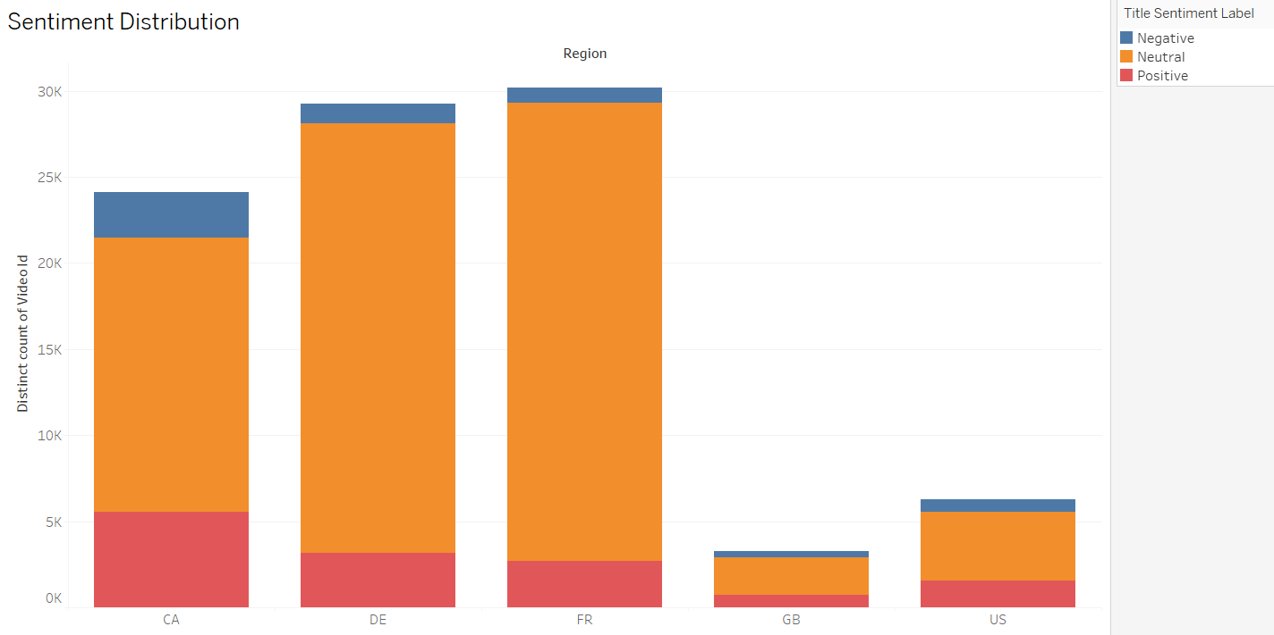
Key Findings
Insights:
France (FR) and Germany (DE) have the highest number of trending videos, each with nearly 30,000+ distinct videos.
Across all regions, the Neutral sentiment dominates, especially in FR and DE, making up the majority of titles.
Canada (CA) shows a relatively high proportion of Positive sentiment videos compared to other regions.
The United States (US) and Great Britain (GB) have significantly fewer trending videos, but still reflect the same overall sentiment pattern.
Negative sentiment is consistently the smallest portion in all countries, indicating that emotionally negative titles are less common—or less likely to trend.
Sentiment Patterns

Slide 5
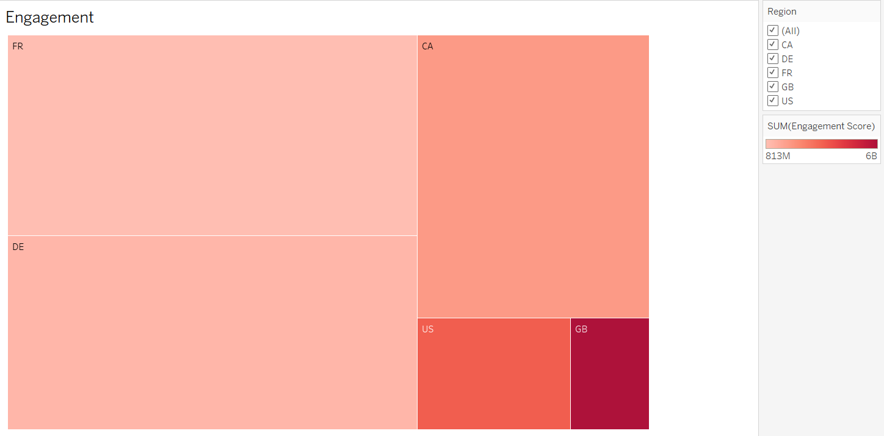
Key Findings
Insights:
France (FR) and Germany (DE) are the top contributors to total engagement, each showing high total interaction volume.
Canada (CA) also stands out with strong engagement, indicating active user interaction relative to its population size and view count.
United States (US), despite having high average views and long trending durations, ranks lower in total engagement—suggesting more passive viewership.
Great Britain (GB) shows the lowest engagement despite leading in trending duration and views at certain points. This indicates that content may be widely watched but not actively interacted with (fewer likes, comments).
Top 10 Most Engaging Videos

Slide 6
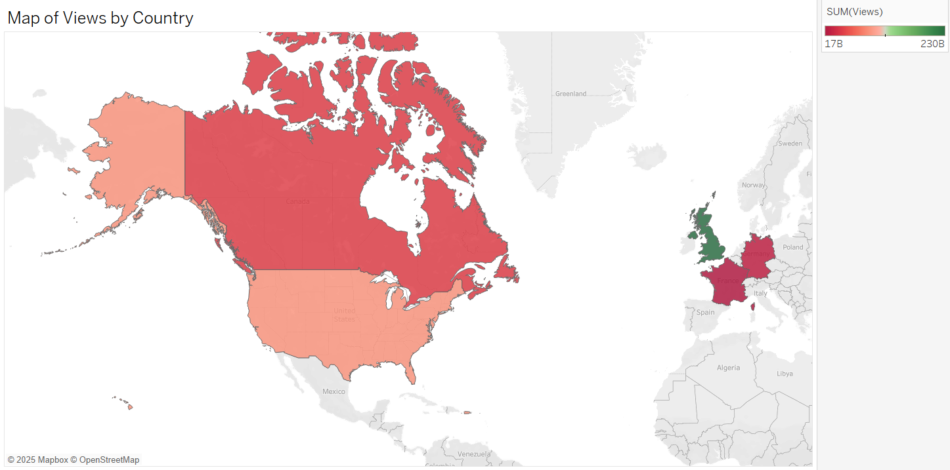
Key Findings
Insights:
Great Britain (GB) stands out as the country with the highest total view count (~230B), indicated by the darkest green shade on the map.
France (FR), Germany (DE), and Canada (CA) follow closely in volume, suggesting widespread audience interest and content consumption.
The United States (US), despite being a global YouTube powerhouse, shows comparatively lower view totals within this dataset.
Color contrast highlights Europe (particularly GB) as a key region for viewership intensity in this dataset
Region Specific Trends

Slide 7
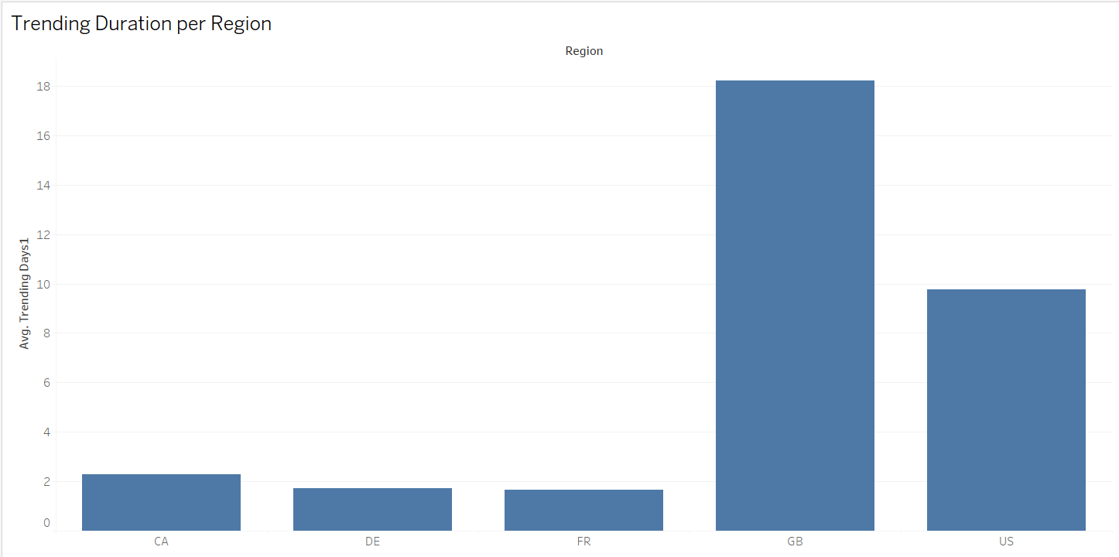
Key Findings
Insights:
Great Britain (GB) leads significantly, with videos trending for an average of 18 days, indicating longer viewer interest and content stickiness.
United States (US) comes second, with an average of around 10 days, still reflecting strong retention.
In contrast, Canada (CA), France (FR), and Germany (DE) show short trending periods, averaging between 1.5 to 2.5 days, suggesting faster turnover and competition in these regions.
Longer trending duration in GB and the US may be due to:
Broader audience base
Platform algorithm differences
More engaging or shareable content
Trending Duration per Region

Slide 8
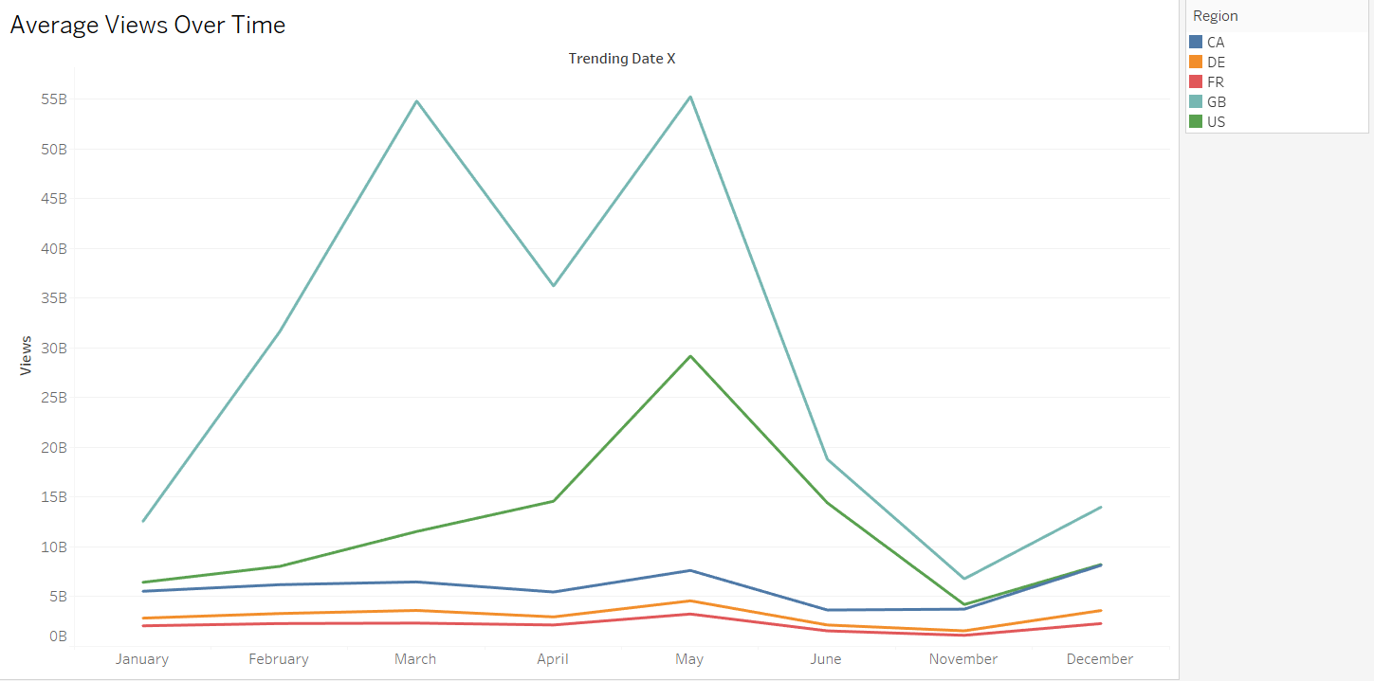
Key Findings
Insights:
Great Britain (GB) dominates viewership with a peak of over 55B average views in both March and May, indicating a strong concentration of viral content during these months.
The United States (US) also shows high viewership, peaking near 29B in May, following a steady rise from January.
Canada (CA) maintains a moderate but consistent viewership throughout the year, with a slight drop in June.
France (FR) and Germany (DE) have relatively lower views but show stable activity, likely due to region-specific trends or language barriers.
A dip across all regions in June and November suggests seasonal changes or content cycles influencing interest.
Average Views Over Time

Slide 9
Visual Summary Table
Metric | Chart Type | Insight
Average Views Over Time | Line Chart | GB and US peak in May; views drop mid-year and rise again in December.
Trending Duration per Region | Bar Chart | GB videos trend longest (~18 days); DE and FR average under 2.5 days.
Engagement by Country | Treemap | FR, DE, and CA have the highest total engagement; GB has the lowest.
Views by Country | Filled Map | GB leads total views (~230B); FR, DE, CA follow; US views are moderate.
Sentiment Distribution | Stacked Bar Chart | Neutral dominates; positive sentiment is strongest in CA; negative is low.

Slide 10
Summary and recommendations
Summary:
The analysis across five key visual dashboards highlights sharp regional differences in how viewers engage with and consume YouTube content:
Great Britain (GB) stands out with the highest viewership and longest trending duration, yet surprisingly low engagement, suggesting more passive viewing behavior.
France (FR), Germany (DE), and Canada (CA) contribute heavily to engagement, making them hotspots for community-driven or interactive content.
United States (US), while strong in average views and trend durations, lags in both engagement and total view volume in this dataset.
Viewership patterns spike in March and May, dip in mid-year, and recover in December, likely tied to events and seasonal cycles.
Positive sentiment in titles aligns with higher engagement, while negative sentiment is minimal and regionally limited.
Key Recommendations:
Target GB and US for visibility, but optimize engagement strategies in regions like FR, DE, and CA.
Use positive and neutral sentiment in video titles to encourage interaction and clicks.
Time releases around known peaks (e.g., March, May, December) for better reach.
Focus on content quality over just quantity—as seen in scatter patterns, some high-engagement videos have modest view counts.
For lasting impact, design content that holds audience attention long enough to trend for multiple days, especially in competitive regions.

