Slide 1
Micro Credit Defaulter Project
Submitted By – Sanya Dubey
Notes:
Submitted By – Sanya Dubey

Slide 2
INTRODUCTION
Micro Finance refers to all financial products and services developed for those excluded from traditional banking channel as it encourages social and banking inclusion, by enabling socially vulnerable people to benefit from productive loans, savings solutions and more. Microfinance allows people to take on reasonable small business loans safely, and in a manner that is consistent with ethical lending practices. Thus, today, it is widely accepted as a poverty-reduction tool, representing $70 billion in outstanding loans and a global outreach of 200 million clients.
The Micro Finance Services (MFS) is very beneficial while targeting people living in the remote areas by providing them financial services such as Group Loans, Agricultural Loans, Individual Business Loans and so on.
According to many researchers and policy makers, microfinance encourages entrepreneurship, increases income generating activity thus reducing poverty, empowers the poor (especially women in developing countries), increases access to health and education, and builds social capital among poor and vulnerable communities.

Slide 3
DATA SET
This dataset contains the information about the details of the customer to predict whether the customer is a defaulter or not. The user is considered a defaulter if he doesn’t pay back the loaned amount within the time period of 5 days. If the loan amount is 5, the payback amount is 6 and if the loaned amount is 10, the payback amount will be 12. This dataset contains 209593 rows and 37 columns including the target variable which is ‘Label’. The whole dataset is in numeric form except ‘pcircle’ and ‘pdate’ columns which are of object data type. The data variable used in the present data is describes as below:-
Variable | Definition
label | Flag indicating whether the user paid back the credit amount within 5 days of issuing the loan{1:success, 0:failure}
msisdn | mobile number of user
aon | age on cellular network in days
daily_decr30 | Daily amount spent from main account, averaged over last 30 days (in Indonesian Rupiah)
daily_decr90 | Daily amount spent from main account, averaged over last 90 days (in Indonesian Rupiah)
rental30 | Average main account balance over last 30 days
rental90 | Average main account balance over last 90 days
last_rech_date_ma | Number of days till last recharge of main account
last_rech_date_da | Number of days till last recharge of data account
last_rech_amt_ma | Amount of last recharge of main account (in Indonesian Rupiah)
cnt_ma_rech30 | Number of times main account got recharged in last 30 days
fr_ma_rech30 | Frequency of main account recharged in last 30 days
sumamnt_ma_rech30 | Total amount of recharge in main account over last 30 days (in Indonesian Rupiah)
medianamnt_ma_rech30 | Median of amount of recharges done in main account over last 30 days at user level (in Indonesian Rupiah)
medianmarechprebal30 | Median of main account balance just before recharge in last 30 days at user level (in Indonesian Rupiah)
cnt_ma_rech90 | Number of times main account got recharged in last 90 days
fr_ma_rech90 | Frequency of main account recharged in last 90 days
sumamnt_ma_rech90 | Total amount of recharge in main account over last 90 days (in Indonasian Rupiah)
medianamnt_ma_rech90 | Median of amount of recharges done in main account over last 90 days at user level (in Indonasian Rupiah)
medianmarechprebal90 | Median of main account balance just before recharge in last 90 days at user level (in Indonasian Rupiah)
cnt_da_rech30 | Number of times data account got recharged in last 30 days
fr_da_rech30 | Frequency of data account recharged in last 30 days
cnt_da_rech90 | Number of times data account got recharged in last 90 days
fr_da_rech90 | Frequency of data account recharged in last 90 days
cnt_loans30 | Number of loans taken by user in last 30 days
amnt_loans30 | Total amount of loans taken by user in last 30 days
maxamnt_loans30 | maximum amount of loan taken by the user in last 30 days
medianamnt_loans30 | Median of amounts of loan taken by the user in last 30 days
cnt_loans90 | Number of loans taken by user in last 90 days
amnt_loans90 | Total amount of loans taken by user in last 90 days
maxamnt_loans90 | maximum amount of loan taken by the user in last 90 days
medianamnt_loans90 | Median of amounts of loan taken by the user in last 90 days
payback30 | Average payback time in days over last 30 days
payback90 | Average payback time in days over last 90 days
Pcircle | telecom circle
Pdate | Date

Slide 4
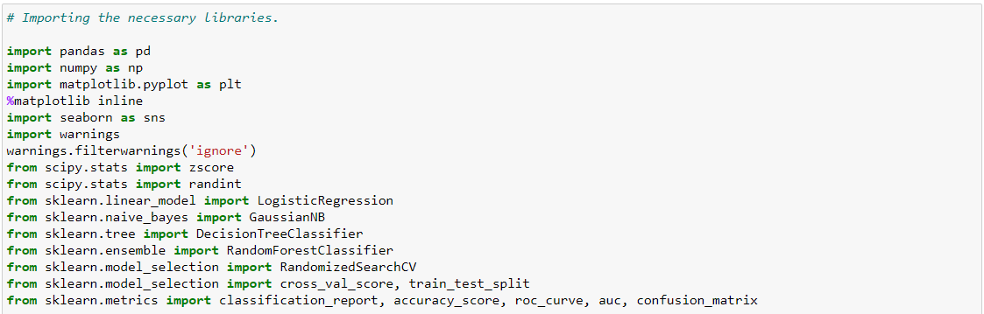
The code in this project is written in Python 3.8 - Anaconda3. To begin the project, importing essential libraries are extremely initial and the very base step as it provides fast, expressive, and flexible data structures to easily work with.
The libraries includes :

Slide 5
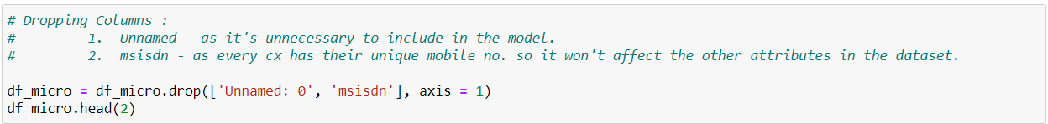
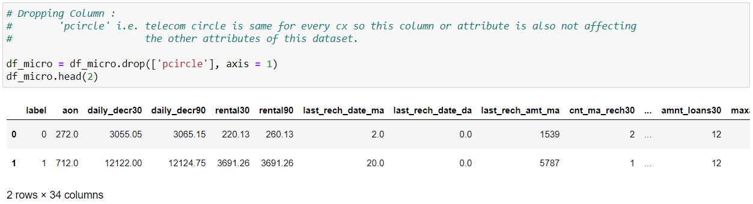
ANALYTICAL PROBLEM FRAMING/METHODS
Dropping unnecessary columns declines the chances of producing errors.
Due to the wide range of given data, it is extremely fruitful to clean, shape and set the data in the most suitable form. Dropping unnecessary columns declines the chances of producing errors.
After dropping the columns and checking the shape again, only 34 attributes are present in the model including the target variable. Checking the value count shows there are no null values present in this dataset.
There are no null values present in this dataset

Slide 6
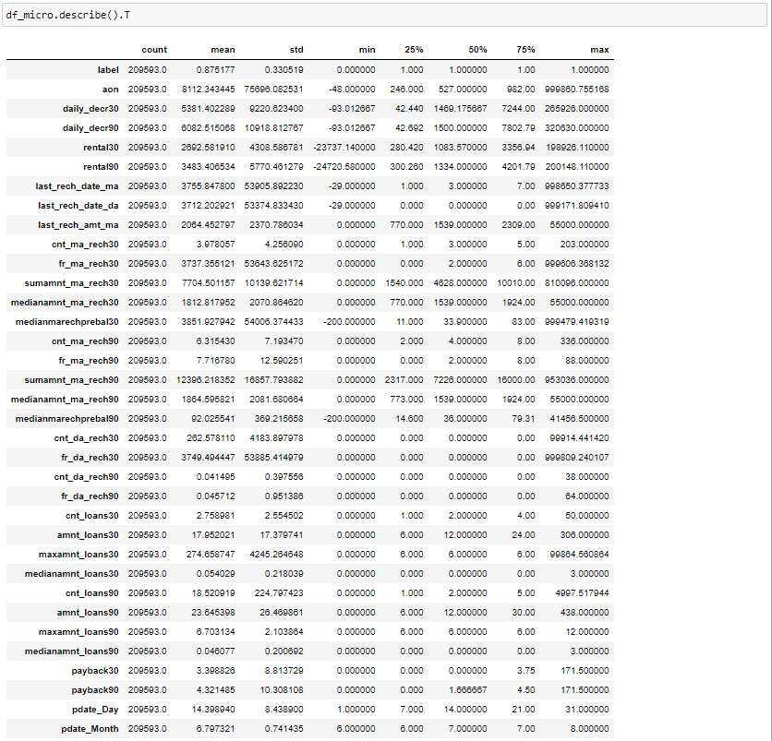
Statistical Summary
The statistical summary of the dataset depicts:-
The mean of most of the attributes is greater than its median.
2.There is a bit difference between the values of mean and median of the attributes.
3. The minimum values of attributes except for pdate_Day and pdate_Month is 0 and in negative value.
4. The range of the attributes merely differs from each other as major attributes are of high range and some ranges from 0-88.
5. The closest std for the attributes to it's mean is ‘medianamnt_loans90=’ - 0.20 and the farthest is ‘sumamnt_ma_rech90’ - 16857.793882. Thus more the std, more wide spread the attribute is
.6. There are outliers present as per the statistical summary

Slide 7
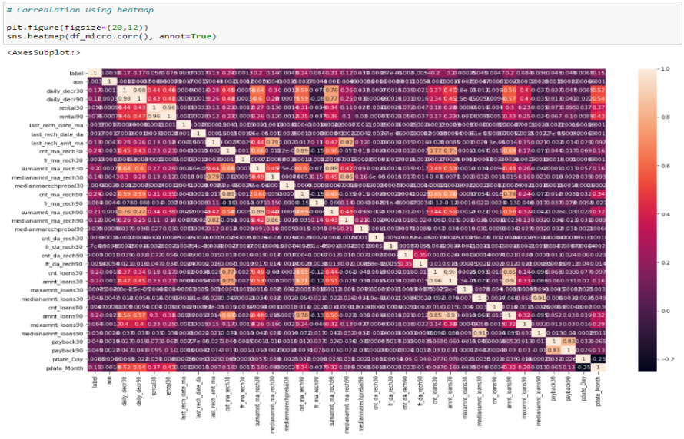
CORRELETION
1. The strongest positive correlation between - 'medianamnt_loans30' and 'medianamnt_loans90',
- 'amnt_loans30' and 'amnt_loans90', - 'amnt_loans30' and 'cnt_loans30', - 'rental30' and 'rental90' & - 'daily_decr30' and 'daily_decr90
2. The 'cnt_ma_rech90' is strongly negatively correlated with the target variable i.e. 'fr_ma_rech90'.
3. With the target variable 'label' the attributes are nuteral as they are nether highly positively correlated not sytongly negatively correlated.
4. Overall the dataset is not either strongly positive nor strongly negatively correlated.

Slide 8
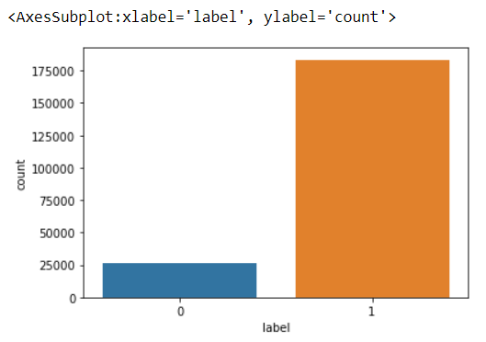
VISUALIZING THE DATA
Visualizing the target variable
Visualizing the value counts of target variable shows that that the count of customers who have paid back the credit amount within 5 days is more than the customers who haven't paid back the credit amount within the stipulated timeframe. The difference between the count of both the customers is high as the value of not being defaulter being 1 has approximately 87.5% records. While, the defaulters being represented by 0 has approximately 12.5% recordes. Thus, dataset is imbalanced.

Slide 9
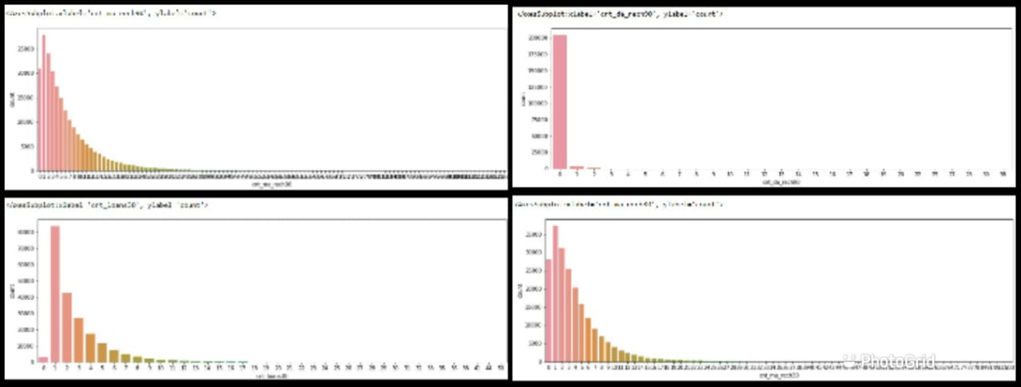
'cnt_da_rech90' - The data account in last 90 days majorily dosen't got recharged.cnt_loans30 - the users have taken loan majorily 1 time in the last 30 days followed by 2 times. here, a indirect proportionality can be seen as the number increases, the number of loans users taken decreases. 'cnt_ma_rech30' and 'cnt_ma_rech90'- In both, maximum only one time the main account got recharged in last 30 days followed by the 2 times. As the number increases the the slope or the account to be recharged no. of times decreases and at a point no recharge is made

Slide 10
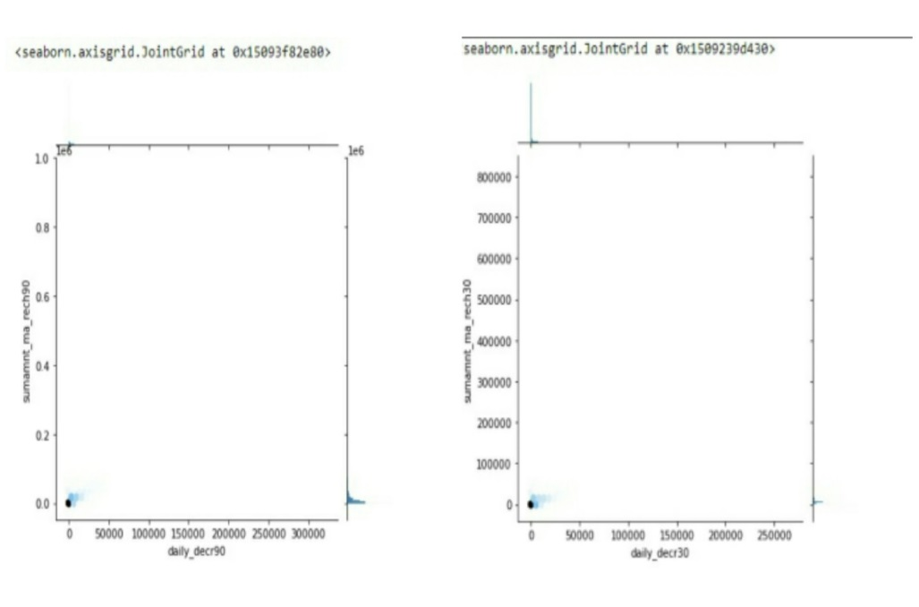
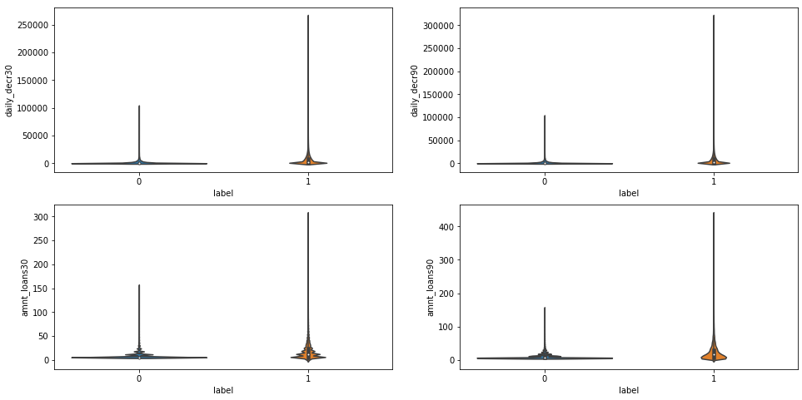
The below Violin plot show how daily_decr30, daily_decr90 ,amnt_loans30 and amnt_loans90 with respect to the customers being defaulter and not.
The above two jointplot visualize the relation between Total amount of recharge in main account over last 30 days (in Indonesian Rupiah) and over last 90 days (in Indonesian Rupiah) AND Daily amount spent from main account, averaged over last 30 days (in Indonesian Rupiah) and over last 90 days (in Indonesian Rupiah). Both shows that the value being 0.

Slide 11
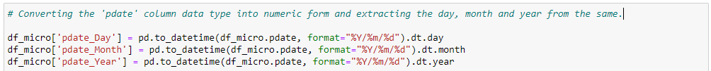
DATATYPE TRANSFORMATION
The attributes -> ‘pdate’ is of object type in the dataset, which needs to be converted into numeric and extracting the day and month from the same using to_datetime(). Thus, handling the categorical data.
HANDLING SKEWNESS AND OUTLIERS
Removing skewness gives symmetry or distribute evenly in a set of data. The removed data is referred to as outliers which may cause error if not removed. The highly skewed data affects the standard deviations and counts as an outliers. Therefore, after checking the skewness, the highly skewed data was reduced using sqrt function and the outliers are removed using z-score.
After reducing and removing the skewness and outliers respectively present in the dataset. The missing values are found which were filled by their medians respectively.

Slide 12
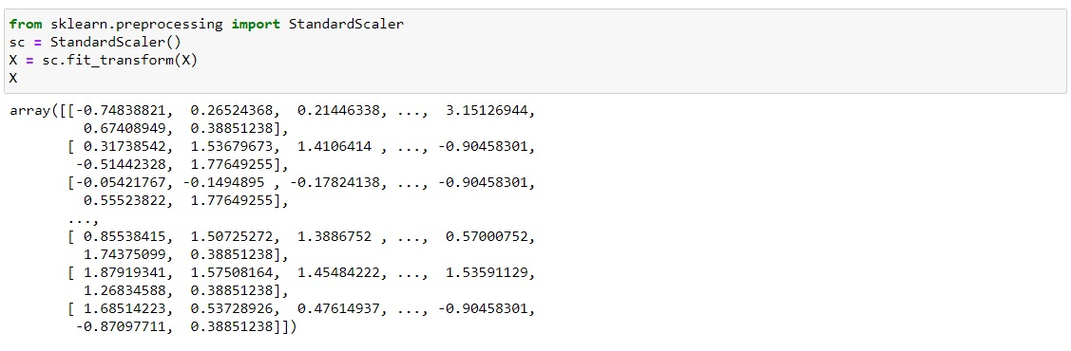
FEATURE SELECTION
After the data is separated into input and out variables being the output/target variable 'label'. The input variables are scaled because standardization makes the input variables being in the same range of values. The scaled variable would be calculated by subtracting the mean of the original variable from the raw value and then divide it by the standard deviation of the original variable. This can be done by importing ‘StandardScaler’ from sklearn.preprocessing.

Slide 13
TESTING IDENTIFIED APPROCHES
The data is first spiltted into training and testing data as it models minimizes the effects of data discrepancies and better understand the characteristics of the model. Thus now comes the machine learning part. The train and test data is to be split by done by importing ‘train_test_split’ from sklearn libraries.
Similarly, cross-validation is used to evaluate machine learning models on a limited data sample like the training data. Thus, this enables the machine to cross check or validate the accuracy scored by training the data. Importing ‘cross_val_score’ from sklearn Libraries.
The training data is used to make the machine recognizes patterns in the data, the cross-validation data is used to ensure better accuracy and efficiency of the algorithm used to train the machine, and the test data is used to see how well the machine can predict new answers based on its training.

Slide 14
The different algorithms tested in this dataset are :
Logistic Regression - Maximum Accuracy score obtained is 0.8734400644102437 achieved at 55 random state.
GaussianNB - Maximum Accuracy score obtained is 0.73 58251014151673 achieved at 73random state.
DecisionTreeClassifier - Maximum Accuracy score obtained is 0.8806242839005357 achieved at 55 random state.
RandomForestClassifier - Maximum Accuracy score obtained is 0.9206329545102654 achieved at 55 random state.

Slide 15
HYPERPARAMETER TUNING USING RandomizedSearchCV
The algorithms parameters are now hyper tuned using RandomisedSearchCV. The accuracy score obtained after hypertuning the paramerts are:
Logistic Regression - Maximum Accuracy score obtained is 0.8734400644102437 achieved at 55 random state.
GaussianNB- Maximum Accuracy score obtained is 0.746539497723965 achieved at 73 random state.
DecisionTreeClassifier - Maximum Accuracy score obtained is 0.8929489363019849 achieved at 55 random state.
RandomForestClassifier - Maximum Accuracy score obtained is 0.9209426191434676 achieved at 55 random state.

Slide 16
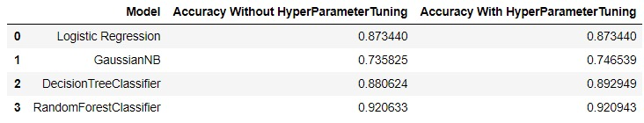
Comparing the results of algorithms with and without hyperparameter tuning.
There is no such big difference on comparing the scores with and without hyper tuning
there is a mere difference in GaussianNB and DecisionTreeClassifier just a increase in score by 1 point or 1 %

Slide 17
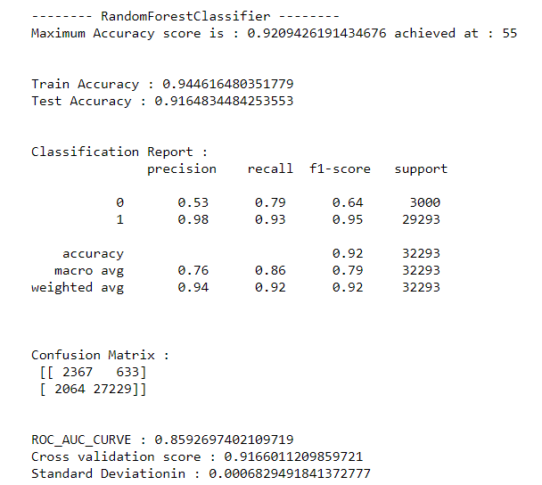
EVALUATING THE MATRICES AND FINALIZING THE MODEL
On Comparing the results of algoritjms with and without hyperparameter tuning, RandomForestClassifier is giving the best score among all the algorithms tested i.e. accuracy score being 0.92 at the random state 55. Thus selecting the same as a model.
The evaluation matrices scores include sklearn classification metrics, which basically helps in evaluating the model that how well the model performance is, it includes:
1.Classification Report, displays the precision, recall, f1-score, and support for each class.
2.Confusion Matrix, is a handy presentation of the accuracy of a model with two or more classes.
3.ROC AUC Score, depicts how well our machine learning classifier is performing.

Slide 18
CONCLUSION
Predicting Micro Finance Defaulter is really important for the companies or such institutions as it enables them to make strategies and innovations in order to control the such scenarios. For any sector, industry etc. customers plays a vital role. Since default is a particularly important issue for client protection, to explore how microfinance institutions (MFIs) treat clients who are unable to repay their loans. It was motivated by a lack of information on the client-facing actions MFIs take when a borrower moves into default.
The dataset used for predicting the defaulters of the Microfinance company concludes that out of the proposed algorithms tested being sample data as 80% for training and 20% for testing, the RandomForestClassifier proved itself efficient as a model giving the maximum and highest accuracy score of 0.92%. The AUC value achieved is 0.85%. Such scores are achieved by performing the effective feature transformation, feature selection, correlation ,statistical summary, handling the missing values, skrewness, feature engineering, also via pre-processing to remove the outliers, which results the positive effect on the dataset. Hence, the results from this analysis shows that predicting the customer churn with high accuracy is successful.

Slide 19
Thank You
Notes:
Thank You

