Slide 1
Name:-Sanyam Jain
Roll no:-IT-2k20-03
Subject:-ADA
(End Semester Paper)

Slide 2
Que.no 1). Analyse the time complexity of the Quick Sort algorithm in average case and provide a step by step explanation of sorting process
Time Complexity Analysis (Average Case): In the average case, Quick Sort exhibits a time complexity of O(n log n), where 'n' is the number of elements in the array. This is considered efficient and makes Quick Sort one of the fastest sorting algorithms in practice.

Slide 3
Step-by-Step Explanation of the Sorting Process:
Choose a pivot: Select a pivot element from the array. The choice of pivot can impact the performance of the algorithm, and different strategies can be used (e.g., choosing the first, last, or middle element).
Partitioning: Rearrange the array in such a way that all elements less than the pivot are placed before it, and all elements greater than the pivot are placed after it. This step ensures that the pivot element is in its correct sorted position.
Recursive calls: Recursively apply the above two steps to the sub-arrays on the left and right of the pivot. This means repeating the partitioning step for each sub-array until the entire array is sorted. The recursion ends when the sub-arrays contain only one element or are empty.
Combine: Since the elements are rearranged in-place during the partitioning step, no additional combining or merging is required.
Repeat until sorted: Repeat steps 1-4 until the entire array is sorted. At each step, the pivot element is placed in its final sorted position, reducing the size of the sub-arrays that need to be sorted.

Slide 4
Que no 2). Critically evalute Strassen's matrix multiplication algorithm and compare its time complexity with the traditional matrix multiplication method.
Answer:- Strassen's matrix multiplication algorithm is an algorithm that aims to reduce the time complexity of matrix multiplication compared to the traditional method. It achieves this by using a recursive approach and dividing the matrices into smaller submatrices. However, while Strassen's algorithm provides a theoretical improvement in time complexity, it has practical limitations and is not always faster than the traditional method.

Slide 5
Here's a critical evaluation of Strassen's matrix multiplication algorithm:
Advantages of Strassen's Algorithm:
Reduced time complexity: Strassen's algorithm has a time complexity of O(n^log2(7)), which is approximately O(n^2.81). This is an improvement over the traditional matrix multiplication, which has a time complexity of O(n^3) using the straightforward approach.
Efficient for large matrices: Strassen's algorithm is particularly effective when dealing with large matrices, as the reduction in the number of multiplications can significantly reduce the overall computation time.
Disadvantages and Limitations of Strassen's Algorithm:
Overhead: Strassen's algorithm introduces additional overhead due to recursive calls and matrix additions. This overhead can offset the benefits gained from reducing the number of multiplications, especially for smaller matrices. As a result, the traditional method can be faster for small to medium-sized matrices.
Increased memory usage: Strassen's algorithm requires additional memory to store the submatrices created during the recursive process. This increased memory usage can be problematic for large matrices, as it may exceed the available memory capacity.

Slide 6
Comparison of Time Complexity: The traditional matrix multiplication algorithm has a time complexity of O(n^3), while Strassen's algorithm has a time complexity of O(n^log2(7)). In terms of theoretical time complexity, Strassen's algorithm is better than the traditional method, as it has a lower exponent.
In practice, the traditional matrix multiplication algorithm can outperform Strassen's algorithm for smaller matrices due to the overhead and extra arithmetic operations involved in Strassen's approach. Strassen's algorithm becomes more advantageous for larger matrices where the reduced number of multiplications outweighs the additional overhead.

Slide 7
Que no 3.)Evaluate Prims algorithm for finding the minimal spanning tree and provide a real world scenario where it can be applied
Answer:-Prim's algorithm is a greedy algorithm used to find the minimum spanning tree (MST) in a weighted undirected graph. It starts with a single vertex and grows the MST by iteratively adding the shortest edge that connects an already included vertex to an excluded vertex.
Here's an evaluation of Prim's algorithm and a real-world scenario where it can be applied:-

Slide 8
Advantages of Prim's Algorithm:
Efficiency: Prim's algorithm has a time complexity of O(V^2) with an adjacency matrix representation and O(E log V) with an adjacency list representation, where V is the number of vertices and E is the number of edges. This makes it efficient for dense graphs and relatively efficient for sparse graphs.
Guaranteed Minimum Spanning Tree: Prim's algorithm guarantees the construction of a minimum spanning tree. The resulting tree has the minimum total weight among all possible spanning trees in the graph, ensuring optimal connectivity.
Suitable for Distributed Systems: Prim's algorithm is well-suited for distributed systems, as it can be easily parallelized. Each node can independently compute the minimum weight edge connected to it, making it efficient for distributed implementations.

Slide 9
Real-World Scenario:
Telecommunication Network Planning A real-world scenario where Prim's algorithm can be applied is in telecommunication network planning. Consider a telecommunications company that wants to establish a network infrastructure connecting multiple cities with the least amount of cable usage. The cities can be represented as vertices, and the cables required to connect them can be represented as weighted edges.

Slide 10
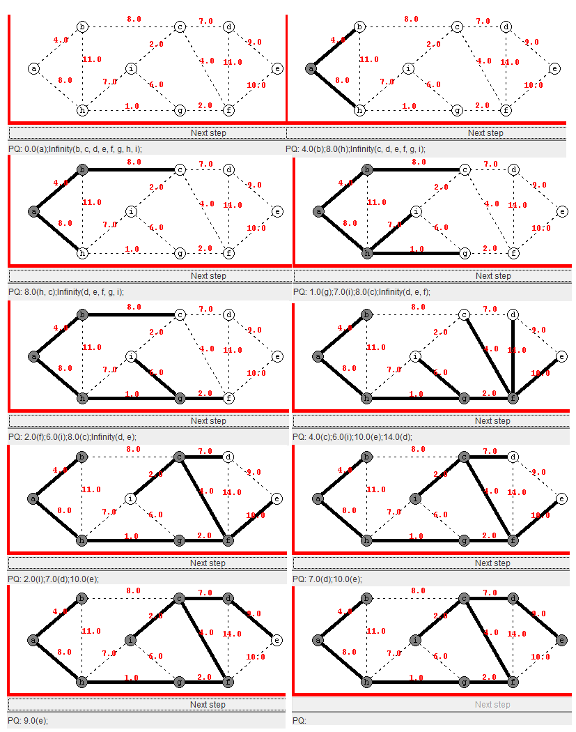

Slide 11
Que 3).
a). Analysis Hamiltonian cycle and provide an example of how they can be used in real life application
Answer:- A Hamiltonian cycle is a path in a graph that visits every vertex exactly once and ends at the starting vertex. In other words, it is a closed walk that traverses all the vertices of a graph without repeating any vertex, except for the starting vertex.

Slide 12
Analysis of Hamiltonian Cycles:
NP-Completeness: The problem of determining whether a Hamiltonian cycle exists in a graph is known to be NP-complete, which means it is computationally challenging to find an optimal solution in polynomial time for large graphs.
Exhaustive Search: Due to the NP-completeness, finding Hamiltonian cycles often requires exploring all possible paths, making it an exhaustive search problem. As the number of vertices increases, the search space grows exponentially, leading to computationally intensive operations.
Optimization: While finding a Hamiltonian cycle is challenging, optimizing the cycle for specific objectives (e.g., minimizing distance or maximizing efficiency) can be approached using heuristic algorithms or approximation techniques.

Slide 13
Real-Life Application: Traveling Salesman Problem One significant real-life application of Hamiltonian cycles is in the Traveling Salesman Problem (TSP). The TSP involves finding the shortest possible route for a salesman to visit a given set of cities and return to the starting city, covering all cities exactly once.

Slide 14
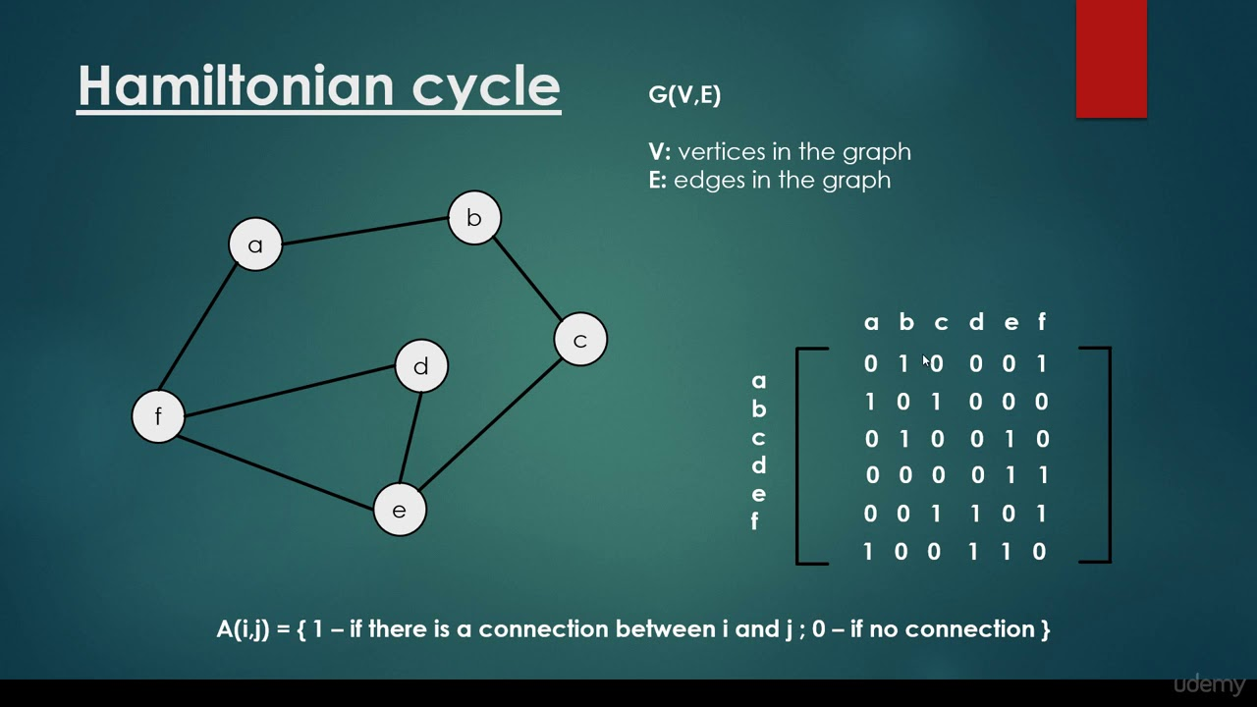

Slide 15
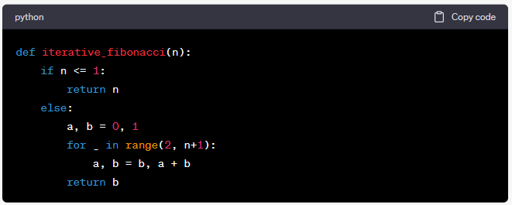
Que no 4).Derive the time complexity of iterative and recursive version of fibonacci function and compare there efficiency
Answer:-To derive the time complexity of the iterative and recursive versions of the Fibonacci function, let's analyze each approach separately.
Iterative Fibonacci Function: The iterative version of the Fibonacci function calculates the Fibonacci sequence iteratively using a loop. Here's the code:

Slide 16
The time complexity of the iterative Fibonacci function is O(n) since it performs a loop that runs 'n' times, where 'n' is the input number. Each iteration involves a constant amount of work, so the time complexity grows linearly with 'n'.

Slide 17
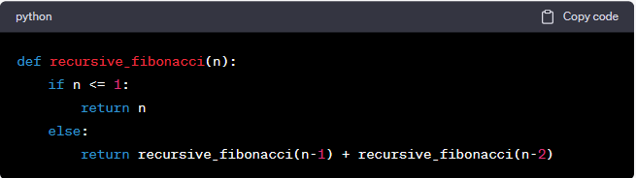
Recursive Fibonacci Function: The recursive version of the Fibonacci function calculates the Fibonacci sequence by recursively calling itself. Here's the code:
The time complexity of the recursive Fibonacci function can be derived using a recurrence relation. Let T(n) represent the time complexity for calculating the nth Fibonacci number.

Slide 18
Efficiency Comparison:-
The iterative Fibonacci function is significantly more efficient than the recursive version. While the iterative approach has a linear time complexity of O(n), the recursive approach has an exponential time complexity of O(2^n). As a result, the recursive function becomes increasingly inefficient as 'n' grows larger.
The inefficiency of the recursive Fibonacci function is primarily due to the repeated calculations of the same subproblems, resulting in redundant work. In contrast, the iterative function avoids redundant calculations and calculates Fibonacci numbers in a bottom-up manner, leading to better performance.

Slide 19
Question 5).(a.) Write non deterministic search and non deterministic sort algorithm
Answer:-
Non-Deterministic Search Algorithm:
Non-deterministic search algorithms do not follow a specific deterministic path but explore multiple possible paths simultaneously, with the hope of finding a solution. One such algorithm is the Non-Deterministic Depth-First Search (NDFS).

Slide 20
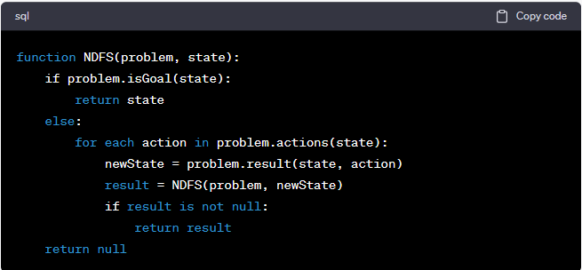
Here's the pseudocode for NDFS:

Slide 21
Non-Deterministic Sort Algorithm:
Non-deterministic sort algorithms are based on the concept of non-deterministic computation, where multiple possible outcomes are explored at the same time. However, it's important to note that non-deterministic sorting algorithms do not exist in practice since sorting is typically a well-defined and deterministic problem. Nevertheless, I can provide a simple example of a non-deterministic sorting algorithm called Non-Deterministic Bubble Sort for illustrative purposes:

Slide 22
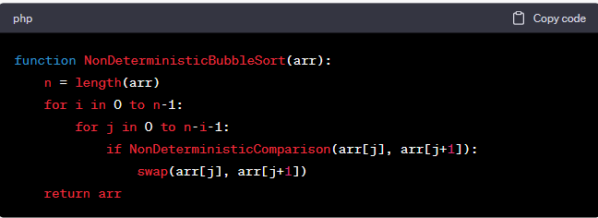

Slide 23
Question 5).
Analysis and compare the class p, NP ,
NP hard and NP complete problem and provide example of each . Discuss their significance in computer science and their potential in real world application

Slide 24
Answer:-In computer science, the complexity classes P, NP, NP-hard, and NP-complete play a fundamental role in understanding the difficulty of computational problems. Here's an analysis and comparison of these complexity classes along with examples and their significance in computer science and real-world applications:
Class P (Polynomial Time): A problem is in class P if there exists an algorithm that can solve it in polynomial time, meaning the running time of the algorithm is bounded by a polynomial function of the problem size.
Significance: Problems in class P have efficient algorithms that can solve them in a reasonable amount of time for large inputs. They are considered computationally tractable and form the basis for many practical applications in areas like data processing, optimization, and algorithm design.

Slide 25
Class NP (Non-Deterministic Polynomial Time): A problem is in class NP if a proposed solution can be verified in polynomial time. While NP stands for "non-deterministic polynomial," it does not necessarily mean that problems in NP can be solved in polynomial time.
Significance: Problems in NP represent a class of problems where a proposed solution can be quickly verified, even though finding the solution may be computationally challenging. NP problems are of great interest in computer science, as they include many real-world optimization, decision, and scheduling problems. Solving NP problems efficiently is a significant open question in computer science, with implications for cryptography, optimization, and artificial intelligence.

Slide 26
NP-hard (Non-Deterministic Polynomial-Time hard): A problem is NP-hard if it is at least as hard as the hardest problems in class NP. In other words, an NP-hard problem is as difficult as or harder than any problem in NP.
Significance: NP-hard problems represent a set of computationally challenging problems that do not necessarily belong to class NP. Solving NP-hard problems optimally for all inputs is considered intractable, and efficient algorithms for NP-hard problems are a topic of active research. Many real-world optimization problems can be modeled as NP-hard problems, and developing approximation algorithms and heuristics for these problems is crucial.

Slide 27
NP-complete (Non-Deterministic Polynomial-Time complete): A problem is NP-complete if it is both in class NP and is NP-hard. NP-complete problems are the hardest problems in NP, and a solution to any NP-complete problem would imply a solution to all NP problems. Examples of NP-complete problems include the Boolean Satisfiability Problem (SAT), the Knapsack Problem, and the Traveling Salesman Problem (TSP).
Significance: NP-complete problems are of utmost importance in computer science as they represent the most challenging problems in class NP.

Slide 28
THAnk -you

