Slide 1


Industrial Practical Training Presentation
as
Data Analyst
in
Lighthouse Department
at
KPMG India
(13th January 2022 to 10th July 2022)
Institute Mentor: Presented by:
Dr Urvashi Sanyamdeep Singh
(Assistant Professor) 18103083
Computer Science and Engineering Department Dr B R Ambedkar National Institute of Technology, Jalandhar (144011)

Slide 2
Contents
About the Company
Training Summary
List of Courses/Tech Stack
Certifications
Capstone Project
Objective
Workflow and Architecture
Azure Services used
Ingestion Workflow
Transformation
Visualization
Dashboards

Slide 3
About the company
KPMG is British-Dutch company and is one of the Big Four accounting firms in the world, headquartered in Amstelveen, Netherlands, although incorporated in the United Kingdom, KPMG is a network of firms in 145 countries, with over 236,000 employees and has three lines of services: financial audit, tax, and advisory.
KPMG in India is one of the leading providers of risk, financial and business advisory, tax and regulatory services, internal audit, and corporate governance.
KPMG Lighthouse is the centre of Excellence for data-driven technology. The Lighthouse department deals with data analytics , business intelligence , data engineering , artificial intelligence and machine learning.

Slide 4
Training Summary
Completed some Linked In Learning courses in first 2 weeks
Training by Cloudthat started in first week of February and ended in April in which all courses were related to azure data engineering.
After the completion of training we were supposed to get certifications done .
Then a hands on Capstone Project where we have to apply all our learnings.
Data engineers are responsible for building pipelines, ingesting data from different sources and processing raw data to make it more useful

Slide 5
List of courses covered in training
Azure fundamentals
Data fundamentals
Python
SQL
Spark
Data factory
Azure log analytics
Azure Devops
Azure synapse analytics
Azure Databricks

Slide 6
Azure Fundamentals
AZ-900 Microsoft certification
Learnt about cloud computing and services provided by azure
Public , private and hybrid mode of cloud computing
Created an account on azure portal
Azure regions , availability zones , region pairs
Deployed a virtual machine
Azure pricing calculator , azure advisor

Slide 7
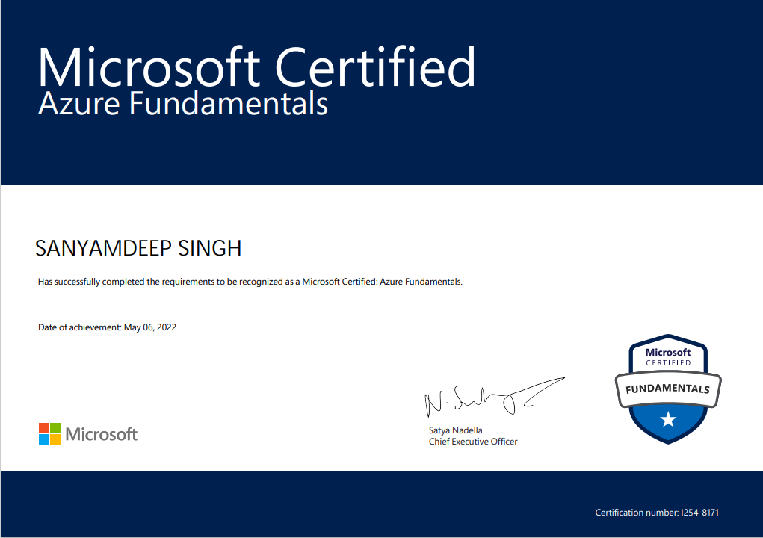
Azure Fundamentals Certification

Slide 8
Data Fundamentals
DP-900 Microsoft certification
What is data and how it is stored?
Relational tables , normalization , SQL to query relational tables
Azure data services are available for MySQL, MariaDB, and PostgreSQL
Azure storage and its types : blob , data lake , files , tables
Data ingestion and pipelines
Batch vs stream data processing

Slide 9
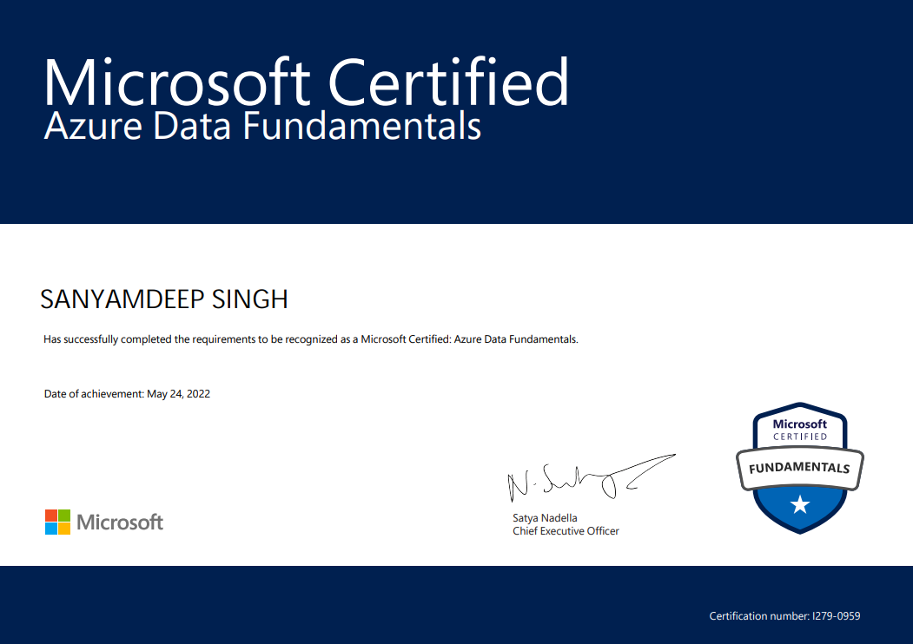
Data Fundamentals Certification

Slide 10
DP-203 Data engineering on Microsoft azure
Synapse analytics , databricks , data factory are tools used by azure data engineers.
How to ingest data from different sources?
How to perform transformations and make data more useful?
How to build pipelines and trigger them?
How to run notebooks and work with data frames in databricks?

Slide 11

DP-203 Data engineering Certification

Slide 12
Capstone Project - Problem Statement
Building azure data platform for COVID data analysis for health provider industry
As the increase in COVID cases across the world has set up a sense of distress among the global population, various countries have been largely affected by this economically. Countries have tried to make use of various response measures which have somewhat reduced the cases but still, the issue stands at large.
ECDC collaborates with national health protection agencies across Europe to enhance and develop pan-continental disease surveillance and early warning systems. ECDC develops authoritative scientific opinions regarding the risks posed by current and emerging infectious diseases by collaborating with health experts from across Europe.

Slide 13
Capstone Project - Understanding Dataset
We were given three sources related to covid : Confirmed cases and mortality rate, Hospitalization and ICU cases, Testing numbers.
We have 4 csv files. The first one cases_deaths.csv has the weekly number of cases and deaths in each country and also the total number of cases and deaths till each week.
The second csv file hospital_admissions.csv contains the day wise daily hospital and ICU occupancy and weekly new hospital & ICU admissions per 100K in each country. We have date, year_week column.

Slide 14
Capstone Project - Understanding Dataset
The third csv file testing.csv contains data like number of tests done and new cases each week in different regions of different countries. It also contains testing rate and positivity rate of each week. There are different regions like Burgenland with region code AT11 in Austria country with country code AT.
The fourth csv file contains data about the responses each country took and on which dates.
We had to come up with a solution using the technologies we had learnt.

Slide 15
Objective
Ingestion Requirements-
We would be Using ‘Copy Activity’ in Azure Data Factory to pull raw data from HTTP Source and would store the data in Azure Data Lake.
Transformation Requirements –
Some of the transformation would be done through ‘Data Flow’ in Data Factory, such as removing the unnecessary Columns, adding some columns from lookup tables (if required), adding Derived Columns, and changing the names of some column to a suitable name.
More Complex Transformation Queries would be run on DataBricks Services (using Databricks Notebook Activity in ADF, after creating a Cluster for Databricks), including converting the Data in Columnar format like Parquet Files
These Files after ETL processes would be stored in Separate Folder in Azure Data Lake (Gen2).

Slide 16
Objective (Contd.)
Visualization Requirements –
Power BI service can be used to create dashboards and analyses, as well as Azure SQL Database Service can also be used to create Charts.
Would be bringing out insights such as trends persisting to cases and deaths reported, weekly and daily hospital and ICU admissions/occupancy etc. through Power BI
Scheduling Requirements –
Triggers would be used on Pipeline accordingly to automate on suitable events

Slide 17
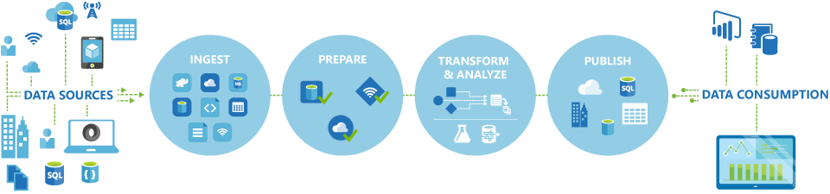
Structure of Azure Workflow

Slide 18
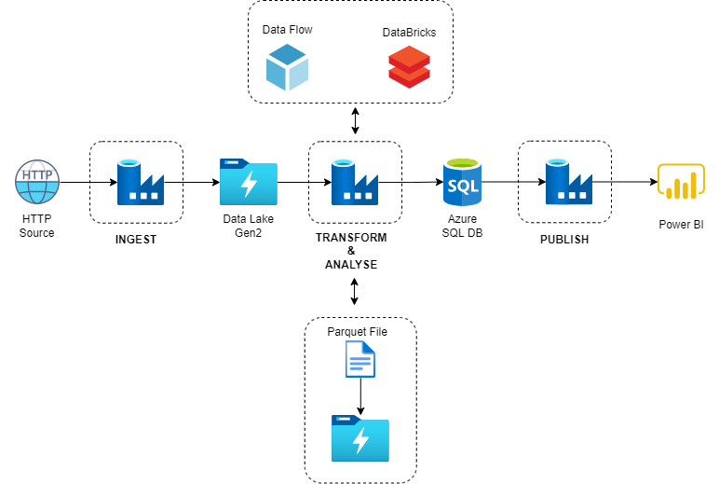
Solution Architecture

Slide 19

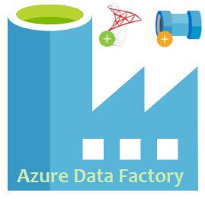
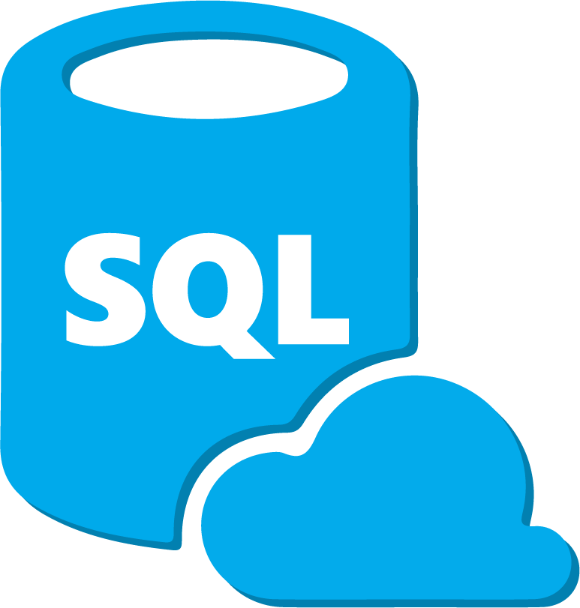
Azure Services used
Azure Data Factory,Databricks
Azure Data Lake Gen 2
Azure SQL Data Base
Azure Power BI

Slide 20
Ingestion
The first step of our solution is INGESTION.
Data Ingestion is simply the process of extracting data from multiple sources and accumulating it in a processing environment.
It includes following steps :
Creating Storage account
Creating Data Factory to ingest data
Creating pipelines to ingest data
Ingest data in datalake

Slide 21
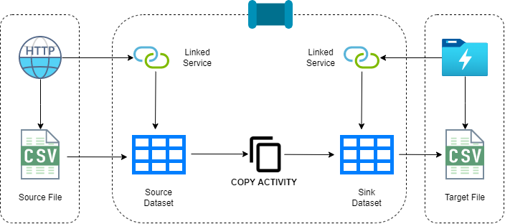
Ingestion (Contd.)
We would be using Azure Data Factory for Ingestion. A Pipeline containing Copy Activity would be created (with Parameters) to Ingest data from HTTP Source into Data Lake (Gen2).

Slide 22
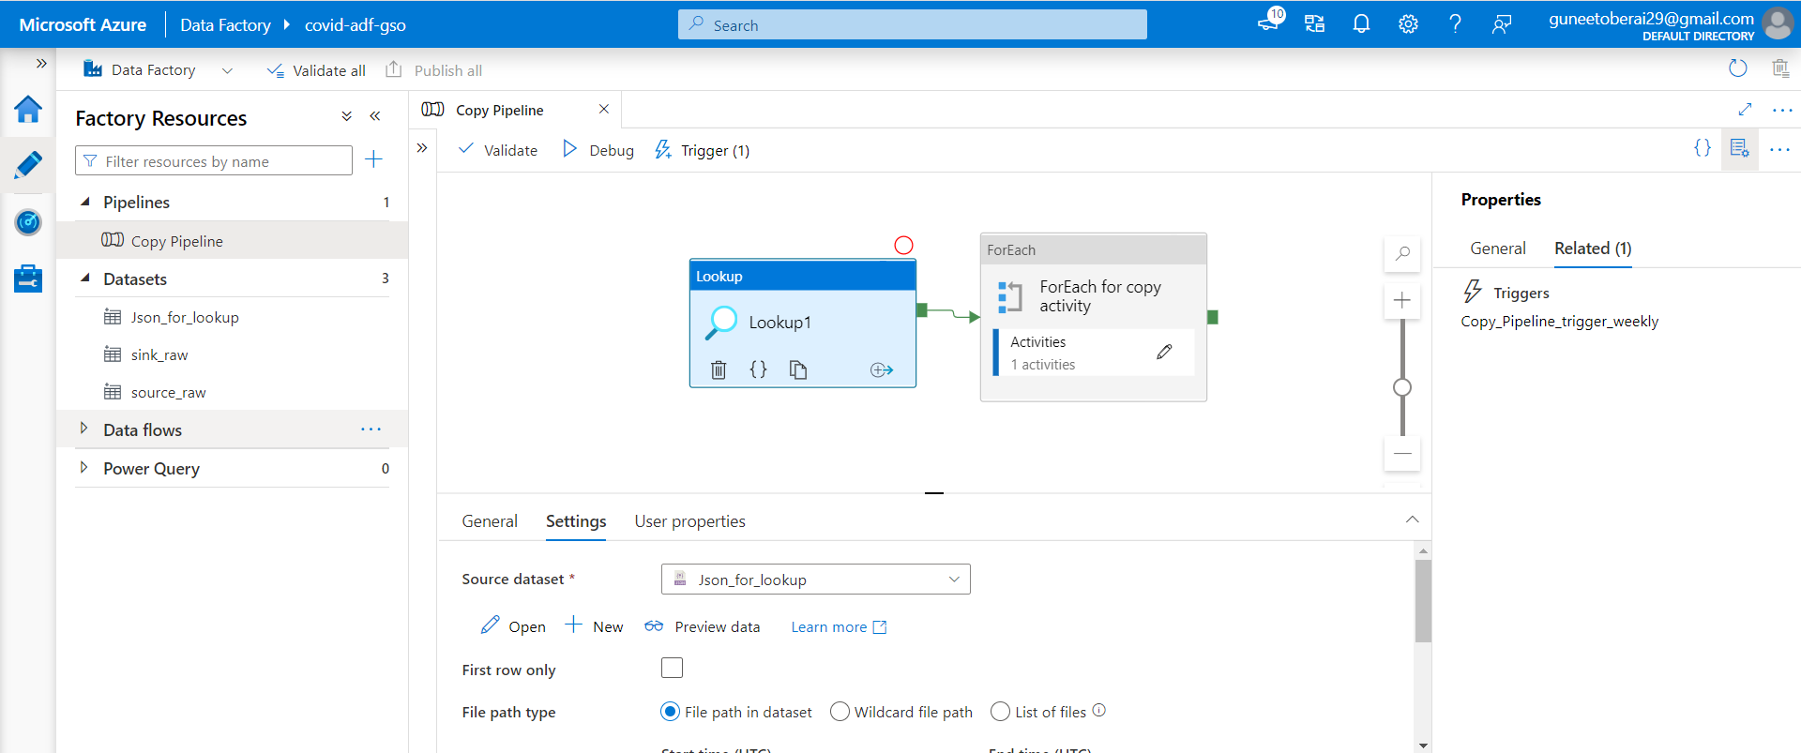
Ingestion (Contd.)
To Automate the Whole Ingestion Process (Including All 4 HTTP Source) Using Minimum no. of Pipeline, we would be going with the following approach –
We would be using only 1 pipeline named ‘Copy Pipeline’ as shown below:

Slide 23
Ingestion (Contd.)
We create a pipeline consisting of Lookup & ForEach Activity. The ForEach Activity Contains the Copy Activity.
The Lookup Activity is connected to ‘Json_for_lookup’ Dataset, that Contains the Values of Parameters (‘SoureceUrl’ & ‘SinkName’) to be ingested in Copy Activity .
Two more Datasets are created – 1. Source Raw 2.Sink Raw
These Datasets are linked to – 1.HTTP URL 2.Data Lake Gen 2 respectively through Linked Services .
So total 2 Linked Services are used.
A Schedule Trigger is created that ingest Data on Weekly Basis as the data is a batch Data and has Weekly Counts.

Slide 24
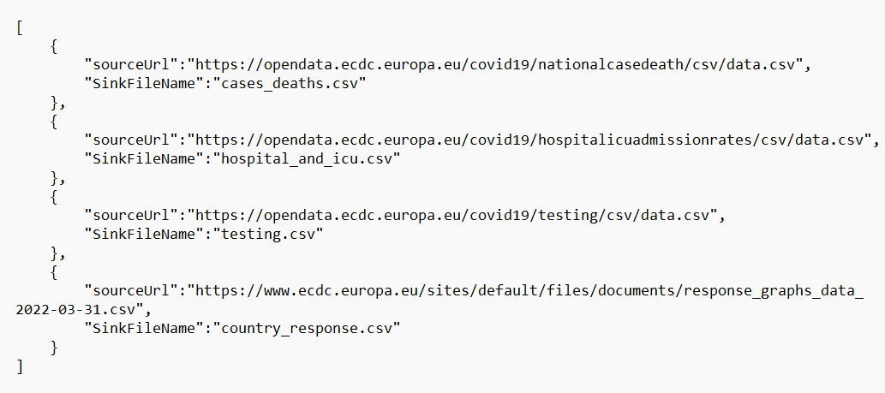
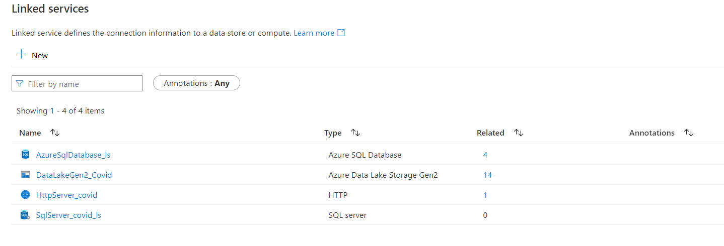
JSON FILE
LINKED SERVICE

Slide 25
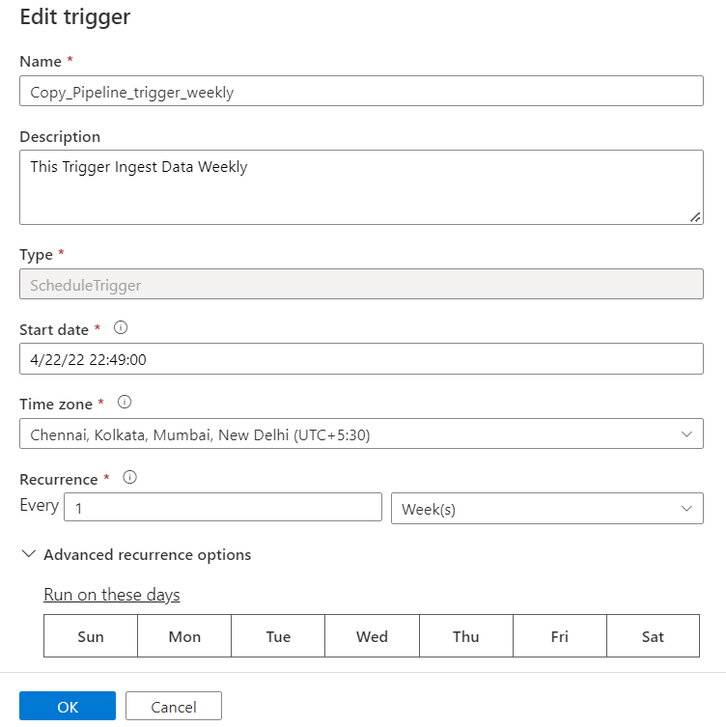
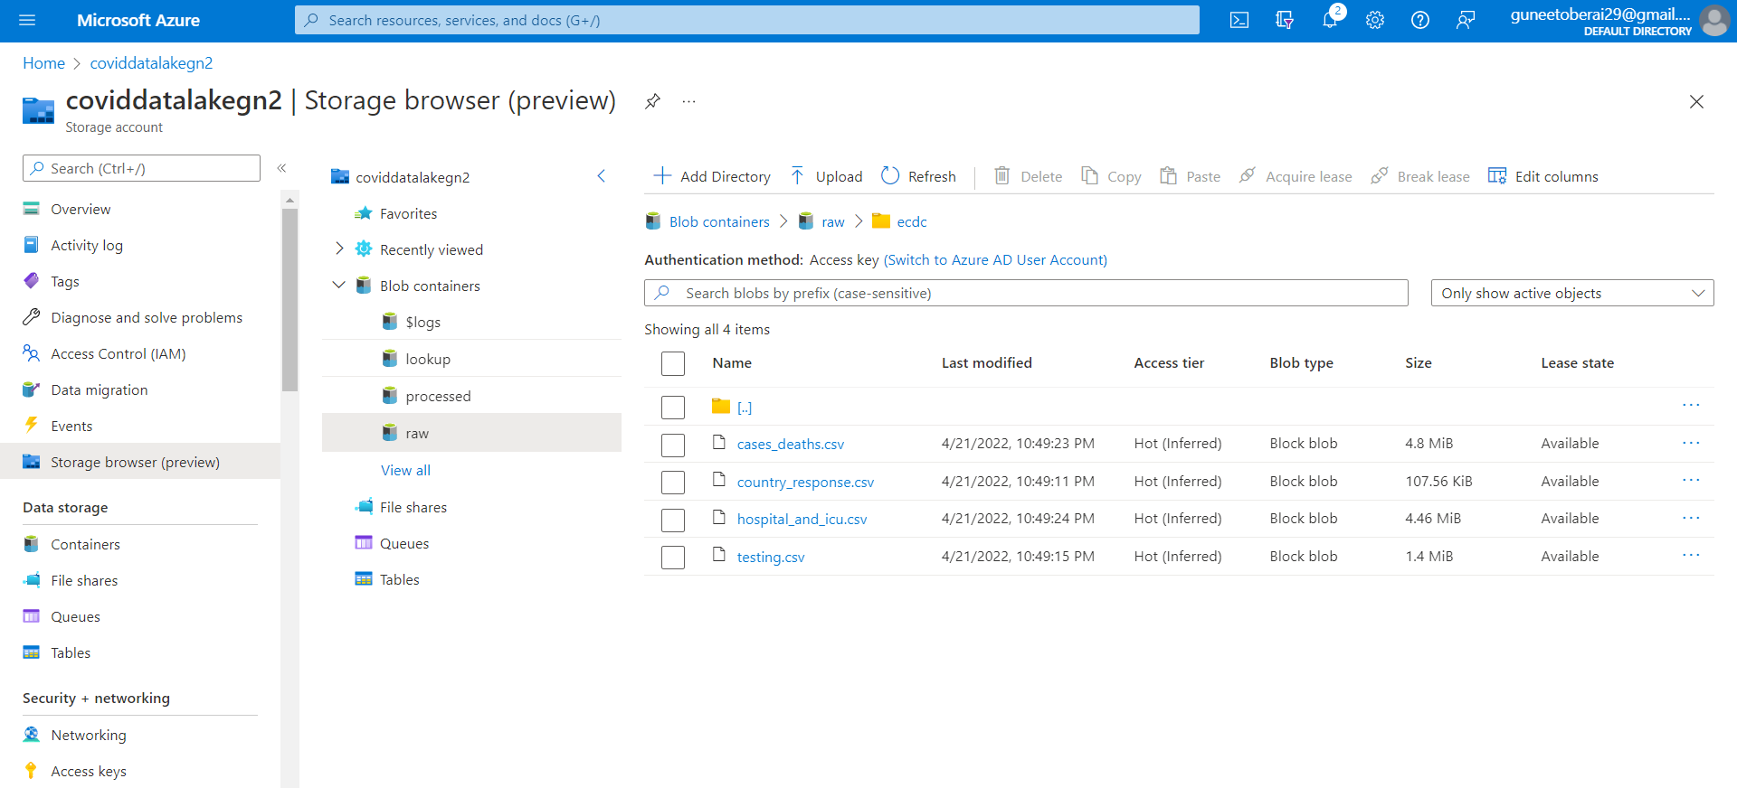
SCHEDULE TRIGGER
STORAGE ACCOUNT

Slide 26
Transformation
Basic Transformation on Cases & Death File-
The Country Code contains 3 Digit Code, so ‘2 Digit Country Code’ Column would be added so it becomes easier to join it with Testing Data as it contains 2 Digit Country Code. For this we can create a Lookup File with Columns- Country Name, 3 Digit Country Code,2 Digit Country Code.
We would be Filtering out the Data and would be including Data from Europe only.
Afterward Continent Column would be removed. Rate_14_day Column can also be removed.
Indicators Column has 2 Values – Cases & Death.
We can create 2 Derived Columns from it – Cases_count & Death_count from it.

Slide 27
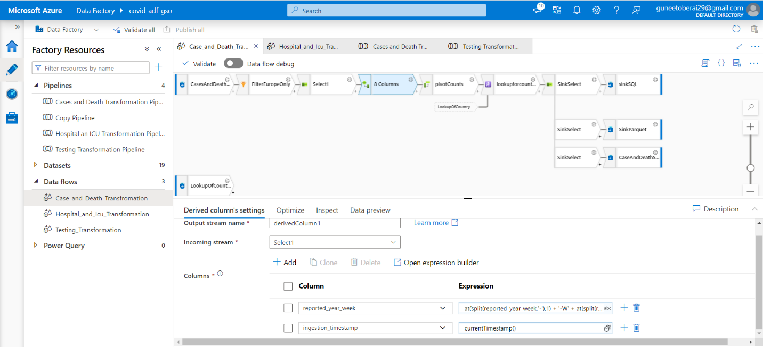
Data Flow

Slide 28
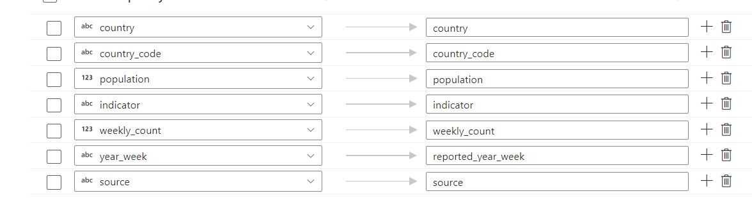
Control Flow for Cases & Death
Source has the Dataset from Gen2, where the raw files are stored.
Filter is used to filter out only Europe Countries Data.
Select helped to only select required Columns like -
The Derived Column – ‘derived column1’ is used to
Change the format of reported_year_week, to Unify with the Format of all other Datasets to make it easier to joins and analysis. Ex. Format changed from ‘2020-01’ to ‘2020-W01’
Ingestion Timestamp has been added as an AUDIT Column to signify Date & Time of Ingestion of Data.

Slide 29
Control Flow for Cases & Death
Lookup helped in adding both 2 digits & 3-digit country code Columns. From another CSV File that was separately created containing- Country Name, Country 2 Digit Code, Country 3 Digit Code & Population.
Sink Select was created to delete any Duplicate Columns
3 SINKS are created- 1. DataLake Sink(csv), 2. Parquet Sink, 2. SQL Sink
DataLake Sink – This exported the processed CSV File in the Processed Folder in DataLake.
Parquet Sink- Exported a Parquet File in DataLake in Processed/Parquet folder.
SQL Sink – This ingested the data in SQL Database in Table. The Tables were created beforehand with proper schema.

Slide 30
Transformations
Basic Transformation on Hospital Admission File-
We would be adding Columns such as Country code- Both 2 & 3 Digit, Population from The Lookup File.
On The Basis od Indicator Column we can Divide this Dataset into 2 Dataset –
1.Daily File
2. Weekly File
These files will have further 2 Derived columns for Indicators like – Hospitals Occupancy Counts & ICU Occupancy Count

Slide 31
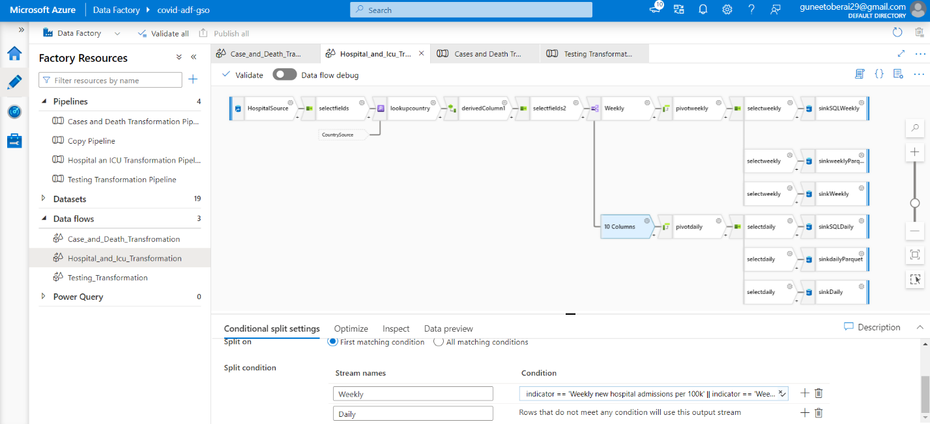
Data Flow for Hospital and ICU Dataset

Slide 32
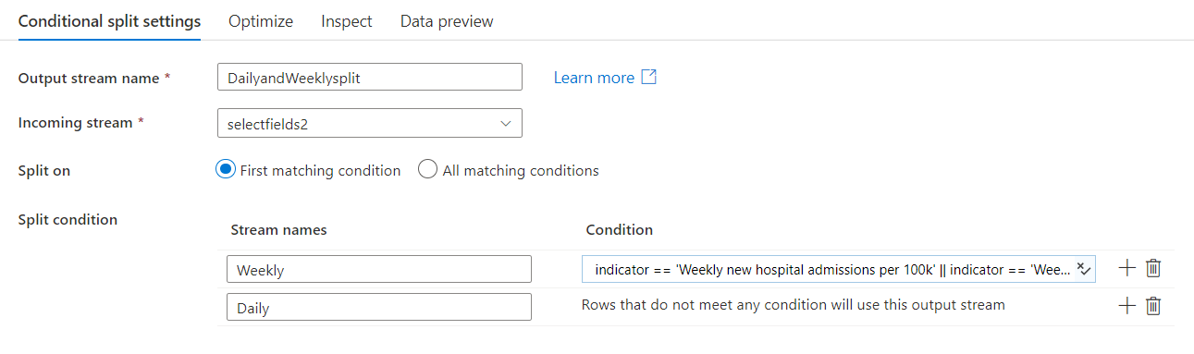
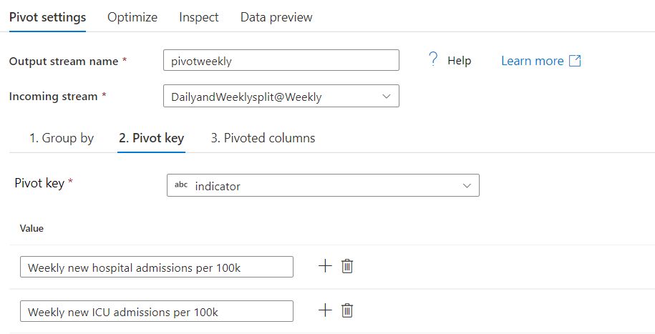
Transformations
Here Split is used to Slit the Data in Weekly and Daily.
Then Pivot is used for respectively.

Slide 33
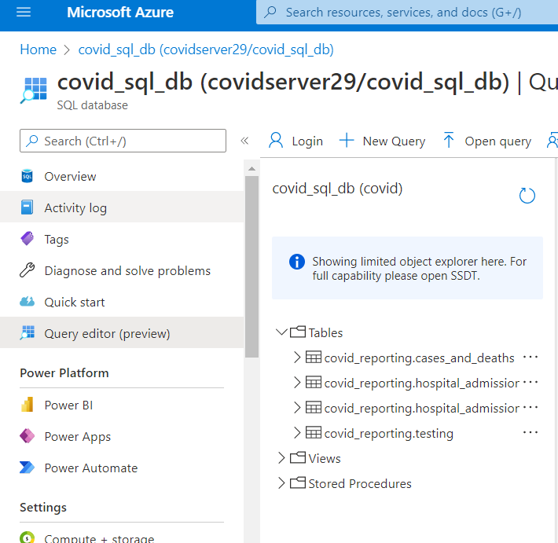
Visualization
Data visualization is the representation of data through use of common graphics, such as charts, plots, infographics, and even animations.
Service Used is PowerBI & Azure SQL Database.
There are 4 Tables in Database-
Cases_and_deaths
Hospital_and_Icu_Admission_Daily
Hospital_and_Icu_Admission_Weekly
Testing
This SQL Database was Further used in PowerBI to Generate Dashboards.

Slide 34
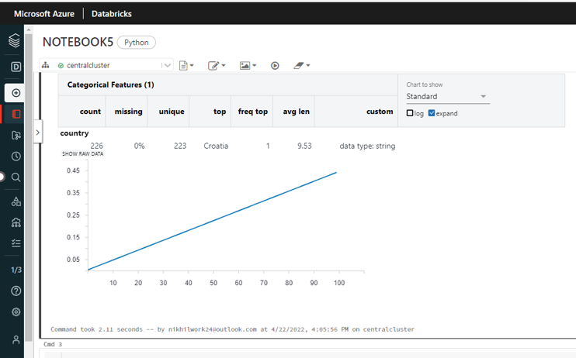
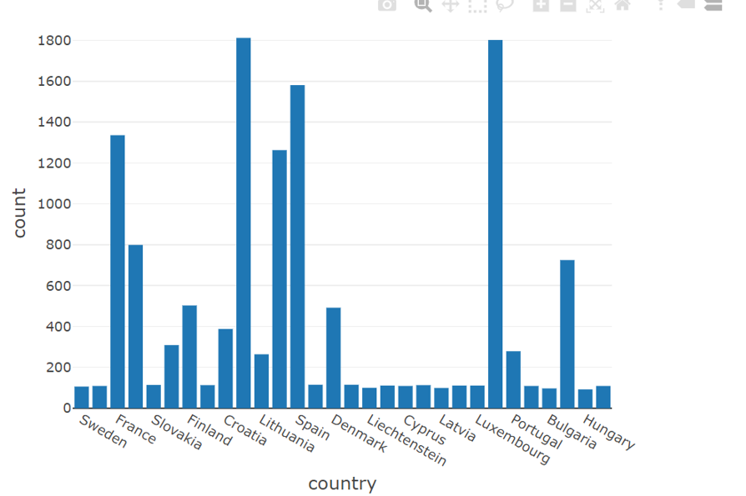
Visualization (Contd.)

Slide 35
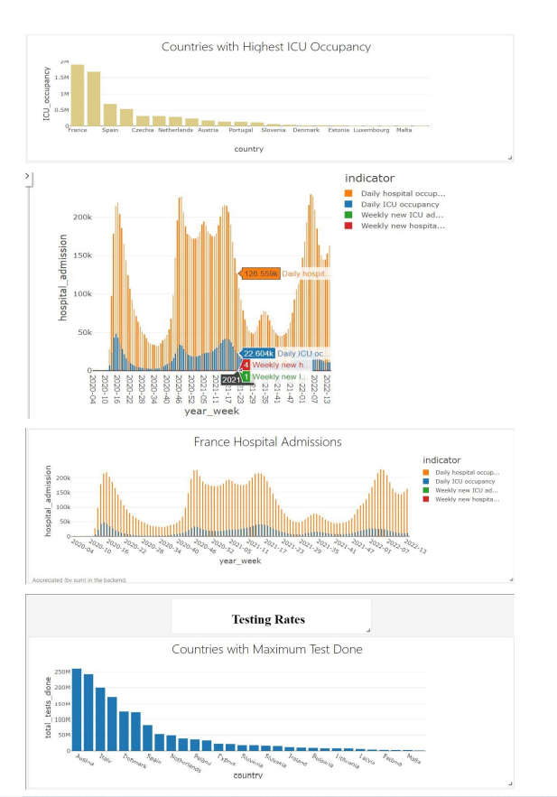
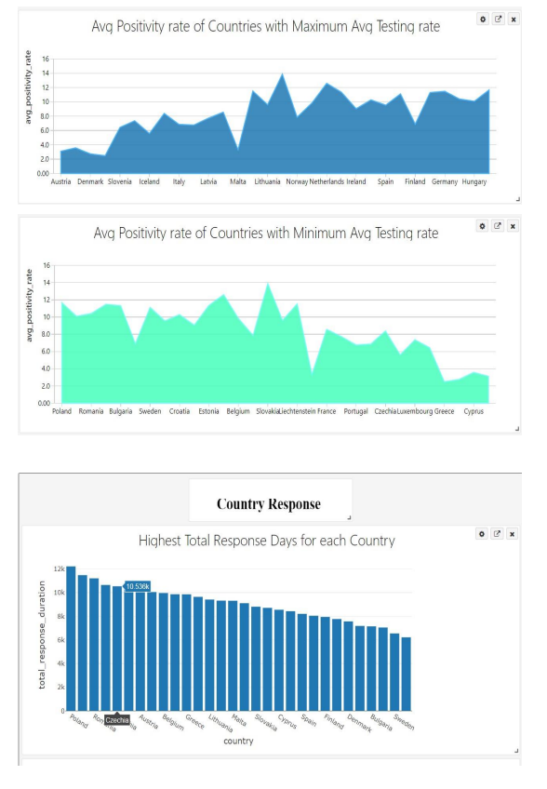
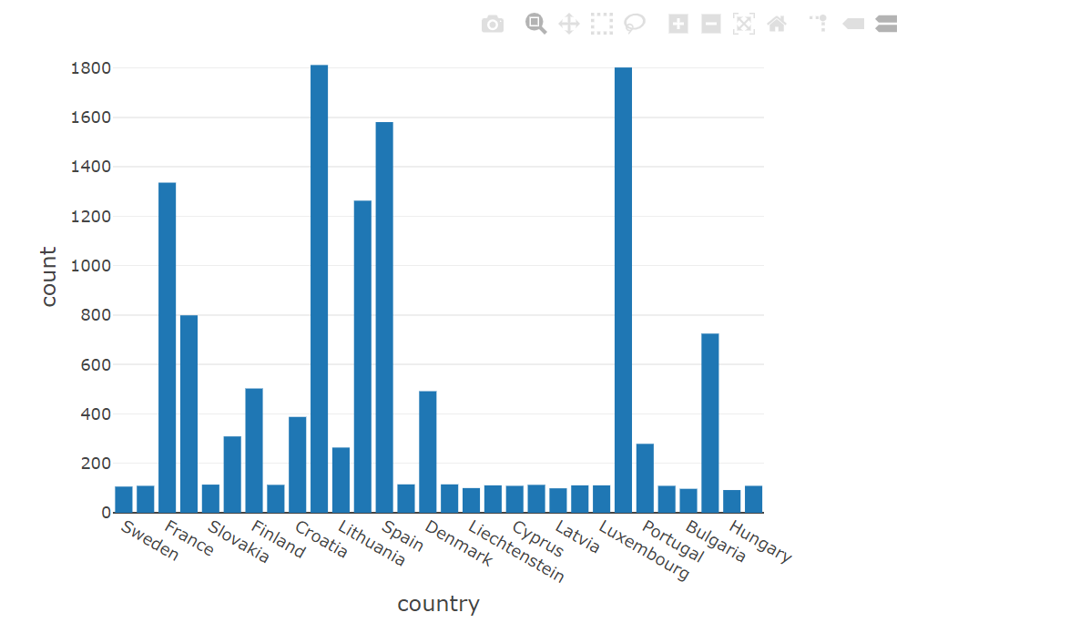
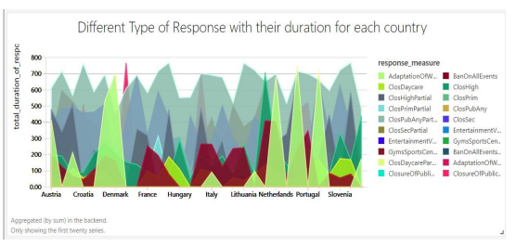
Visualization (Contd.)

Slide 36
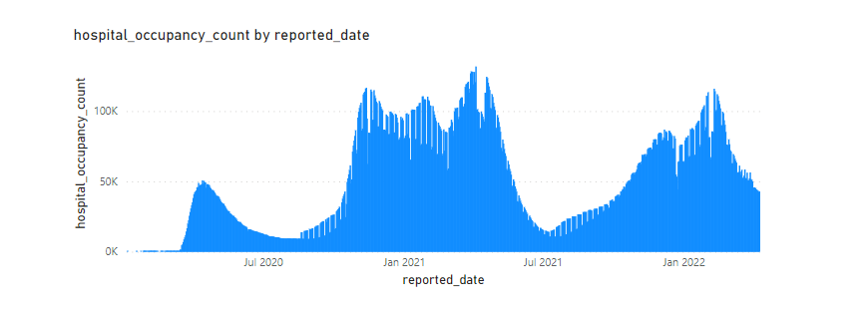
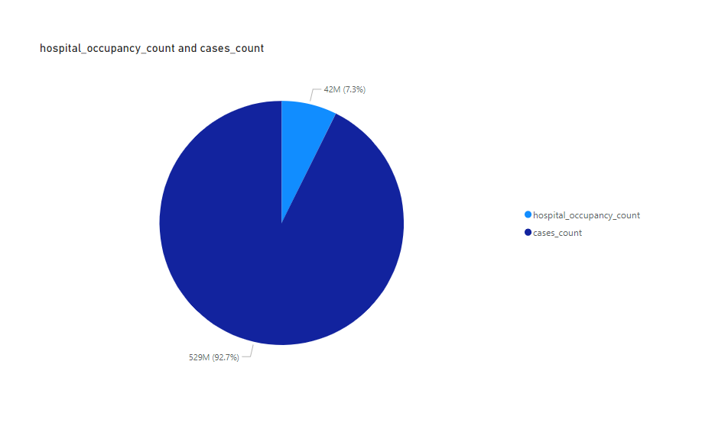
Dashboards
Hospital Occupancy by Reported Date
We can observe that there was peak in mid of Jan2021 and Jul 2021. And there was low in the month of June,2021.
Share of Hospital Occupancy v/s Total Cases

Slide 37
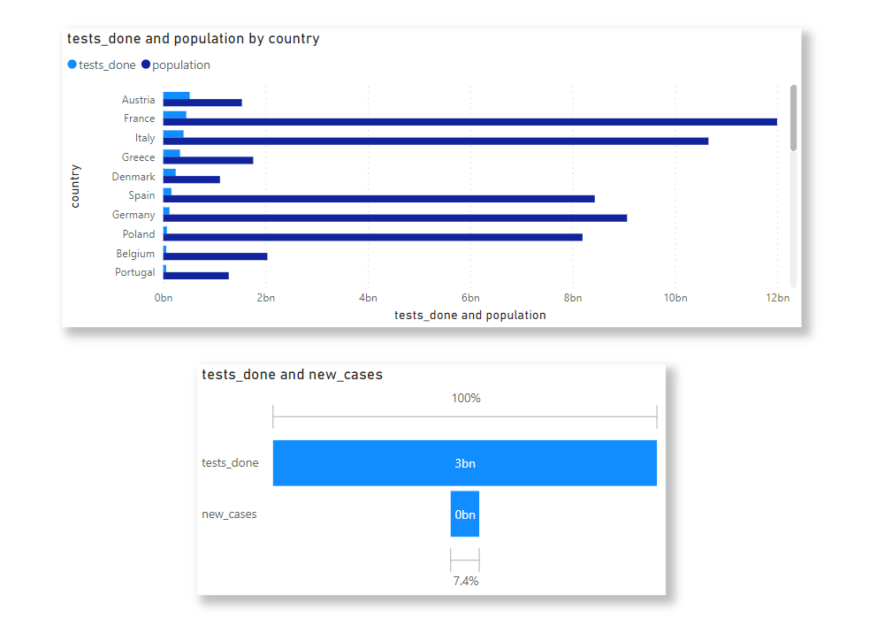
Dashboards (Contd.)
The first chart shows the testing with respect to their Total Population done by the countries in Europe.
The second chart shows Share of New Cases in total tests done.

Slide 38
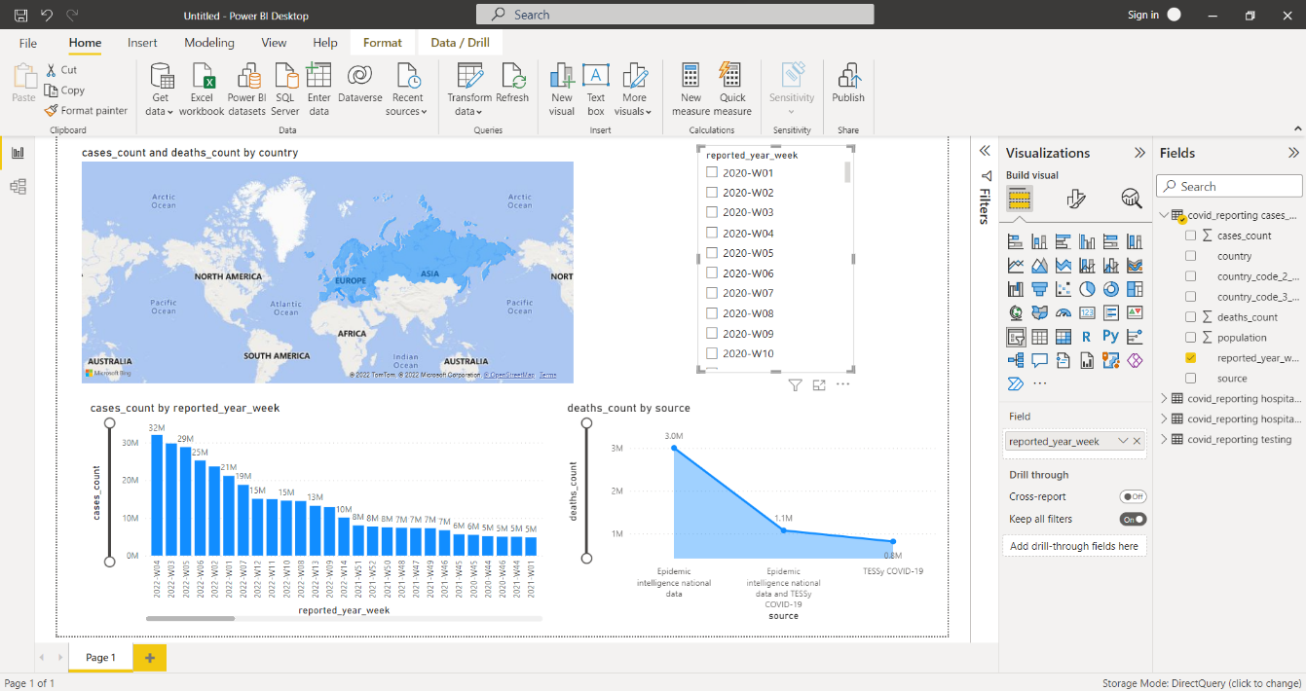
Dashboards (Contd.)
The Dashboard generated following insights:
- World Map
- Cases count by reported year week
- Deaths count by source

Slide 39
Conclusion
Cloud computing now creates opportunities for all researchers to find patterns or anomalies in their data even with a limited budget. Furthermore, the lower cost of storage means the research community at large can curate and share data, promoting deeper collaboration within the community and enabling data mashups with the potential to reveal new insights.
Microsoft Azure provides the necessary cloud platform to reduce not only the time to discovery, but also the cost of discovery.
With the help of Microsoft Azure Services we are able to achieve our objective of –
Ingestion
Transformation i.e. ETL Processed
Visualizations

Slide 40
Thank You

