Slide 1
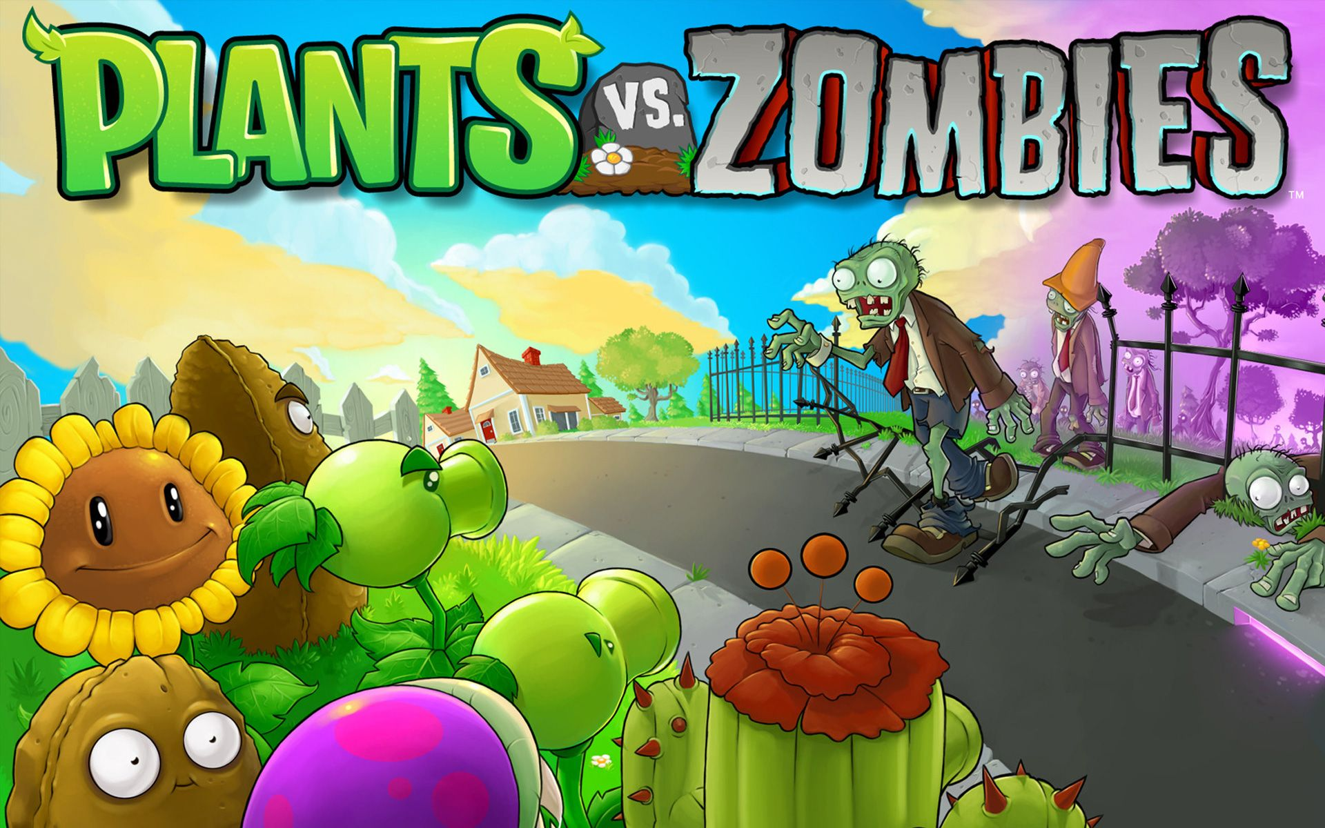

Slide 2
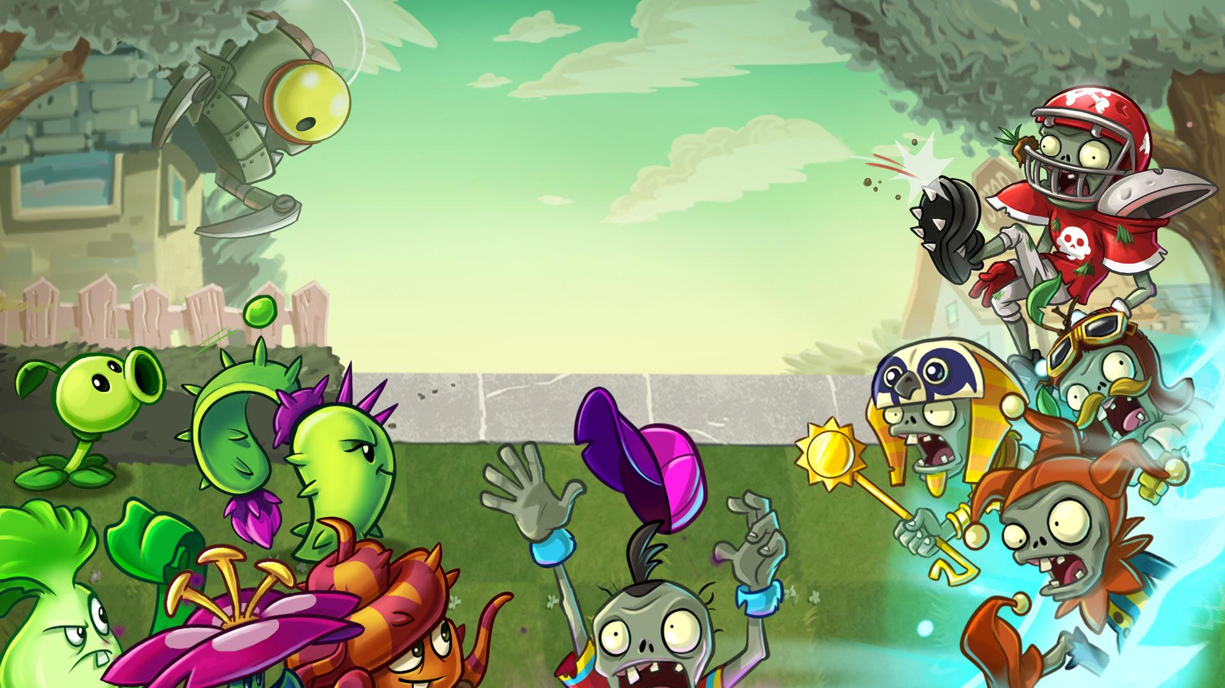
Group - 2 Shubham Mittal - 2018101 Sanyam Agrawal - 2018261

Slide 3
Design and Features:-
An app class to start the game.
MainMenu, NameMenu, LevelMenu, GameMenu classes for user interface.
TimeLine which updates the game screen every 20 milliseconds.
Options to save current state of the game, load previous game, pause game, etc.
Five different types of plants.
Five levels to enjoy the game.

Slide 4
Design and Features:-
Player class stores the details of the user and is in composition relationship with collection of level class
Level class contains all details of a particular level: its graphic components, no of zombies and so on
Gameplay involves plant picker, autonomous zombies and lawnmowers, shovel ability and many more

Slide 5
Contributions
By Shubham:-
GUI structure
Game Sounds
UML
Creating Sun Tokens
Zombie generator
Score update and progress bar
By Sanyam:-
Shooting of Peas
Save & Load
Plants Picker
UML
Interaction bw Plants & Zombies
Lawnmowers movement
shovel

Slide 6
Bonus
Cursor changes on selection of plant, becomes the image of the plant
Music tunes to liven up gaming experience
Special attention paid to memory aspects: Too many objects will still move smoothly due to careful memory organisation
Smooth animations
High quality graphics

Slide 7
Thank You

