Slide 1
SAMSUNG PRISM GENAI HACKATHON 3.0 · THEME 02
Smart Guided Troubleshooting Engine
A vague Galaxy complaint in. A validated, one-tap troubleshooting plan out.
13.7 ms
4.4 s
0
$0.00
cache hit, P95
live plan, P95
URL leaks
per query
Notes:
Galaxy users describe problems vaguely. This engine turns such a complaint into a schema-valid troubleshooting plan whose settings steps open the right Settings screen in one tap. Headline numbers: 13.7 ms P95 on a cache hit, 4.4 s P95 for a live plan from a local 1.5B model, zero URL leaks, and no per-query cost.

Slide 2
The problem
Turn a complaint into a plan an agent or the user can follow immediately
What every answer must do
What users actually write
1
Valid JSON in the given schema
every response, no exceptions
“My Galaxy S22 screen inputs are delayed and the touch responsiveness is laggy.”
“My screen got cracked when I dropped it. Also, every tap takes ages to register.”
“My battery dies by lunchtime even though I barely touch my phone.”
2
Steps only from the support article
nothing invented
3
Deeplinks copied from the catalog
never synthesised by a model
4
No web URLs anywhere
even if the article contains one
Optionally with a knowledge-base article: then the plan must be built from that article alone.
5
Fast
P95 ≤ 300 ms cached, ≤ 8 s live
Notes:
The input is a free-text complaint, optionally with a knowledge-base (SIIS) article. The output is a plan in the problem statement's schema. Five hard rules: valid JSON, steps only from the source, catalog deeplinks only, zero web URLs, and the latency budgets.

Slide 3
Three rules the design never breaks
Each rule turns a failure mode into something that cannot happen
1
2
3
The model never writes user-facing text
The model never sees or writes a deeplink
The cache is the pipeline, frozen
It selects step numbers from the article; code copies those steps verbatim.
It describes the screen it wants; a BM25 + dense retriever finds the catalog entry.
Cached plans are the same pipeline's output, run once per article at build time.
A step that is not in the source cannot appear.
An invented URI is structurally impossible.
No hand-written answer path to drift or hard-code.
Notes:
These three invariants come from ADR-001, ADR-002 and the build design. Because the model only emits indices and screen descriptions, hallucinated steps and hallucinated URIs are impossible by construction rather than filtered after the fact.

Slide 4
How a request is handled
POST /v1/troubleshoot → one of three paths; every plan returned has passed the gates
Split into problems
(one clause each)
Match each to a
cached plan (bge-small)
One plan per problem
in milliseconds
no
Article
supplied?
No match, or out of scope → empty plan, fallback: no_siis_context
Complaint
+ optional article
yes
Article seen
before?
qwen2.5:1.5b picks
step numbers
Retriever links
deeplinks
Gates G0–G16
→ live plan
Seen before (a supplied article, or planned earlier) → its stored plan, no model call
Build time: the same pipeline ran once per supplied article with Claude Opus 5; the validated plans and their embeddings are frozen in artifacts/. No hosted model is called at runtime.
Notes:
Without an article, the complaint is split at explicit problem boundaries and each part is matched to a pre-validated plan by meaning, not keywords. Complaints about topics no plan covers fall back instead of getting the nearest display plan. With an article, the article decides: a known article returns its stored plan instantly; an unseen one goes to the local model, which only picks step numbers. A retriever maps screens to catalog deeplinks, and 17 gates validate the result.

Slide 5
The cache path: meaning, not strings
11 validated plans, 130 cached phrasings, no model call
How it works
13.7 ms
84.6%
Two-factor acceptance: a match must be similar enough, and either very close or clearly ahead of the runner-up plan.
Multi-intent: split only at explicit boundaries (sentence ends, “also”, “, and the…”), each part judged like a whole query.
Out-of-scope anchors: topics no plan covers (battery, connectivity…) pull a complaint to a fallback instead of the nearest display plan.
Thresholds tuned on one set, reported on a test set written before evaluation.
P95 for a phrasing never seen before (0.1 ms exact)
hit rate on 26 tuning paraphrases · 100% on 27 written afterwards
340/340
37/38
complaints naming two known problems got both plans
held-out out-of-scope complaints correctly fell back
Notes:
The semantic cache embeds the query with bge-small and compares it to the cached phrasings of each plan. The calibration set tuned the thresholds; a separate test set, written before evaluation, measures the result honestly. Out-of-scope anchors cut false hits from 1/12 to 0/12 on the calibration set and 2/38 to 1/38 on the test set without losing hit rate.

Slide 6
The live path: a 1.5B model on a laptop GPU
For a new article: plan it in seconds, locally, with nothing invented
1
Pick
qwen2.5:1.5b selects step numbers and groups them into actions, under a JSON-schema grammar.
2.6 s
4.4 s
Link
Each settings screen is resolved against the 578-entry catalog by hybrid retrieval.
median (P50)
P95, against an 8 s budget
2
3
Order
Settings screens first, hands-on checks next, destructive steps like a factory reset last.
33/33
$0.00
live plans pass every gate
~880 tokens, local inference
4
Validate
Gates G0–G16: schema, URL scrub, catalog URIs, one action = one screen; repaired or rejected.
The first validated plan for an article is kept, so repeats are identical and instant.
Notes:
The live path runs qwen2.5:1.5b through Ollama on an RTX 4050 laptop GPU. The model output is constrained by a JSON schema and contains only indices and screen descriptions. Retrieval, ordering and validation are deterministic. 33 of 33 live plans passed every gate; median 2.6 s, P95 4.4 s.

Slide 7
Why a retriever, not the model, picks deeplinks
Precision@1 on 43 hand-labelled Display screens
What else the ablation showed
Masked URIs are opaque, so a model writing them invents 42 of 43.
Hybrid takes 16.9 ms per screen (P95), against 279 ms for a model call.
On free-form wording, hybrid recall@1 is 66.7% vs 13.3% for rules alone.
100% on 26 Battery, Camera and Performance screens.
Notes:
This is the Appendix C architectural ablation. Letting the model write the URI fails completely because the catalog's URIs are masked. Letting it choose among the retriever's top 8 keeps URIs valid but only reaches 60.5%. Rules-only BM25 is close on catalog wording but collapses on free-form wording, so the shipped hybrid combines BM25 and dense embeddings.

Slide 8
Choosing the local model: seven measured
Same 11 articles, 3 passes each, one run on the final code (seconds)
Why qwen2.5:1.5b
Fastest median, narrowly: the 4-bit llama3.2 1B is within 2%.
33/33 plans pass every gate; gemma3 1B and 4B do not.
Best step accuracy: 2.97 of 3.
The 3B models link more screens but cost about 1.3 s more at the median.
The 4-bit llama3.2 1B is as fast (lowest P95) but loses on quality: 63 of 72 action names replaced, step accuracy 2.87.
Latency moves 5–10% between runs; the dedicated benchmark measured qwen2.5:1.5b at 4.4 s P95.
Notes:
All seven models ran on the same inputs in one run. The 4-bit llama3.2 1B ties at the median and has the lowest P95, but its plans needed most action names replaced and it writes 37% more tokens. qwen2.5:1.5b gives the best balance of speed, validity and accuracy.

Slide 9
Results against the problem statement's targets
Full report in Appendix C format: docs/metrics.md
Measure | Target | Measured
Cache hit, P95 latency | ≤ 300 ms | 0.1 ms exact · 13.7 ms new phrasing
Live plan, P95 latency | ≤ 8 s | 4.4 s (median 2.6 s)
Schema-valid responses | ≥ 99% | 100% (325/325 over HTTP, 20/20 batch)
Web-URL leaks | 0 | 0, including planted URLs
Deeplinks from the catalog | 100% | 100%, no model writes one
Cache hit rate, unseen phrasings | ≥ 80% | 84.6% tuning · 100% held-out
Step accuracy (0–3) | rubric | 2.92 cached · 2.97 live
Deeplink relevance (0–2) | rubric | 1.78
Cost per query | tracked | $0.00, local inference
Measured on one laptop (i5-13420H, RTX 4050 6 GB) with nothing else running.
Notes:
Every target is met. The raw output behind each figure is in the reports folder, and every number can be regenerated with scripts/run_reports.py.

Slide 10
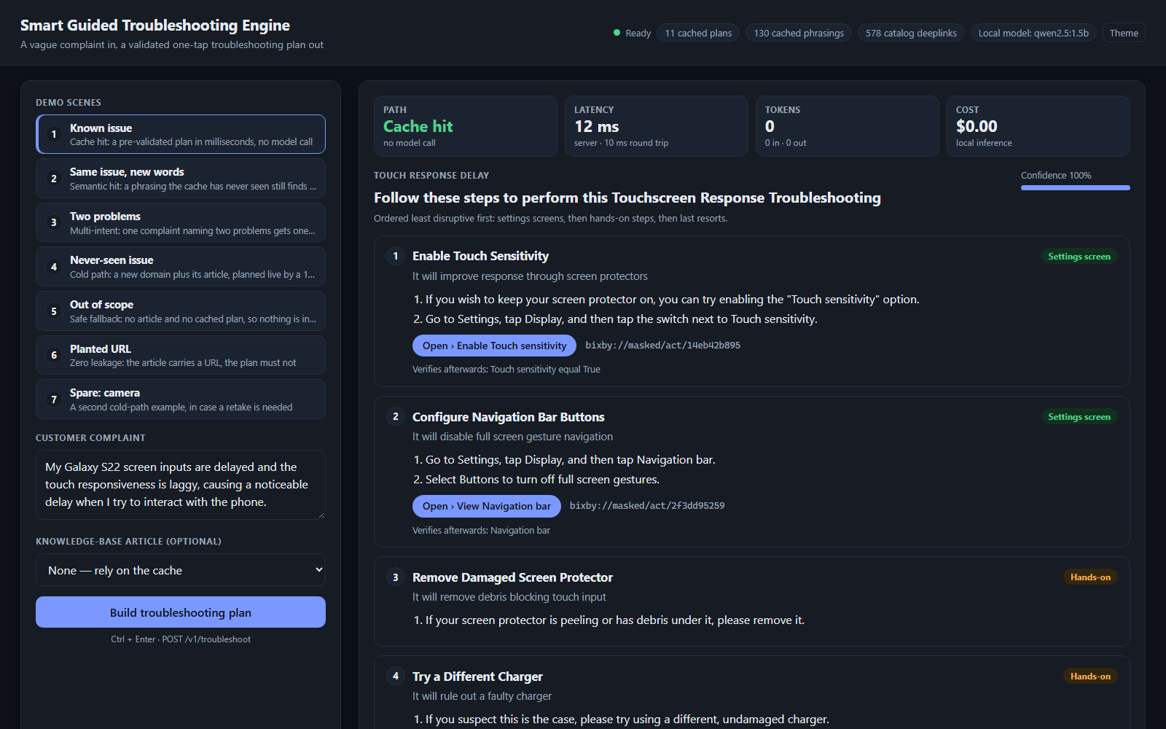
The demo
python scripts/demo.py → http://127.0.0.1:8000/demo
Seven scenes
1
Known issue: cache hit in ms
2
Same issue, new words
3
Two problems: two plans
4
Never-seen issue: live plan
5
Out of scope: safe fallback
6
Planted URL: 0 leaks
7
Spare: camera (live)
Notes:
The demo page calls the real API. Each scene shows the path taken, latency, tokens and cost. The Open buttons show the catalog deeplink; on a phone they would open the Settings screen.

Slide 11
What it does not do yet
Measured limits, from docs/metrics.md §6
Limitations
Next steps
Cached plans cover Display only: all supplied data is Display.
Live plans link a specific screen for 19% of settings actions (69% cached).
In a two-problem complaint, a problem with no plan is dropped silently.
A new article always takes the live path, even if the complaint matches a cached plan.
Compile plans for Battery, Camera and Performance articles.
Tell the caller when part of a complaint went unanswered (needs a meta key).
Decide whether live plans may be shared with other callers' similar queries.
Raise live-path deeplink coverage with better screen descriptions.
Notes:
These are the main limits from the metrics report, each with evidence there. Sharing live plans across callers is held back deliberately: it risks serving one caller's article-derived plan to others.

Slide 12
Try it
pip install -r requirements.txt
ollama pull qwen2.5:1.5b
python scripts/demo.py
github.com/Sanyam-Ahuja/prism
Tag PRISM_GENAI_HACKATHON_Y2026 · README, metrics report, AI disclosure and demo runbook inside
Notes:
Everything shown is in the repository: code, tests, the reports behind every number, and the demo script. Thank you.

