Slide 1

SAMSUNG PRISM
Generative AI
Hackathon
3rd Edition 2026 – 27
Theme ID - Theme 02 · Smart Guided Troubleshooting Engine
Team Name - DeadlockDodgers
College Name - Thapar
Member Name & Email 1- Vyom Khanna · vkhanna_be25@thapar.edu
Member Name & Email 2- Sanyam Ahuja · sahuja2_be25@thapar.edu
Member Name & Email 3- Shauryajit Singh · ssingh4_be25@thapar.edu
Member Name & Email 4- Parin Gupta · pgupta_be25@thapar.edu
Submission Github link - github.com/Sanyam-Ahuja/prism
Notes:
Theme 02, Smart Guided Troubleshooting Engine, by team DeadlockDodgers from Thapar: Vyom Khanna, Sanyam Ahuja, Shauryajit Singh and Parin Gupta. Code, demo video and this deck are in the GitHub repository under the tag PRISM_GENAI_HACKATHON_Y2026.

Slide 2
Theme
Theme 02 · Smart Guided Troubleshooting Engine: the problem in our words, and how we answer each ask
The problem, in our words
The theme asks for | What we built
Query enrichment: normalise a raw complaint | Normalise, split into separate problems, match by meaning against 130 LLM-written phrasings; 8–10 query_variations in every response
A two-stage LLM engine returning ordered steps as JSON | Stage 1: a strong LLM compiles checked plans offline. Stage 2: a local 1.5B LLM plans new articles live. Least disruptive step first
Map each step to the exact Settings deeplink | Hybrid BM25 + dense retriever over the 578-entry catalog; deeplinks are copied, never written
Fast-path cache under 300 ms | 13.7 ms P95 on wording it has never seen
REST API; mapping reusable for 10k+ scenarios | POST /v1/troubleshoot. A new scenario = compile one article; no retraining
Report step accuracy, latency, cost | 2.92–2.97 of 3 · 4.4 s P95 live · $0.00 per query
Galaxy owners describe what they feel, not what is wrong. A support agent turns that into troubleshooting steps by hand (about 15 minutes per scenario, across millions of calls), and the user still has to hunt through Settings to act on the advice.
We want the complaint in, and a checked plan out: ordered steps taken from the support article, each settings step one tap from the right screen.
How people actually type it (all answered in our demo)
“tapping takes forever to register”
“phone lags when i tap anything”
“dropped it and screen cracked. also touch is slow af”
“battery dies so fast lol”
Notes:
In our words: people describe symptoms, not causes, and today a human translates that into steps. The table maps each ask of the theme to what we built. Two stages: a strong model compiles checked plans once, offline; a small local model plans new articles at request time. Deeplinks always come from the supplied catalog.

Slide 3
Existing Solutions & Gaps
Every current option gives up one of: speed, grounding in the article, or a one-tap fix
Existing approach | How it works | The gap
Human support agent | Reads the complaint, finds the article, writes the steps by hand | About 15 minutes per scenario; the user still hunts through Settings
Help-centre search / FAQ | Keyword search over support articles | Vague wording misses; the user reads a whole article; no one-tap links
Generic LLM chatbot | The model writes the steps and links itself | Our test, same model: only 47% of written steps were the article's own words; 2.3% of written deeplinks were correct
Keyword rules for Settings links | Match screen names to the catalog (BM25) | Our test: 13.3% right on free-form screen descriptions (hybrid retrieval: 66.7%)
The gap we close: answers in milliseconds from a cache, or seconds from a local model; every step is the article's own text; every deeplink comes from the catalog; every response is checked before it leaves.
Notes:
The 15-minute figure is from the theme brief. The chatbot and keyword-rule numbers are our own measurements with the same data (reports/ablation_steps.txt, ablation_generate.txt, dl_paraphrase_*.txt). Fluent generated text is the problem: it looks right and is not the article.

Slide 4
Our Solutions & Architecture Diagram
One pipeline, run twice: once offline to build a cache of checked plans, and live for articles it has not seen
BUILD TIME · OFFLINE, ONCE PER ARTICLE
Theme 02 kit
11 articles · 578 deeplinks · 20 queries
Build-tier LLM (Claude Opus 5)
picks steps, names actions, writes phrasings
compile_plans.py
gates G0–G16; fails on any error
artifacts/
11 plans · 130 phrasing vectors · catalog vectors
loaded at startup
RUNTIME · LOCAL, PER REQUEST (POST /v1/troubleshoot)
Client / app
complaint + optional article
FastAPI
request limits, error boundary
Stage 0 · Normalise
split into problems
Article
sent?
Stage 1 · Semantic cache
bge-small · two-factor match · out-of-scope anchors
Cached plan
13.7 ms P95 · no model
no
yes
Article seen before?
yes → its stored plan, no model call
Stage 2 · Local LLM
qwen2.5:1.5b (Ollama) picks step numbers, JSON grammar
Stage 3 · Retriever
BM25 + dense → catalog deeplink
Stage 4 · Order
least disruptive first
Stage 5 · Gates
G0–G16, URL scrub
Live plan
4.4 s P95
no
Output: schema-valid JSON with every action, its steps and deeplinks, plus query_variations and meta (latency, cache hit, model, cost, tokens). Out of scope or no valid plan → an honest empty-plan fallback. No hosted model is called at runtime.
Notes:
Top: the build tier runs the same pipeline once per supplied article with a strong model; its output is validated by 17 gates and frozen into artifacts. Bottom: a request is normalised and split; without an article each problem is matched to a cached plan by meaning. With a new article, the local 1.5B model only picks step numbers, a retriever maps each settings screen to a catalog deeplink, steps are ordered least disruptive first, and the gates check the result before it leaves.

Slide 5
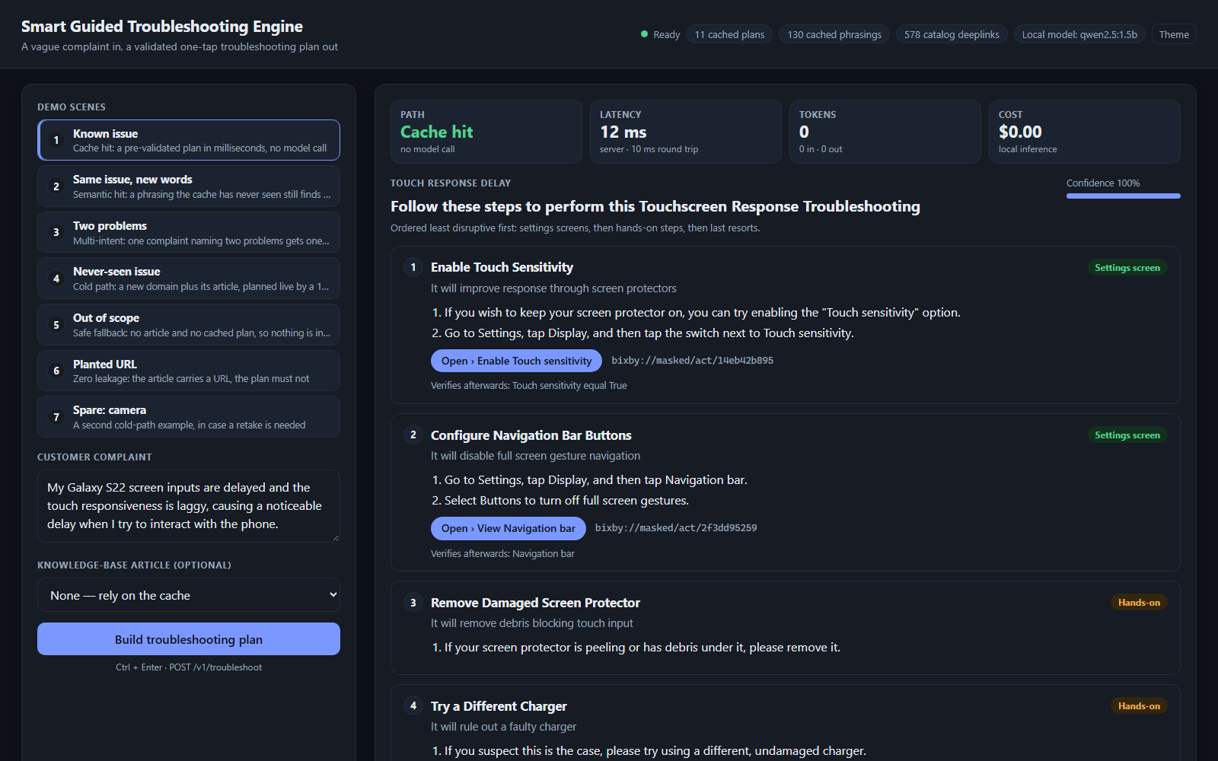
Demo & Product Walkthrough
The real system on a laptop: python scripts/demo.py opens a demo page on the actual API
Walkthrough: typed like a real user
1
“tapping takes forever to register”
cached plan in milliseconds
2
“phone lags when i tap anything”
same plan, different words
3
“screen flickering like crazy”
a different plan
4
“dropped it and screen cracked. also touch is slow af”
two problems, two plans
5
“battery dies so fast lol” + battery article
live plan from the local model
6
Same article again
stored plan, instant
7
“earbuds wont connect”
out of scope: honest fallback
8
URL planted in the article
1 URL in → 0 in the response
Demo video: Thapar_DeadlockDodgers_Demo.mp4 (repo root)
Notes:
The video is a screen recording of the real system: the actual API, a local model answering live, nothing mocked. Every complaint is typed the way people really type: short, lowercase, slang. It shows cache hits, the same plan for different words, a two-problem complaint, a live plan for a new battery article, the repeat served instantly, an out-of-scope fallback and the URL-leak check.

Slide 6
Tools and tech stack used
Small, local and open: everything runs on one laptop (i5-13420H, RTX 4050 6 GB)
Models
API & runtime
Retrieval & cache
qwen2.5:1.5b (4-bit) via Ollama on the GPU: picks steps for new articles
BAAI/bge-small-en-v1.5 on the CPU: embeddings for the cache and retriever
Claude Opus 5: offline build tier only, never at runtime
Python 3.12 · FastAPI · Uvicorn
Pydantic v2 with the supplied schema.py, unmodified
httpx client for the local Ollama server
Hybrid rank-bm25 + dense cosine over 578 deeplinks
Semantic cache over 130 phrasings (NumPy)
Out-of-scope anchors and multi-intent splitting
Guardrails
Testing & measurement
Packaging & demo
JSON-schema-constrained decoding (Ollama format)
17 gates G0–G16 and a URL scrubber on every plan
Deterministic decoding: temperature 0, fixed seed
pytest: 81 regression tests
Scripts for accuracy, latency, ablations and HTTP stress
python scripts/run_reports.py regenerates every number
Dockerfile + docker-compose (API + Ollama)
Offline image: encoder weights baked in
Demo page (HTML/JS); video recorded with Playwright
Notes:
Everything at runtime is local and open: a 1.5B model through Ollama on the laptop GPU and a small embedding model on the CPU. The only hosted model, Claude Opus 5, was used once, offline, to compile the cached plans, and its output is validated by the same gates. Packaging is a Dockerfile plus a compose file that also starts Ollama.

Slide 7
Impact & Use case
Who uses it, and what changes for them
1
Contact-centre agent assist
13.7 ms
$0.00
The agent pastes the customer's words and gets an ordered, checked plan in milliseconds, instead of writing one by hand (about 15 minutes per scenario today).
P95 cached answer
per query: all local
2
Self-service in the phone
70 req/s
0
In a support app or the voice assistant, the user taps a step and the exact Settings screen opens. Each step's validationDeeplink lets the app check the setting's current value.
on a laptop, 8 clients
invented steps or links
3
Support-content onboarding
Built for 10k+ scenarios
Plans are keyed by article and deeplinks come from the catalog, so adding a scenario means compiling one article. No model is fine-tuned.
A new support article becomes a plan in 2.6 s (median) with no retraining, and the plan is kept for every later request for that article.
Notes:
Three users: the contact-centre agent, the phone owner doing self-service, and the team that writes support content. The 70 requests per second is the cache path under 8 concurrent clients on the laptop, with P95 still under 300 ms. Nothing is fine-tuned, so new scenarios are a compile step, not a training run.

Slide 8
Innovation highlights, results and limitations
Measured on the laptop with nothing else running; raw output in reports/, full report in docs/metrics.md
Innovation highlights
Result | Target | Ours
Cache hit, P95 | ≤ 300 ms | 13.7 ms
Live plan, P95 | ≤ 8 s | 4.4 s (P50 2.6)
Schema-valid | ≥ 99% | 100% (325/325)
Web-URL leaks | 0 | 0
Deeplinks from catalog | 100% | 100%
Hit rate, new wording | ≥ 80% | 84.6% · 100%*
Step accuracy (0–3) | rubric | 2.92 · 2.97 live
Deeplink relevance (0–2) | rubric | 1.78
Cost per query | tracked | $0.00
Limitations
The model picks, never writes. It returns step numbers; code copies the article's steps verbatim.
No model touches a deeplink. A hybrid retriever maps each screen to a catalog URI.
The cache is the pipeline, frozen. Cached plans are its own checked output.
Two problems, two plans; off-topic complaints get an honest fallback (37 of 38).
Casual wording works. Matching is by meaning, so “touch is so slow” finds the same plan as the formal query.
Cached plans cover Display only: all supplied data is Display.
Live plans link a specific screen for 19% of settings actions (69% for cached plans).
In a two-problem complaint, a problem no plan covers is dropped without notice.
A new article always takes the live path, even when a cached plan fits.
Very vague wording (“my phone is being weird”) gets the fallback; two problems need a clear break between them.
* 84.6% on the tuning set, 100% on 27 phrasings written afterwards
Notes:
Innovation: the model never writes user-facing text or deeplinks, so hallucinated steps and URIs cannot occur by construction. Every target in the problem statement is met. The limitations are measured, with evidence in docs/metrics.md section 6.

Slide 9
What’s next
From a laptop prototype to a worklet: each step builds on what is already measured
1
Cover Battery, Camera, Performance
2
Device-state-aware plans
Compile plans from their articles. The pipeline already maps their screens: 100% on 26 labelled deeplinks.
Read each step's validationDeeplink on the phone and skip steps whose setting is already right.
3
Say what went unanswered
4
More one-tap links in live plans
Tell the caller when one problem in a complaint had no plan, instead of dropping it.
Raise specific-screen coverage from 19% toward the cached plans' 69% with better screen descriptions.
5
On-device
6
More languages
Measure the 1.5B model on a Galaxy phone's CPU/NPU, so plans work offline.
Hindi and code-mixed Hinglish complaints, via multilingual embeddings.
Notes:
The first four remove the measured limitations. Device-state awareness uses a field the schema already has, validationDeeplink. On-device and multilingual support are what would make this a Samsung product.

Slide 10
Brownie points slide( differentiation)
We measured the design choices, not just the system: same 1.5B model, same 11 articles
Steps: pick, don't write
Deeplinks: retrieve, don't write
Also different
Plan steps that are the article's own words
Screens linked correctly (43 hand-labelled)
Seven local models benchmarked on the same inputs before choosing qwen2.5:1.5b.
Test sets written before evaluation, separate from the tuning set.
Every number regenerates with one command: python scripts/run_reports.py.
Offline container; no hosted model or API key at runtime.
AI use disclosed in AI_DISCLOSURE.md.
Writing: 61% more tokens and 10.1 s P95, over the 8 s budget (picking: 4.5 s).
Catalog URIs are masked: a model writing them invents 42 of 43.
Notes:
These are our two ablations. When the same model writes steps, fewer than half are the article's own words and latency breaks the budget; when it picks step numbers, all of them are. For deeplinks, a model writing masked URIs gets 1 of 43 right, the retriever 95.3%. Sources: reports/ablation_steps.txt, ablation_generate.txt, dl_display_hybrid.txt, compare_models.json.

Slide 11
Checklist- Updated on Public GitHub
Working prototype code — public or shared GitHub repo (Y/N) — Y: github.com/Sanyam-Ahuja/prism (tag PRISM_GENAI_HACKATHON_Y2026)
README with reproducible setup instructions (Y/N) — Y: README.md (pip or Docker Compose)
Demo video, max 5 minutes (YouTube or Drive link) — Y: under 5 min · Thapar_DeadlockDodgers_Demo.mp4 (repo root)
Presentation file (PPT or PDF) (Y/N) — Y: Thapar_DeadlockDodgers_Submission.pptx (+ PDF), repo root
Also in the tagged commit: Dockerfile and docker-compose.yml · requirements.txt (also requirement.txt) and requirements.lock · AI_DISCLOSURE.md · reports/ with the raw output behind every number
Notes:
Everything the submission guideline asks for is in the commit tagged PRISM_GENAI_HACKATHON_Y2026.

Slide 12
Thank you
DeadlockDodgers · Thapar · github.com/Sanyam-Ahuja/prism
Organised by the Language AI Team and the PRISM Team, Samsung R&D Institute India
Notes:
Thank you. The code, the reports behind every number, the demo video and this deck are in the repository.

