Slide 1
Traffic Speed in NYC
NYC Speed Limits
Central Park Weather Data
Clean each dataset using HMR.
Using Hive, merge the Traffic Speed and the Weather datasets.
Using HMR, combine the initially merged datasets with the Speed Limit set.
Using Hive/Impala, analyze the merged dataset and find trends.
Conclude where police officers need to be placed to catch speeding violators in NYC.

Slide 2
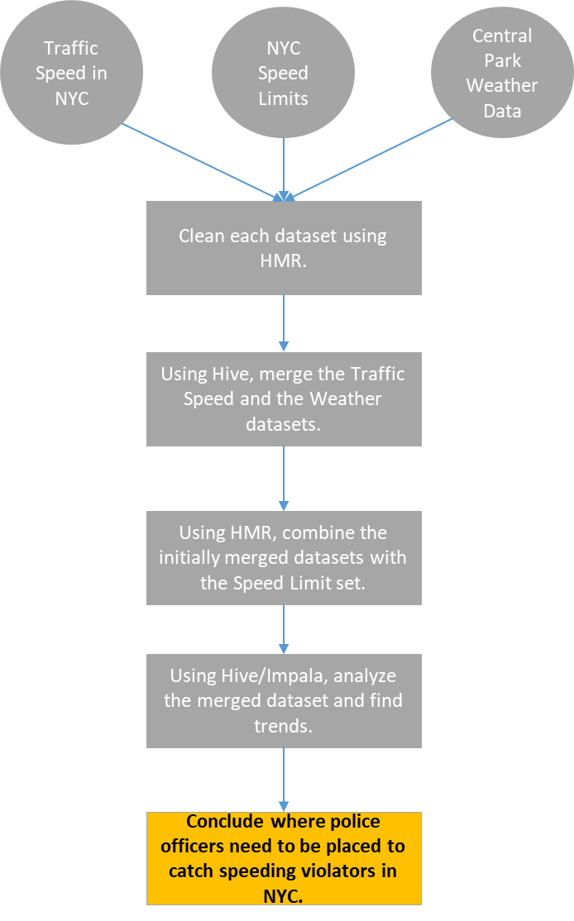

Slide 3
HDFS- raw data
Use Spark MLlib (e.g. KNN, Clustering)
find relation between #1 and #3 datasets
Compare results with test data
MapReduce- data cleaning and feature engineering
HDFS- save clean and structured data
MapReduce- Collaborative Filtering with Amazon Reviews data
Output recommended products

