Slide 1
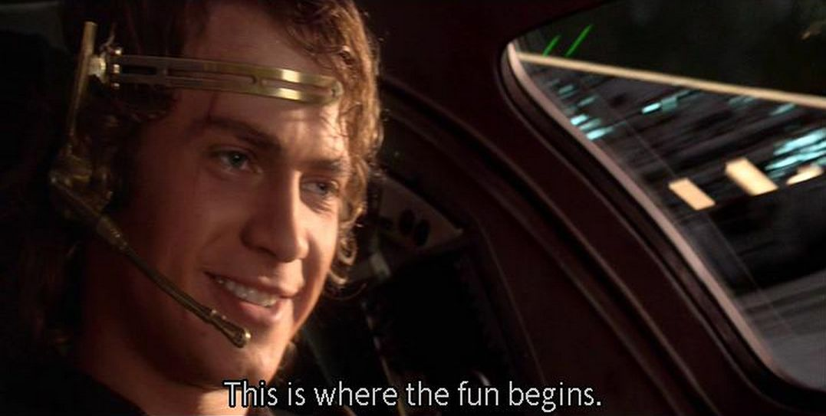
AKS-3:
Project Overview
PS2: DATA VISUALIZATION | PS3: ASTRONOMY | PS4: IDEATHON
Team members
Aayush Mangla • Shahil Kumar • Harkabir Singh
Argdeep Sarkar • Sanyam Jain

Slide 3
AKS-3 | PROJECT OVERVIEW | 02
What we worked on
A quick overview of the three problem statements.
PS2 — Solar radiation
PS3 — Exoplanets
PS4 — Space supply chain
Analyse 32,686 observations from Sep–Dec 2016.
Explore patterns over time and relationships with temperature and humidity.
Use a Random Forest model to estimate radiation.
Use brightness dips to look for possible transiting planets around STAC-1, STAC-2 and STAC-3.
Estimate periods, sizes and orbital distances, then compare possible habitability.
Propose an asteroid-mining logistics system using solar-tether launch and reusable containers.
Compare cost drivers, risks and a potential L4 customer.
Common approach
1. Start from the supplied data or scenario 2. Apply a method/model 3. Compare results 4. State assumptions and limitations
2

Slide 4
AKS-3 | PROJECT OVERVIEW | 03
PS2 — Solar radiation: data and code
Python is used to clean, summarize and visualize the supplied CSV.
CSV
Pandas
Analysis
Plots
Model
SolarPrediction.csv
Read timestamps
and columns
Hourly/daily summaries
and correlations
Time series, scatter
plots and matrix
Random Forest
regression
Libraries used
How to run it
pandas — load data, parse timestamps and group observations
NumPy — numerical calculations and time features
Matplotlib — create and save plots
Open the code in Google Colab, upload the supplied CSV, check the file path used by the script, then run it.
Results depend on the supplied dataset and code.
Code idea: turn raw measurements into interpretable trends, then use the model for a radiation estimate.
3

Slide 5

when the code keeps on showing errors:

Slide 6
AKS-3 | PROJECT OVERVIEW | 04
PS2 — Main findings
Summary values reported from the dataset and included script.
32,686
207.12
1,601.26
12:00
valid observations
mean radiation
maximum radiation
hour of mean-radiation peak
Relationships
What the plots help show
Radiation–temperature correlation: +0.735
Radiation–humidity correlation: −0.226
Temperature had the strongest absolute linear correlation with radiation.
Hourly means reveal the broad time pattern. Scatter plots compare radiation with temperature and humidity. Correlation indicates association, not causation.
Reported peak: 1,601.26 on 4 Sep 2016 at 12:15. Sharp changes may reflect weather or outliers; night-time radiation readings are close to zero.
4

Slide 7
AKS-3 | PROJECT OVERVIEW | 05
PS3 — Detecting possible exoplanets
The transit method looks for a small, repeated decrease in a star's brightness.
Concept of a transit
What we estimate
• Period: time between repeated dips
• Transit depth: fractional brightness decrease
• Planet radius: using depth and stellar radius
• Orbital distance: using Kepler's third law
Planet crosses the star → measured brightness dips
Important limitation
Habitability comparison
Sparse observations cannot rule out stellar activity, binary stars or instrumental error. These are candidates, not confirmed planets.
Compare estimated orbital distance with an approximate habitable-zone distance, plus planet size and host-star properties.
5

Slide 8
AKS-3 | PROJECT OVERVIEW | 06
PS3 — Candidate comparison
Values follow the supplied analysis; STAC-3's period remains uncertain.
Star
Period
Depth
Radius
Orbit (AU)
HZ (AU)
STAC-1
~4 days
0.003
5.98 R⊕
0.0493
1.000
STAC-2
80 days
0.001
2.76 R⊕
0.337
0.632
STAC-3
~40 days*
0.00088
1.62 R⊕
0.182
0.283
*STAC-3 shows four 40-day intervals followed by a 30-day interval; the period estimate is not settled.
Preliminary conclusion
Do not overclaim
STAC-3 is the most promising candidate in the supplied comparison.
Being nearer to an estimated habitable zone does not prove liquid water or life.
6

Slide 9
AKS-3 | PROJECT OVERVIEW | 07
PS3 — What the calculations mean
Equations connect the brightness signal to approximate physical properties.
Transit depth
Planet radius
Orbital distance
δ = (Fnormal − Ftransit) / Fnormal
Brightness dip as a fraction of normal brightness.
δ ≈ (rp / Rstar)²
So rp ≈ Rstar × √δ, using the supplied stellar radius.
Kepler's third law: a³ = P²M
Use period in years and stellar mass in solar masses.
What to observe next
Further checks
Collect more frequent observations over several predicted transits. Check whether dips repeat consistently and measure their shape.
Check instrumental effects and stellar variability; obtain more information about the star and planet atmosphere before making habitability claims.
7

Slide 10
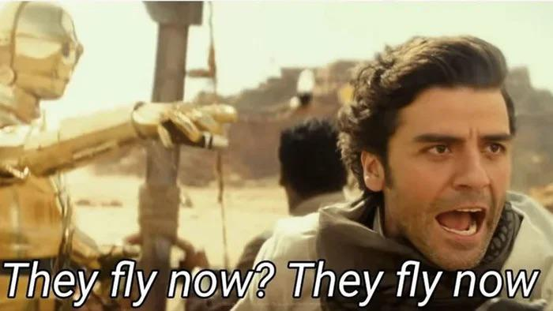
Calculations so tough that rewatching star war sequels seems like a better option….

Slide 11
AKS-3 Presents
Mining the Asteroids with no propellant needed
This is where the fun begins…
Governments of the world have come together to create a massive deep space habitat and industrial complex at Earth-Sun L4 as a stepping stone to making humanity truly space faring and are looking for partners and suppliers for the same….
Team: AKS-3 (Hello there!)

Slide 12
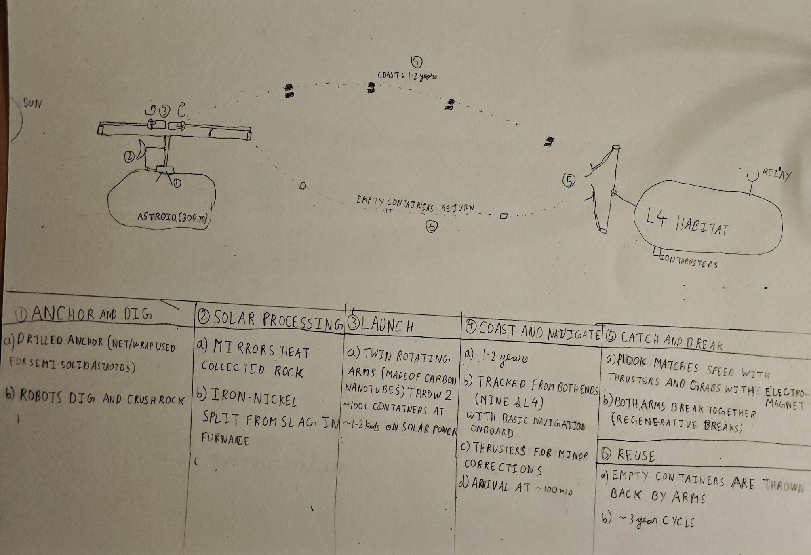

Slide 13
AKS-3 | STAC WARS • PS 4 | 03
How it operates
1. Scout and anchor
navigation and communication
Survey the target near earth asteroid; approach at walking pace. Drill into solid rock or use a net/mesh for rubble piles.
containers only has basic star navigation along with transponder and communication devices.
containers have small thrusters for maneuvering and are solar powered. autonomous control available to control thrusters, can also be remote controlled
Navigation is mostly handled from both L4 and asteroid mine acting as relay stations.
2. Mining and refining
robotic arms dig up rock and crush it. solar powered furnace separates metal from slag
Repair and maintenance
on site robots and spare parts available for repairs.
sensors installed to detect any damage or malfunction
minimum complexity refining and no contact motors for minimum wear and tear
3. launch and catch
the solar powered arms throw containers containing metal and slag towards the destination where robotic arms catch it using electromagnets after they are moving at little relative velocity
bonus: materials existing in 2026 can be used to make the launcher for near earth asteroids’s but to ensure that the system can be scaled up to be used in astroid belt, we are proposing a technological breakthrough: carbon fibre nano tubes to maximum strength at the high velocities required at the hook
3

Slide 14
AKS-3 | STAC WARS • PS 4 | 04
Three major cost drivers
1. Hardware from Earth
2. Moving the cargo
3. Downtime and repair
Problem: launching every replacement part is expensive.
Proposed fix: make frames and wear parts from asteroid iron.
Assumption: on-site iron processing works.
Problem: tugs need engines and propellant to move each load.
Proposed fix: solar tether launch plus light reusable containers.
Assumption: shell mass is ~2% of payload.
Problem: help is far away and repairs can take a long time.
Proposed fix: modular parts, parallel units and repair robots.
Assumption: robots can replace parts autonomously.
Model baseline: 100,000 t/year; 15-year expected life; container fleet estimated at ~90% of transport cost
4

Slide 15
AKS-3 | STAC WARS • PS 4 | 05
Comparison with other approaches
“Never tell me the odds” -Han solo
Dimension
Tug-based mining
Full Astroid Relocation
AKS-3 concept
Cargo movement
Tug carries each load with its own engines
Complete asteroid moved
Solar tether and reusable containers
Propellant
Chemical ~40% of cargo; electric ~5% at 1.5 km/s
alot of propellant required
~0.3% for station-keeping (assumed)
Throughput
Batches per trip
the entire asteroid
Target: 100,000 t/year
Weak point
Fleet cost rises with volume
a lot of fuel wasted in transporting; high risk near the habitat
Tether is unproven; container mass matters
our concept is clearly superior to chemical propulsion and easily beats electric propulsion at higher volumes
5

Slide 16
AKS-3 | STAC WARS • PS 4 | 06
Part C: Business model
The business case depends on a reliable customer at L4.
What we sell
Who buys it?
How funding works
• Rubble for shielding
• Iron-nickel for hulls
• Water and volatiles. water as possible propellant feedstock as a later addition
• Platinum-group metals as a byproduct
Anchor customer: L4 project organising committee.
Possible second buyer: a shipyard building deep-space craft at L4.
Assumption: customers value in-space supply because it avoids launching from Earth.
1. Han funds a technical demo.
2. Demo milestones unlock a capex advance from the L4 organising committee
3. Deliveries repay the advance through rebates.
4. Expand to the asteroid belt if near-Earth targets deplete.
Revenue: per-tonne supply contract. Pricing below Earth-launch cost is an assumption, not a confirmed market price.
6

Slide 17
AKS-3 | STAC WARS • PS 4 | 07
Risks and roadmap
Test the difficult parts early before committing to the full system.
Single customer
PROPOSED ROADMAP
Minimum-purchase clause, termination payment for unrecovered capex, and a second buyer.
1. Demo
Scout, anchor, small launch and catch in order to seqire funding
Tether strength
2.rubble and
metal
Deliver shielding mass to L4; provide hull building material
carbon nanotubes for maximum strength and spare tether on site in case of breakage.
3. volatiles and
propellant
start selling water as propellant; provide habitat with volatiles like carbon, hydrogen, oxygen, nitrogen from c-type asteroids
Anchoring failure
Survey each target and choose drilled anchors, netting or wrapping as appropriate.
4.expand the operations
start mining in asteroid belt as the demand increases, start supplying to the ship building and other industries at L4 and beyond
note: Han's equity in the company and other terms still to be agreed.
7

Slide 18
AKS-3 | STAC WARS • PS 4
THANK YOU
May the code be with you…

