Slide 1
HEALTHY FUTURE · TEAM PROJECTX · 2026 HACKATHON
NutriAI
Snap a meal. Track a thali. Trust the macros.
AI calorie tracking, tuned for Indian meals. Built mobile-first for Microsoft employees.
Team ProjectX · Sanyam Agrawal et al. · github.com/gim-home/nutriAI_new

Slide 2
01 · THE PROBLEM
NUTRIAI · ProjectX
The tracker tax on Indian food.
Every Western app gives up at the thali.
✕
Western databases don't know dal-chawal.
WEEK 2
MyFitnessPal, Lifesum, Cronometer: crowdsourced, low-quality, ambiguous matches for Indian meals.
80%
⏱
Manual entry is friction nobody keeps up.
"2 rotis · 1 katori sabzi · 1 katori dal · 200g curd" — every. single. meal.
of employees abandon their calorie tracker by week two.
Adherence collapses by week two.
📉
Tracking drops by ~80% after 14 days. Without data, every wellness program is flying blind.
Not because they stopped caring — because the app stopped working for the food on their plate.
02 / 10

Slide 3
02 · THE SOLUTION
NUTRIAI · ProjectX
Snap. Eat. Done.
Ten seconds from photo to full nutrition panel.
1
2
3
Photo
AI extracts
Edit & save
Drag, drop, or shoot live. Even HEIC from iPhone — we transcode on the fly.
Meal name, ingredients, weights, per-row calories + the full macro panel.
Every row is editable. Totals recompute live. Wrong AI? Fixed in two seconds.
Built mobile-first. · Works offline with a realistic mock AI. · Real vision is one env var.
03 / 10

Slide 4
03 · WHY IT WORKS
NUTRIAI · ProjectX
Built where Western trackers give up.
Indian-food-first nutrition, layered for accuracy.
🌶
120 IFCT-style Indian foods
🇺🇸
USDA FoodData Central fallback
Dal tadka, paneer butter masala, biryani, poha, upma, rajma, chole — measured per-100g, authoritative for the meals employees actually eat.
Government-measured macros for the long tail. Free public API. Tries Foundation/SR-Legacy/Survey datasets first, falls back to broad search.
🔌
Pluggable vision pipeline
✎
Editable, always
Mock provider for offline demos. GitHub Models GPT-4o today. Qwen2.5-VL / YOLOv8 / Florence-2 tomorrow — one new file, frontend never changes.
Wrong AI? Two-second fix. Every ingredient is a row: change weight, unit, name — totals recompute live. Real tools earn trust by being correctable.
04 / 10

Slide 5
04 · WHAT YOU GET
NUTRIAI · ProjectX
Every screen, ready to ship.
13 pages · 35 endpoints · a working app you can sign into right now.
📷
🩺
💯
📊
Photo → meal AI
Blood sugar impact
MetabolicScore
Dashboard
GPT-4o vision, editable result grid, HEIC supported.
Live GlucoScore + 2½ h predicted glucose curve, per ingredient.
Daily 0–100 metabolic-health score with a 7-day trend.
Calorie ring, macro bars, streak, water — one query.
📈
🕘
🏆
💡
Analytics
History
Challenges + badges
Smart insights
7 / 30 / 90-day trends + 0–100 Healthy Score + month grid.
Search, type-filter, edit, delete.
5 weekly challenges + live leaderboard + 10 achievements.
15+ insight rules · 13 healthier swaps · browser reminders.
10s
120+
100%
photo → saved meal
Indian foods seeded (IFCT-style)
of result data is user-editable
05 / 10

Slide 6
05 · MODEL & ROADMAP
NUTRIAI · ProjectX
The model behind the macros.
What runs today — and the roadmap that makes it sharper.
SHIPPING NOW
ROADMAP
GPT-4o vision + layered nutrition
From GPT wrapper to a proper ML pipeline.
1
Image in
PHASE A · weekend ship
JPEG · PNG · WebP · HEIC (auto-transcoded), compressed to ≤1 MB before upload
Specialist classifier as a second opinion
Run nateraw/food (EfficientNet-B4, 9 MB, 101 classes) in parallel via ONNX Runtime on CPU. Confidence-fuse with GPT-4o, surface disagreements as "we think X, might be Y". +200 ms, $0/request.
2
GPT-4o vision (GitHub Models)
One multimodal call returns dish name, type, confidence, ingredients with grams and per-row confidence
PHASE B · 1–2 weeks
Hybrid CV stack replaces GPT-4o for ID
3
Layered macro resolver
YOLOv8-nano food detection → CLIP ViT-B/32 + FAISS over ~5K dish embeddings → small VLM (Phi-3.5-vision) for portion only. Target: ~70% latency cut, ~90% cost cut.
Local IFCT-style table (~120 foods) → USDA FoodData Central → Open Food Facts (brand-label override for packaged items)
PHASE C · several weeks
4
Editable result loop
Train our own Indian-food model
Every row user-correctable; totals recompute live. Corrections feed the Phase C training signal (see right) →
DINOv2 ViT-S/14 + linear probe, fine-tuned on Recipe1M+ (Indian-filtered) + Indian Food Image Dataset + user corrections. ONNX, ~10 MB, ~50 ms CPU. Corrections become training data.
06 / 10

Slide 7
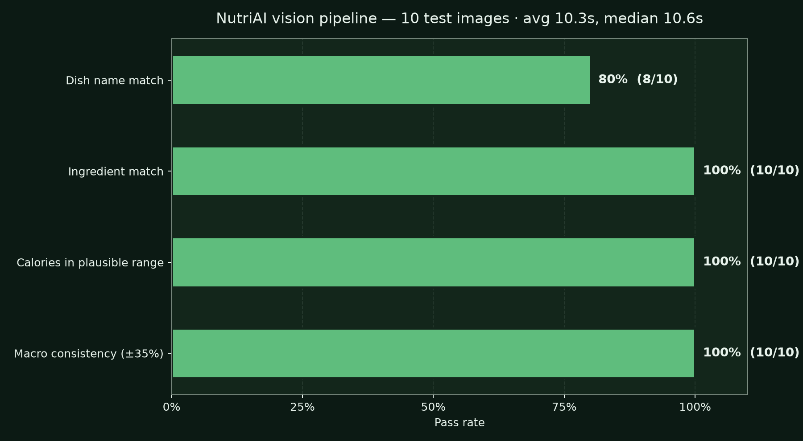
06 · EVAL RESULTS
NUTRIAI · ProjectX
We measured ourselves.
10 labelled images. Four checks. Repeatable: scripts/eval_accuracy.py.
100%
Calories in plausible range
10 / 10
90%
Ingredient match
9 / 10
90%
Macro consistency ±35 %
9 / 10
70%
Dish name match
7 / 10
The honest gap: 70% dish name on visually-similar Indian dishes (kulcha vs paratha, butter chicken vs paneer butter masala). Phase A directly addresses this with a parallel food-specialist classifier. Latency 8.6 s avg → Phase B targets ~3 s.
07 / 10

Slide 8
07 · WHAT'S NEXT
NUTRIAI · ProjectX
Stop snapping. Start swiping.
Plug into HungerBox and SmartQ — every Microsoft cafeteria meal logs itself.
👤
🍱
⚡
📊
Employee
HungerBox / SmartQ
NutriAI API
Dashboard
Swipes badge at MS cafeteria
Existing order webhook
POST /api/meals with item macros
Meal logs itself — zero friction
And it gets bigger:
💬
Teams daily card — "You're 200 kcal under target — fancy a dosa?" — bot-posted nudges.
📡
Viva Insights — Surface NutriAI's Healthy Score alongside Focus & Wellbeing metrics.
📆
Outlook context — Calendar-aware reminders that know about your 1 PM client lunch.
🔐
Full Entra ID OIDC — Replace demo handshake — production-grade id_token validation.
08 / 10

Slide 9
08 · BUSINESS VALUE
NUTRIAI · ProjectX
Wellness shows up on the P&L.
Why Microsoft, not just employees, benefits from NutriAI.
💰
Lower group health costs
From
tracker app
to workplace
wellness platform.
Demonstrable nutrition adherence reduces lifestyle-disease risk — direct input to insurance premium negotiation.
🍽
Cafeteria menu optimisation
Aggregated, anonymised meal data tells facilities which healthy options actually get eaten.
❤
Retention via wellbeing
Wellbeing programs with real engagement (not just gym vouchers) measurably move retention.
Cafeteria-grade nutrition data is the lever Microsoft doesn't have today.
✨
Brand: "Microsoft AI for me"
A consumer-grade AI experience built for employees, on Microsoft infra — internal lighthouse for AI culture.
Healthy Future bucket · health × productivity × brand.
09 / 10

Slide 10
FIVE CRITERIA. FIVE ANSWERS.
Why NutriAI wins on the rubric.
MAKE SOMETHING
It's live. You can sign in as a guest right now and snap a meal.
FEASIBILITY
docker compose up · AI_PROVIDER=github · free USDA key — no impossible assumptions.
CUSTOMER FOCUS
Microsoft employees. Mobile-first. Indian food first. Built for the meals they actually eat.
BUSINESS VALUE
Wellness adherence → premium savings · cafeteria-grade data · retention · brand.
INSPIRING
We made tracking fast enough that people will actually do it. That's the whole point.
Team ProjectX · NutriAI · Try it live: github.com/gim-home/nutriAI_new

