Slide 1
Unveiling Retail Insights: A Quarter in Review
Presented by Sanyukta
Notes:
Good Morning!

Slide 2


Agenda
Introduction
Sponsored Products Overview
Key Metrics Analysis
Revenue Analysis
Organic Site Performance
Insights
Recommendations
Q&A
Thank You

Slide 3

Introduction
Atune Sponsored Products (ASP) allows brand advertisers (e.g. Levi's) to advertise their products on retailer websites (e.g. macys.com). We have a variety of placements on each website and frequently have multiple placements on one page. Placements can contain advertisements for one or more SKUs (SKUs are how we refer to each distinct product) and each SKU has its own impression within a placement--it is common to have multiple SKUs from multiple brand advertisers displayed in one placement. In our exchange, brand advertisers bid against one another with CPCs (cost per click--what they are willing to pay if somebody clicks on their ad) to fill these placements with their SKUs. These brand advertisers are frequently operating on quarterly budgets (i.e. the total amount of money they will pay for clicks each quarter) which they try to spend evenly throughout the period. Sometimes they will temporarily change their bidding behavior to capitalize on shopper trends around key dates and events (e.g. Black Friday).
In addition to tracking our ads, we are also able to track ALL page views (regardless of whether or not we served ads there) and ALL sales (not just for products that are being advertised by us) on each retailer's website.
Google Colab link : ASP_without_Outliers.ipynb - Colaboratory (google.com)

Slide 4

Sponsored Products Overview
All fields beginning "paid_" can be thought of as relating to sponsored products being advertised through Atune on the given retailer's website.
* paid_impressions: The sum of impressions shown. Each impression represents one ad for one SKU. There are frequently multiple impressions on one page.
* paid_clicks: The sum of clicks on our paid_impressions. Paid_clicks does not capture clicks on anything that is not sponsored.
* paid_ad_revenue: The sum of revenue generated from paid_clicks. This is the sum of each paid_click multiplied by the CPC that was bid to win its impression.
All fields beginning "organic_" contain values that are not related to our sponsored products. They provide a view into the retailer site's traffic and performance.
* organic_page_views: The sum of page views AKA site traffic on a retailer's website. This includes all page types (e.g. Browse, Search, Home, Product Detail...) but does not include sales.
* organic_transactions: The number of orders placed on a retailer's website, regardless of what they contain. Ex: If I purchase 2 shirts and 1 pair of pants in the same checkout, it is 1 transaction.
* organic_sales_units: The total quantity of products purchased. The example of one order with 2 shirts and 1 pair of pants, has a total of 3 organic_sales_units.
* organic_sales_revenue: The revenue generated from sales. This is the number of unit sales of each SKU multiplied by the sale price of the SKU.

Slide 5
Key Metrics Analysis
1. Paid Clicks:
On average, 25,957 clicks are recorded for Atune sponsored products.
The median paid clicks stand at approximately 25,729, indicating a balanced distribution.
A standard deviation of 4,924 highlights the variability around the mean, suggesting fluctuations in click counts.
2. Paid Impressions:
The average number of impressions for Atune sponsored products is 29,286,800.
The median paid impressions, at approximately 29,361,300, showcases the midpoint of the dataset.
A standard deviation of 5,695,958 suggests considerable variability around the mean in impressions.
3. Correlation Between Clicks and Impressions:
Paid clicks and paid impressions exhibit a strong positive correlation, with a coefficient of 0.99.
Both metrics follow a normal distribution, contributing to a reliable statistical analysis.
Potential outliers in CPI are observed, primarily associated with Retailer B in February.
Average CPI is 0.088, while outliers show an average CPI of 0.1064.
4. Time Series Analysis:
Time series charts for paid clicks and paid impressions indicate a lack of discernible trend.
However, cumulative charts reveal a positive trend, suggesting an overall increase over time.
5. Seasonality Insights:
Seasonality in non-cumulative series implies patterns repeating within short-term intervals (e.g., weekly or monthly).
Cumulative clicks and impressions, showcasing both trend and seasonality, offers a comprehensive view of overall clicks and impressions growth.
6. Anomaly Detection:
An anomaly is observed between 1st Feb – 15th Feb, where a straight line indicates an unusual absence of seasonality.
Further investigation is recommended to understand and address this anomaly in the dataset.
Notes:
Let's begin by examining the performance of paid clicks."
"On average, we observe a substantial number of clicks—25,957 to be precise."
"Moving on to paid impressions, a crucial metric for assessing visibility."
"With an average of 29,286,800 impressions, our products are making a significant impact."
"However, the considerable standard deviation of 5,695,958 suggests fluctuations that merit further exploration."(Need to check what could be the cause of std. dev fluctuation)
"As we delve into the time series analysis, we notice an interesting trend."
"While individual time series charts for clicks and impressions show no discernible trend, cumulative charts reveal a positive overall increase over time."
"This suggests a cumulative growth story that might not be evident in shorter time frames."

Slide 6
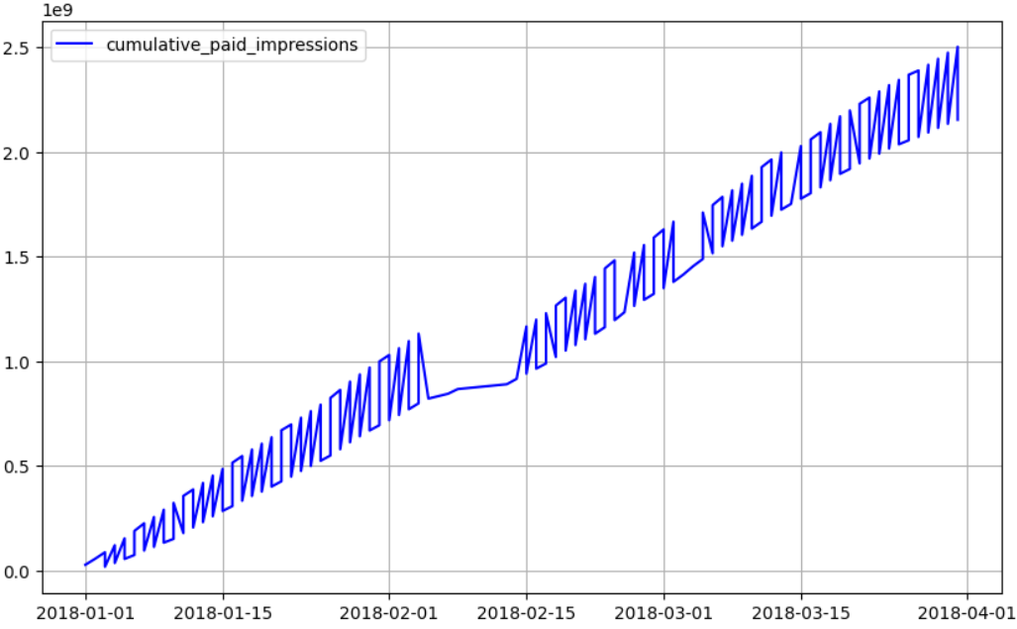
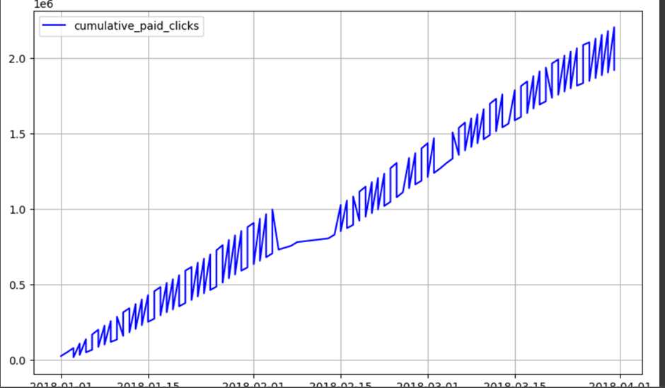
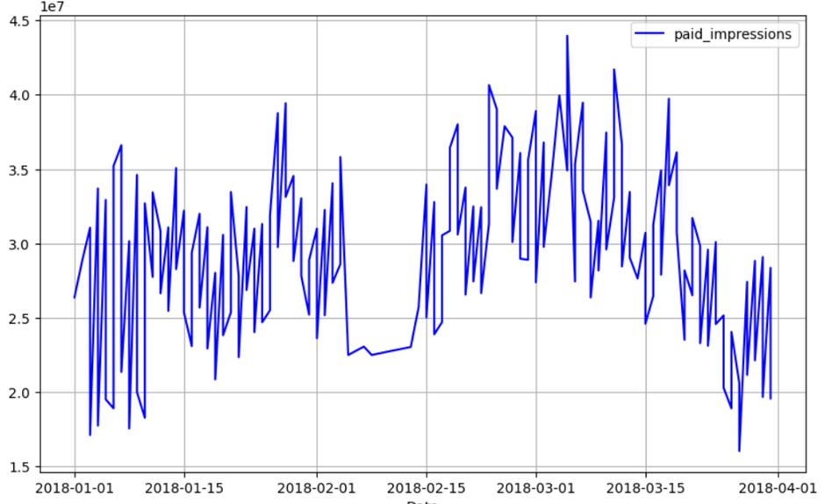
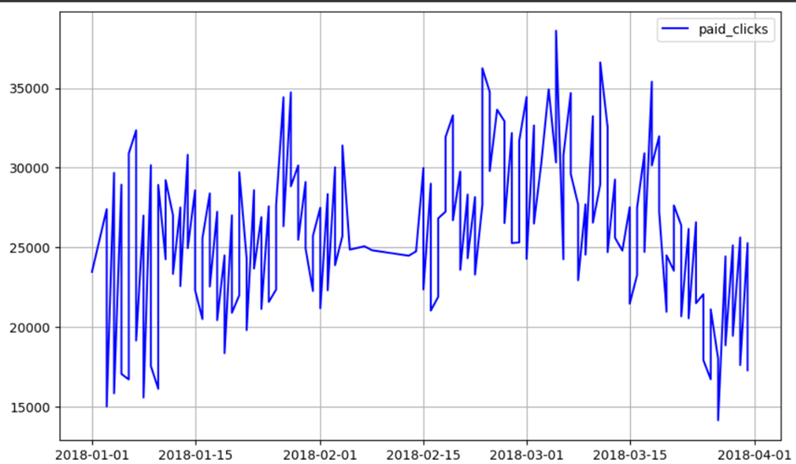
Graphs & Charts

Slide 7
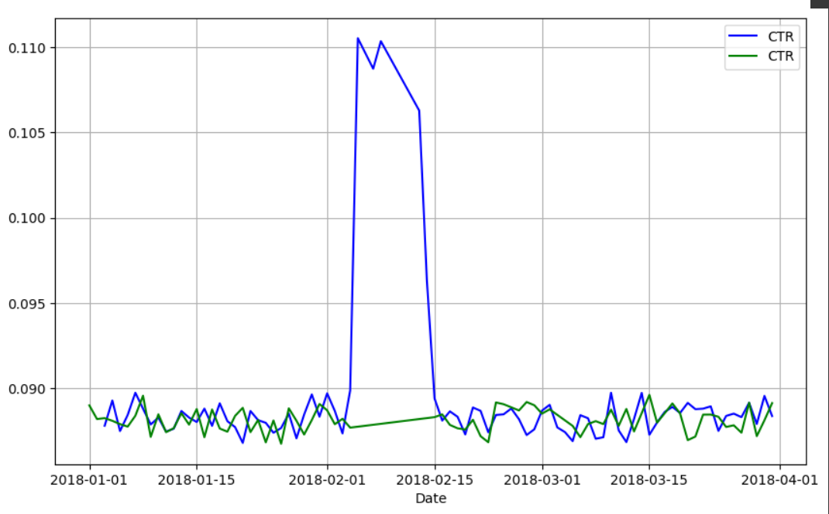
Graphs & Charts

Slide 8
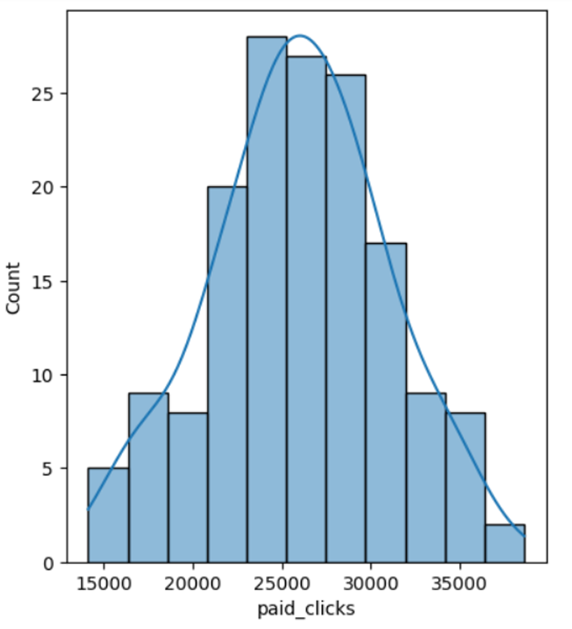
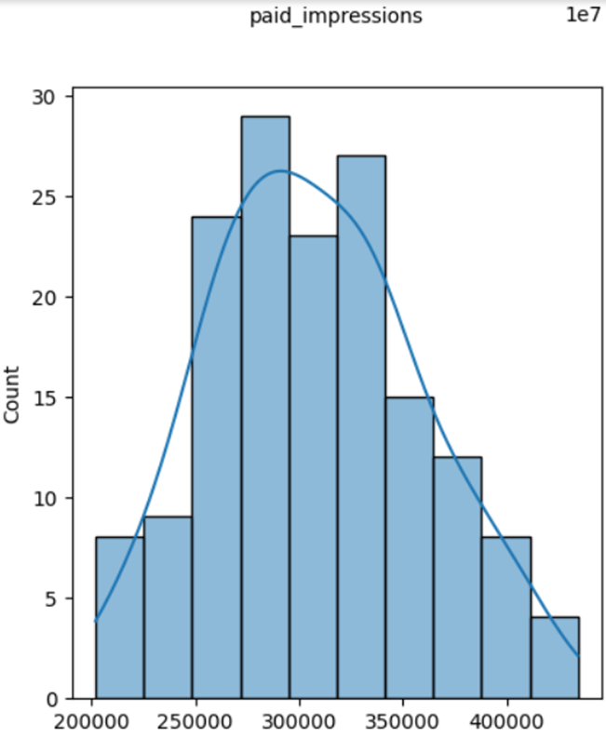
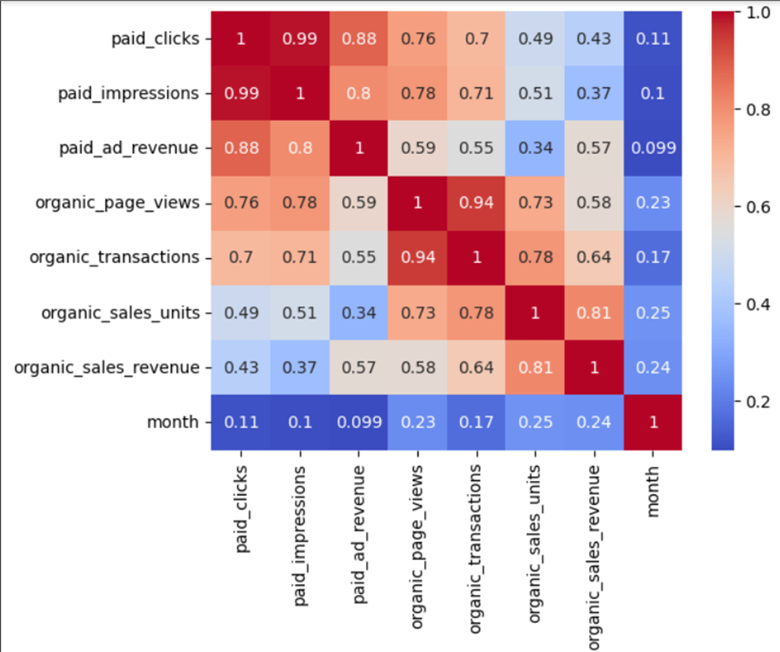
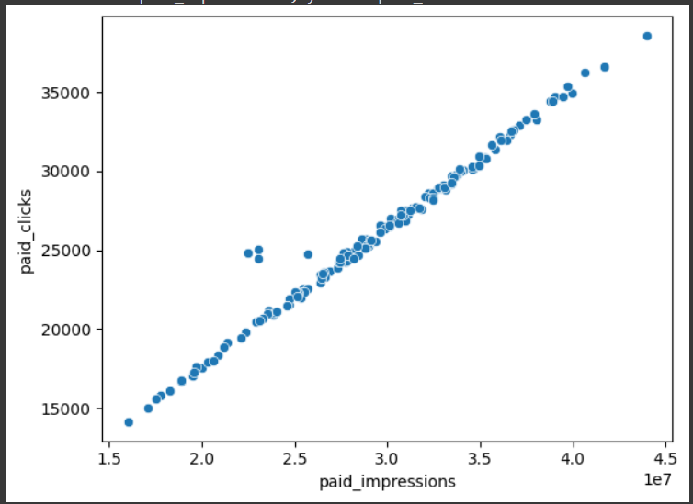
Graphs & Charts

Slide 9
Revenue Analysis
1. Revenue Insights:
After addressing outliers in February, an average revenue of 33,011 is generated from Atune sponsored products.
The median revenue of approximately 32,868 indicates a balanced distribution.
Cumulative paid revenue exhibits both trend and seasonality, offering a comprehensive view of overall growth over time.
2. Time Series Analysis:
Time series analysis reveals significant seasonality and trend patterns in cumulative paid ad revenue.
3. Correlation Between Metrics:
A positive correlation of 0.8 and 0.88 exists between clicks, impressions, and revenue on ASP, emphasizing their interdependence.
4. Derived Metrics – CPC(Cost per click):
Potential outliers in CPC and CPI are observed, primarily associated with Retailer B in February.
Average CPC is 1.27, but outliers, specific to Retailer B in February, have an average CPC of 1.99.
5. Correlation Analysis:
With a 95% confidence level, CPC and CPI are positively correlated with a coefficient of 0.93.
CPC shows an inverse relationship with paid clicks and paid ad revenue.
6. Weekly Trends:
Paid ad revenue, clicks, and impressions peak on Sundays, indicating heightened user engagement.
Conversely, CPC and CPI are lower on Sundays, suggesting more cost-efficient advertising strategies on these days.
7. Possible Implications:
Efficiency: The positive correlation suggests that higher costs per click may result in increased engagement, as reflected in clicks per impression.
Bid Strategy: Advertisers might be adopting a more aggressive bidding strategy on specific days to secure impressions leading to higher clicks and revenue.

Slide 10
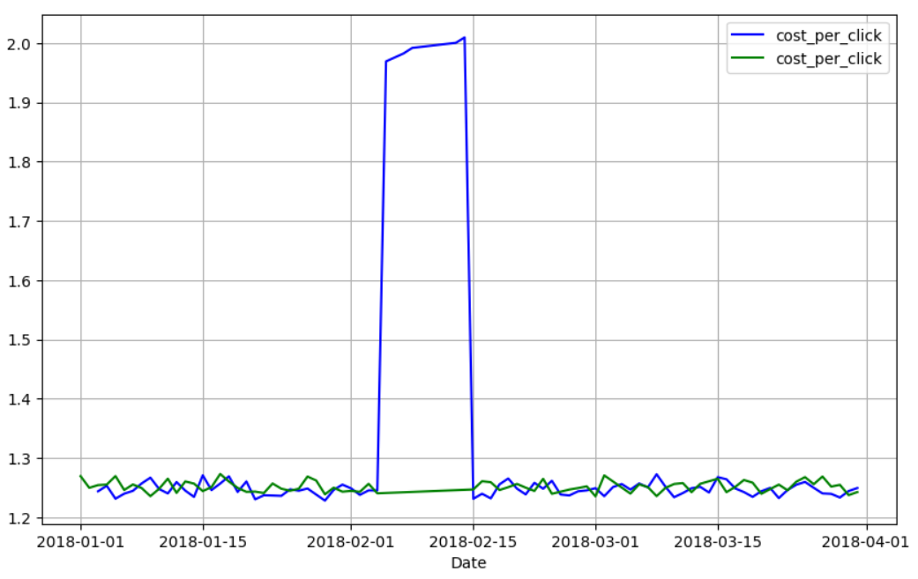
Graphs & Charts

Slide 11
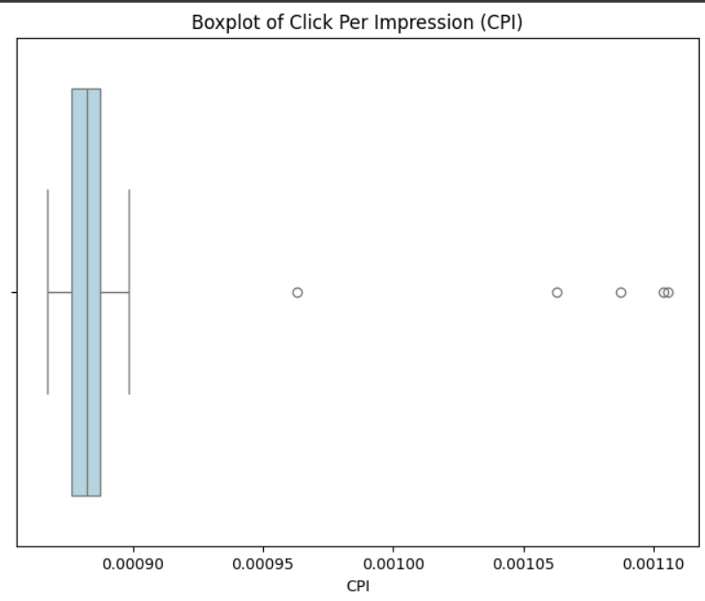
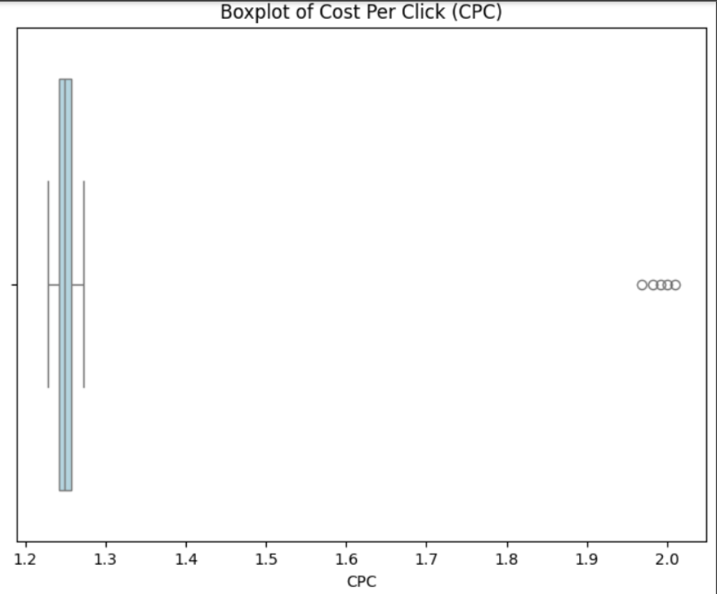
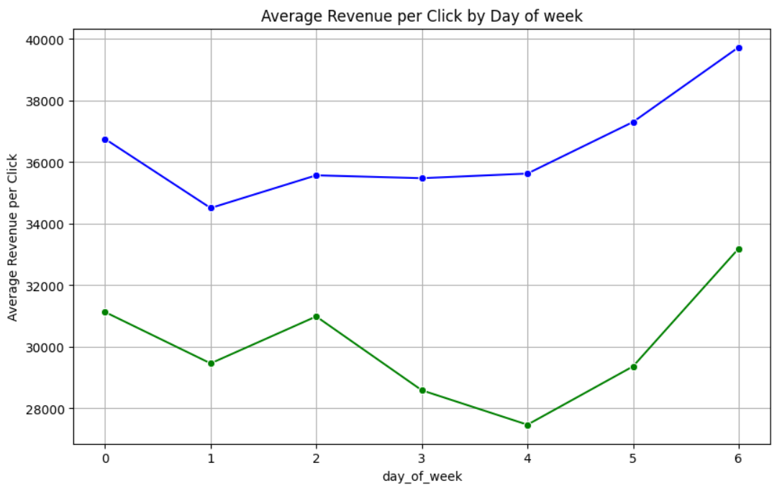
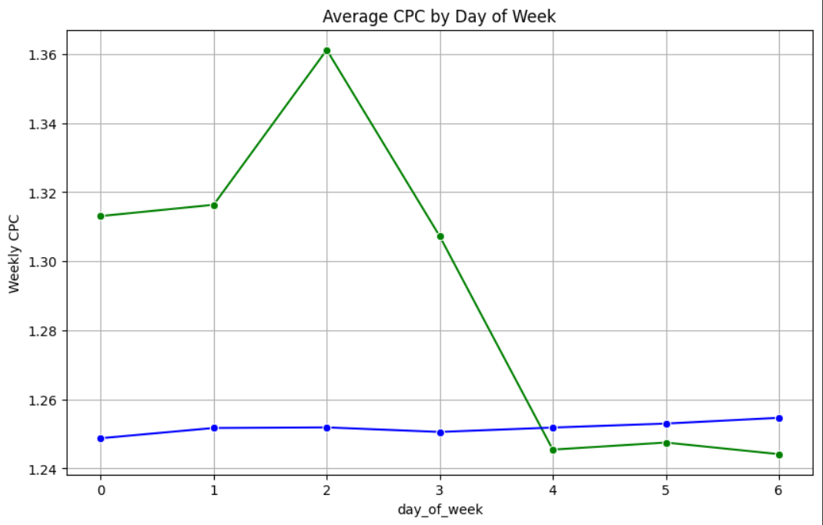
Graphs & Charts

Slide 12
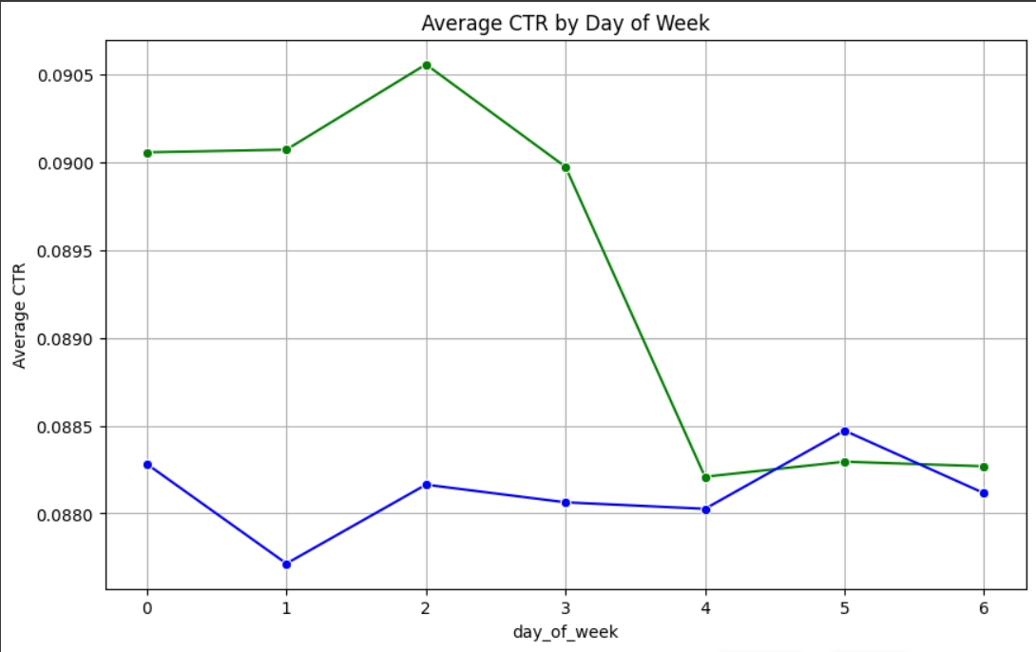
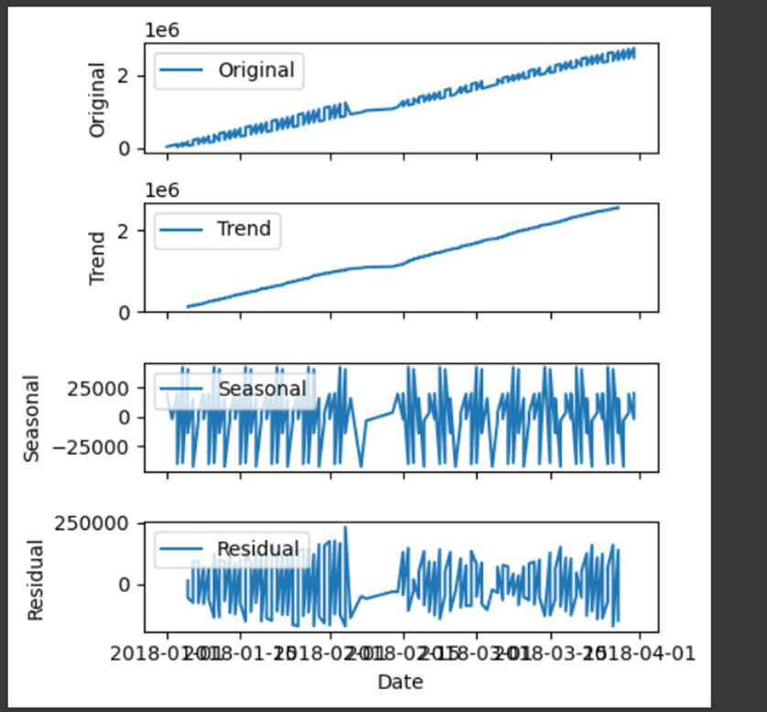
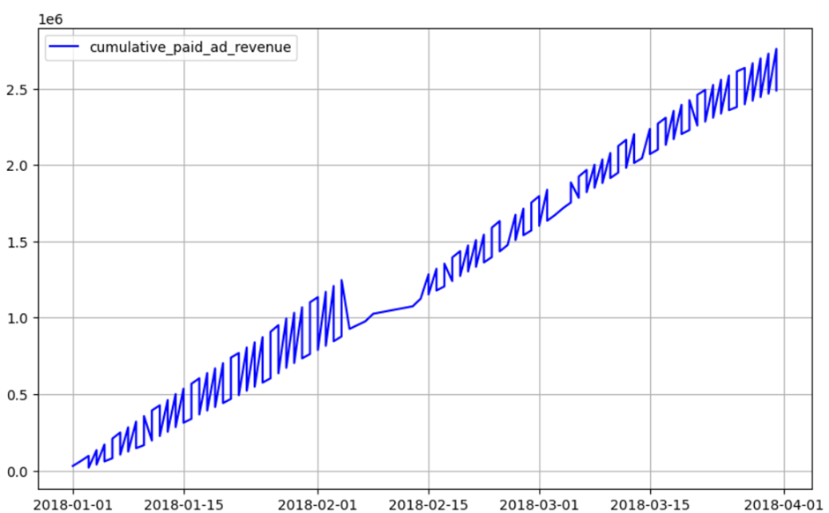
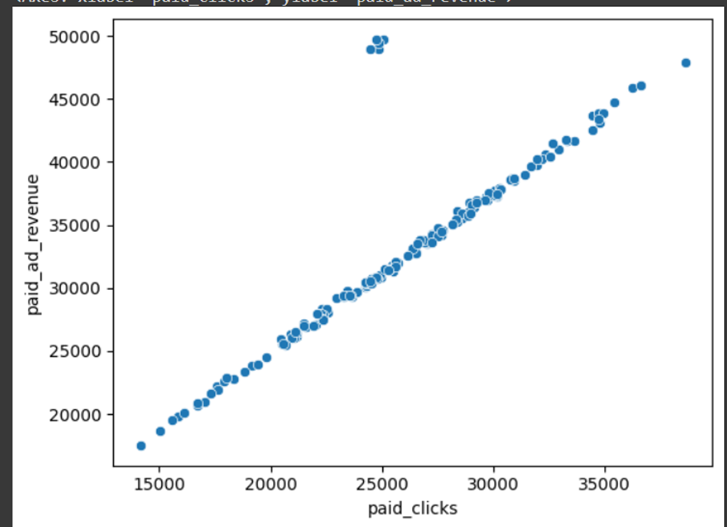
Graphs & Charts

Slide 13
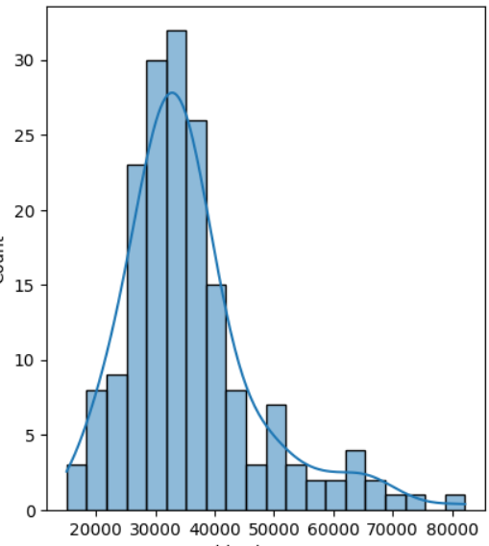
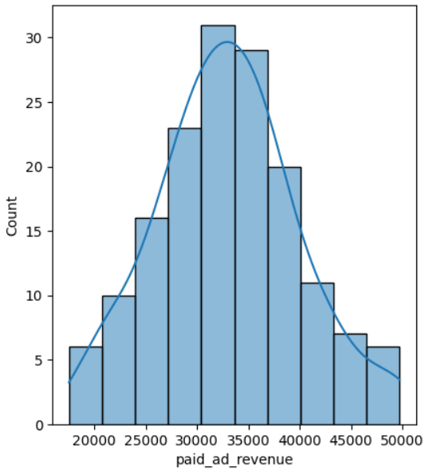
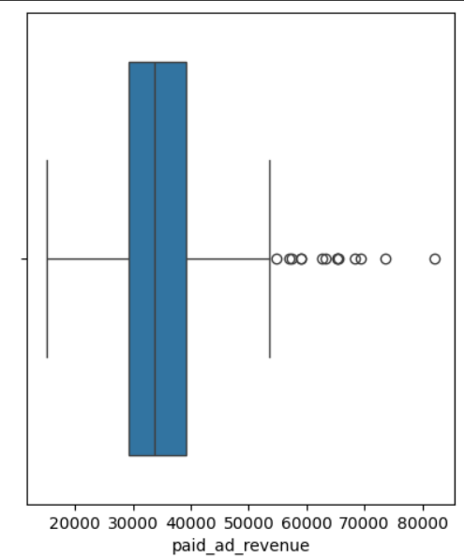
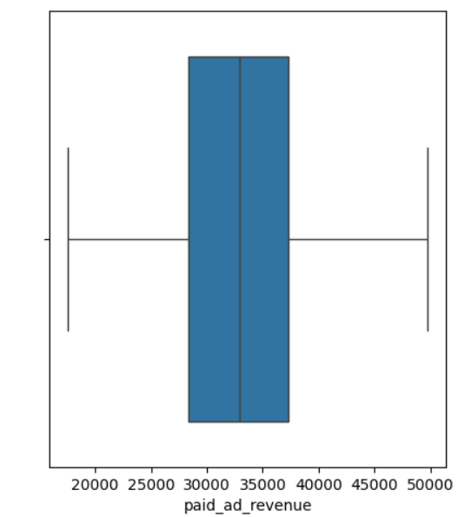
Graphs & Charts
Before Outlier Removal
After Outlier Removal

Slide 14
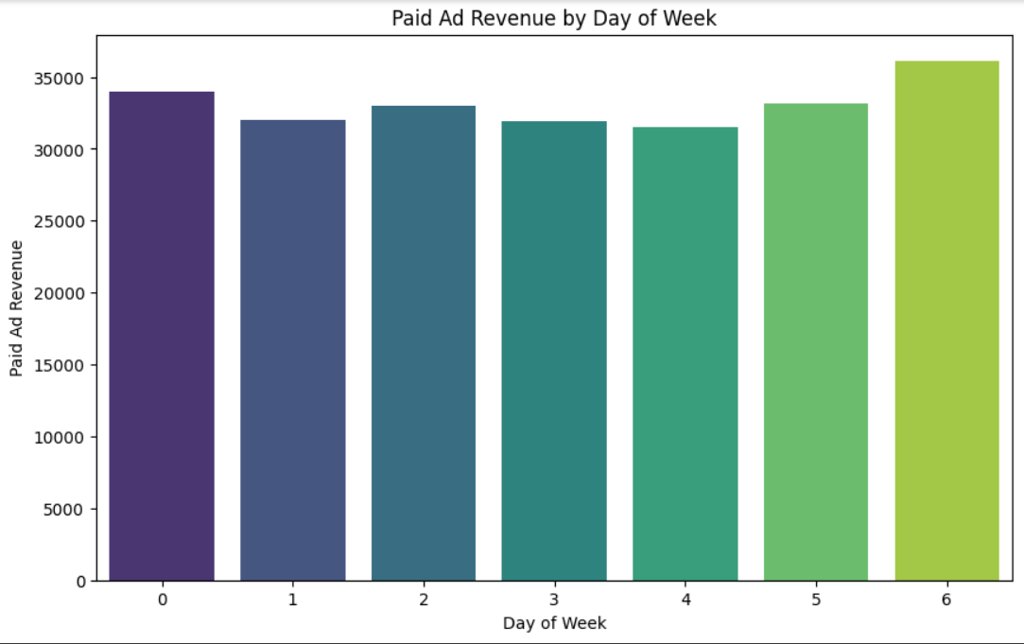
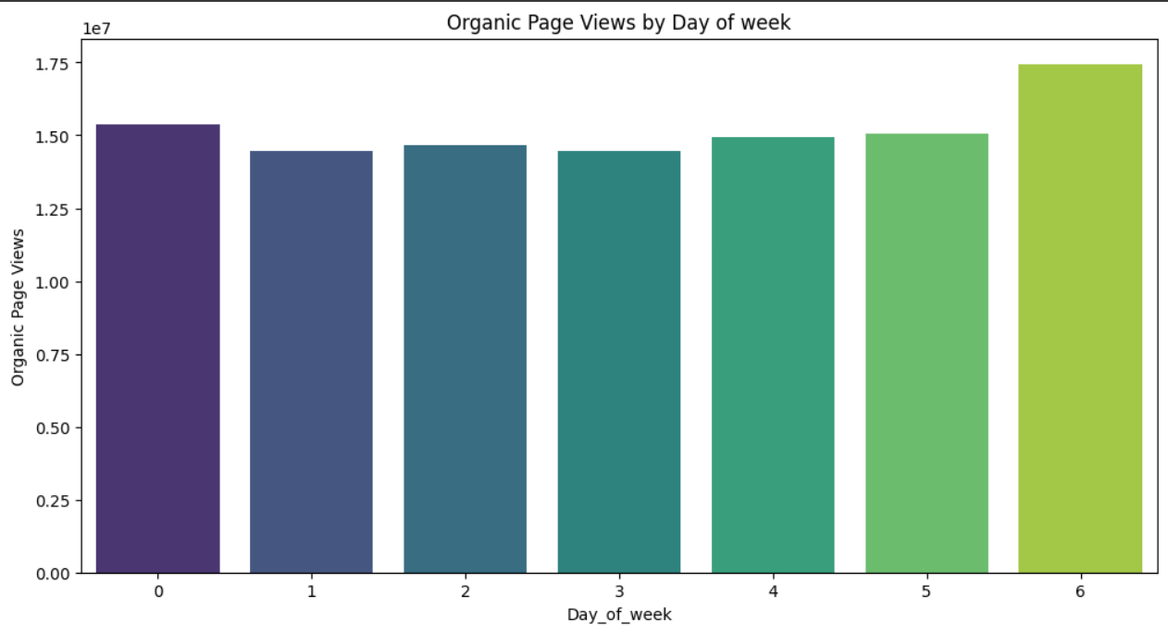
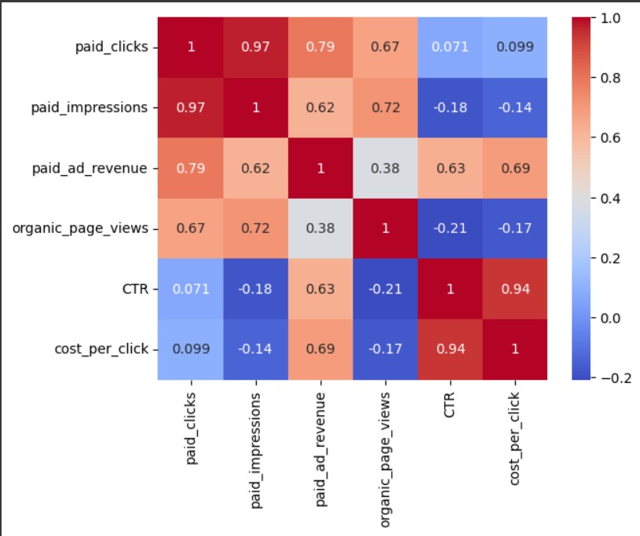
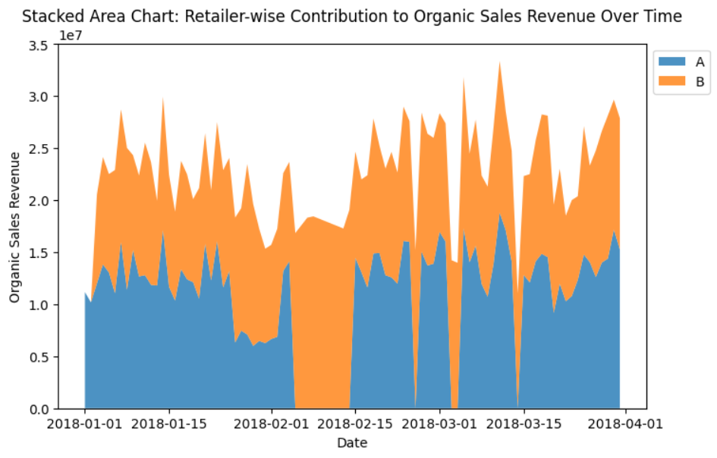
Graphs & Charts

Slide 15
Organic Site Performance
1. Organic Metrics Overview:
Displaying key organic metrics - organic_page_views, organic_transactions, and organic_sales_revenue.
2. Comparing Organic and Paid Metrics:
A comparative analysis of organic data with paid metrics reveals consistent patterns during the observed time period.
3. Derived Metrics Analysis:
Two derived columns, Clicks per Transaction (CPT) and Conversion Rate (CR), exhibit potential outliers. Interestingly, these outliers align with specific dates.
4. Correlation Insights:
Pearson correlation coefficients between organic_page_views, paid_clicks, paid_impressions, and paid_ad_revenue are 0.76, 0.78, and 0.59, respectively, with a 95% confidence level.
5. Key Takeaways:
Organic-Paid Synergy: The strong positive correlations between organic_page_views and paid metrics (clicks, impressions, ad revenue) suggest a potential synergistic relationship. Engaging organic content may contribute to increased paid ad performance.
Derived Metrics Alignment: Outliers in Clicks per Transaction (CPT) and Conversion Rate (CR) align with specific dates, indicating a potential impact on user engagement and conversion.
Holistic Campaign Analysis: The observed correlations highlight the interconnectedness of organic and paid strategies. A comprehensive analysis considering both realms can unveil valuable insights for a more holistic and effective marketing campaign. Regression Analysis will be more efficient here.

Slide 16
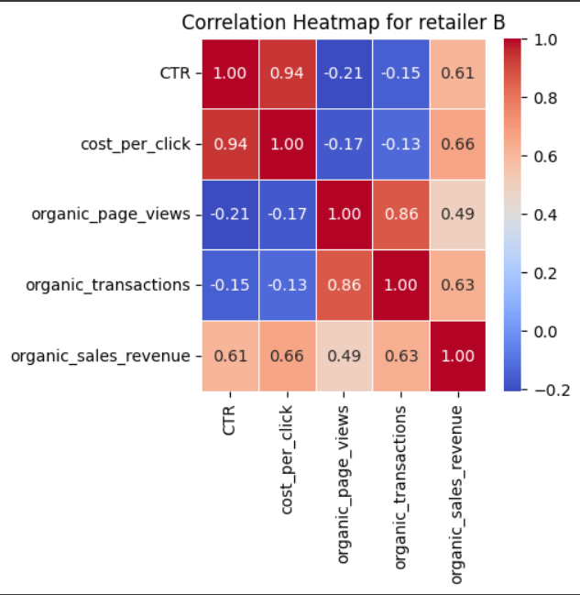
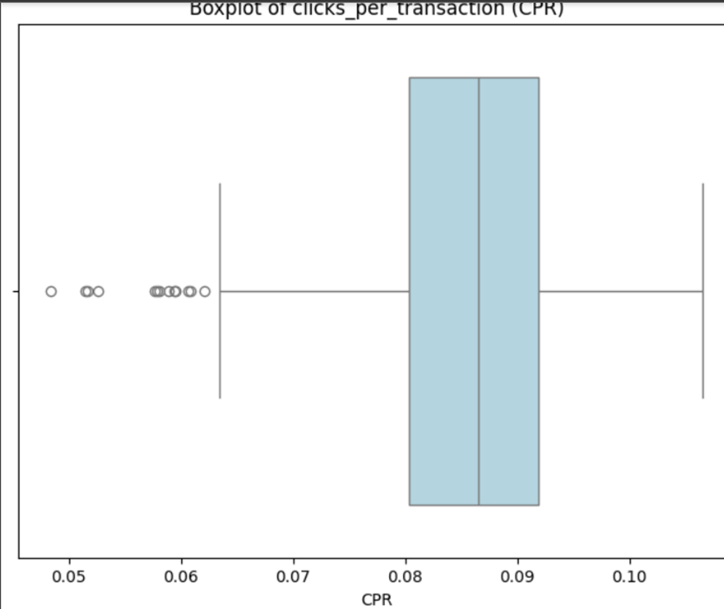
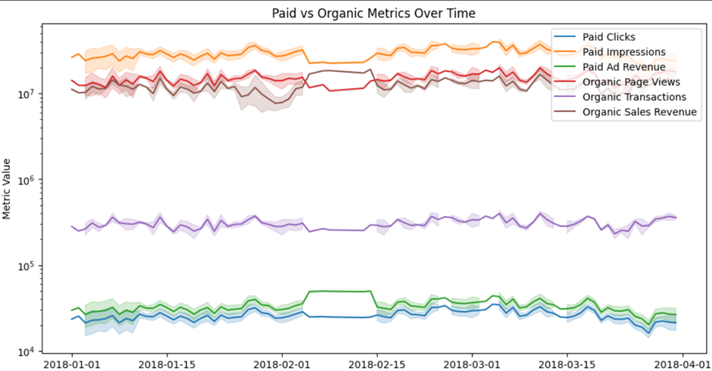
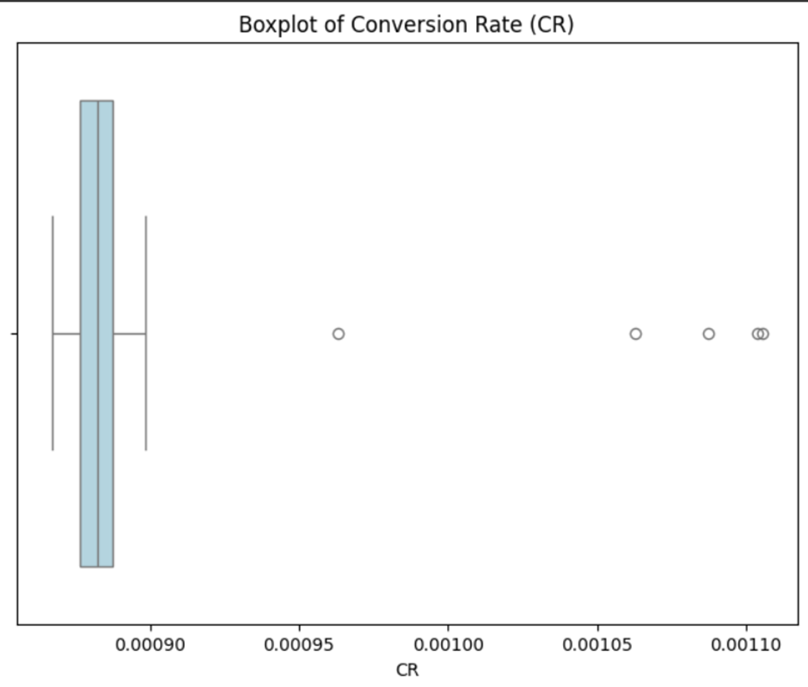
Graphs & Charts

Slide 17
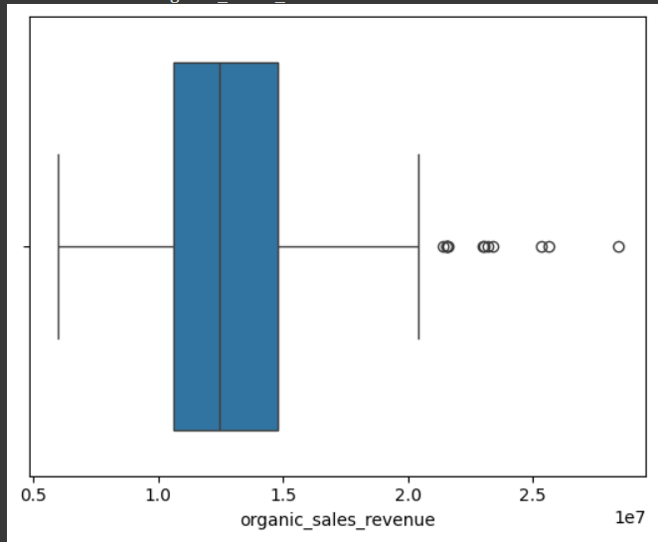
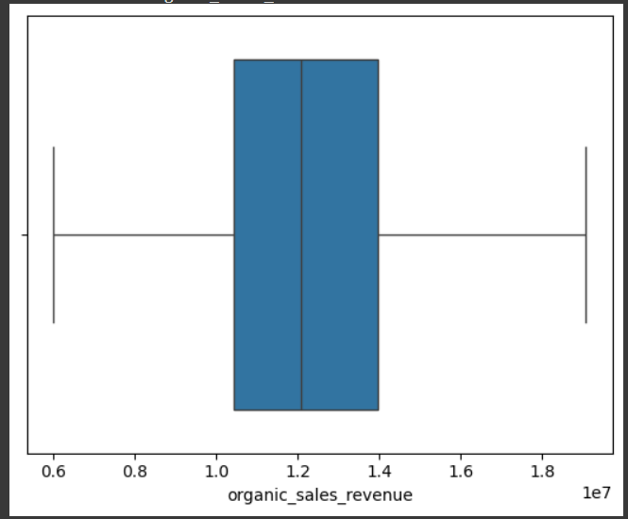
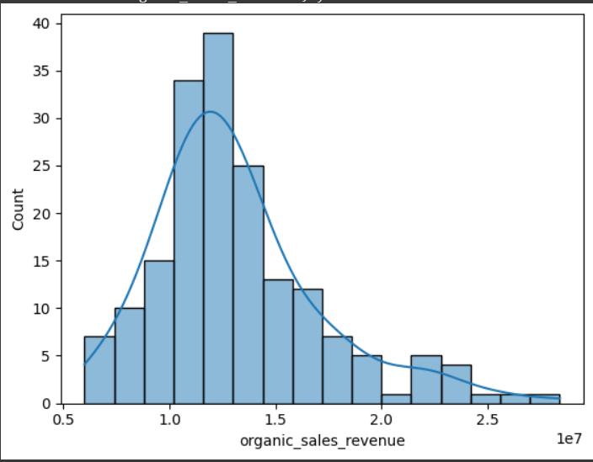
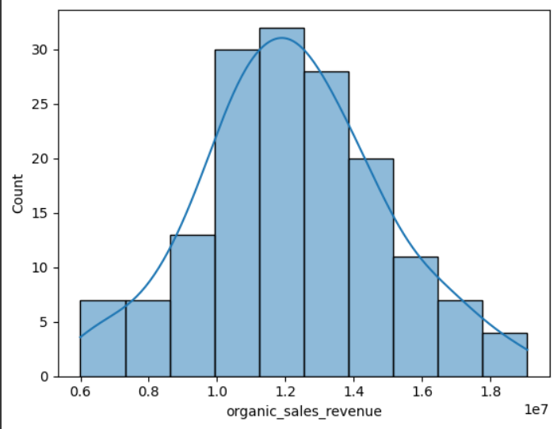
Graphs & Charts
Before Outlier Removal
After Outlier Removal

Slide 18
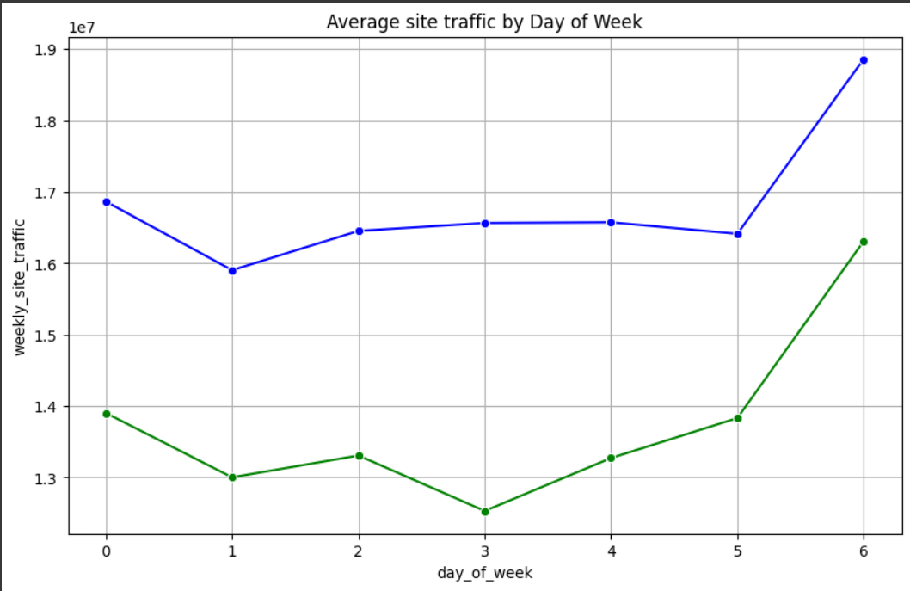
Graphs & Charts

Slide 19

Insights
1. Performance Metrics Overview:
Average clicks and impressions for Atune sponsored products are consistent, exhibiting a normal distribution.
Strong positive correlation (0.99) between paid clicks and impressions suggests an aligned user response to ads.
2. Time Series Analysis:
Lack of discernible trends in time series charts for paid clicks and impressions, but positive trends in cumulative charts signify overall growth over time.
Anomaly detection highlights an unusual absence of seasonality from 1st Feb – 15th Feb, requiring further investigation.
3. Organic-Paid Synergy:
Pearson correlations indicate a strong positive relationship between organic_page_views and paid metrics (clicks, impressions, ad revenue).
Emphasizes the potential synergies between organic and paid strategies, advocating for a cohesive marketing approach.
4. Derived Metrics and Outliers:
Derived metrics CPT and CR exhibit potential outliers aligning with specific dates, impacting user engagement and conversion.
Correlations between organic and paid metrics suggest intricate relationships; outliers may warrant targeted analysis.
5. Revenue Insights:
After addressing outliers, an average revenue of 33,011 is generated, showcasing consistent and balanced distribution.
Seasonality and trend patterns in cumulative paid revenue offer a comprehensive view of overall growth over time.
6. CPC and CPI Analysis:
Outliers in CPC and CPI, particularly associated with Retailer B in February.
Average CPC is 1.27, with outliers having an average CPC of 1.99, emphasizing potential cost variations.
7. Weekly Trends:
Sundays witness peaks in paid ad revenue, clicks, and impressions, indicating heightened user engagement on these days.
Lower CPC and CPI on Sundays suggest potentially cost-efficient advertising strategies on these days.

Slide 20

Recommendations
1. Holistic Marketing Approach:
Leverage the strong correlation between organic and paid metrics to inform a cohesive strategy. Coordinated efforts across both realms can maximize overall performance. Use of Regression Model can help better understand correlation between paid and organic metrics.
2. Anomaly Investigation:
Thoroughly investigate the anomaly observed between 1st Feb – 15th Feb to understand the unusual absence of seasonality. This anomaly could impact the interpretation of trends during that period.
3. Targeted Analysis of Outliers:
Address potential outliers in CPT and CR with targeted analysis. Understand the specific impact on user engagement and conversion, providing insights for optimization.
4. Refined CPC Strategies:
Consider refining CPC strategies, especially for Retailer B in February, to align with average CPC values. Analyze outlier periods to uncover insights for more effective bidding.
5. Strategic Day-based Planning:
Capitalize on weekly trends by strategically planning advertising efforts on Sundays when user engagement peaks. Optimize CPC and CPI strategies for more cost-effective outcomes.

Slide 21
Q&A Thank you!

