Slide 1
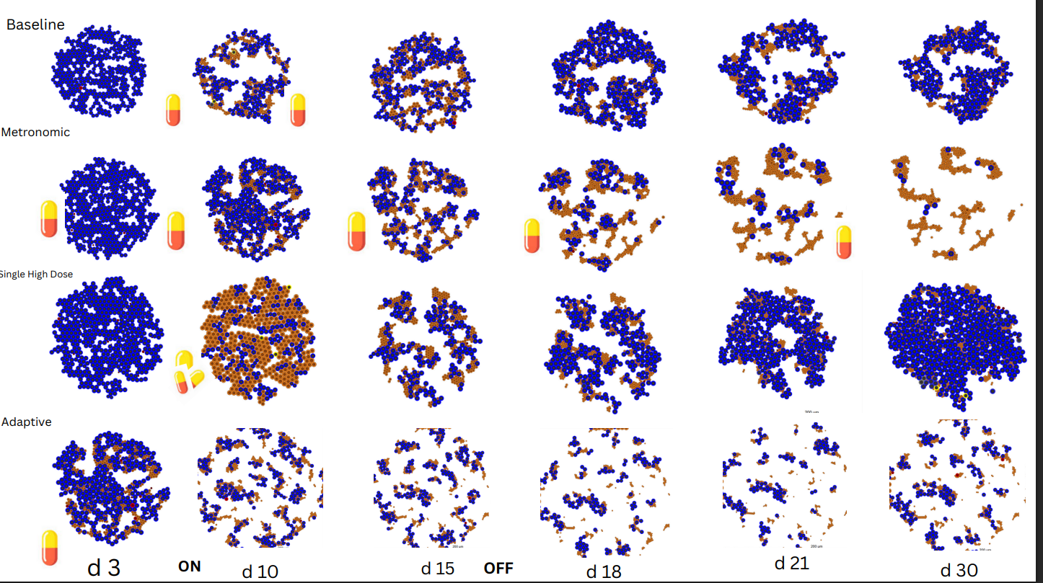
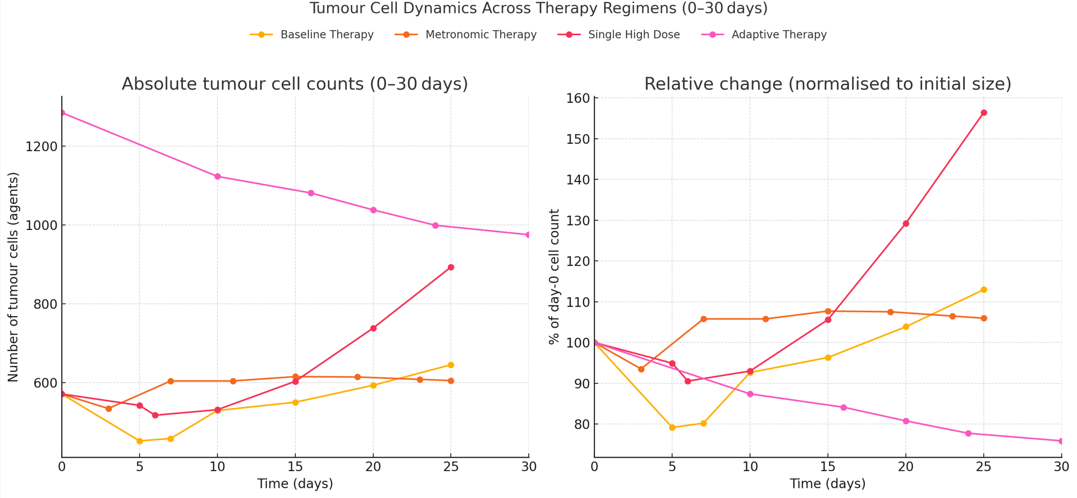
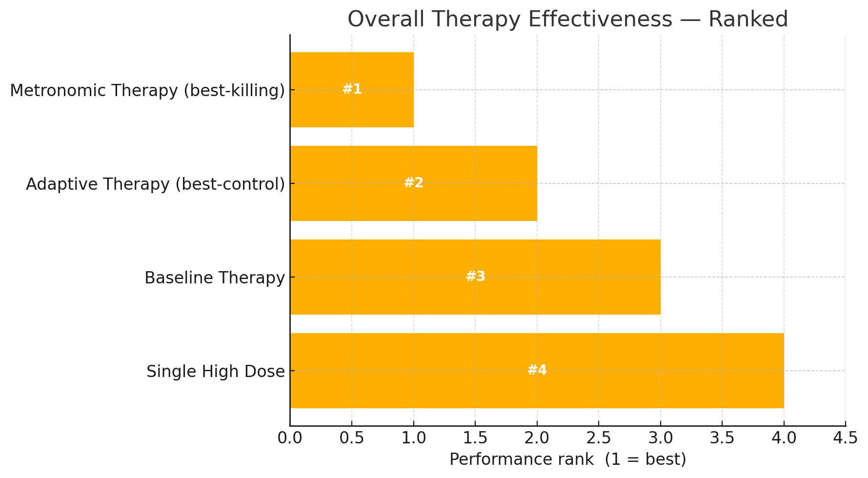
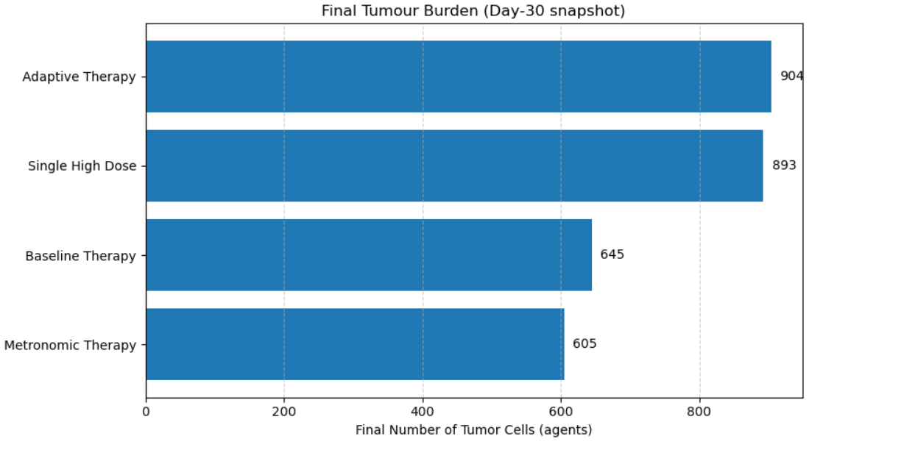
Cancer Nanoparticle Optimization Sanyukta Chapagain¹, Emily Morley², Evanka Amin³ and Professor Mary Loveless^{*,1} ^{1,2,3}, Indiana University, Bloomington, IN USA *corresponding author: melovele@iu.edu
#1
Cancer therapy remains a major clinical challenge due to the dynamic and adaptive nature of tumor growth.
Nanoparticle-based therapies offer a powerful approach for targeted drug delivery in cancer treatment, enabling controlled intracellular release, reduced systemic toxicity, and improved tumor targeting.
However, optimal delivery strategies remain a challenge due to tumor heterogeneity and the complex pharmacokinetics of nanoparticles (NPs).
To explore these dynamics, we used pc4nanobio, a high-throughput, agent-based modeling framework built on PhysiCell, which enables detailed simulation of NP internalization, and intracellular drug release.
Our model captures the interaction between drug-loaded NPs and individual tumor cells in a 3D spheroid, allowing us to evaluate how varying dose schedules and mechanisms affect tumor growth suppression. This work contributes toward understanding biologically realistic cancer nanotherapy strategies.
Model Framework and Therapy Design
Simulations were implemented using the pc4nanobio framework, an extension built upon PhysiCell (version 1.10.4) [5]. A 3D tumor spheroid model was constructed to study drug delivery and therapy responses.
Four distinct therapeutic strategies were evaluated:
(1) Baseline Therapy — Two moderate-dose drug administrations at Day 5 and Day 10.
(2) Metronomic Therapy — Frequent low-dose therapies delivered every ~4 days (Days 3, 7, 11, 15, 19, 23).
(3) Single High Dose Therapy — A single high-dose drug pulse applied at Day 5.
(4) Adaptive Therapy — Therapy dynamically activated when tumor size exceeded 850 live cells and deactivated when below 600 live cells.
Each therapy was simulated for 30 days, and tumor response was monitored through cell counts and phenotypic changes.
Key Parameters Used
Drug Effect Modeling and Therapy Logic
In Baseline, Metronomic, and Adaptive therapies, drug-induced apoptosis was modeled using an AUC-based pharmacodynamic function:
Drug Effect = (AUC^HillPower) / (AUC^HillPower + EC50^HillPower)
For Single High Dose therapy, the drug effect was modeled based on instantaneous extracellular drug concentration C:
Drug Effect = (C^HillPower) / (C^HillPower + EC50^HillPower)
In Adaptive Therapy, treatment was dynamically activated when live tumor cells exceeded 850 agents and deactivated when the count dropped below 600 agents.
Microenvironment Parameters
🔵 Blue - Viable tumor cells 🟠 Orange/Brown - Drug-Stressed or Apoptotic Cell
Metronomic Therapy was the most effective strategy, achieving the greatest tumor reduction by Day 30. Adaptive Therapy showed consistent tumor control with dynamic dosing, though residual tumor mass remained. Baseline Therapy provided moderate suppression, while Single High Dose Therapy was the least effective due to strong regrowth after initial shrinkage.
These findings highlight the trade-offs between aggressive and adaptive treatment strategies. While adaptive dosing improves control, its design must be optimized to reduce long-term tumor burden. Future work will integrate cancer stem cell dynamics into the model and use genetic algorithms to evolve more effective nanoparticle therapies tailored to heterogeneous tumor populations.
Parameter | Baseline | Metronomic | Single High Dose | Adaptive
Dose Strength | 1.0 | 0.5 | 15.0 | 5.0
Dose Timing | Day 5, 10 | Day 3,7,11,15,19,23 | Day 5 only | Dynamic ON/OFF
Dose Duration | 4 hr | 4 hr | 12 hr | Continuous
Effect Model | AUC-based | AUC-based | Concentration- based | AUC-based
EC50 | 0.1 | 0.15 | 0.15 | 0.025
Hill Power | 1.5 | 1.5 | 1.8 | 1.5
Initial Tumor Size | ~571 cells | ~571 cells | ~571 cells | ~1285 cells
Simulation Duration | 25 days | 25 days | 25 days | 40 days
.
Metronomic Therapy maintained the lowest final tumor burden, with minimal regrowth.
Adaptive Therapy began with the largest tumor and showed the greatest percentage reduction, but stabilized at a higher final size.
[1] Y. Wang, E. Bucher, H. Rocha, V. Jadhao, J. Metzcar, R. Heiland, H. B. Frieboes, and P. Macklin, “Drug-loaded nanoparticles for cancer therapy: a high-throughput multicellular agent-based modeling study,” bioRxiv, preprint, Apr. 9, 2024. doi: 10.1101/2024.04.09.588498.
[2] A. Makrooni, P. Macklin, and D. Romano, “An evolutionary computational platform for the automatic discovery of nanocarriers for cancer treatment,” Comput. Mater. Sci., vol. 196, p. 110506, Jun. 2021. doi: 10.1016/j.commatsci.2021.110506.
[3] M. Savić, V. Kurbalija, I. Balaz, and M. Ivanović, “Heterogeneous tumour modeling using PhysiCell and its implications in precision medicine,” in Cancer, Complexity, Computation, vol. 157, Springer International Publishing, 2022, pp. 157–189. doi: 10.1007/978-3-031-04379-6_7.
[4] A. Ghaffarizadeh, R. Heiland, S. H. Friedman, S. M. Mumenthaler, and P. Macklin, “PhysiCell: an open source physics-based cell simulator for 3-D multicellular systems,” PLoS Comput. Biol., vol. 14, no. 2, p. e1005991, Feb. 2018. doi: 10.1371/journal.pcbi.1005991.
Figure 2 ranks therapies by effectiveness (lower = better), with metronomic therapy best at tumor killing, adaptive therapy maintaining excellent control with a stable residual mass, baseline therapy yielding moderate suppression, and single high-dose therapy performing worst with significant regrowth after initial decline.
Substrate | Role | Diffusion Coefficient (μm²/min) | Decay Rate (/min) | Boundary Condition | Special Behavior
Oxygen (O₂) | Supports viability | 1×10⁵ | 0.1 | Constant Dirichlet | Hypoxia triggers necrosis
Nanoparticle (NP1) | Triggers apoptosis | 1×10³ | 0.001 | Dirichlet during therapy events | Internalization drives apoptosis
We want to thank Paul Macklin for developing the PhysiCell platform, which was essential to the implementation of our simulations.
Our objective is to determine biologically realistic, computationally-supported therapy designs for improving cancer treatment outcomes by doing experiment over the span of 30 days
As shown in Figure 3, metronomic therapy produced the lowest final tumor burden, followed by baseline therapy, whereas single high-dose and adaptive therapies left higher residual tumors.

