Slide 1
CSE 299 Junior Design Project
Faculty: Shaikh Shawon Arefin Shimon
SAS3

Slide 2
Tools
What tools are we going to use to do CSE299 PROJECT MANAGEMENT?
Piazza
GIT
GITHUB
TRELLO
Microsoft word/EXCEL

Slide 3
PIAZZA
Classroom communication tool
Each Group has its own piazza thread.
Groups are only allowed to use this when communicating with both groupmates and Faculty

Slide 4
Version control tool
Code with multiple version:
Final.cpp
Final_1.cpp
Final_final_1.cpp
What happens in industry?
What happens when you made a mistake and need to revert back to earlier version of your project?

Slide 5
Version control tools
Version control tools are tools used by software teams that manage changes to source code over time.
Keeps track of every modification to the code in a special kind of database
If mistake is made, developers can revert back to earlier version of code.
Minimizes disruption to all team members

Slide 6
What kind of VC tools available?
Subversion
Cvs
Perforce
Clearcase
git

Slide 7
git
Git is a open source and free distributed version control system
Widely used in industry in 2019. everything else is obsolete.
Every company uses it and a must know in today’s software engineering
Extremely fast performance compared to other version control systems
Can handle small or very large projects

Slide 8
git
Resources: https://git-scm.com/
https://www.atlassian.com/git/tutorials/what-is-git
https://try.github.io/

Slide 9
git
If you are doing version control on own machine, installing git is enough
Poor man’s git : CTRL + S (Save)
Do you need to know command lines for cse299?
*Bleep* no
What happens when two or more people are working on the same project?
Need to have an online repository

Slide 10
ONLINE GIT repositories
Github
Bitbucket
gitlab

Slide 11
github
You need to create github account using NSU Email ID.
You can add your personal email to this account.
https://github.com/nsuspring2019cse299sec2
https://github.com/nsuspring2019cse299sec4
https://github.com/nsuspring2019cse299sec8
Each group has its own project space

Slide 12
github
Join github project spaces.
Clone your repository in your machine
Step 1:
Using git tools, edit your respective readme files for adding your project member names, student ids, emails, courses and section.

Slide 13
Command Line?
No thanks. I love to torture but not that much.
Use gui tools.
https://desktop.github.com/
Or
https://www.sourcetreeapp.com/
Lots of other git gui client out there.

Slide 14
Project space
Inside each group’s project repository, there should be the following structure for folders.
Group X
Readme.md
.gitignore
Documentation
Idea
Project proposal
feature list
MockUp
Project code

Slide 15
Folder structure
Readme.md
File that contains the number of the group and group member details.
.gitignore
From time to time, there are files in your project you don’t want git to check In github.
For example, .exe file or binary files.
If your project is in c++, then ideally all .cpp and .h files should be checked in.
All .bin, .exe files should be avoided.
https://help.github.com/articles/ignoring-files/

Slide 16
.gitignore
Ideally, inside every folder you can create a local gitignore file.
Understand your own requirements – what to ignore and what not.

Slide 17
documentation
Idea:
In this folder, you will create one (1) word document named
Group_x_idea.docx
This idea file will be continuously edited.
Multiple versions will not be created.
Make a small change. Commit. Push. Pull. Make a small change. Commit. Push. Pull.
With each change, the commit messages should be descriptive.
Do not say things like ”Removed a semicolon”.

Slide 18
documentation
You get the idea about the restß

Slide 19
How I want you to work
For each person, create a branch from main code base.
Independently work on your branches.
Merge your works.
You are going to mess up, without a shread of doubt.

Slide 20
Tracking your project progress
Git commits
I will check commits by individual people
Small commits, one each day. Good commit messages which clearly describe what the new changes are.
Each person should make commits.
Same project can yield A and D for members based on project contribution.

Slide 21
presentation
Powerpoint
Mockup tools:
Balsamiq or other ux design tools.
Each week project update.

Slide 22
Project tracking tools
Best in business: JIRA
Jira not free for students. Will see what can be done from next semester.
Use trello for now.
Free.

Slide 23
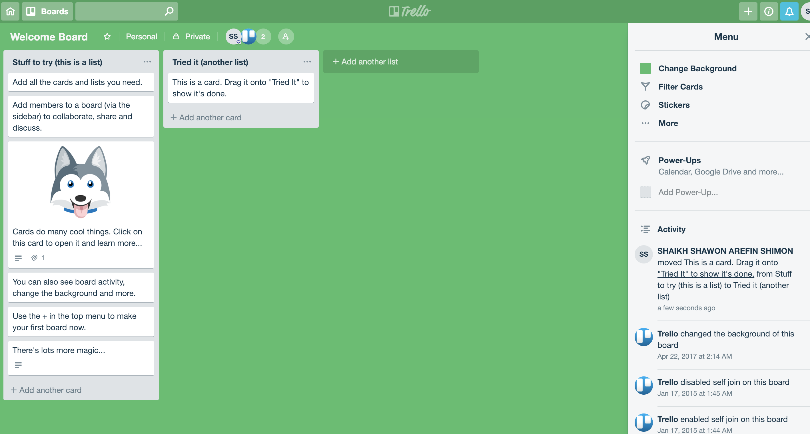
Trello

Slide 24
Gantt chart
Table that illustrates the course of a project and elements involved.
Timeline view of all your upcoming tasks and deadlines
Trello has gantt chart software integrated
https://elegantt.com/
Any other proposals?

Slide 25
Gantt chart
Bar chart illustrating project schedule

Slide 26
Anything else?

