Slide 1
Assignment #03 - Software Engineering
Made by: Sanzhar Kipshakbaev 20B030346
25.10.2022

Slide 2
Chapter 6. Exercise 6.1- When describing a system, explain why you may have to start the design of the system architecture before the requirements specification is complete

Slide 3
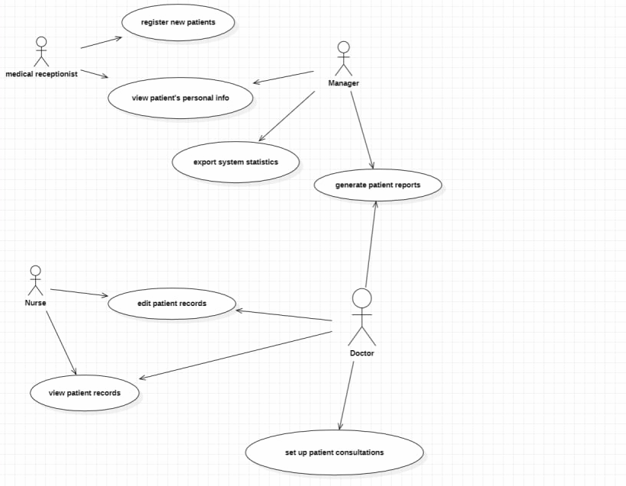
7.2

Slide 4
The architecture has to be designed before specifications are written for the following reasons:
1. To provide a means of structuring.
2. The specification and developing different sub-system specifications concurrently.
3. To allow manufacture of hardware by sub-contractors and to provide a model for system costing.

Slide 5
Chapter 6. Exercise 6.6- Suggest an architecture for a system (such as iTunes) that is used to sell and distribute music on the Internet. What Architectural patterns are the basis for your proposed architecture?

Slide 6
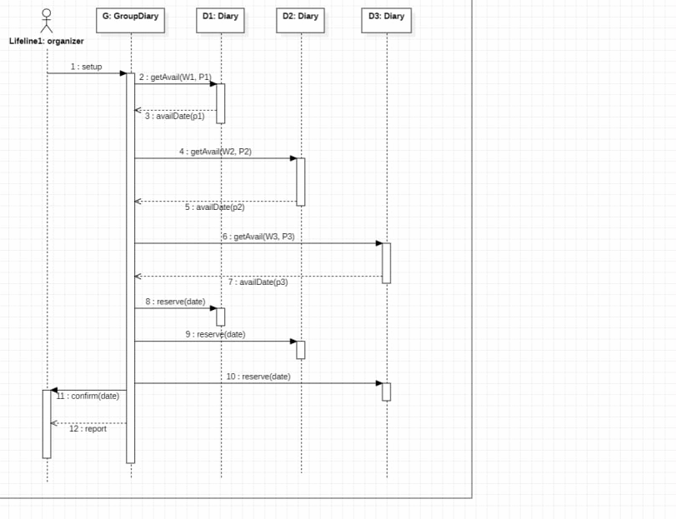
7.7

Slide 7
The architecture needed for this type of system is a client-server model. iTunes will have a database that has records on all the music that is available through their system. These music records can be searched for by the user by artist name, genre, etc., through a web based interface and downloaded for a certain price. The server handles music orders through the web based interface. The architectural pattern that is the basis for this is client-server pattern.

Slide 8
Thank you for your attention!

