Slide 1
SAMSUNG ELECTRONICS
Financial Performance,
Resilience & Business-Segment Analysis
FY2022–FY2025
The 2023 earnings shock, the recovery, remaining vulnerabilities, and practical responses.
Based on Samsung consolidated disclosures and the accompanying Excel analysis.
PORTFOLIO PRESENTATION

Slide 2
The financial story in one view
01 • EXECUTIVE
₩333.6T
₩43.6T
13.1%
₩37.8T
2025 revenue
2025 operating profit
2025 operating margin
2025 free cash flow
+10.4% vs 2022
+0.5% vs 2022
vs 14.4% in 2022
~3× 2022
Strong recovery — but not a full return to 2022
CORE MESSAGE
• 2023 was an earnings shock: revenue fell 14.3%, while operating profit fell 84.9%.
• By 2025, operating profit was slightly above 2022 and gross margin had fully recovered.
• Net income remained 18.8% below 2022; operating margin remained 1.3 points lower.
• The balance sheet remains strong, but liquidity and asset-efficiency cushions have narrowed.
Recovery is real. The next challenge is making earnings more resilient and capital more productive.
MAIN EXPOSURES
Semiconductor cyclicality • SG&A intensity • rising liabilities • slower efficiency
Samsung Electronics Financial Analysis • FY2022–FY2025 | 2

Slide 3
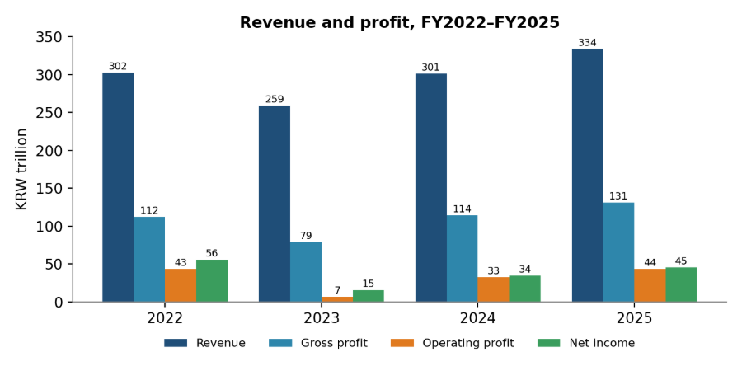
Revenue recovered — profit recovered faster
02 • PERFORMANCE
2023 SHOCK
Revenue −14.3% | Operating profit −84.9% | Net income −72.2%
2025 RECOVERY
Revenue +10.4% vs 2022 | Operating profit +0.5% vs 2022
BOTTOM-LINE GAP
2025 net income ₩45.2T — still 18.8% below 2022’s ₩55.7T.
KRW trillion. The 2023 problem was disproportionately a profitability problem.
Samsung Electronics Financial Analysis • FY2022–FY2025 | 3

Slide 4
Gross margin recovered; cost intensity is holding back operating margin
03 • PROFITABILITY
GROSS MARGIN
39.4% in 2025 vs 37.1% in 2022 — more than recovered.
SG&A PRESSURE
SG&A rose ₩68.8T → ₩87.8T (+27.5%), faster than revenue (+10.4%).
IMPLICATION
Gross profitability improved, but the larger operating-cost base limits margin recovery.
Samsung Electronics Financial Analysis • FY2022–FY2025 | 4

Slide 5
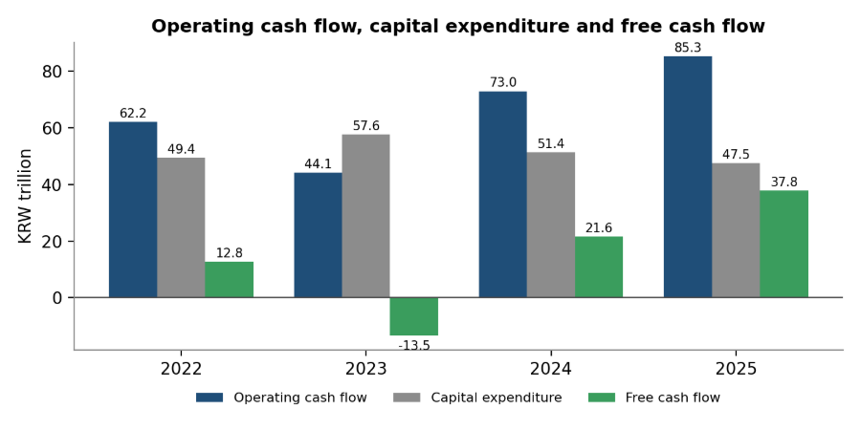
Cash generation has become a major strength
04 • CASH FLOW
2023 PRESSURE
OCF ₩44.1T vs capex ₩57.6T → FCF −₩13.5T.
2025 TURNAROUND
OCF ₩85.3T; capex ₩47.5T → FCF ₩37.8T.
ACTION SIGNAL
Link major capex decisions to expected cash-flow returns and capacity utilization.
FCF here = operating cash flow − PP&E purchases; intangible-asset purchases are excluded.
Samsung Electronics Financial Analysis • FY2022–FY2025 | 5

Slide 6
The balance sheet is strong — the cushion is gradually narrowing
05 • FINANCIAL POSITION
2.33x
1.83x
29.9%
₩566.9T
2025 current ratio
2025 quick ratio
Liabilities / equity
2025 total assets
2.79x in 2022
2.12x in 2022
26.4% in 2022
+26.4% vs 2022
What changed?
READ IT CORRECTLY
• Current liabilities grew 35.8% from 2022–2025, faster than current assets (+13.4%).
• Total liabilities rose 39.4%, while equity rose 23.0%.
• Cash and cash equivalents were still 16.5% above 2022 — this is not a liquidity crisis.
The issue is a thinner cushion, not financial distress.
RESPONSE
Monitor liquidity floors, short-term obligations and working capital together.
Samsung Electronics Financial Analysis • FY2022–FY2025 | 6

Slide 7
Capital is growing faster than the sales it supports
06 • EFFICIENCY
ASSET GROWTH
Assets +26.4% vs revenue +10.4% (2022–2025).
RECEIVABLES
Trade receivables +43.1%; year-end turnover fell 8.46x → 6.52x.
CAUTION
Average-balance turnover is more stable. Treat receivables as a watch item, not proof of collection failure.
Samsung Electronics Financial Analysis • FY2022–FY2025 | 7

Slide 8
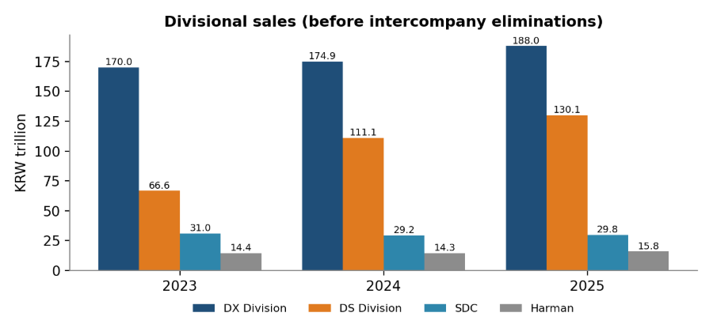
The recovery is increasingly semiconductor-led
07 • BUSINESS MIX
DS: GROWTH ENGINE
Sales +95.3% from 2023–2025; share 23.6% → 35.8%.
DX: STILL LARGEST
Sales +10.6%; share 60.3% → 51.7%.
SDC: LAGGING
Sales −3.9%; share 11.0% → 8.2%.
Divisional sales are before intercompany eliminations; 2025 divisional totals exceed consolidated revenue.
Samsung Electronics Financial Analysis • FY2022–FY2025 | 8

Slide 9
Growth is strongest in the Americas and Asia & Africa
08 • GEOGRAPHY
AMERICAS
₩92.1T → ₩133.3T | +44.7% | 40.0% of 2025 sales
ASIA & AFRICA
₩73.1T → ₩100.4T | +37.3% | 30.1% of 2025 sales
SLOWER REGIONS
Europe +10.8%; Korea +2.2% — slower than the two leading growth regions.
Regional sales reconcile to consolidated revenue, so these shares are directly comparable.
Samsung Electronics Financial Analysis • FY2022–FY2025 | 9

Slide 10
From evidence to action: four priorities
09 • SOLUTIONS
01
EARNINGS RESILIENCE
02
WORKING CAPITAL
Reduce sensitivity to one cycle
Protect the liquidity cushion
Higher-value semiconductors
Recurring/service revenue in DX & Harman
Flexible cost base
Track DSO by customer/region
Review credit & payment terms
Manage inventory + receivables
03
CAPITAL DISCIPLINE
04
STRENGTHEN SLOWER BUSINESSES
Make growth more cash-efficient
Improve growth & margin quality
Test capex against cash-flow returns
Track post-investment utilization
Separate R&D from overhead targets
Premium / automotive displays
Premium DX mix + services
Allocate capital using divisional profitability
Analytical recommendations derived from the report’s evidence — not claims about Samsung’s adopted strategy.
Samsung Electronics Financial Analysis • FY2022–FY2025 | 10

Slide 11
Make the recommendations measurable
10 • ACTION DASHBOARD
Management-style action tracker
Problem signal
Action
Track every quarter
Operating margin 13.1% vs 14.4%
Control SG&A intensity; test R&D returns
Operating margin + SG&A / sales
Receivables +43.1% vs sales +10.4%
Tighten terms & collection discipline
DSO + ageing + overdue share
Assets +26.4% vs sales +10.4%
Raise utilization / investment hurdle
Asset turnover + capacity use
DS share 35.8% of divisional sales
Build higher-value & non-memory exposure
Mix + margin by business
SDC sales −3.9%
Prioritize higher-growth display uses
Sales growth + divisional profitability
Turn a financial finding into a repeatable monitoring system.
Samsung Electronics Financial Analysis • FY2022–FY2025 | 11

Slide 12
FINAL TAKEAWAY
Samsung is financially strong in 2025 —
but resilience is the next test.
• Operating profit and free cash flow have recovered strongly.
• Gross margin is above 2022, but operating margin has not fully returned because SG&A intensity remains high.
• The balance sheet remains conservative, yet liquidity and efficiency cushions have narrowed.
• The recovery is increasingly semiconductor-led, while SDC has lagged.
RESEARCH CONCLUSION
Prioritize earnings diversification, working-capital discipline, capital productivity and stronger performance from slower-growing businesses.
Descriptive and diagnostic analysis, FY2022–FY2025. No forecast, valuation or investment recommendation.

Slide 13
Thank you.
Questions?
LIMITATIONS
Four-year window only
Segment sales without full profit breakdown
Liabilities-based leverage measure
Simplified free cash flow excluding intangibles
No detailed net income decomposition
This is a descriptive educational analysis, not investment advice.
Educational Analysis · September 2026

