Slide 1
COURSE NO: CSE384 COURSE NAME: DATABASE DESIGN LAB DATE: 19-08-2022
Travel Agency Management System
SUBMITTED BY SUBMITTED TO
NAME: Sanzida Afrin Maisha Name: Nahin Kumar Dey
ID: 2020000000068
BATCH: 54

Slide 2
Project Overview:
Travel agency management is a specialism, which is based around organizing corporate travel for the people who loves to travel. A travel agency management system refers to a platform that offers travel inventory, travel policies and reporting but it also refers to the overall process of managing corporate travel. There are many places around the world to travel and for travelling we have to know about the place, hotels, food.
By DBMS, we can easily find out everything about place where we want to go. It is helpful for the general people who have not much knowledge about place where they want to go. From this project, people will be benefitted about travelling.
And also, by this project people can save their time and money. Because, travel on an unknown country or place, sometimes it takes more time and costs as well.
There are mainly four entities for this project and here is my entity table to descried why I use this entity .

Slide 3

DATABASE TABLE | DESCRIPTION
CUSTOMER PACKAGE TOUR GUIDE TOUR ORDER | This is the table for customer who wants to travel with this agency. There are four attributes: Customer ID, Name, Address and Phone No. This is the table for package. And in this entity, customers all details related to travelling that where they want to go, how many people wants to go and their desirable price range. There are six attributes: Package ID, Tour Guide ID, Persons, Destination, price and Expire Date. This the table for all information about tour guide which will be provided with the customers. There are seven attributes: Tour Guide ID, Name, Phone No, Address, Salary, Available, Tour area. This is the table for tour order which has all the information related to customer’s travelling. There are five entities: Tour Order ID, Customer ID, Package ID, Tour Guide ID and Date.
​

Slide 4
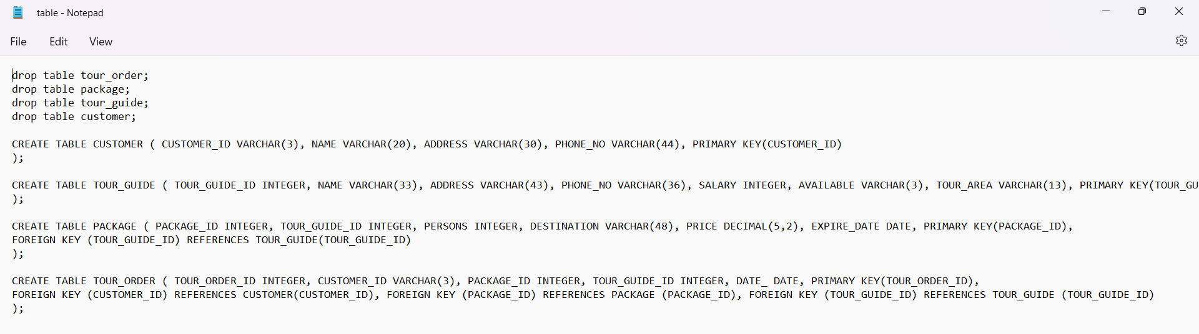
Functionality:
The database allow the technicians to do the following functions:
• Enter & modify new customer and their information
• Enter & modify new tour guide, destination, tour area and their information
The administrator handle all the operations and monitor them.
There are some functions and procedure in my project which is describing below:
Function(using Join): I have used natural join, equivalent join, left outer join, right outer join and full outer join among the tables.

Slide 5
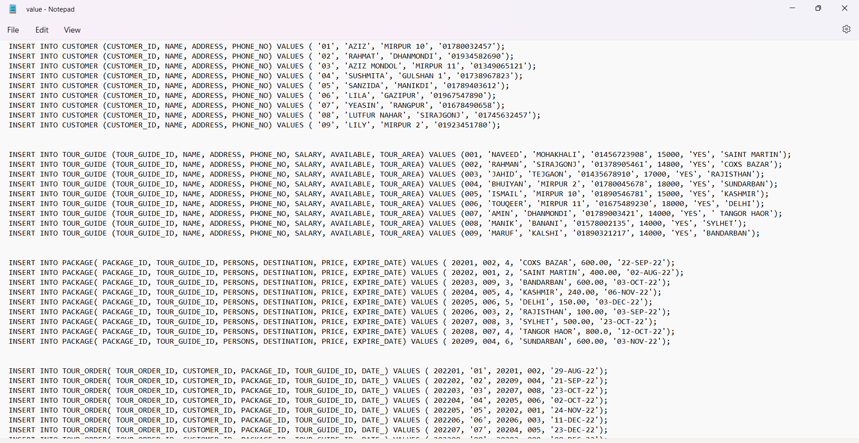
Here is how we insert value into a table:

Slide 6
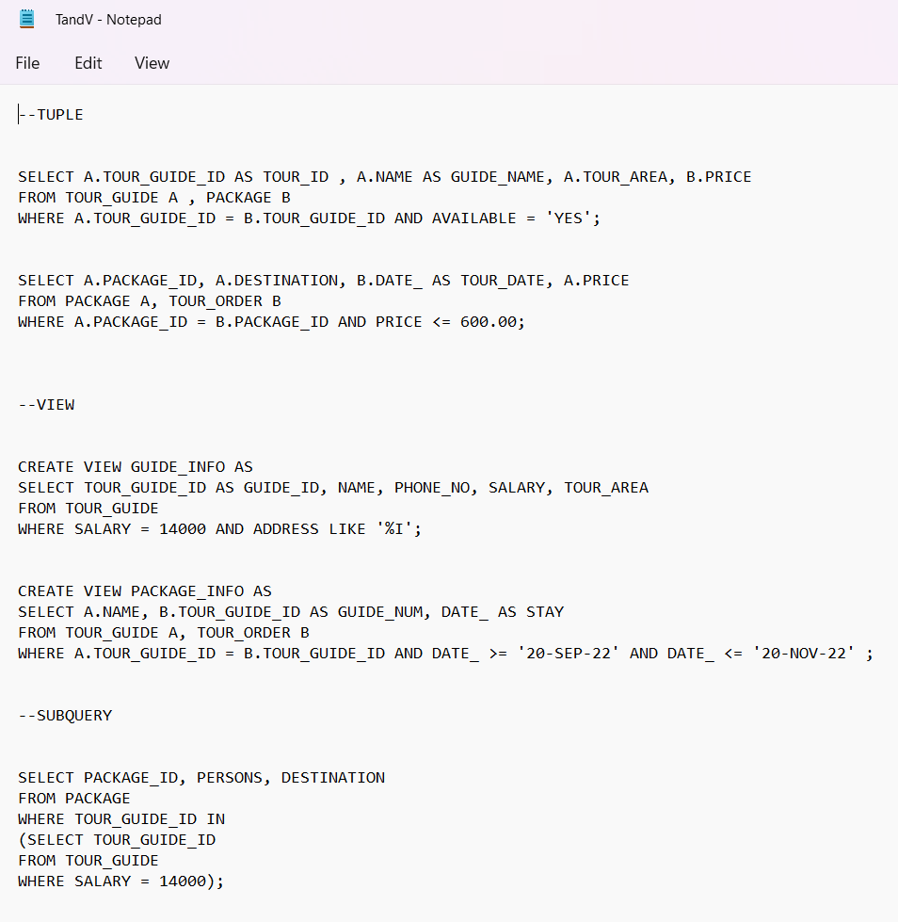
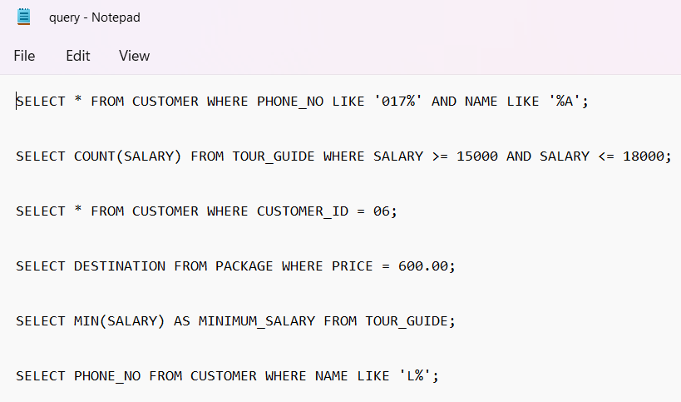
Here is some query, Tuple, View, Subquery on our tables:
Query

Slide 7
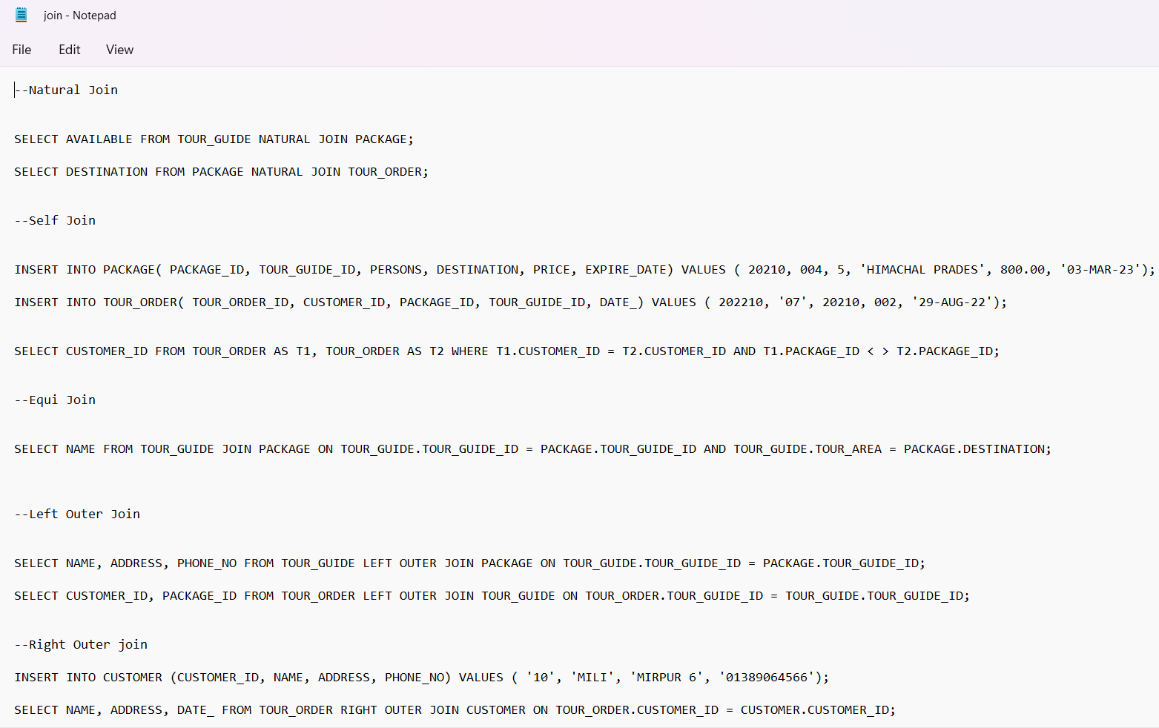
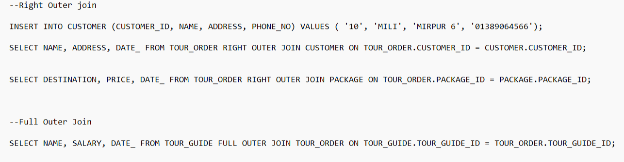
Here is some query on join instruction:
Join statement has some parts. Here sre the parts:
Natural Join
Self Join
Equi Join
Outer Join:
a. Left Outer Join
b. Right Outer Join
c. Full Outer Join
5. Inner Join

Slide 8
Database Design Process:
Customer/Audience:
The main customers or audience for this database management system who wants to travel in a budget friendly and comfortable way. And travel agency will be benefitted by those customer’s review. As customer’s details is important for us. So, this database system will help us to store those data of customers.
For this database project our approach was to take an existing basic prototype and optimize the database design. I have developed it with oracle as it was my goal. We determined that the best course of action was to optimize the database design a stand-alone application so that it is at least ready for use.
I designed and developed four tables. Our table design provides future flexibility for growth and changes to the database tables .

Slide 9
Example, tour order entity can add more attribute for database’s betterment. It will help us for customer’s all details which belong to us. In, tour order table there are three foreign keys which are customer id , package id and tour guide id and one primary key which is tour order id. Foreign keys tells that which customer takes which package and tour guide. And same goes for rest of the table.
We learned several important lessons through this database process.
One of the most important things is how we design a table as there may be some tables which won't be required much, for that we have to keep in mind that the lowest number of tables with the same effectiveness is better.
SQL should be done in an effective way.
Being able to design a database well for a client requires a lot of understanding about the business process and needs behind the applications.
Revising an existing database is quite harder than building a database which is why initial design.
We must be careful about composite keys.

Slide 10
Future of The Database:
The database is currently functional Oracle back-end and can begin to be used. It is anticipated that
the following tasks will need to be done in order to achieve the goals stated above:
Collect more detailed information about the customer, package and tour order.
Add an option rating of the different attributes packages and tour guide by the registered customers.
More file based operations.
Option for booking via online.
Rich design architecture.
Summary:
In this course, we learnt many real life implementation thing which encourage me to learn more about this database design course. Not only learn something new but also i added these learnings in my project also. I must say i have gathered much knowledge and improved myself. Now I’m looking forward to improve and apply in real life applications as well.

Slide 11
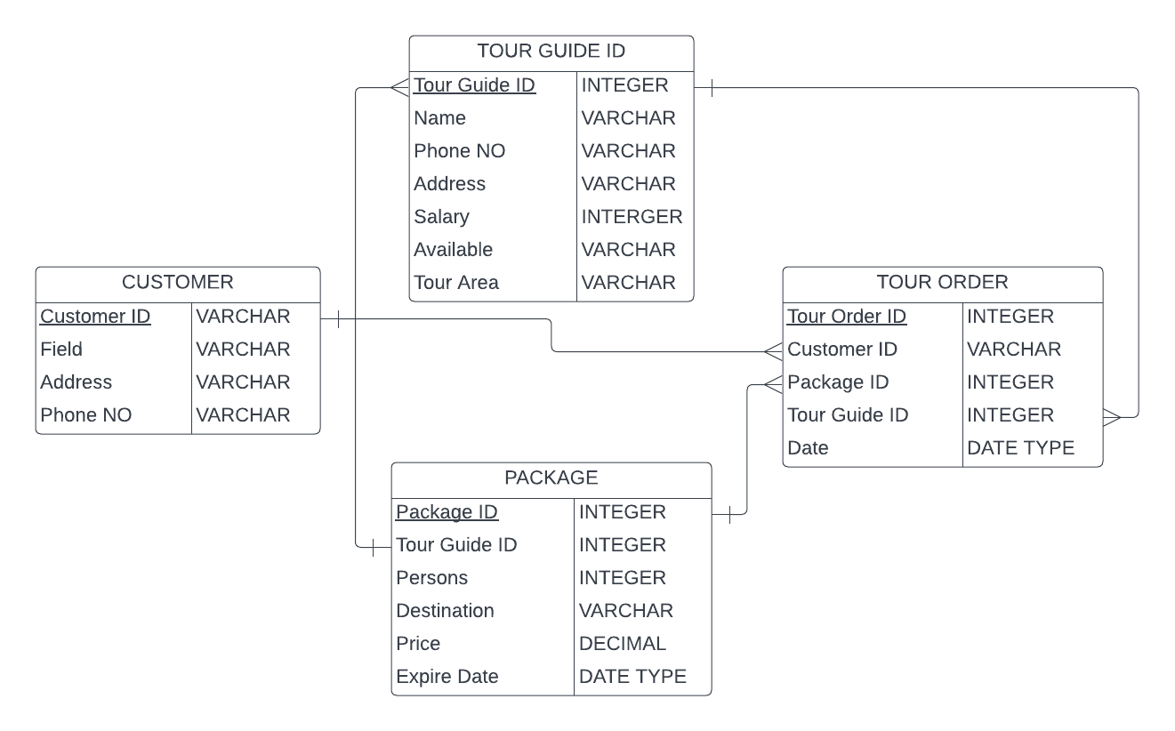
Schema Diagram:

Slide 12
Thank you

