Slide 1
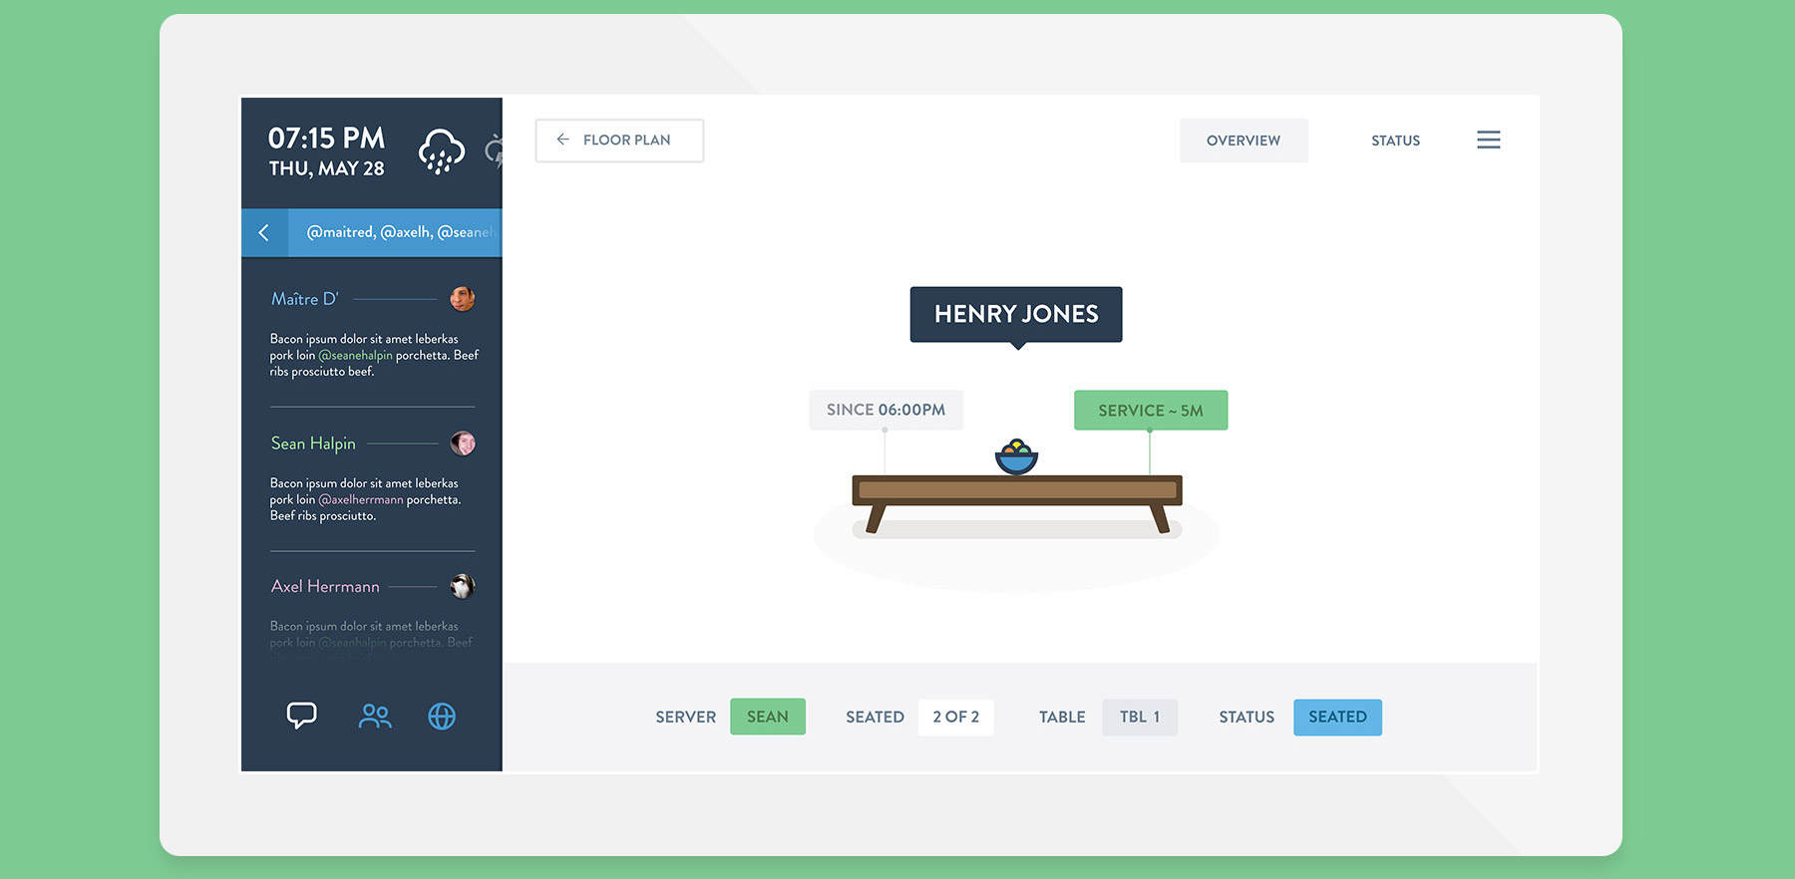
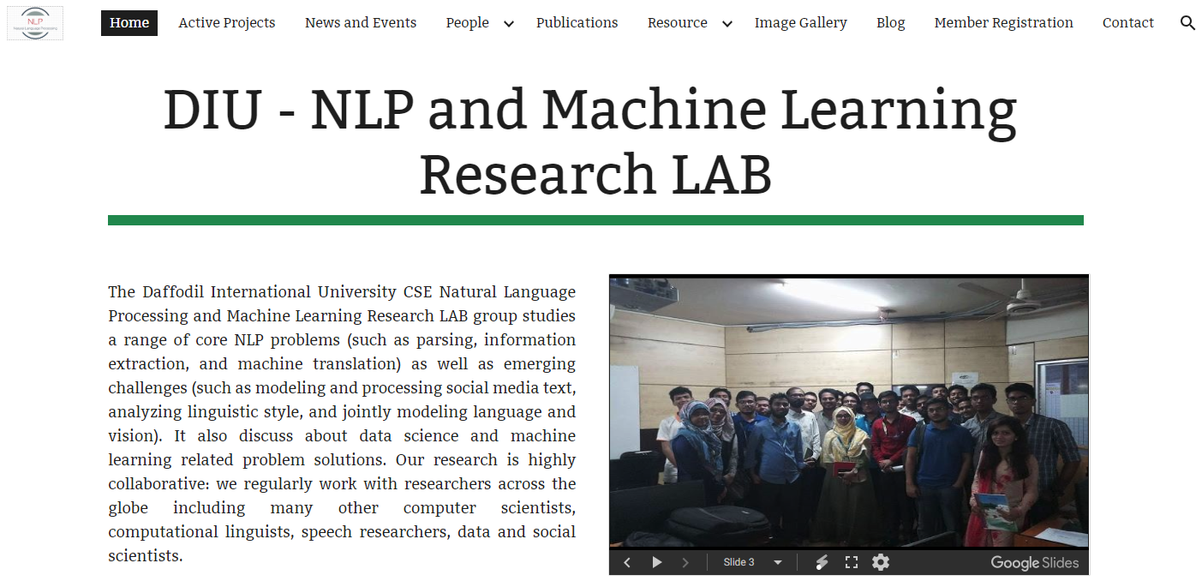
Researcher
Code Member & Researcher at DIU NLP & ML Research Lab
NLP
Machine Learning
Computer Vision
Deep Learning

