Slide 1

THE FRENCH SUPPLIER
MANUFACTURING, DESIGN AND SOURCING

Slide 2
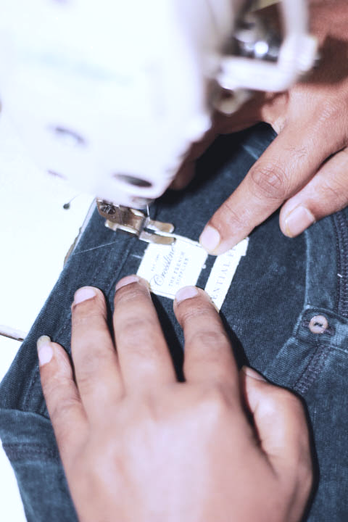

ABOUT US
Crossline is a European supplier with its own factories and a strong design and graphic team.
We propose collections all around the year and work closely with our customer teams to deliver the best looking product at the cheapest cost.
Crossline produces knit woven and sweater items and delivers more than 20 millions pieces per year.

Slide 3
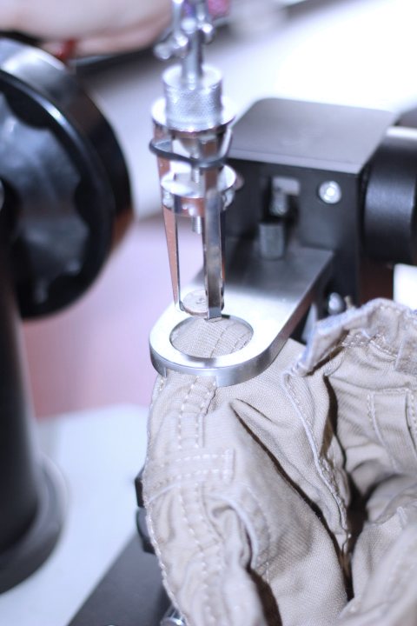
OUR SERVICES
We can tailor-make your needs and provide total supply chain management
PRODUCTION
We have set up our own factories i.e. Crossline Knit Fabrics (circular knit) and Crossline Woven Apparel and also work in a strong partnership with 4 sweater factories.
DESIGN AND GRAPHIC SERVICES
Our strong design and graphic teams proposes several times a year new ladies, men, kids collections matching with our buyer’s needs.
We have a special design and production team dedicated to each market (men, ladies, kids...) including a special team dedicated to plus size products

Slide 4
OUR FACTORIES
CROSSLINE KNIT FABRICS
25, Vadam, Nishatnagor, Tongi
Gazipur, Bangladesh
Contact : Roland Mok
roland.mok@crossline-bd.com
1,300 000 pcs / month
Knitting/Dyeing. 19 tons/day
Sewing 40 lines
Printing Aop and screen printing
T shirts, sweat shirts, polos, leggings…
Certifications: Wrap, oeko-tex, gots, Sedex, Accord
CROSSLINE WOVEN APPARELS LTD
Sarifpur, Mondal Bari, Sonda,National university,
Gazipur Sadar 1704, Bangladesh
Contact: Madoo Carooppunnen
madoo.carooppunnen@crossline-bd.com
450 000 pcs / month
Denim, non denim
Long Pants, Bermuda, Jackets, Skirts, Shorts
Worldwide fabric sourcing
Washing plant partnership
Certifications: Accord, Bsci, ICS, Wca, Sedex, Ilo,OCS

Slide 5
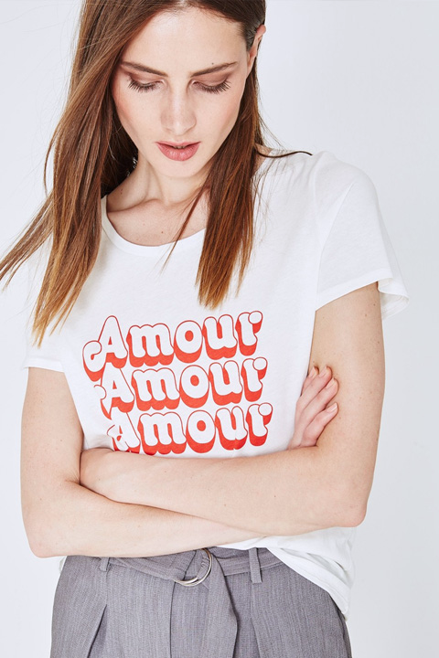
OUR PRODUCTS
Focus on Fashion Apparel :
KNIT, WOVEN & SWEATER
Graphic designers and Fashion designers work with our customers and travel from head offices to production sites.
Men,Women, Kids, Baby and Plus size products
Crossline produces knit, woven and sweater items and delivers more than 20 millions pieces per year.

Slide 6
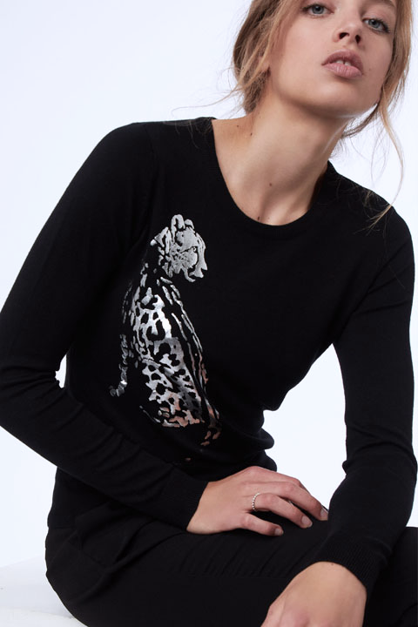
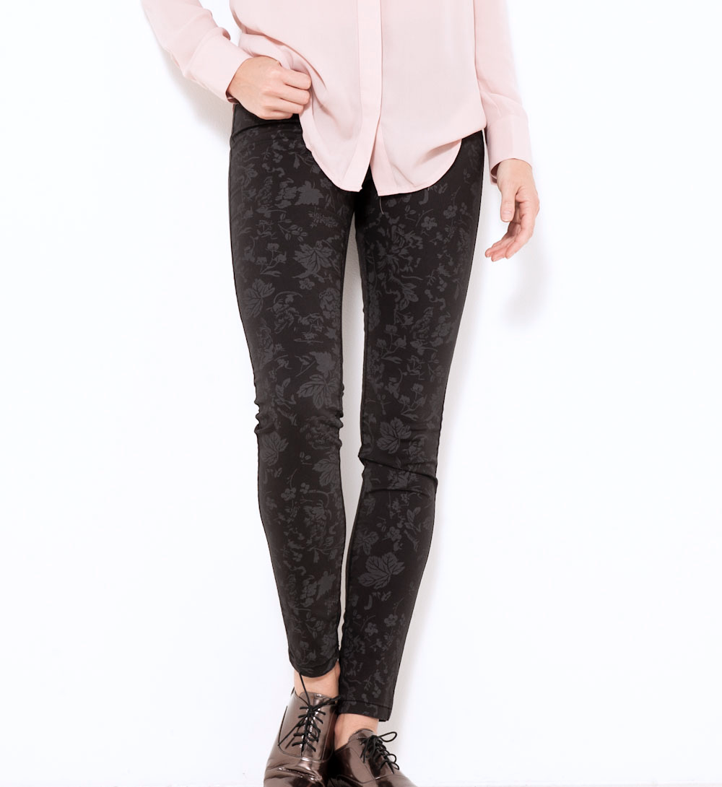
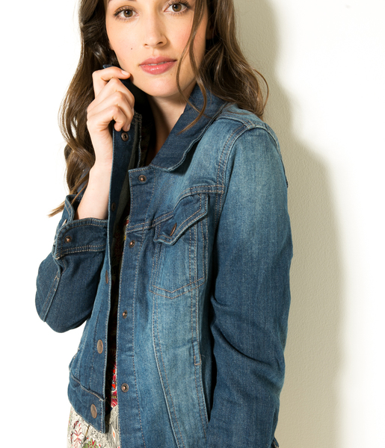

Slide 7
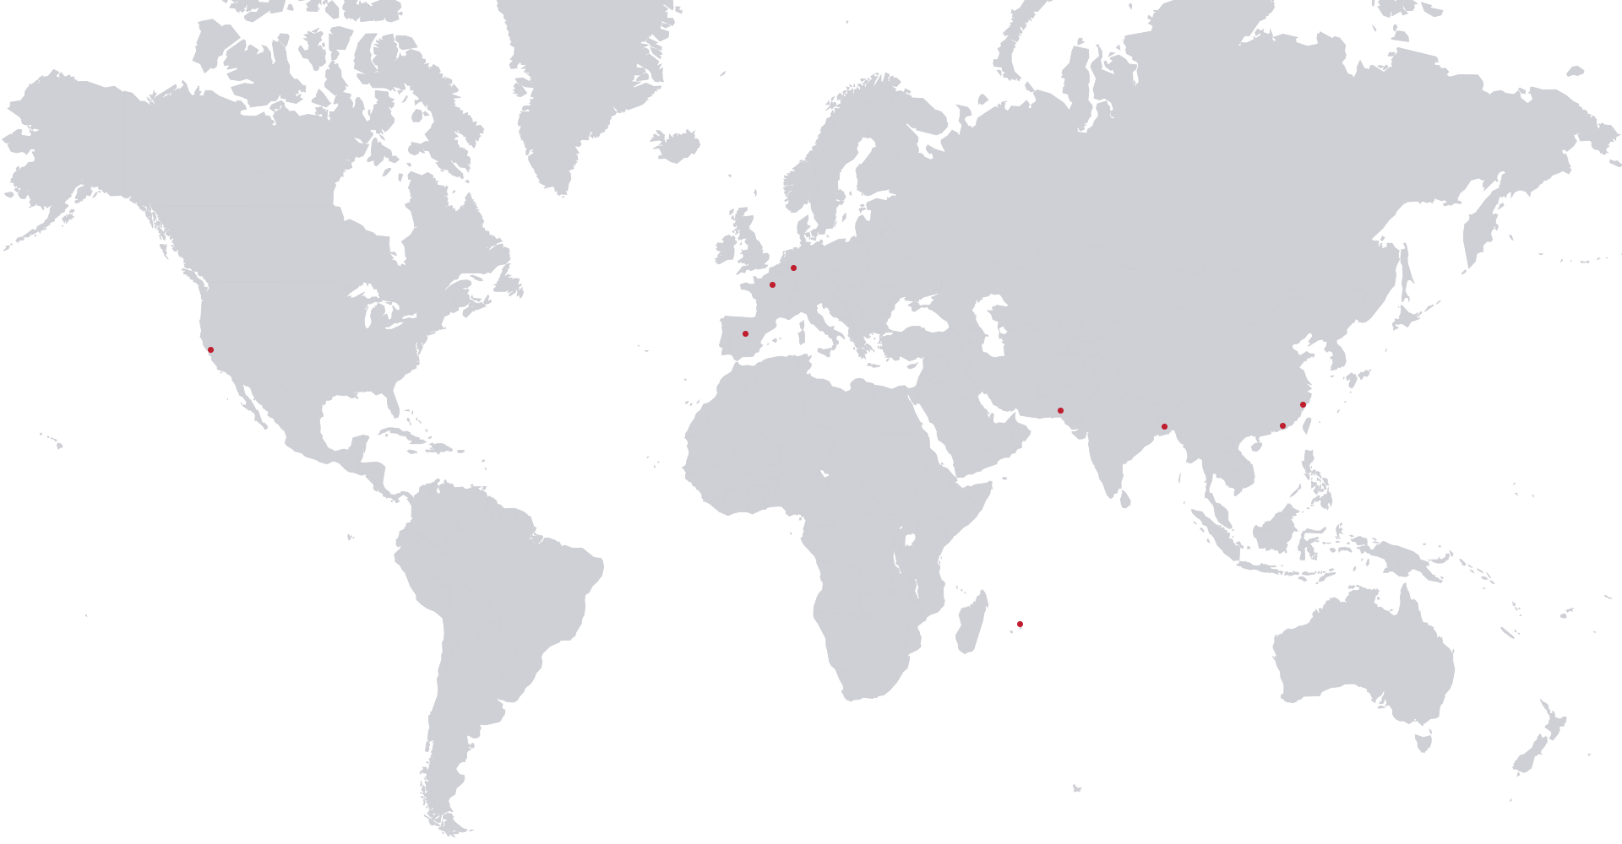
CROSSLINE
IN THE WORLD
Crossline is a rapidly growing international structure with customer offices in France, Spain, Germany and U.S.A and production sites in Bangladesh, Pakistan, China and Mauritius
PRODUCTION
Bangladesh, Pakistan, China, Mauritius
CUSTOMERS
France, Spain, Germany, U.S.A

Slide 8
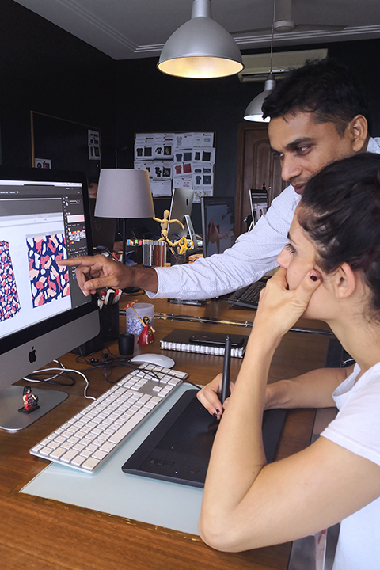
OUR TEAM
11 languages spoken in crossline
15 expatriates in Asia
12 fashion & graphic designers from Spain, France, Bangladesh and Mauritius
5000 workers and 250 skilled and hand’s on professionals dedicated to quality, planning, testing, compliance, sourcing, accessories and follow up.

Slide 9
OUR PARTNERS
MANGO
FOREVER 21
ZARA
PROMOD
GALERIES LAFAYETTES
TCHIBO
CAMAIEU
KIABI
OKAIDI

Slide 10
CONTACT
CROSSLINE PRODUCTION
Karuna Ishri
Bangladesh +880 (0)19 55 535878 Ikaruna.ishri@crossline-bd.com
Sujaur Rahman
Bangladesh +880 (0)19 55 535788
sujaur@crossline-bd.com
www.crossline-group.com

